Slide 1

BANKING ASSISTANCE SYSTEM
SUMMER INTERNSHIP PROJECT
BANTI JHA
BCA 5A
(02090202020)
HARSIMRAN KAUR
BCA 5A
(03790202020)
MADHAV SHARMA
BCA 5A
(04990202020)

Slide 2
CONTENTS
PROBLEM STATEMENT
RELEVANCE : RESEARCH NOTES
OUR SOLUTION
TECHNOLOGIES USED
WHY PYTHON?
SOFTWARE TESTING

Slide 3

PROBLEM STATEMENT
Even in today's digital era we see, more than 60% percent of the bank user's do not prefer using ATM System and Net Banking Software, because they find it difficult to interpret. The ATM system and Net Banking Systems can use any kind of interface. But it should be user friendly and not confusing. Help manuals should be provided in case any customer has problem working with the software.

Slide 4
RELEVANCE : RESEARCH NOTES
MARKET RESEARCH STATISTICS
Objectives of the Study :
To examine the awareness level of ATM services
To study the level of customer satisfaction on various aspects of ATM services
To identify the problems faced by customers while using ATM services
To offer suggestions to overcome the problems in ATM services in near future

Slide 5
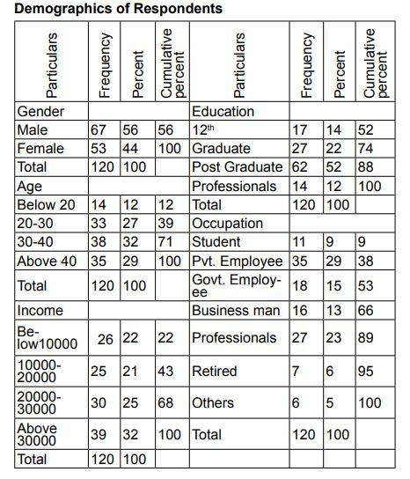

Slide 6
RELEVANCE : RESEARCH NOTES
MARKET RESEARCH STATISTICS
Findings :
Most of the respondents (40 per cent) belong to the age group of 30 to 40 years.
Majority (56 per cent) of the respondents are males.
Most of the respondents (52 percent) are post graduate.
Nearly 32 per cent of the respondent‘s monthly income is above Rs. 30000
68 per cent respondents are availing ATM services for more than 2 years.
54 per cent of the respondents using ATM service 2 to 5 times in a month.
Nearly 72 per cent of the respondents opined that ATM service was preferred for quick cash withdrawal.
Majority of the customers (84 per cent) said that there is no inconvenience in operating ATM.
Maximum days(20-30) taken by the bank solve ATM related problems
Nearly 60 per cent of respondents are satisfied with the limit of withdrawal per day.
Most of the respondents (96 per cent) are fully satisfied with Bank ATM services.  Most of the respondents (62 per cent) are not satisfied with the queuing at ATM counter
Most of the respondents face network related problem while using ATM

Slide 7
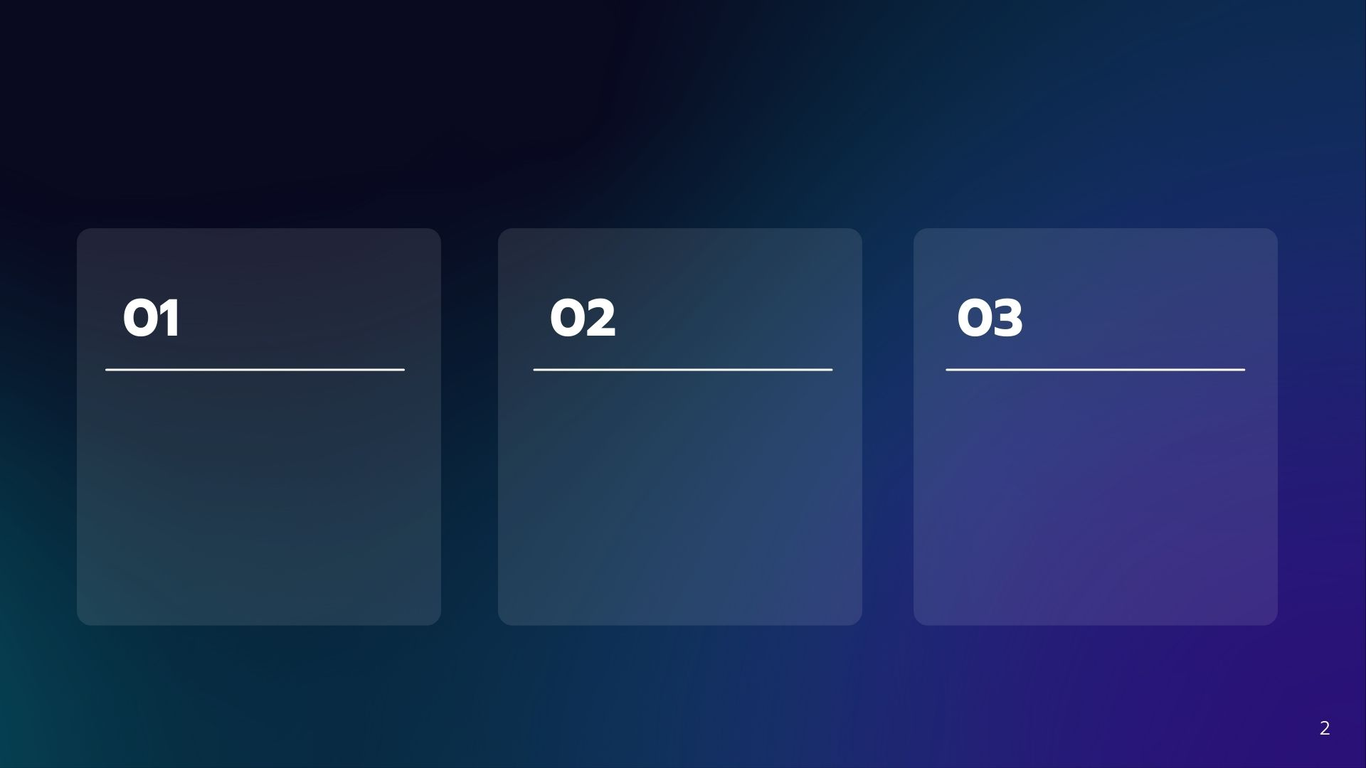
Opportunities
During Covid-19, digitalization took a stride, people became more IT inclined, and it made it easier for users to trust and use the ATM and Net Banking Systems.
Our greatest opportunity is, more and more people are getting inclined towards using UPI methods, making it easier for us make a grab hold.
Steps taken by govt. for Customer Protection – Limiting Liability of Customers in Unauthorized Electronic Banking Transactions, made people relieved and at ease and helped in gaining trust.

Slide 8

OUR SOLUTION
Our objective was to create one single software solution working as both an ATM and net banking system. We built our Banking Assistance System with the motive of providing a solution for easy, convenient, secure and user-friendly banking solution to the customers.
While working on this project our objective was to provide a banking solution to the customer that they find familiar with. In this project we wanted to create an application that could help the customer experience familiarity with both the ATM and net banking system and make it easier for the user to understand the features of both and feel comfortable using both ATM and Net banking systems.
We made a one stop solution for people a same interface from which they can use full fledge banking facilities. ATM to all net banking features. Learn it once and use it.

Slide 9
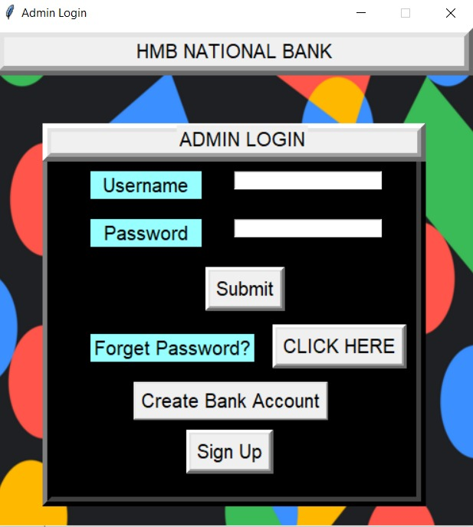

Slide 10
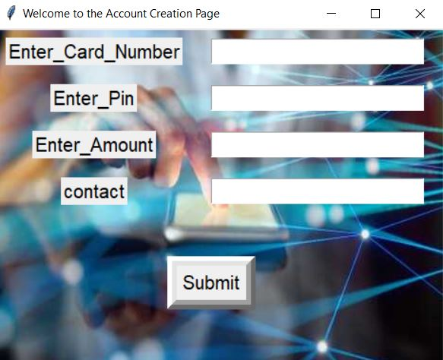

Slide 11
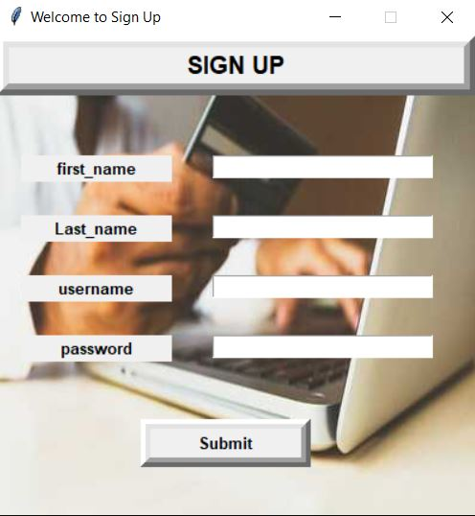

Slide 12
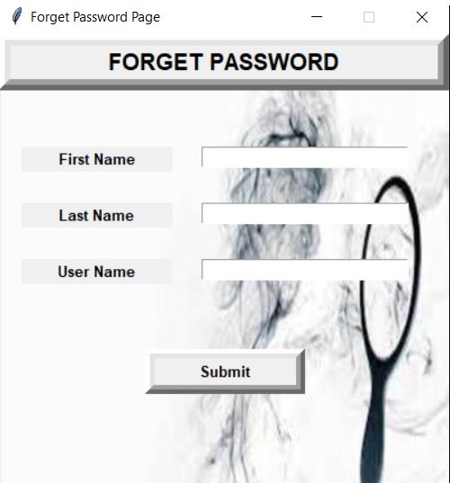

Slide 13
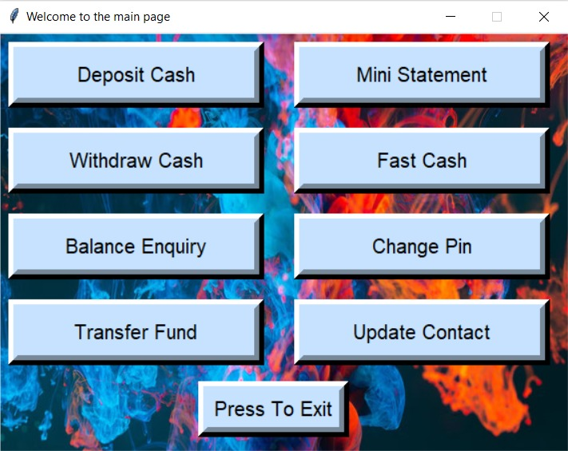

Slide 14
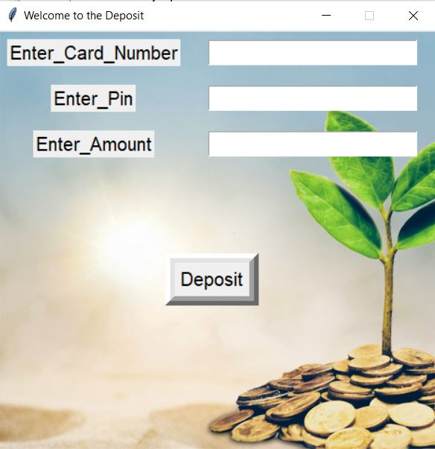

Slide 16
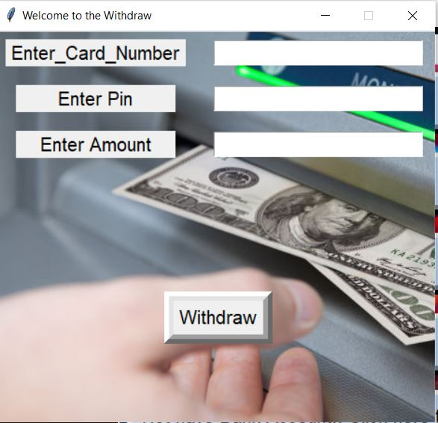

Slide 18
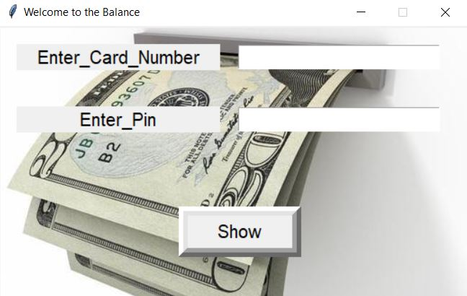

Slide 20
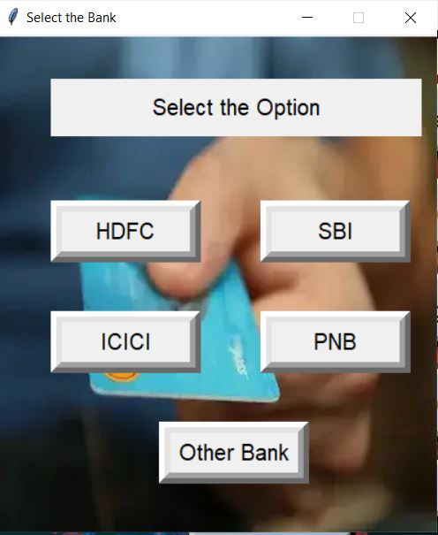

Slide 21
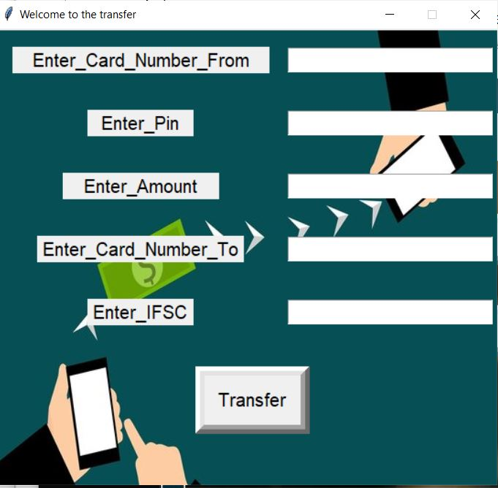

Slide 23
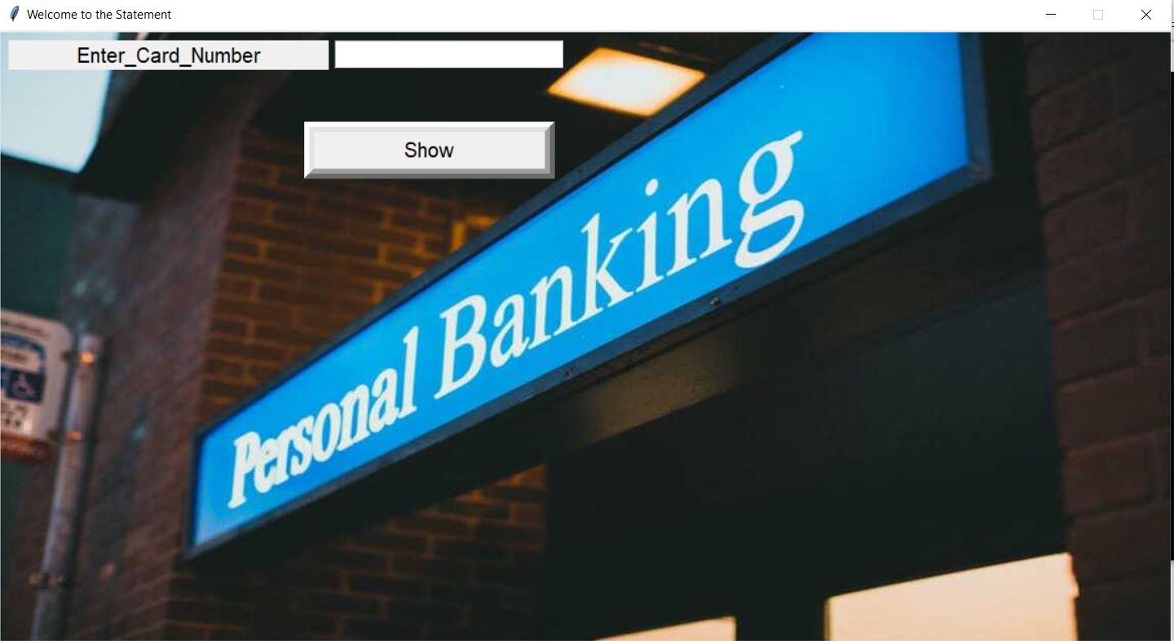

Slide 25
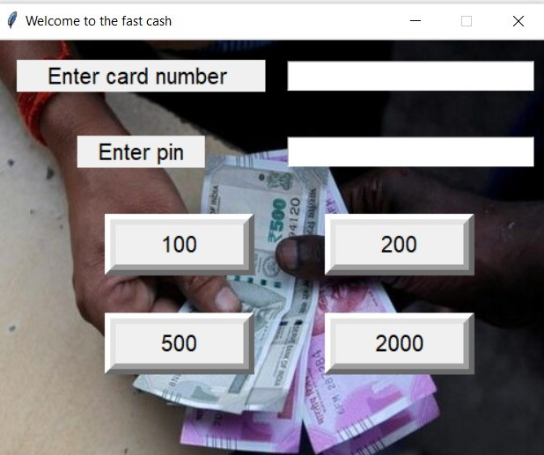

Slide 27
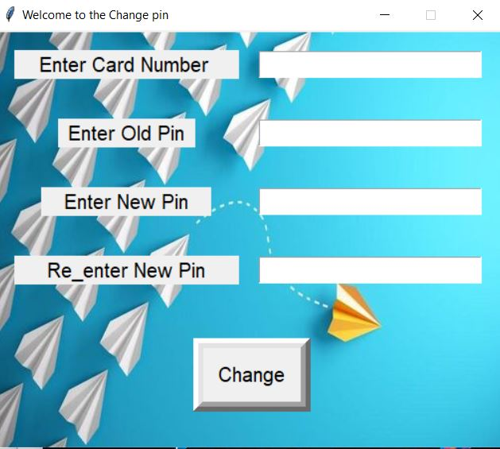

Slide 29
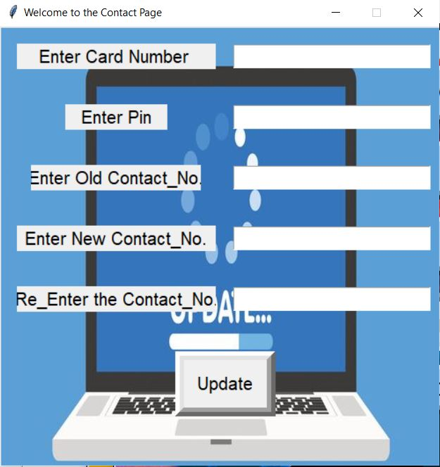

Slide 30

TECHNOLOGIES USED
FRONT-END : PYTHON
BACK-END : MySQL
MySQL is a free-to-use, open-source database that facilitates effective management of databases by connecting them to the software. It is a stable, reliable and powerful solution with advanced features like the following:
Data Security.
On-Demand Scalability.
High Performance.
Round-the-clock Uptime.
Comprehensive Transactional Support.
Complete Workflow Control.
Reduced Total Cost of Ownership.
The Flexibility of Open Source.
The MySQL database server provides the ultimate in scalability, sporting the capacity to handle deeply embedded applications with a footprint of only 1MB to running massive data warehouses holding terabytes of information.
Python is a high-level, general-purpose and a very popular programming language. Python programming language (latest Python 3) is being used in web development, Machine Learning applications, along with all cutting edge technology in Software Industry.

Slide 31

WHY PYTHON?
The biggest strength of Python is huge collection of standard library which can be used for the following:
Machine Learning
GUI Applications (like Kivy, Tkinter, PyQt etc. )
Web frameworks like Django (used by YouTube, Instagram, Dropbox)
Image processing (like OpenCV, Pillow)
Web scraping (like Scrapy, BeautifulSoup, Selenium)
Test frameworks
Multimedia
Scientific computing
Text processing and many more…

Slide 32
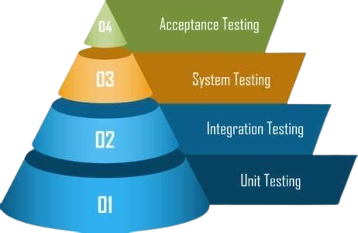
SOFTWARE TESTING

Slide 33
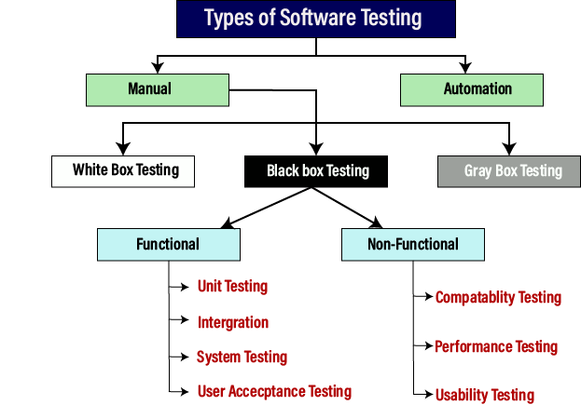
SOFTWARE TESTING
We adopted BLACK BOX TESTING, Black Box Testing is a software testing method in which the functionalities of software applications are tested without having knowledge of internal code structure, implementation details and internal paths. Black Box Testing mainly focuses on input and output of software applications and it is entirely based on software requirements and specifications. It is also known as Behavioral Testing.
Types of Black Box Testing
Functional Testing – This black box testing type is related to the functional requirements of a system; it is done by software testers.
Non-Functional Testing – This type of black box testing is not related to testing of specific functionality, but non-functional requirements such as performance, scalability, usability.
Regression Testing – Regression Testing is done after code fixes, upgrades or any other system maintenance to check the new code has not affected the existing code.

Slide 34
THANK YOU

