Slide 1


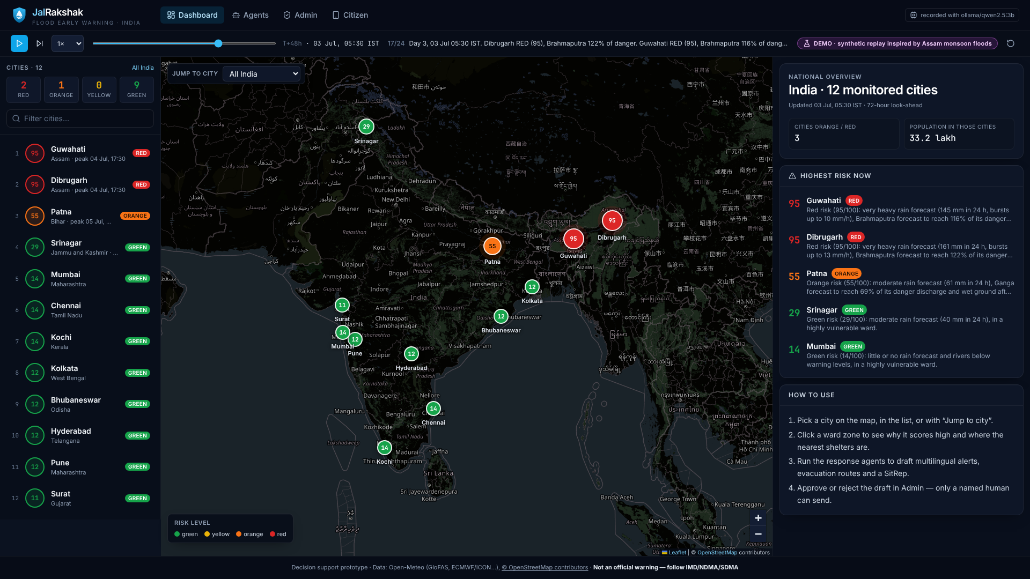
Hacktopia Pune 2026
Round 1 · Idea + prototype
JalRakshak
Agentic flood early warning and response for India
Open forecasts → ward-level risk → AI agents draft 5-language alerts and evacuation plans → an officer approves. Free data, local LLM, runs on a laptop.
Madhav Zanwar · Divyani Papalkar
Pimpri Chinchwad College of Engineering (PCCoE), Pune
JalRakshak · Hacktopia Pune 2026
1 / 14
Notes:
Introduce JalRakshak and the team in one breath, then go straight to the problem.

Slide 2



THE PROBLEM
Problem relevance
Forecasts exist. Last-mile action doesn't
Warnings stop at the district
Officers are overloaded
Vague alerts don't help
Rain and river forecasts exist (IMD, CWC, GloFAS) but rarely become ward-level, local-language instructions in time.
Control rooms juggle gauges, bulletins, shelters and translations by hand while the water rises.
"Heavy rain likely" doesn't say which ward, how bad, where to go or whom to call.
≈40 Mha
1,09,374
₹4.0 lakh cr
22 lakh
of India is flood-prone, about 12% of its land area
deaths from floods and heavy rain, 1953–2018 (≈1,700 a year)
flood damage 1953–2018, ≈₹6,150 crore a year on average
people hit in 28 of 35 Assam districts on 26 June 2022; 2.17 lakh in relief camps
Rashtriya Barh Ayog (1980), via PIB 2022
Parliament Standing Committee on Water Resources (17th Lok Sabha)
Parliament Standing Committee on Water Resources (17th Lok Sabha)
UNICEF Assam Floods SitRep, 27 Jun 2022 (state data)
Sources: PIB 2022; Standing Committee on Water Resources, 17th Lok Sabha (via Down To Earth); UNICEF SitRep 27 Jun 2022. URLs: submission/SOURCES.md
JalRakshak · Hacktopia Pune 2026
2 / 14
Notes:
Numbers: 40 Mha flood-prone (1980 national flood commission), 1.09 lakh deaths and ₹4 lakh crore damage 1953-2018 (Parliament standing committee), 22 lakh affected in Assam on 26 June 2022.

Slide 3




OUR SOLUTION
Innovation
JalRakshak turns open forecasts into actions
From forecast to an approved, multilingual alert in minutes, with every step explained.
Sense
Score
Act — AI agents
Approve & reach
Open-Meteo rainfall + GloFAS river discharge
12 flood-prone cities, 96 wards
Cached, works on last-known data
Transparent 0–100 ward risk, next 72 h
IMD rain categories + GloFAS thresholds
Optional LightGBM probability
Monitor decides when to alert
Drafter writes SMS + WhatsApp in 5 languages
Evacuation routes + SitRep PDF
Officer approves every alert
Citizen page for low-end phones
Offline-capable PWA
Zero paid services · zero API keys · local open LLM · one command: docker compose up
JalRakshak · Hacktopia Pune 2026
3 / 14
Notes:
Four verbs: sense, score, act, approve. Stress the human approval gate.

Slide 4




AGENT LAYER
Innovation
Technical
Agentic AI on a local open LLM, with guardrails
Monitor
Alert drafter
Evacuation planner
SitRep
Reads ward risk and river gauges; decides if, where and how urgently to alert.
Writes SMS (≤160 chars) and WhatsApp alerts in EN, HI, MR, TA, BN.
Finds the nearest safe shelters and hospitals for the riskiest wards.
Writes a district-officer situation report, exported as a PDF.
Tools: get_city_risk, get_gauges, get_ward_risk
Tools: vetted templates, verified facts
Tools: find_facilities, OSRM route (straight-line fallback)
Tools: risk summary, plans, alert status
GUARDRAILS (every draft)
No invented numbers
Script matches language
SMS length
Must include 112
Human approval before send
Own ReAct tool-calling loop
Ollama · Qwen2.5 3B, local
Humans stay in charge
Thought → tool call → observation, written from scratch (no agent framework). Every step is logged with reasoning and inputs.
No cloud LLM and no API key. If the model is missing or slow, a deterministic rules engine takes over.
Agents draft; officers decide. Dispatch is simulated and logged, so the full flow can be demoed safely.
JalRakshak · Hacktopia Pune 2026
4 / 14
Notes:
Explain the ReAct loop and why a small local model is enough: the LLM reasons and chooses tools; numbers always come from tools, and guardrails reject anything that doesn't match.

Slide 5




OPTIONAL LIGHTGBM MODEL · HONEST BACKTEST
Technical implementation
Transparent score + honest ML backtest
0.86 vs 0.79
0.78 vs 0.77
Training data
GloFAS v4 river discharge (1997–2024) + hourly ERA5 rainfall reanalysis, 12 cities.
PR-AUC, LightGBM vs our rule score (realistic noisy forecasts)
F1 at the threshold chosen on 2019–20 validation (noisy forecasts)
Time-split, no leakage
Train 1997–2018, validate 2019–20, test 2021–24; label thresholds use training years only.
0.61 vs 0.56
4.4%
PR-AUC with persistence inputs (no-skill lower bound)
flood-days in the test set (17,496 city-days)
Compared to a baseline
Same perturbed inputs for LightGBM and the rule score: perfect, noisy and persistence forecasts.
Held-out test 2021-01-01 to 2024-12-28. Labels are a proxy (GloFAS discharge > P98 or ≥115.6 mm rain), built from the same variables, so the perfect-forecast PR-AUC of 0.98 is an upper bound, not real-world skill. ML adds a modest gain over the transparent score.
Advisory, not in charge
The deterministic score drives alerts; the model adds P(flood-day) as context.
Metrics read from backend/models/backtest.json; method in docs/MODEL.md.
JalRakshak · Hacktopia Pune 2026
5 / 14
Notes:
Be upfront: labels are proxies built from reanalysis, not official flood records.

Slide 6
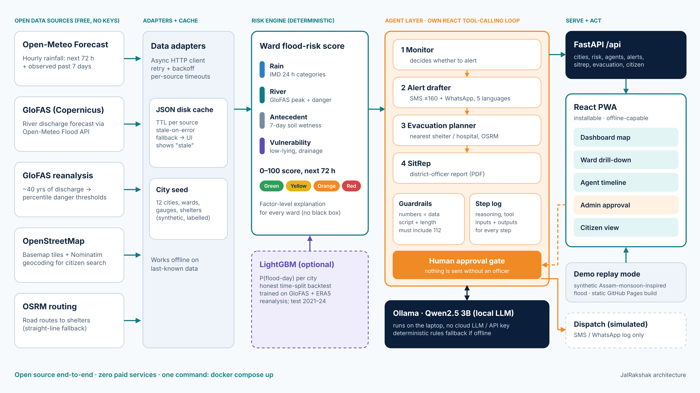
ARCHITECTURE
Technical
Scalability
Architecture: open data in, approved action out
JalRakshak · Hacktopia Pune 2026
6 / 14
Notes:
Walk left to right: sources, adapters + cache, risk engine, agents, API, PWA.

Slide 7
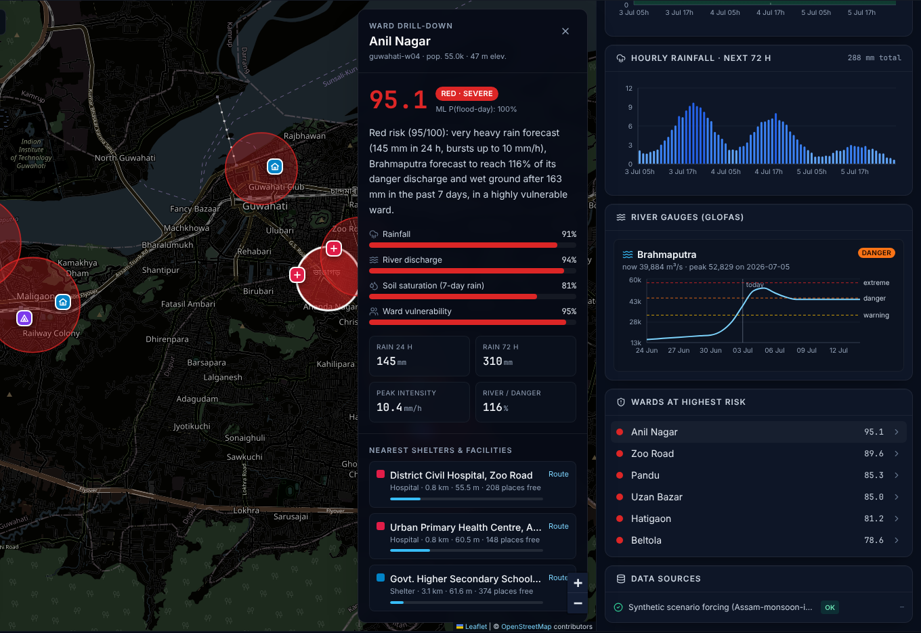
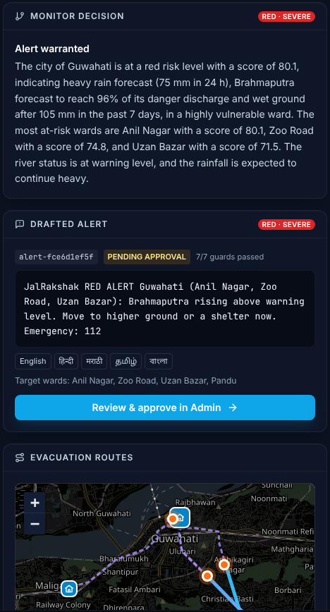
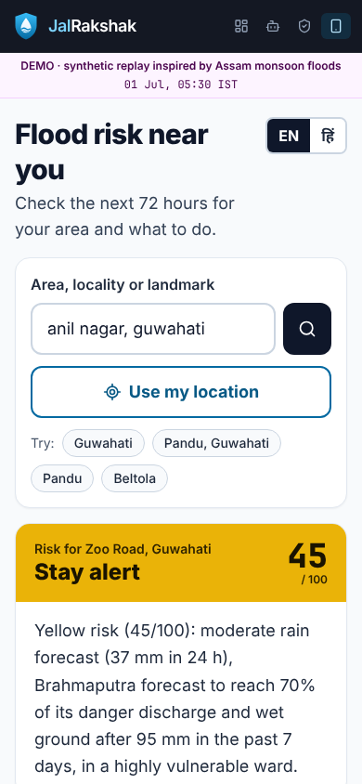
LIVE DEMO · HTTPS://MADHAVZANWAR.GITHUB.IO/JAL-RAKSHAK/
User impact
See it working
Ward drill-down score, factors, shelters, river gauge
Agent output
Citizen view
Screenshots of the demo replay build (synthetic Assam-monsoon-inspired flood; synthetic wards and shelters).
JalRakshak · Hacktopia Pune 2026
7 / 14
Notes:
Real screenshots from the demo replay build.

Slide 8
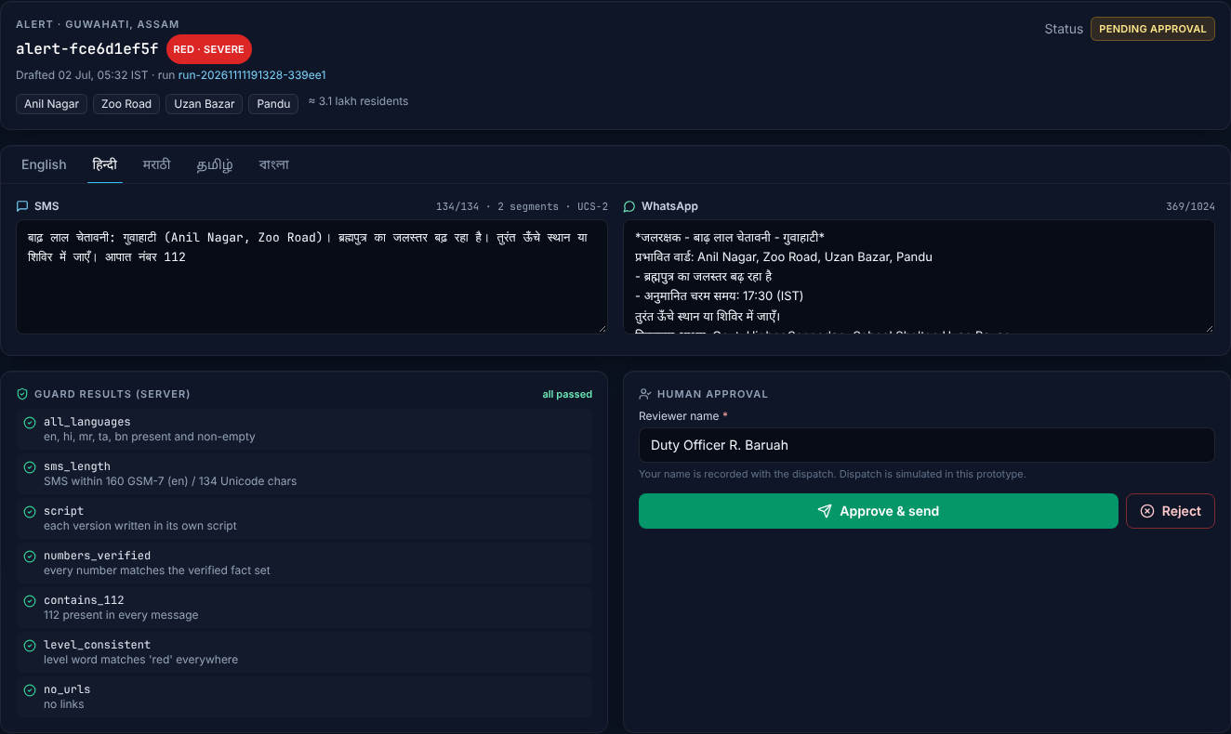
MULTILINGUAL ALERTS + HUMAN APPROVAL GATE
User impact
Five languages, one approval click
English
JalRakshak RED ALERT Guwahati (Pandu, Maligaon): Brahmaputra above danger level. Move to higher ground or a shelter now. Emergency: 112
हिन्दी
बाढ़ लाल चेतावनी: गुवाहाटी (Pandu, Maligaon)। ब्रह्मपुत्र खतरे के निशान से ऊपर। तुरंत ऊँचे स्थान या शिविर में जाएँ। आपात नंबर 112
मराठी
पूर लाल इशारा: गुवाहाटी. ब्रह्मपुत्रा नदी धोक्याच्या पातळीवर. त्वरित उंच ठिकाणी किंवा निवारा केंद्रात जा. आपत्कालीन क्रमांक 112
தமிழ்
வெள்ள சிவப்பு எச்சரிக்கை: குவாஹாட்டி (Pandu). பிரம்மபுத்திரா அபாய அளவை தாண்டியது. உடனே மேடான இடத்துக்கு செல்லவும். அவசர உதவி 112
Admin view: review, edit, approve. Dispatch is simulated and logged.
বাংলা
বন্যা লাল সতর্কতা: গুয়াহাটি (Pandu, Maligaon)। ব্রহ্মপুত্র বিপদসীমার উপরে। এখনই উঁচু জায়গা বা ত্রাণ শিবিরে যান। জরুরি নম্বর 112
7 server-side guards on every version
all_languages · sms_length · script · numbers_verified · contains_112 · level_consistent · no_urls
SMS rendered by our vetted templates for the synthetic Guwahati scenario (127–135 chars). Guards check script, length, numbers and 112.
JalRakshak · Hacktopia Pune 2026
8 / 14
Notes:
Show the language tabs. Point at the guard results and the SMS counter.

Slide 9





FEASIBILITY
Feasibility
Feasible today, on a laptop
₹0 to run
Runs on one laptop
Works when networks fail
Free open data and open-source software. No paid API, no key, no cloud LLM bill.
docker compose up starts API, web app and Ollama. A 3B model runs on CPU.
Cached data with a visible stale flag; the PWA works offline; rules fallback without the LLM.
Safe by design
Known limits
Already built
Human approval before any send, guardrails on every draft, dispatch simulated in the prototype.
Synthetic ward data and proxy flood labels; a pilot needs real ward maps and an SMS gateway.
Working prototype, tests, demo replay, video and a public demo link.
JalRakshak · Hacktopia Pune 2026
9 / 14

Slide 10





SCALABILITY
Scalability
From 12 cities to every flood-prone district
Add a city by config
Add a language
Plug into real channels
City, wards, gauge cell and shelters are data. GloFAS and Open-Meteo already cover all of India.
New template set + script check. Same guardrails, same approval flow.
Dispatch is one interface: swap the simulator for an SMS gateway or a CAP alert feed.
Light infrastructure
Swap the model
Open source (MIT)
Stateless API plus a file cache; one small server per state, LLM optional.
Any Ollama model works; a bigger model improves drafting without changing code.
SDMAs, NGOs and students can audit, fork and extend it.
JalRakshak · Hacktopia Pune 2026
10 / 14

Slide 11


IMPACT
User impact
Expected impact
30%
≈64%
ESTIMATE
ESTIMATE
5.5 crore
≈₹185 cr/yr
less damage when people get just 24 hours' warning of a hazard
of Indians have Hindi, Bengali, Marathi or Tamil as mother tongue
residents in the 12 pilot cities, scored ward by ward
avoidable flood damage if warnings reach 10% of exposed households
Global Commission on Adaptation, cited by UN/WMO Early Warnings for All
Census of India 2011 (C-16), via Factly
Estimate: sum of city populations in our seed data (96 synthetic wards)
Estimate: 30% × 10% reach × ₹6,150 cr/yr average damage
Ward-level warning, 3 days ahead
In the citizen's own language
Clear action: nearest shelter + route
Earlier evacuation, fewer deaths, lower losses
Sources: UN Early Warnings for All; Census 2011 via Factly; Standing Committee on Water Resources. Orange = our estimates. URLs: submission/SOURCES.md
JalRakshak · Hacktopia Pune 2026
11 / 14
Notes:
Separate what is sourced (30%, 64%) from our own estimates (orange tiles).

Slide 12





JUDGING CRITERIA
Presentation
Where each judging criterion is addressed
Innovation
Agents on a local open LLM that draft 5-language alerts with guardrails and a human gate (slides 3–4)
Problem relevance
Floods: 1.09 lakh deaths since 1953; 22 lakh affected in Assam on one day in 2022 (slide 2)
Technical implementation
Monotone tested risk score, LightGBM time-split backtest, own ReAct loop (slides 4–6)
Feasibility
₹0 run cost, one laptop, offline, working prototype today (slide 9)
Scalability
Cities, languages and channels are configuration (slides 6, 10)
User impact
Ward-level local-language alerts, nearest shelter, low-end phones (slides 7, 8, 11)
Presentation
Clear story, live demo link, 3-minute video, open repository with docs
Try it yourself
https://madhavzanwar.github.io/Jal-rakshak/ (no install, works offline after first load)
JalRakshak · Hacktopia Pune 2026
12 / 14

Slide 13
TEAM
Team JalRakshak
MZ
Madhav Zanwar
DP
Divyani Papalkar
Backend, risk engine, AI agents
Frontend, UX, multilingual content
FastAPI + data adapters
Risk formula + LightGBM backtest
ReAct agents on Ollama
React PWA: dashboard, admin, citizen
Alert templates in 5 languages
Demo + pitch
Pimpri Chinchwad College of Engineering (PCCoE), Pune
Code: https://github.com/madhavzanwar/Jal-rakshak · Live demo: https://madhavzanwar.github.io/Jal-rakshak/
JalRakshak · Hacktopia Pune 2026
13 / 14

Slide 14

THANK YOU
JalRakshak: warnings people can act on
Open data, a transparent score, AI agents that draft, and a human who decides.
GitHub
https://github.com/madhavzanwar/Jal-rakshak
Live demo
https://madhavzanwar.github.io/Jal-rakshak/
Run locally
git clone … && docker compose up
Madhav Zanwar · Divyani Papalkar · PCCoE Pune
JalRakshak · Hacktopia Pune 2026
14 / 14

