Slide 1


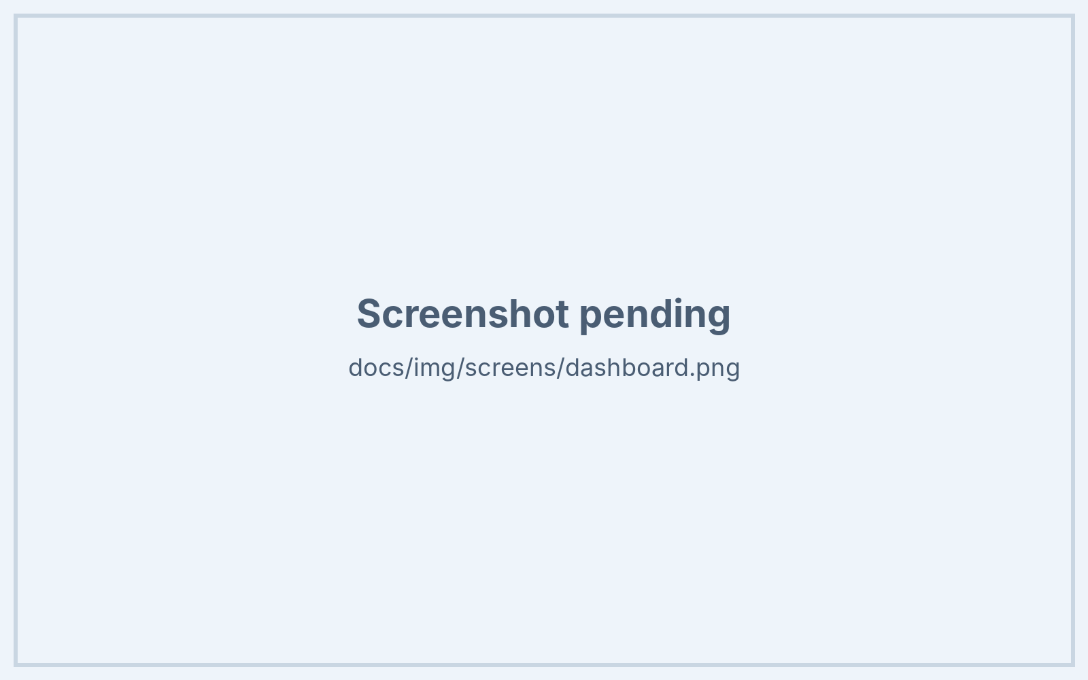
Clash of Commits
AI & Machine Learning
JalRakshak
ML + agentic LLM for flood early warning in India
Open forecasts → ward-level risk → AI agents draft 5-language alerts and evacuation plans → an officer approves. Free data, local LLM, runs on a laptop.
Madhav Zanwar · Divyani Papalkar
Pimpri Chinchwad College of Engineering (PCCoE), Pune
JalRakshak · Clash of Commits
1 / 10
Notes:
Introduce JalRakshak and the team in one breath, then go straight to the problem.

Slide 2



THE PROBLEM
Forecasts exist. Last-mile action doesn't
Warnings stop at the district
Officers are overloaded
Vague alerts don't help
Rain and river forecasts exist (IMD, CWC, GloFAS) but rarely become ward-level, local-language instructions in time.
Control rooms juggle gauges, bulletins, shelters and translations by hand while the water rises.
"Heavy rain likely" doesn't say which ward, how bad, where to go or whom to call.
≈40 Mha
1,09,374
₹4.0 lakh cr
22 lakh
of India is flood-prone, about 12% of its land area
deaths from floods and heavy rain, 1953–2018 (≈1,700 a year)
flood damage 1953–2018, ≈₹6,150 crore a year on average
people hit in 28 of 35 Assam districts on 26 June 2022; 2.17 lakh in relief camps
Rashtriya Barh Ayog (1980), via PIB 2022
Parliament Standing Committee on Water Resources (17th Lok Sabha)
Parliament Standing Committee on Water Resources (17th Lok Sabha)
UNICEF Assam Floods SitRep, 27 Jun 2022 (state data)
Sources: PIB 2022; Standing Committee on Water Resources, 17th Lok Sabha (via Down To Earth); UNICEF SitRep 27 Jun 2022. URLs: submission/SOURCES.md
JalRakshak · Clash of Commits
2 / 10
Notes:
Numbers: 40 Mha flood-prone (1980 national flood commission), 1.09 lakh deaths and ₹4 lakh crore damage 1953-2018 (Parliament standing committee), 22 lakh affected in Assam on 26 June 2022.

Slide 3



USERS
Who it's for
District officers (DDMA)
Citizens in flood-prone wards
Responders + NGOs
SDMAs and smaller cities
See which wards turn red, and why
Approve alerts in 5 languages
One-click SitRep PDF
Personal risk + what to do now
Nearest shelter and route
Works on low-end, offline phones
Shelters and hospitals near hotspots
Shared situation picture
Agent log for handovers
No licence or API cost
Runs on a laptop or one server
Add a city by configuration
Primary user: the district officer who must decide fast. Everyone else benefits from that decision.
JalRakshak · Clash of Commits
3 / 10
Notes:
Primary user: district officer. Secondary: citizens.

Slide 4



OUR SOLUTION
JalRakshak turns open forecasts into actions
From forecast to an approved, multilingual alert in minutes, with every step explained.
AGENTIC AI
Sense
Score
Act — AI agents
Approve & reach
Open-Meteo rainfall + GloFAS river discharge
12 flood-prone cities, 96 wards
Cached, works on last-known data
Transparent 0–100 ward risk, next 72 h
IMD rain categories + GloFAS thresholds
Optional LightGBM probability
Monitor decides when to alert
Drafter writes SMS + WhatsApp in 5 languages
Evacuation routes + SitRep PDF
Officer approves every alert
Citizen page for low-end phones
Offline-capable PWA
Zero paid services · zero API keys · local open LLM · one command: docker compose up
JalRakshak · Clash of Commits
4 / 10
Notes:
Four verbs: sense, score, act, approve. Stress the human approval gate.

Slide 5




OPTIONAL LIGHTGBM MODEL · HONEST BACKTEST
ML + agents: what the models do, and how well
pending
Training data
GloFAS v4 river discharge + ERA5 rainfall reanalysis, 1991–2024, for the 12 cities.
Backtest metrics (backend/models/backtest.json not yet generated)
Time-split, no leakage
Metrics appear here automatically once the backtest has run.
Train on earlier years, test on later years; thresholds use the training period only.
Compared to a baseline
Reported next to the rule-based score, so judges can see what ML adds (or doesn't).
Advisory, not in charge
The deterministic score drives alerts; the model adds P(flood-day) as context.
Metrics read from backend/models/backtest.json; method in docs/MODEL.md.
JalRakshak · Clash of Commits
5 / 10
Notes:
Be upfront: labels are proxies built from reanalysis, not official flood records.

Slide 6

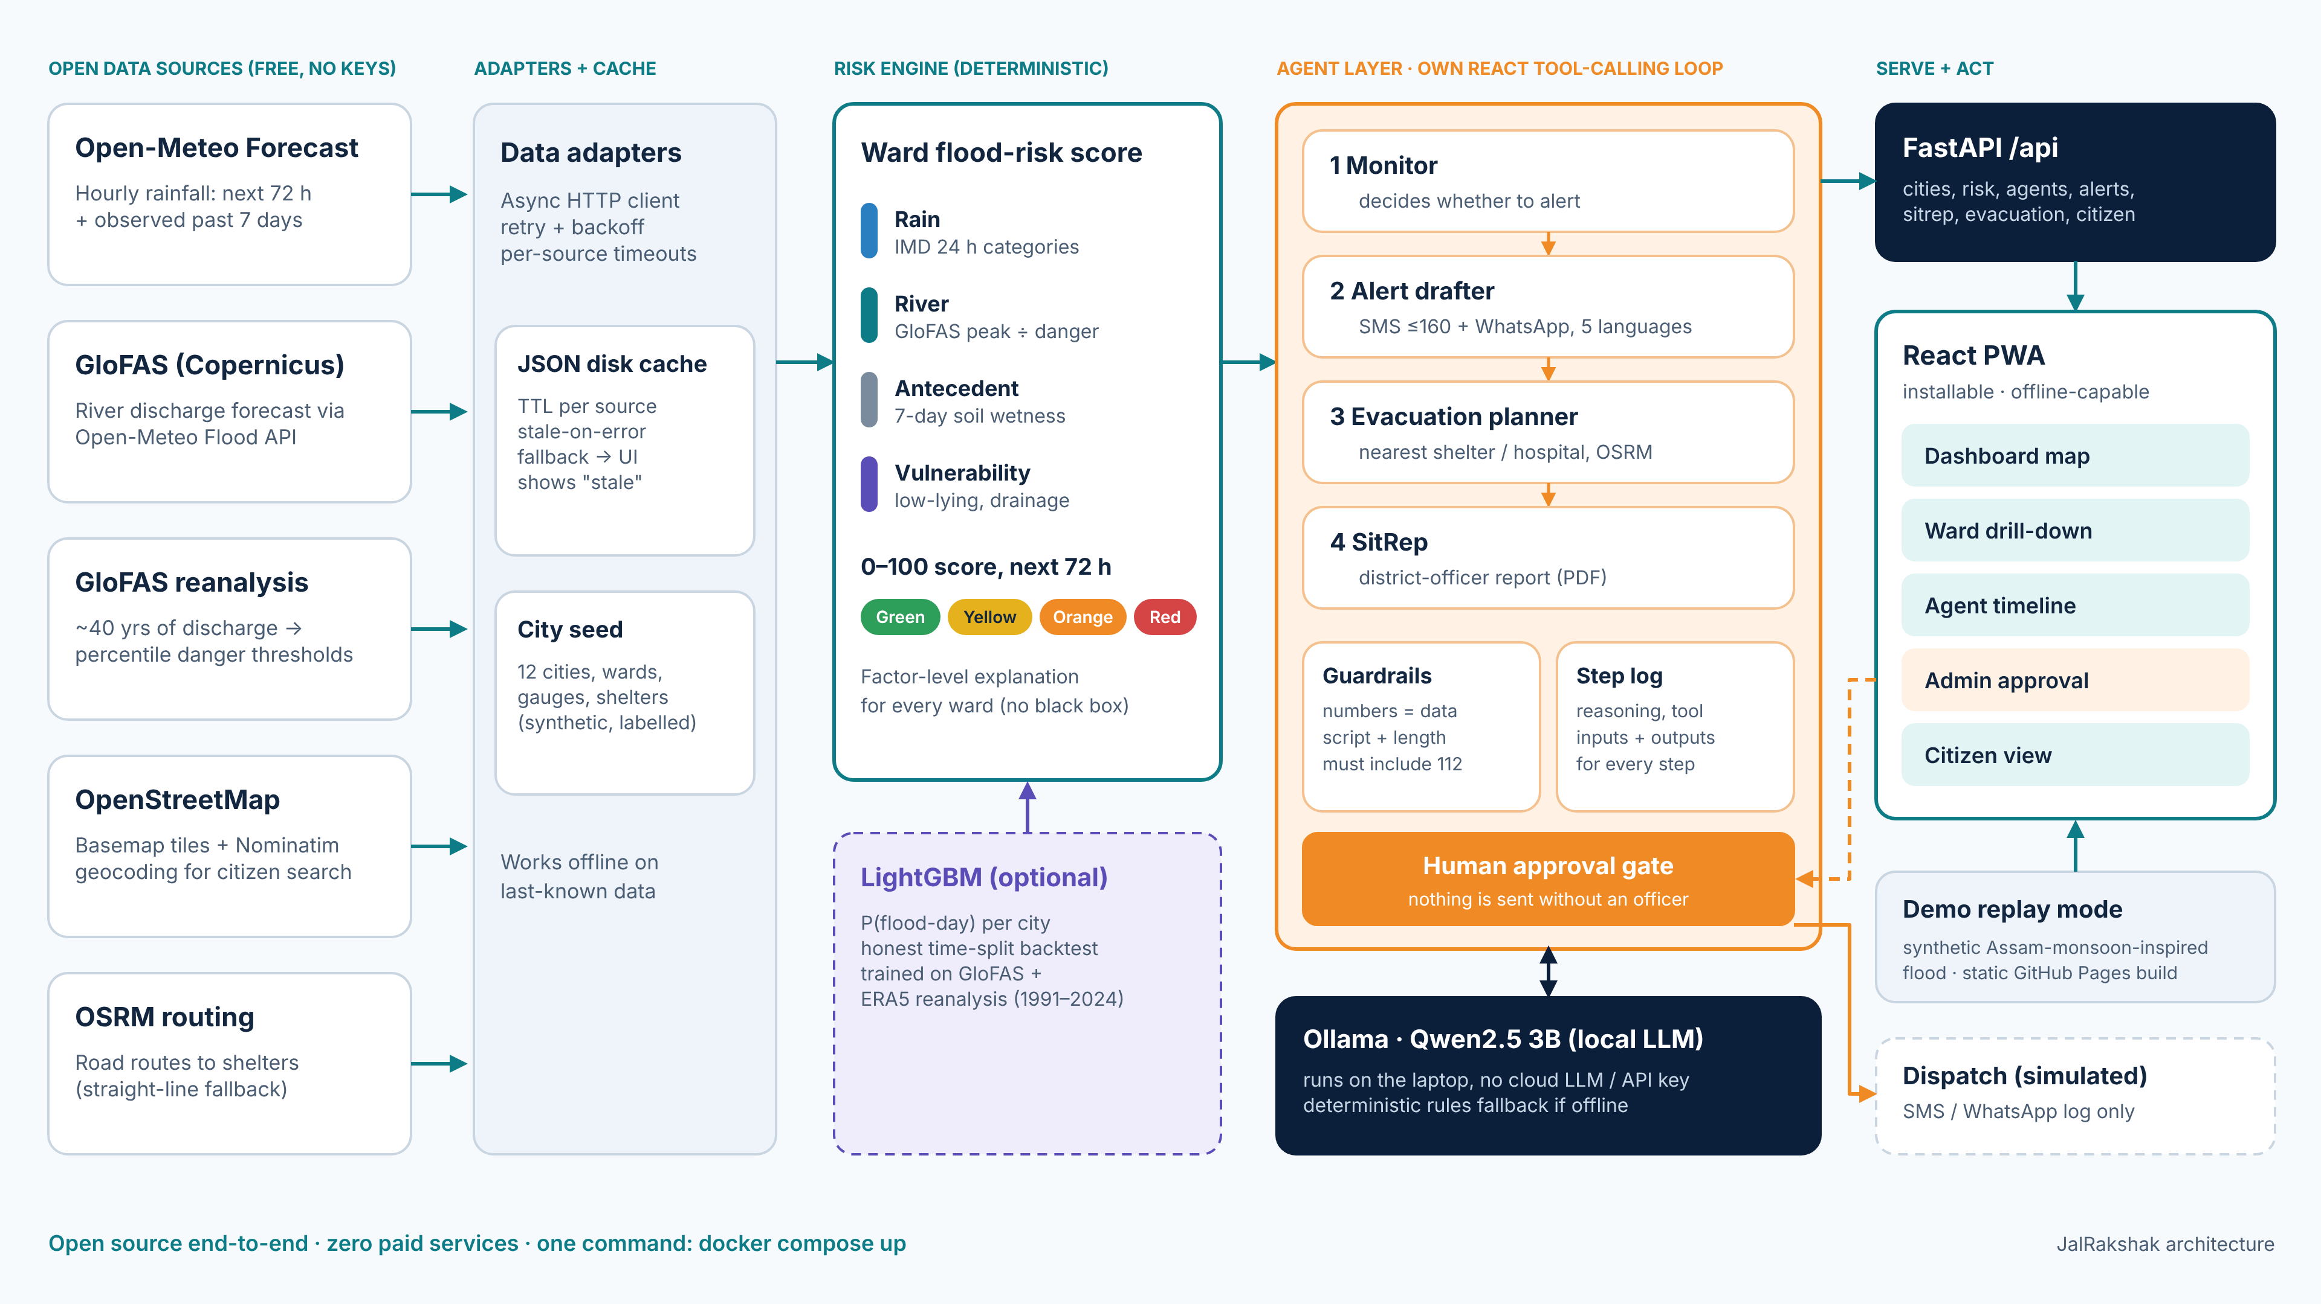




TECH STACK + ARCHITECTURE
Tech stack: open source end to end
Data
Open-Meteo, GloFAS v4, ERA5, OSM, OSRM (no keys)
Backend
Python 3.13, FastAPI, Pydantic v2, httpx, cache
ML + agents
LightGBM · Ollama Qwen2.5 3B · own ReAct loop
Frontend
React 18, Vite, TS, Leaflet, Recharts, PWA
Deploy
Data → adapters + cache → risk engine (+LightGBM) → agents → FastAPI → React PWA
docker compose; static demo on GitHub Pages
JalRakshak · Clash of Commits
6 / 10
Notes:
Everything is open source; credits in CREDITS.md (inspired by FloodGuard and PredictAid).

Slide 7

EXECUTION
Execution and build plan
BUILT
BUILT
BUILT
4
NEXT
5
NEXT
Data + risk engine
Agents + guardrails
PWA + demo replay
Validate with a district
Scale
Open-Meteo + GloFAS adapters, cache
12 cities, 96 wards, shelters
Monotone score, unit tests
Own ReAct loop on Ollama
4 agents, rules fallback
Approval gate, step log
Dashboard, ward drill-down
Admin + citizen views
Offline, GitHub Pages demo
Real ward boundaries
Officer feedback on alerts
Backtest on recorded floods
SMS gateway / CAP feed
More languages
More cities by config
Built and demoable today: one command (docker compose up) or the static demo link.
JalRakshak · Clash of Commits
7 / 10

Slide 8
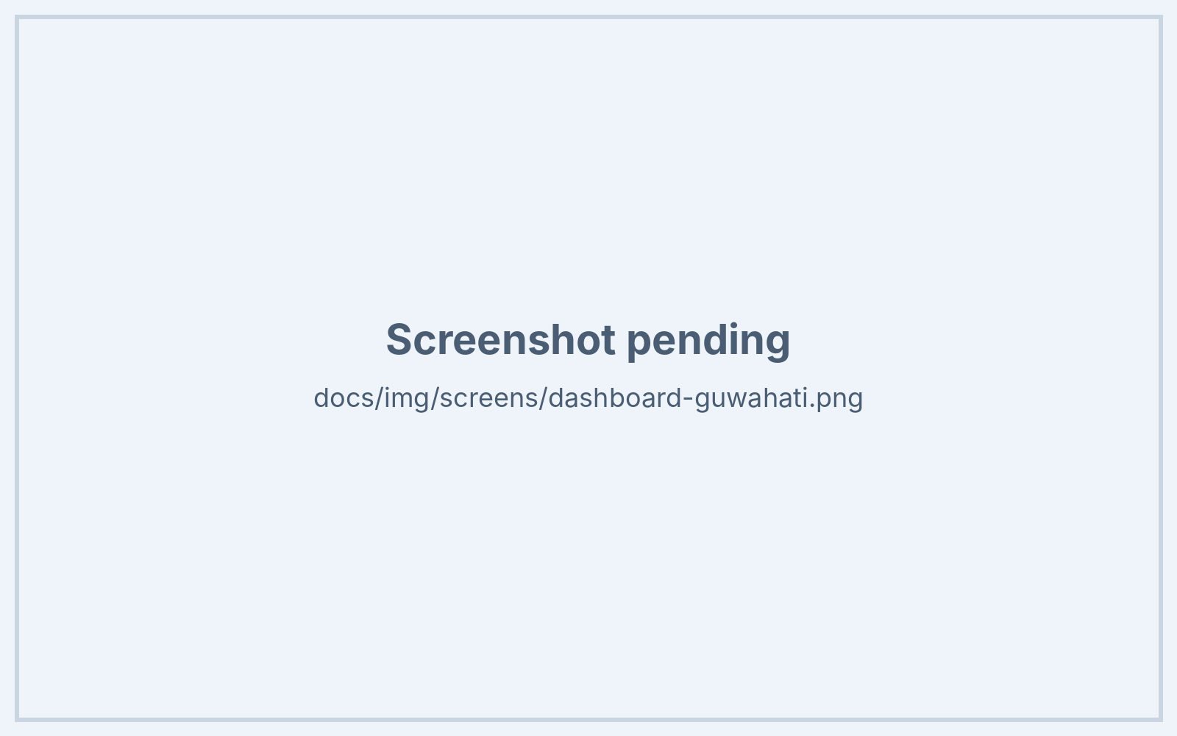
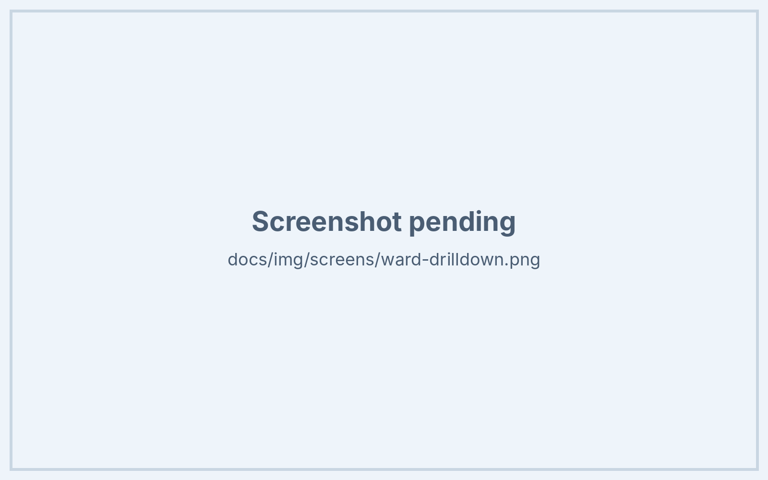
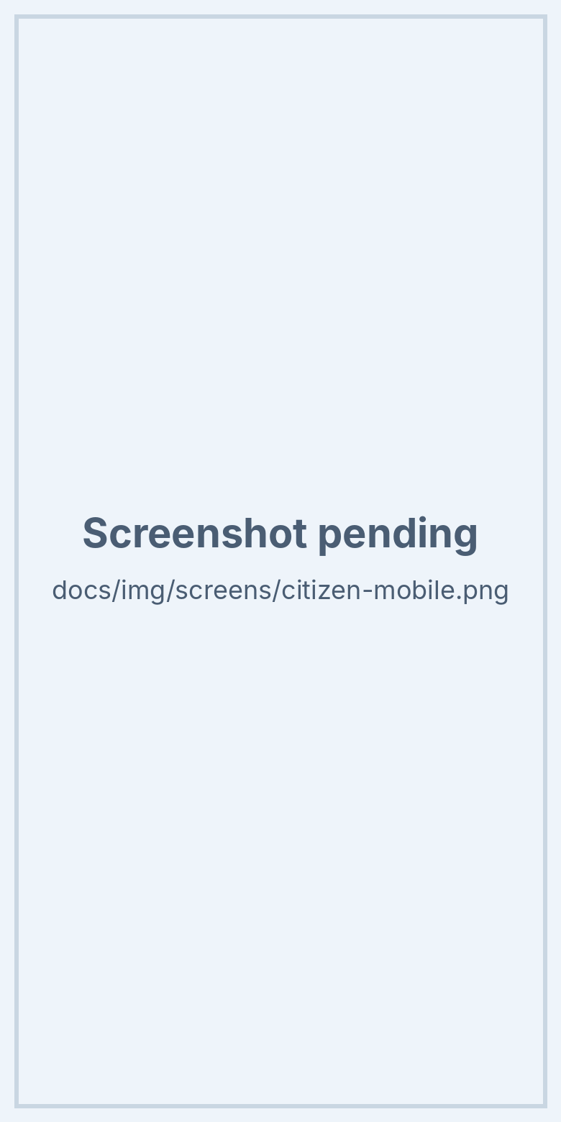
LIVE DEMO · HTTPS://MADHAVZANWAR.GITHUB.IO/JAL-RAKSHAK/
See it working
City risk 72 h horizon, gauges
Ward drill-down factors, shelters
Citizen view
JalRakshak · Clash of Commits
8 / 10
Notes:
Real screenshots from the demo replay build.

Slide 9




IMPACT
Expected impact
30%
≈64%
ESTIMATE
ESTIMATE
5.5 crore
≈₹185 cr/yr
less damage when people get just 24 hours' warning of a hazard
of Indians have Hindi, Bengali, Marathi or Tamil as mother tongue
residents in the 12 pilot cities, scored ward by ward
avoidable flood damage if warnings reach 10% of exposed households
Global Commission on Adaptation, cited by UN/WMO Early Warnings for All
Census of India 2011 (C-16), via Factly
Estimate: sum of city populations in our seed data (96 synthetic wards)
Estimate: 30% × 10% reach × ₹6,150 cr/yr average damage
Ward-level warning, 3 days ahead
In the citizen's own language
Clear action: nearest shelter + route
Earlier evacuation, fewer deaths, lower losses
Sources: UN Early Warnings for All; Census 2011 via Factly; Standing Committee on Water Resources. Orange = our estimates. URLs: submission/SOURCES.md
JalRakshak · Clash of Commits
9 / 10
Notes:
Separate what is sourced (30%, 64%) from our own estimates (orange tiles).

Slide 10

TEAM
Team JalRakshak
MZ
Madhav Zanwar
DP
Divyani Papalkar
Backend, risk engine, AI agents
Frontend, UX, multilingual content
FastAPI + data adapters
Risk formula + LightGBM backtest
ReAct agents on Ollama
React PWA: dashboard, admin, citizen
Alert templates in 5 languages
Demo + pitch
Pimpri Chinchwad College of Engineering (PCCoE), Pune
Code: https://github.com/madhavzanwar/Jal-rakshak · Live demo: https://madhavzanwar.github.io/Jal-rakshak/
JalRakshak · Clash of Commits
10 / 10

