Slide 1
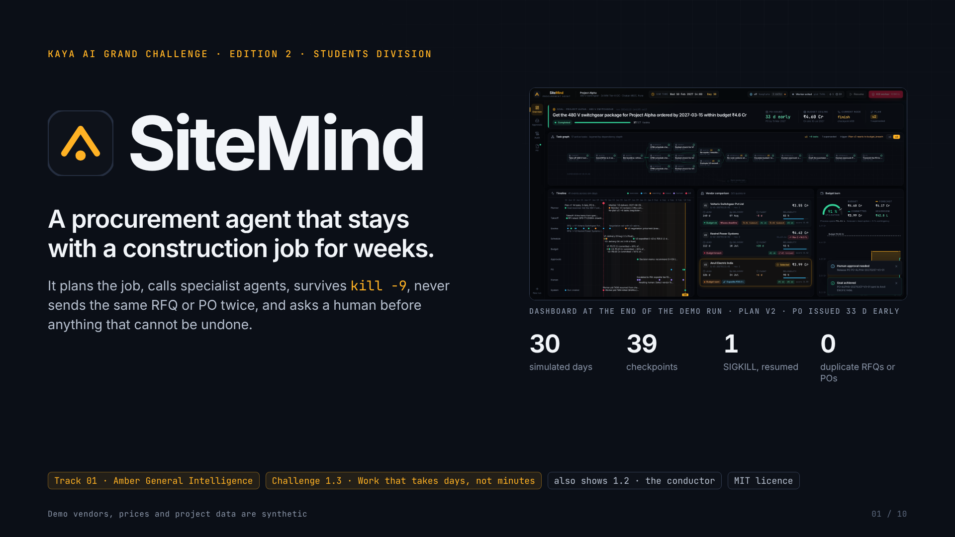
Notes:
SiteMind
Kaya AI Grand Challenge · Edition 2 · Students division SiteMind A procurement agent that stays with a construction job for weeks. It plans the job, calls specialist agents, survives kill -9 , never sends the same RFQ or PO twice, and asks a human before anything that cannot be undone. Dashboard at the end of the demo run · plan v2 · PO issued 33 d early 30 simulated days 39 checkpoints 1 SIGKILL, resumed 0 duplicate RFQs or POs Track 01 · Amber General Intelligence Challenge 1.3 · Work that takes days, not minutes also shows 1.2 · the conductor MIT licence Demo vendors, prices and project data are synthetic 01 / 10

Slide 2
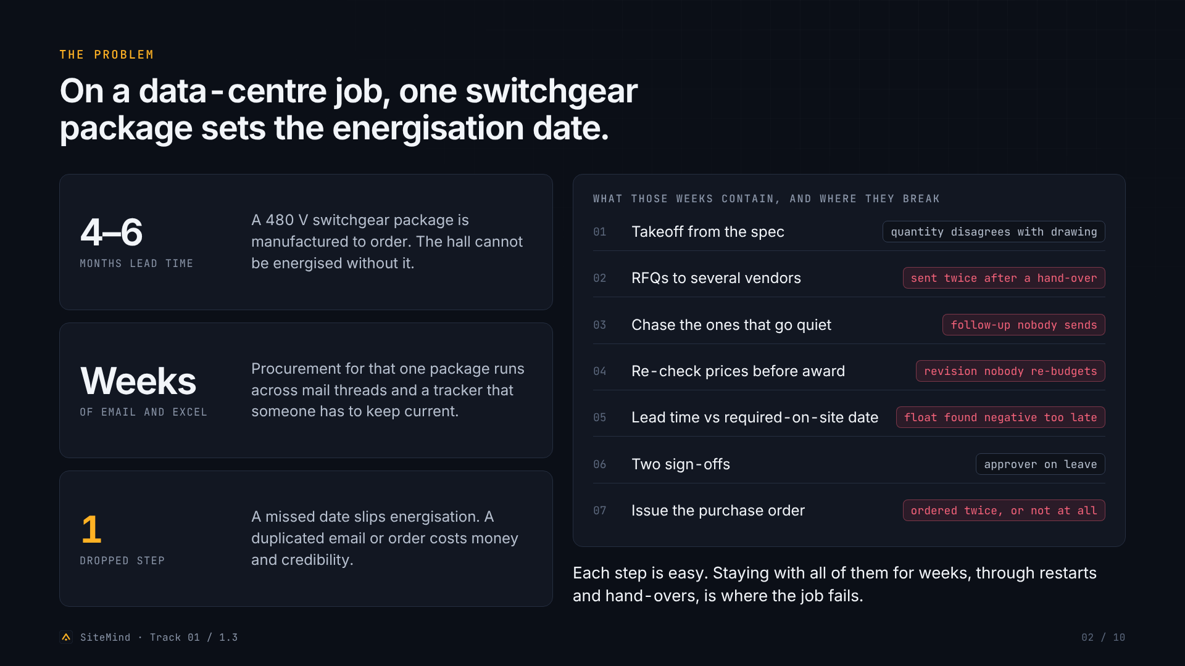
Notes:
The problem
The problem On a data-centre job, one switchgear package sets the energisation date. 4–6 months lead time A 480 V switchgear package is manufactured to order. The hall cannot be energised without it. Weeks of email and Excel Procurement for that one package runs across mail threads and a tracker that someone has to keep current. 1 dropped step A missed date slips energisation. A duplicated email or order costs money and credibility. What those weeks contain, and where they break 01 Takeoff from the spec quantity disagrees with drawing 02 RFQs to several vendors sent twice after a hand-over 03 Chase the ones that go quiet follow-up nobody sends 04 Re-check prices before award revision nobody re-budgets 05 Lead time vs required-on-site date float found negative too late 06 Two sign-offs approver on leave 07 Issue the purchase order ordered twice, or not at all Each step is easy. Staying with all of them for weeks, through restarts and hand-overs, is where the job fails. SiteMind · Track 01 / 1.3 02 / 10

Slide 3
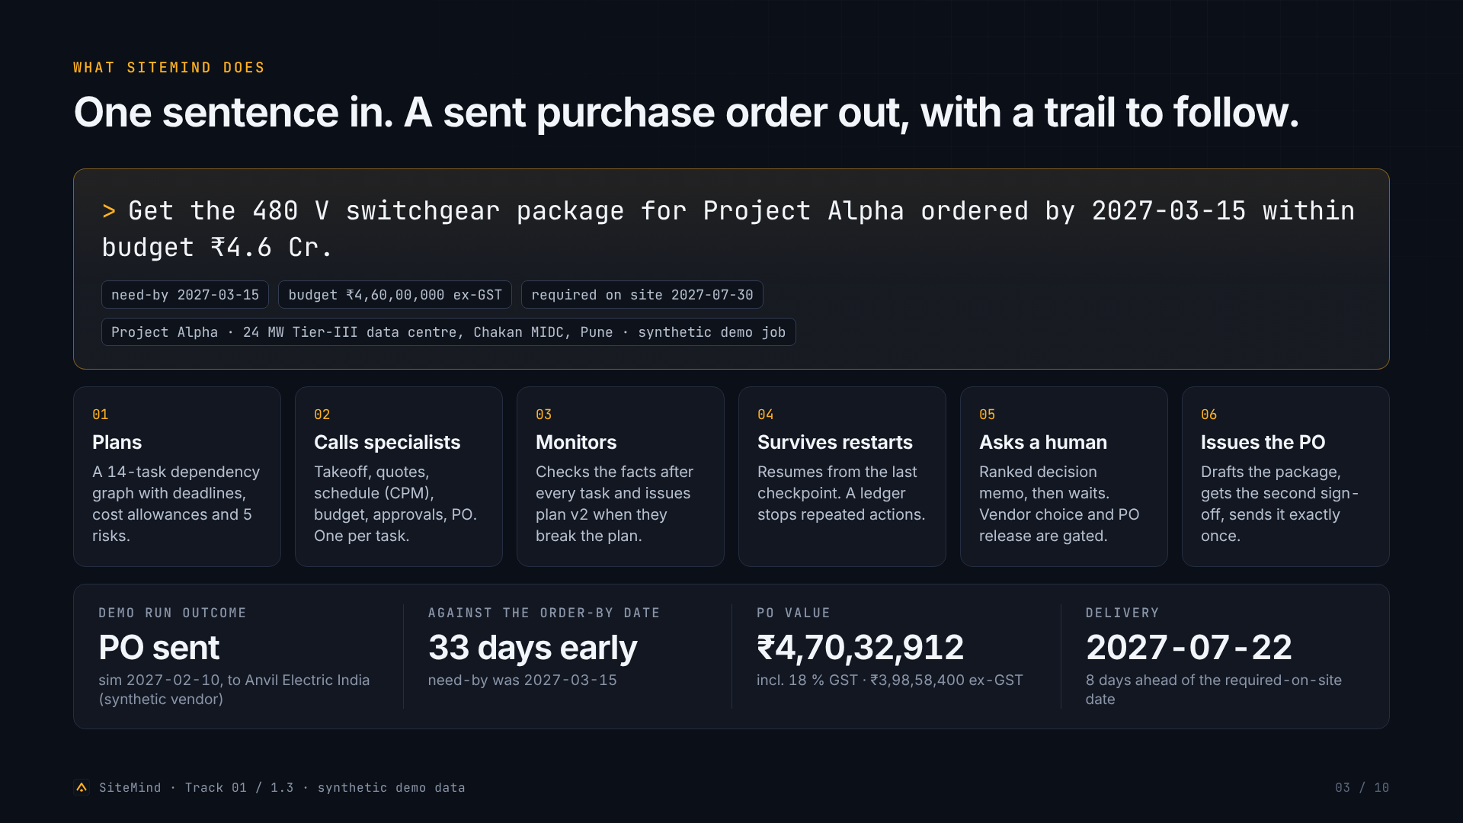
Notes:
The goal and what SiteMind does
What SiteMind does One sentence in. A sent purchase order out, with a trail to follow. > Get the 480 V switchgear package for Project Alpha ordered by 2027-03-15 within budget ₹4.6 Cr. need-by 2027-03-15 budget ₹4,60,00,000 ex-GST required on site 2027-07-30 Project Alpha · 24 MW Tier-III data centre, Chakan MIDC, Pune · synthetic demo job 01 Plans A 14-task dependency graph with deadlines, cost allowances and 5 risks. 02 Calls specialists Takeoff, quotes, schedule (CPM), budget, approvals, PO. One per task. 03 Monitors Checks the facts after every task and issues plan v2 when they break the plan. 04 Survives restarts Resumes from the last checkpoint. A ledger stops repeated actions. 05 Asks a human Ranked decision memo, then waits. Vendor choice and PO release are gated. 06 Issues the PO Drafts the package, gets the second sign-off, sends it exactly once. Demo run outcome PO sent sim 2027-02-10, to Anvil Electric India (synthetic vendor) Against the order-by date 33 days early need-by was 2027-03-15 PO value ₹4,70,32,912 incl. 18 % GST · ₹3,98,58,400 ex-GST Delivery 2027-07-22 8 days ahead of the required-on-site date SiteMind · Track 01 / 1.3 · synthetic demo data 03 / 10

Slide 4
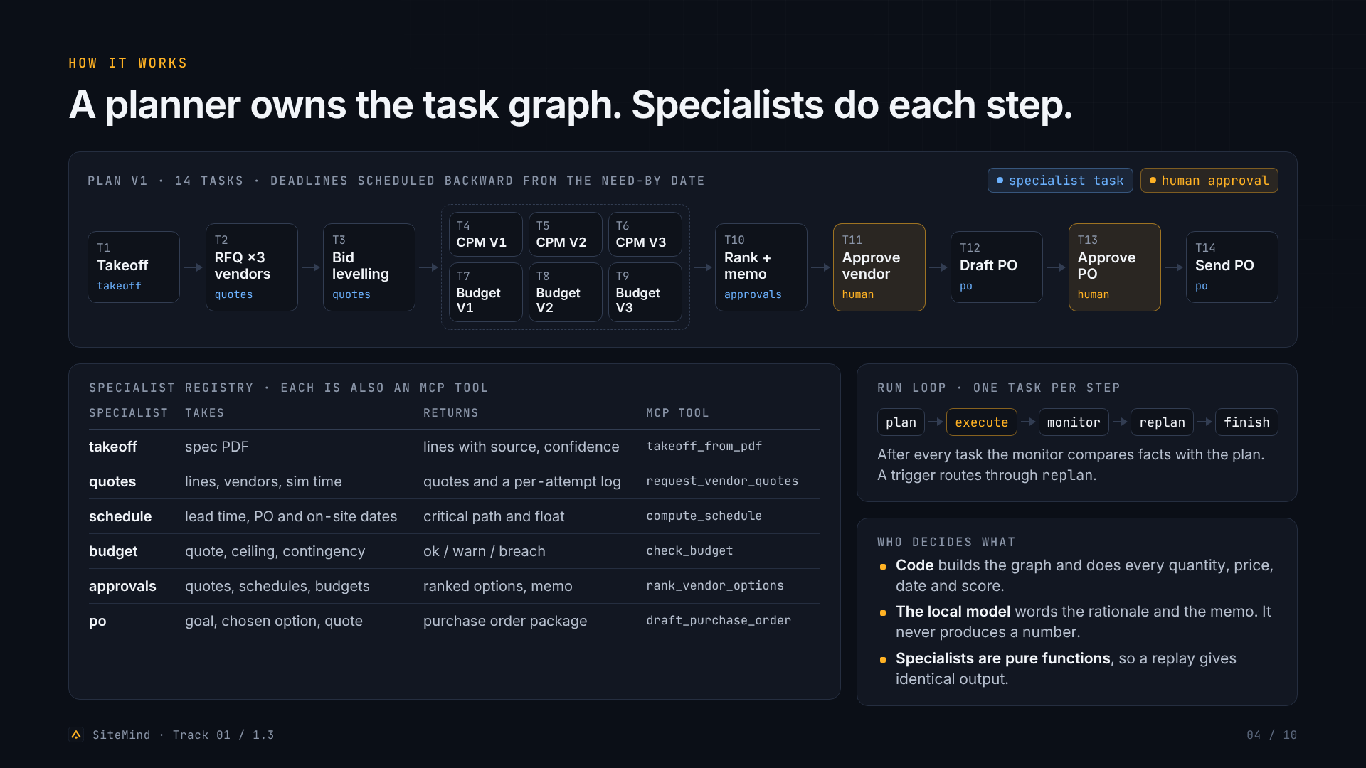
Notes:
How it works: planner DAG and specialist registry
How it works A planner owns the task graph. Specialists do each step. Plan v1 · 14 tasks · deadlines scheduled backward from the need-by date specialist task human approval T1 Takeoff takeoff T2 RFQ ×3 vendors quotes T3 Bid levelling quotes T4 CPM V1 T5 CPM V2 T6 CPM V3 T7 Budget V1 T8 Budget V2 T9 Budget V3 T10 Rank + memo approvals T11 Approve vendor human T12 Draft PO po T13 Approve PO human T14 Send PO po Specialist registry · each is also an MCP tool Specialist Takes Returns MCP tool takeoff spec PDF lines with source, confidence takeoff_from_pdf quotes lines, vendors, sim time quotes and a per-attempt log request_vendor_quotes schedule lead time, PO and on-site dates critical path and float compute_schedule budget quote, ceiling, contingency ok / warn / breach check_budget approvals quotes, schedules, budgets ranked options, memo rank_vendor_options po goal, chosen option, quote purchase order package draft_purchase_order Run loop · one task per step plan execute monitor replan finish After every task the monitor compares facts with the plan. A trigger routes through replan . Who decides what Code builds the graph and does every quantity, price, date and score. The local model words the rationale and the memo. It never produces a number. Specialists are pure functions , so a replay gives identical output. SiteMind · Track 01 / 1.3 04 / 10

Slide 5
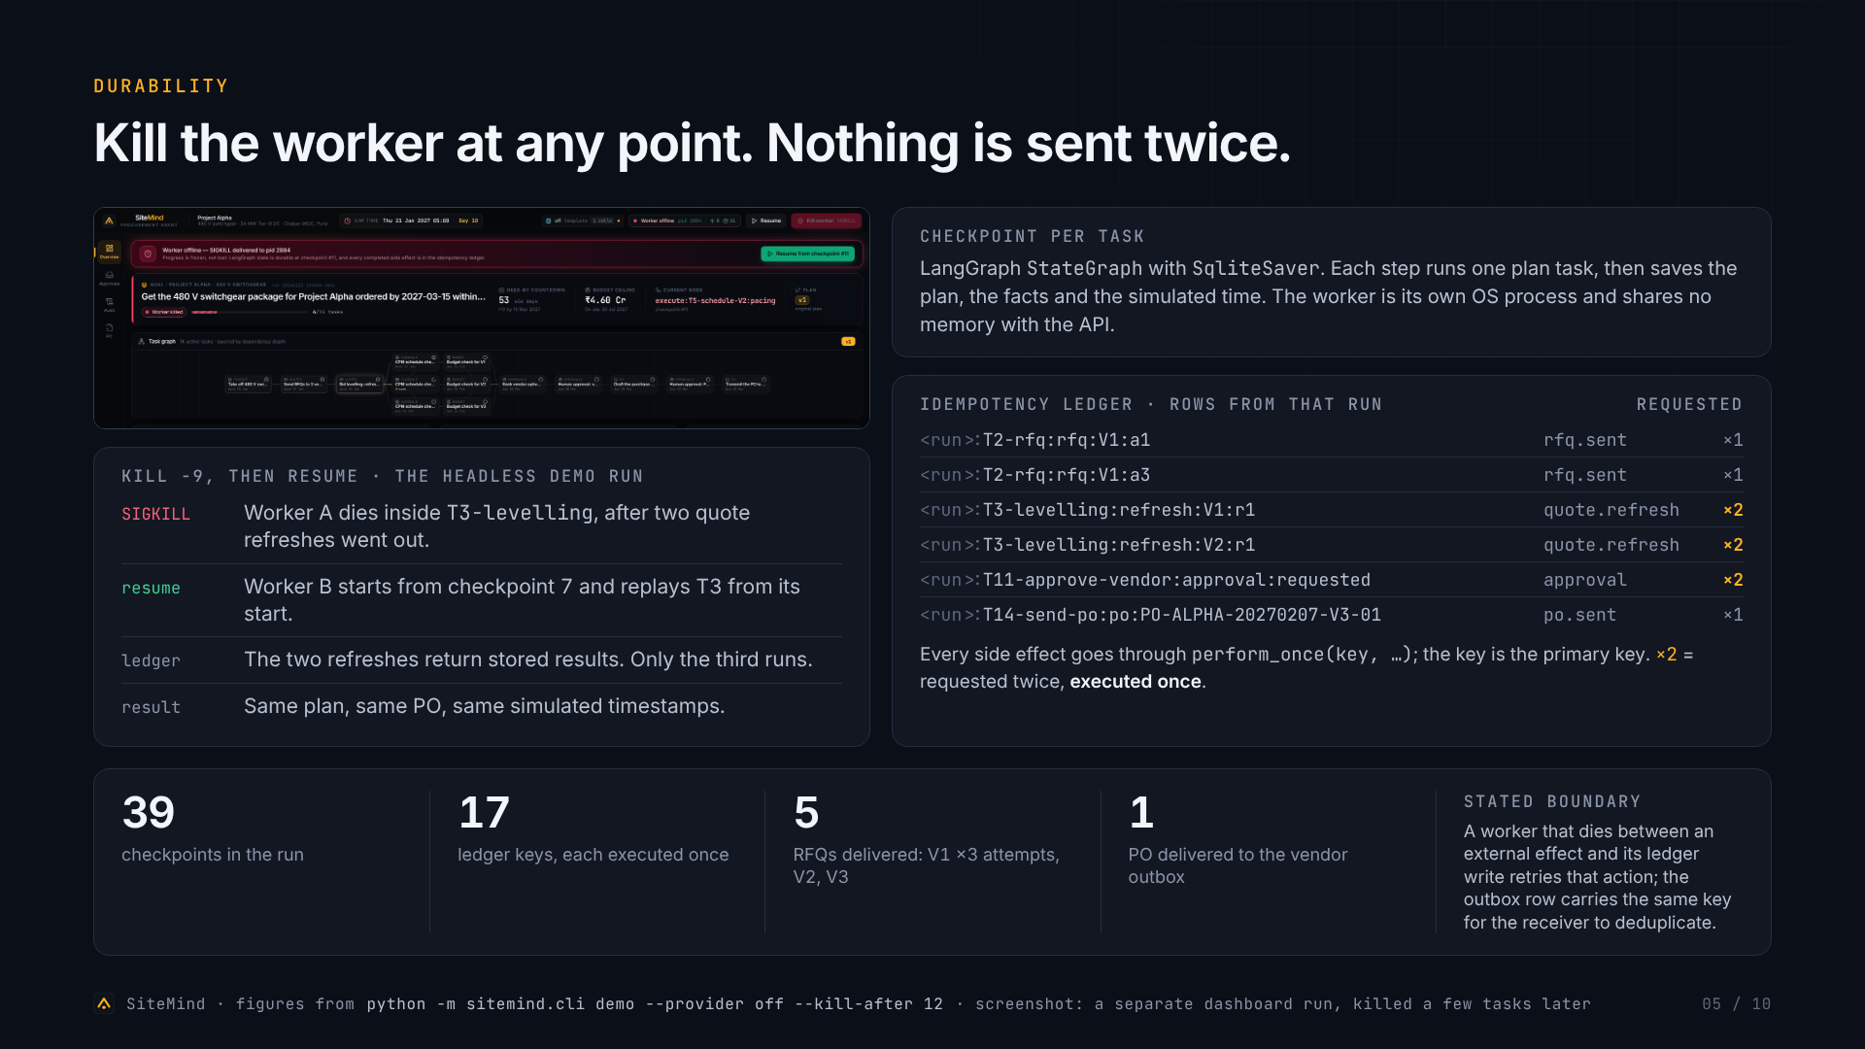
Notes:
Durability: checkpoints, idempotency ledger, kill -9 and resume
Durability Kill the worker at any point. Nothing is sent twice. kill -9, then resume · the headless demo run SIGKILL Worker A dies inside T3-levelling , after two quote refreshes went out. resume Worker B starts from checkpoint 7 and replays T3 from its start. ledger The two refreshes return stored results. Only the third runs. result Same plan, same PO, same simulated timestamps. Checkpoint per task LangGraph StateGraph with SqliteSaver . Each step runs one plan task, then saves the plan, the facts and the simulated time. The worker is its own OS process and shares no memory with the API. Idempotency ledger · rows from that run requested <run>: T2-rfq:rfq:V1:a1 rfq.sent ×1 <run>: T2-rfq:rfq:V1:a3 rfq.sent ×1 <run>: T3-levelling:refresh:V1:r1 quote.refresh ×2 <run>: T3-levelling:refresh:V2:r1 quote.refresh ×2 <run>: T11-approve-vendor:approval:requested approval ×2 <run>: T14-send-po:po:PO-ALPHA-20270207-V3-01 po.sent ×1 Every side effect goes through perform_once(key, …) ; the key is the primary key. ×2 = requested twice, executed once . 39 checkpoints in the run 17 ledger keys, each executed once 5 RFQs delivered: V1 ×3 attempts, V2, V3 1 PO delivered to the vendor outbox Stated boundary A worker that dies between an external effect and its ledger write retries that action; the outbox row carries the same key for the receiver to deduplicate. SiteMind · figures from python -m sitemind.cli demo --provider off --kill-after 12 · screenshot: a separate dashboard run, killed a few tasks later 05 / 10

Slide 6
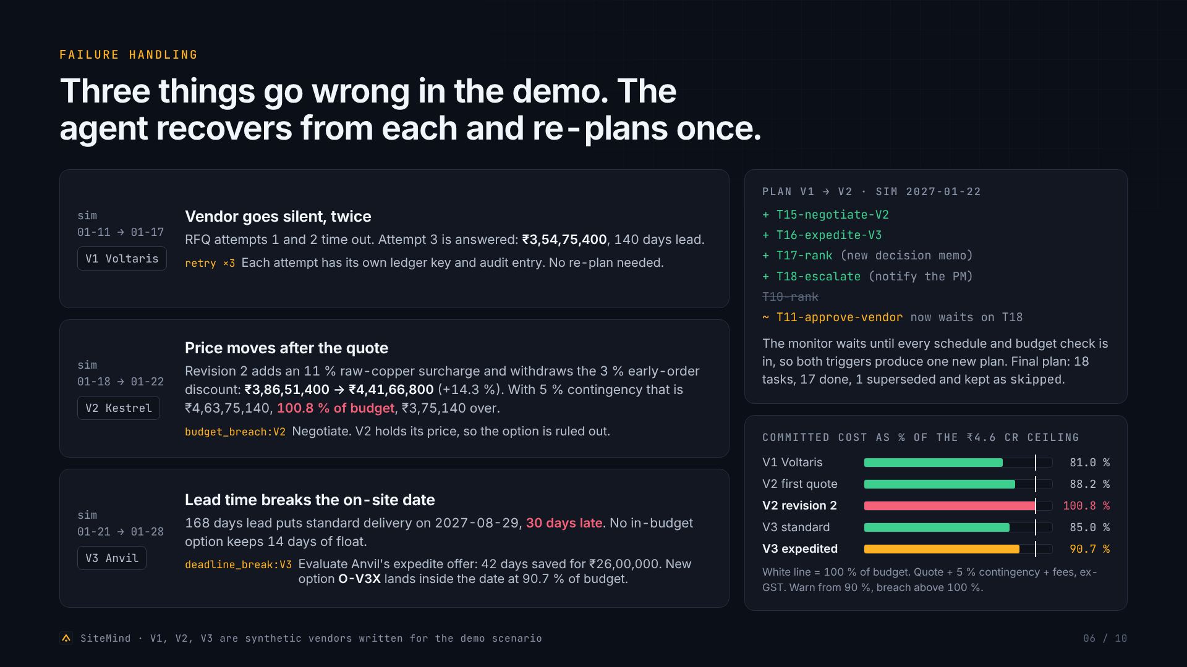
Notes:
Failure handling and the re-plan
Failure handling Three things go wrong in the demo. The agent recovers from each and re-plans once. sim 01-11 → 01-17 V1 Voltaris Vendor goes silent, twice RFQ attempts 1 and 2 time out. Attempt 3 is answered: ₹3,54,75,400 , 140 days lead. retry ×3 Each attempt has its own ledger key and audit entry. No re-plan needed. sim 01-18 → 01-22 V2 Kestrel Price moves after the quote Revision 2 adds an 11 % raw-copper surcharge and withdraws the 3 % early-order discount: ₹3,86,51,400 → ₹4,41,66,800 (+14.3 %). With 5 % contingency that is ₹4,63,75,140, 100.8 % of budget , ₹3,75,140 over. budget_breach:V2 Negotiate. V2 holds its price, so the option is ruled out. sim 01-21 → 01-28 V3 Anvil Lead time breaks the on-site date 168 days lead puts standard delivery on 2027-08-29, 30 days late . No in-budget option keeps 14 days of float. deadline_break:V3 Evaluate Anvil's expedite offer: 42 days saved for ₹26,00,000. New option O-V3X lands inside the date at 90.7 % of budget. Plan v1 → v2 · sim 2027-01-22 + T15-negotiate-V2 + T16-expedite-V3 + T17-rank (new decision memo) + T18-escalate (notify the PM) T10-rank ~ T11-approve-vendor now waits on T18 The monitor waits until every schedule and budget check is in, so both triggers produce one new plan. Final plan: 18 tasks, 17 done, 1 superseded and kept as skipped . Committed cost as % of the ₹4.6 Cr ceiling V1 Voltaris 81.0 % V2 first quote 88.2 % V2 revision 2 100.8 % V3 standard 85.0 % V3 expedited 90.7 % White line = 100 % of budget. Quote + 5 % contingency + fees, ex-GST. Warn from 90 %, breach above 100 %. SiteMind · V1, V2, V3 are synthetic vendors written for the demo scenario 06 / 10

Slide 7
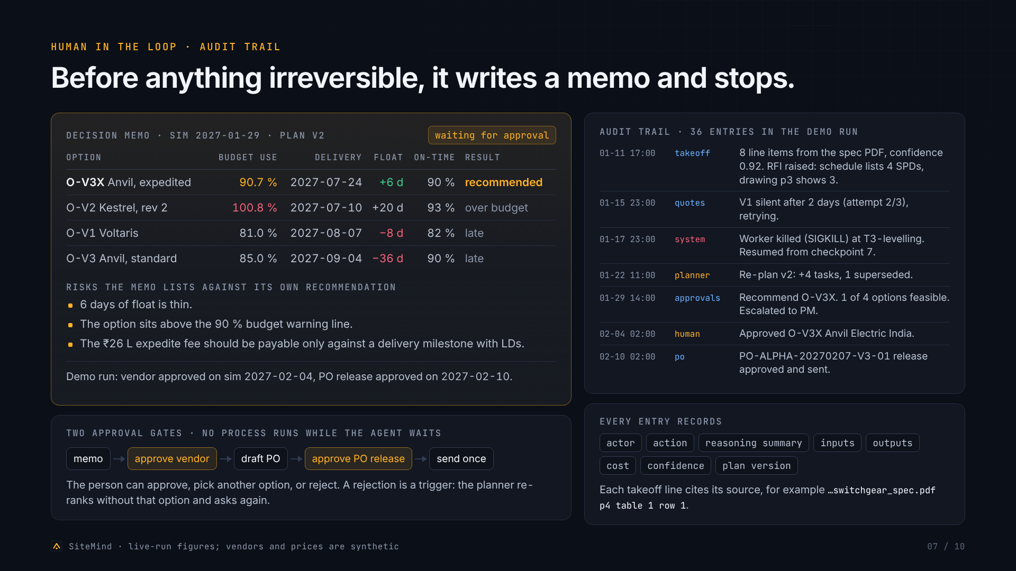
Notes:
Human in the loop and the audit trail
Human in the loop · audit trail Before anything irreversible, it writes a memo and stops. Decision memo · sim 2027-01-29 · plan v2 waiting for approval Option Budget use Delivery Float On-time Result O-V3X Anvil, expedited 90.7 % 2027-07-24 +6 d 90 % recommended O-V2 Kestrel, rev 2 100.8 % 2027-07-10 +20 d 93 % over budget O-V1 Voltaris 81.0 % 2027-08-07 −8 d 82 % late O-V3 Anvil, standard 85.0 % 2027-09-04 −36 d 90 % late Risks the memo lists against its own recommendation 6 days of float is thin. The option sits above the 90 % budget warning line. The ₹26 L expedite fee should be payable only against a delivery milestone with LDs. Demo run: vendor approved on sim 2027-02-04, PO release approved on 2027-02-10. Two approval gates · no process runs while the agent waits memo approve vendor draft PO approve PO release send once The person can approve, pick another option, or reject. A rejection is a trigger: the planner re-ranks without that option and asks again. Audit trail · 36 entries in the demo run 01-11 17:00 takeoff 8 line items from the spec PDF, confidence 0.92. RFI raised: schedule lists 4 SPDs, drawing p3 shows 3. 01-15 23:00 quotes V1 silent after 2 days (attempt 2/3), retrying. 01-17 23:00 system Worker killed (SIGKILL) at T3-levelling. Resumed from checkpoint 7. 01-22 11:00 planner Re-plan v2: +4 tasks, 1 superseded. 01-29 14:00 approvals Recommend O-V3X. 1 of 4 options feasible. Escalated to PM. 02-04 02:00 human Approved O-V3X Anvil Electric India. 02-10 02:00 po PO-ALPHA-20270207-V3-01 release approved and sent. Every entry records actor action reasoning summary inputs outputs cost confidence plan version Each takeoff line cites its source, for example …switchgear_spec.pdf p4 table 1 row 1 . SiteMind · live-run figures; vendors and prices are synthetic 07 / 10

Slide 8
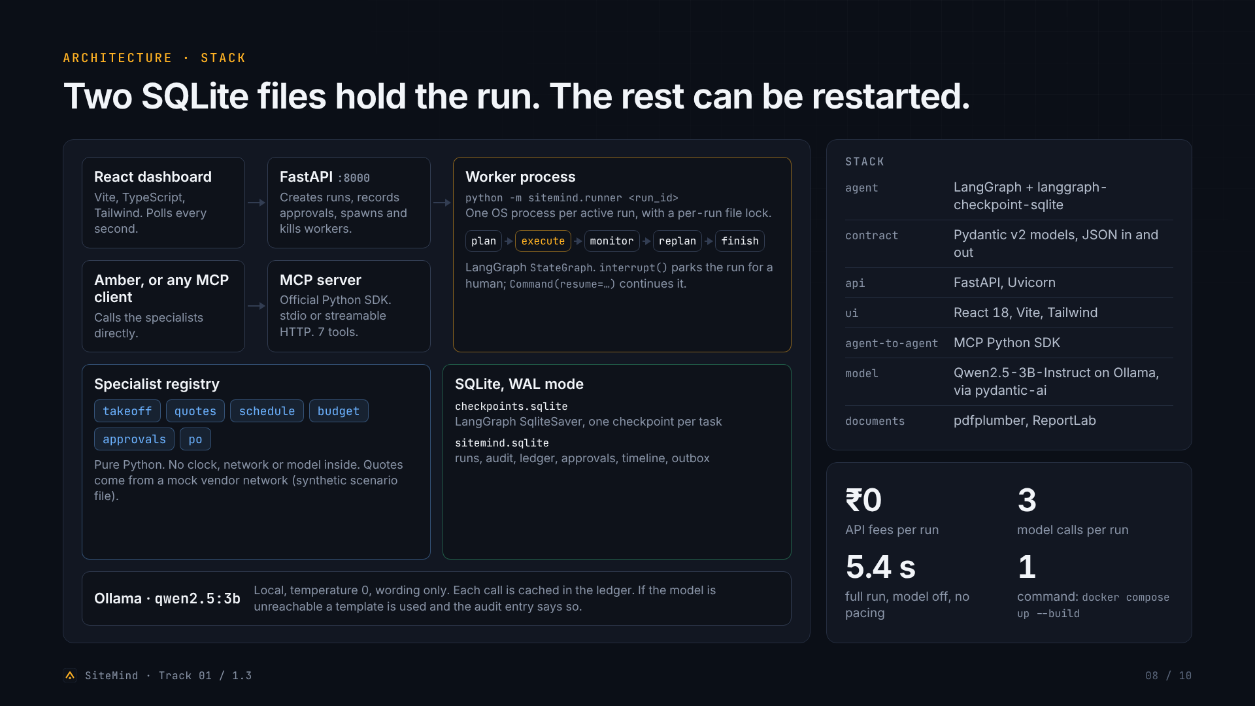
Notes:
Architecture and stack
Architecture · stack Two SQLite files hold the run. The rest can be restarted. React dashboard Vite, TypeScript, Tailwind. Polls every second. FastAPI :8000 Creates runs, records approvals, spawns and kills workers. Worker process python -m sitemind.runner <run_id> One OS process per active run, with a per-run file lock. plan execute monitor replan finish LangGraph StateGraph . interrupt() parks the run for a human; Command(resume=…) continues it. Amber, or any MCP client Calls the specialists directly. MCP server Official Python SDK. stdio or streamable HTTP. 7 tools. Specialist registry takeoff quotes schedule budget approvals po Pure Python. No clock, network or model inside. Quotes come from a mock vendor network (synthetic scenario file). SQLite, WAL mode checkpoints.sqlite LangGraph SqliteSaver, one checkpoint per task sitemind.sqlite runs, audit, ledger, approvals, timeline, outbox Ollama · qwen2.5:3b Local, temperature 0, wording only. Each call is cached in the ledger. If the model is unreachable a template is used and the audit entry says so. Stack agent LangGraph + langgraph-checkpoint-sqlite contract Pydantic v2 models, JSON in and out api FastAPI, Uvicorn ui React 18, Vite, Tailwind agent-to-agent MCP Python SDK model Qwen2.5-3B-Instruct on Ollama, via pydantic-ai documents pdfplumber, ReportLab ₹0 API fees per run 3 model calls per run 5.4 s full run, model off, no pacing 1 command: docker compose up --build SiteMind · Track 01 / 1.3 08 / 10

Slide 9
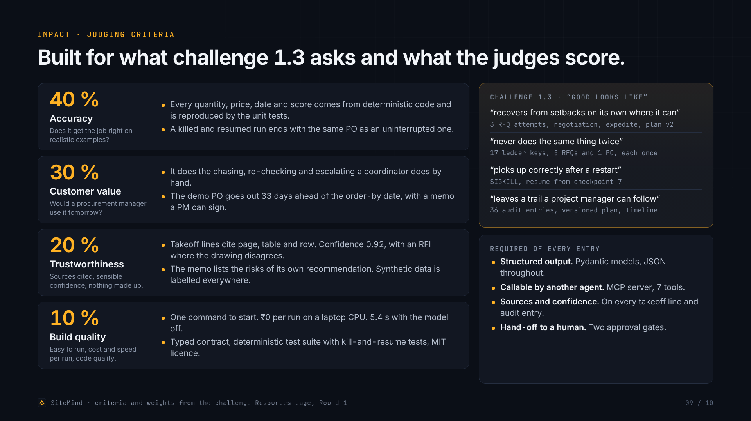
Notes:
Impact and judging-criteria fit
Impact · judging criteria Built for what challenge 1.3 asks and what the judges score. 40 % Accuracy Does it get the job right on realistic examples? Every quantity, price, date and score comes from deterministic code and is reproduced by the unit tests. A killed and resumed run ends with the same PO as an uninterrupted one. 30 % Customer value Would a procurement manager use it tomorrow? It does the chasing, re-checking and escalating a coordinator does by hand. The demo PO goes out 33 days ahead of the order-by date, with a memo a PM can sign. 20 % Trustworthiness Sources cited, sensible confidence, nothing made up. Takeoff lines cite page, table and row. Confidence 0.92, with an RFI where the drawing disagrees. The memo lists the risks of its own recommendation. Synthetic data is labelled everywhere. 10 % Build quality Easy to run, cost and speed per run, code quality. One command to start. ₹0 per run on a laptop CPU. 5.4 s with the model off. Typed contract, deterministic test suite with kill-and-resume tests, MIT licence. Challenge 1.3 · “good looks like” “recovers from setbacks on its own where it can” 3 RFQ attempts, negotiation, expedite, plan v2 “never does the same thing twice” 17 ledger keys, 5 RFQs and 1 PO, each once “picks up correctly after a restart” SIGKILL, resume from checkpoint 7 “leaves a trail a project manager can follow” 36 audit entries, versioned plan, timeline Required of every entry Structured output. Pydantic models, JSON throughout. Callable by another agent. MCP server, 7 tools. Sources and confidence. On every takeoff line and audit entry. Hand-off to a human. Two approval gates. SiteMind · criteria and weights from the challenge Resources page, Round 1 09 / 10

Slide 10
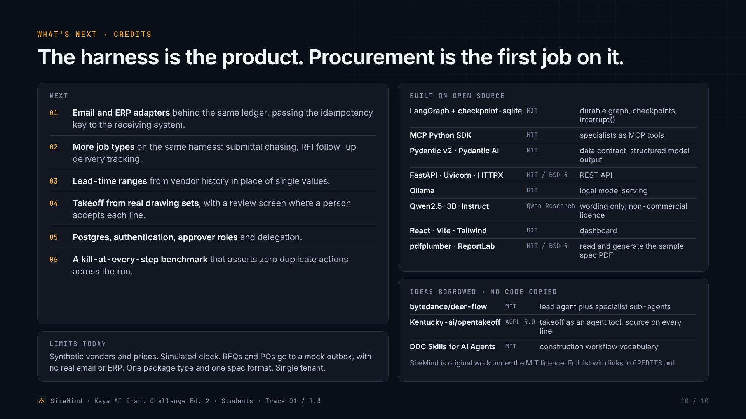
Notes:
What's next and open-source credits
What's next · credits The harness is the product. Procurement is the first job on it. Next Email and ERP adapters behind the same ledger, passing the idempotency key to the receiving system. More job types on the same harness: submittal chasing, RFI follow-up, delivery tracking. Lead-time ranges from vendor history in place of single values. Takeoff from real drawing sets , with a review screen where a person accepts each line. Postgres, authentication, approver roles and delegation. A kill-at-every-step benchmark that asserts zero duplicate actions across the run. Limits today Synthetic vendors and prices. Simulated clock. RFQs and POs go to a mock outbox, with no real email or ERP. One package type and one spec format. Single tenant. Built on open source LangGraph + checkpoint-sqlite MIT durable graph, checkpoints, interrupt() MCP Python SDK MIT specialists as MCP tools Pydantic v2 · Pydantic AI MIT data contract, structured model output FastAPI · Uvicorn · HTTPX MIT / BSD-3 REST API Ollama MIT local model serving Qwen2.5-3B-Instruct Qwen Research wording only; non-commercial licence React · Vite · Tailwind MIT dashboard pdfplumber · ReportLab MIT / BSD-3 read and generate the sample spec PDF Ideas borrowed · no code copied bytedance/deer-flow MIT lead agent plus specialist sub-agents Kentucky-ai/opentakeoff AGPL-3.0 takeoff as an agent tool, source on every line DDC Skills for AI Agents MIT construction workflow vocabulary SiteMind is original work under the MIT licence. Full list with links in CREDITS.md . SiteMind · Kaya AI Grand Challenge Ed. 2 · Students · Track 01 / 1.3 10 / 10

