Slide 1

PROFILE
Madhesh S
AI/ML Enthusiast · Android Developer · Backend Developer
CAREER INTEREST
Backend Development
AI / Machine Learning
Madhesh S
TECHNICAL SKILLS
Machine Learning
Flask & Firebase
B.Tech CSE | CGPA: 9.82
Android Development
Git & GitHub
LANGUAGES
Python
Java
C / C++
Ready to build impactful solutions

Slide 2
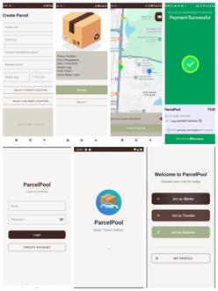
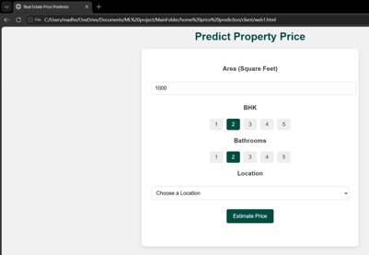
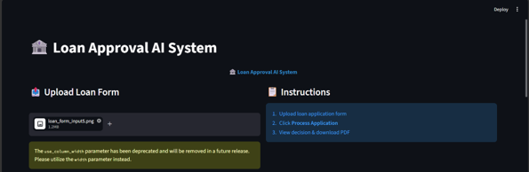
PROJECTS
Featured Projects
Showcasing Expertise in Mobile, Backend, and AI/ML
Mobile
AI/ML
Backend
ParcelPool
Home Price Prediction
Loan Validation System
Java · Firebase · Android
Python · Flask · ML
OCR · NLP · Automation
On-the-way delivery app connecting parcel senders with travelers. Real-time sync, secure auth & route matching.
ML regression system for real-time property valuation. Clean UI for parameter input with instant predictions.
Automated document processing using OCR & NLP validation. Streamlines loan approvals with auto report generation.
01
02
03

Slide 3
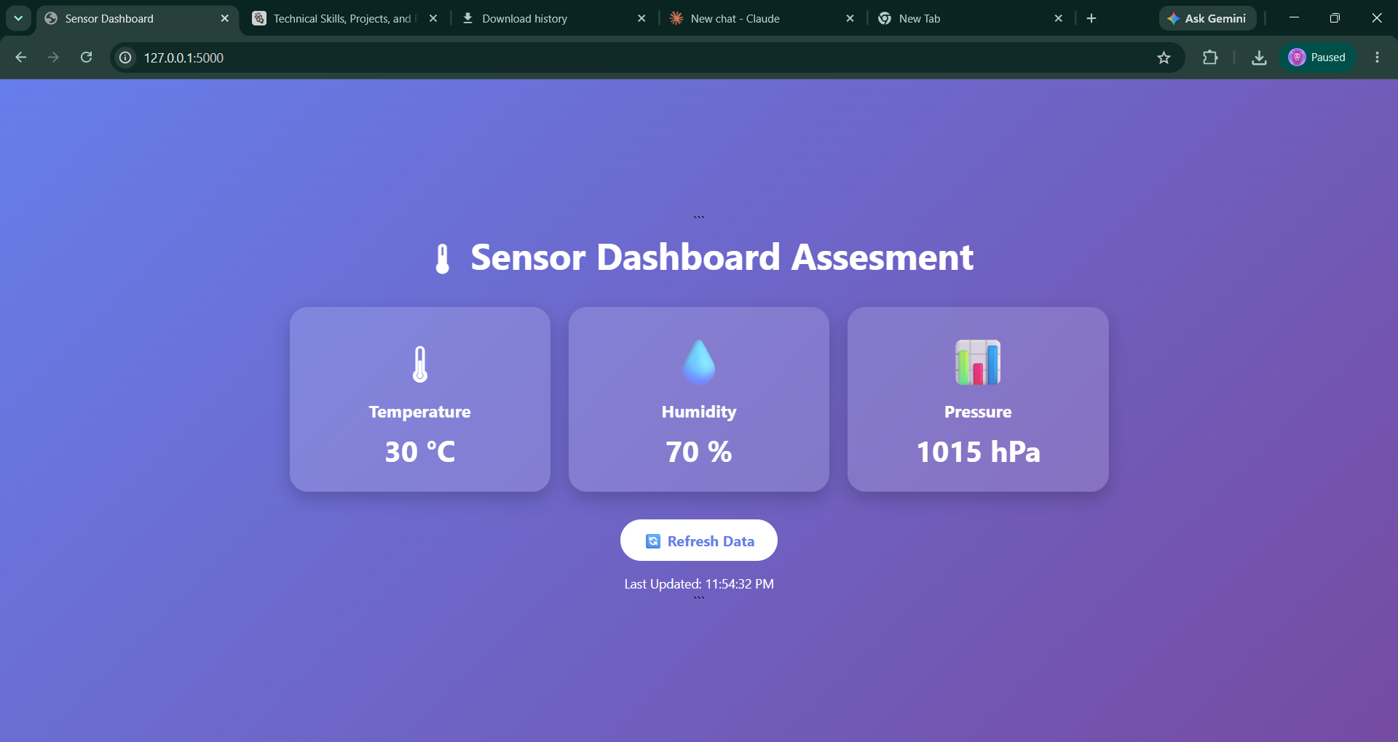
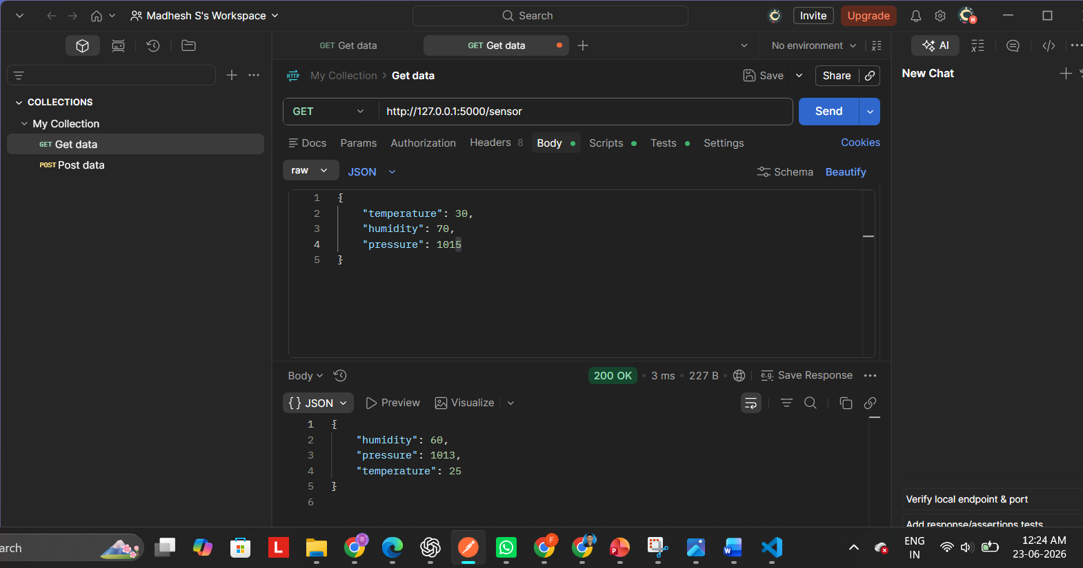
ASSESSMENT
Sensor Dashboard — Full-Stack REST API Integration
API Tested via Postman
GET /sensor
POST /sensor
Real-time UI
Retrieve live data
Update readings
Auto-refresh display
Live Dashboard UI

Slide 4
WORKFLOW
Tools & Development Lifecycle
Technical Stack and Step-by-Step Procedure
TECHNICAL STACK
PROCEDURE
Python
Flask
HTML/CSS/JS
Developed Flask application and robust API endpoints for data handling.
01
VS Code
Postman
Git
02
Designed and built the dashboard UI using modern web standards.
03
Connected frontend to backend and validated API functionality via Postman.
04
Integrated real-time sensor data display with seamless refresh logic.

Slide 5
CONCLUSION
Why I Am Suitable
for the Role
9.82
Combining Academic Excellence with Practical Engineering
CGPA
Strong Academic Foundation
Maintained a high CGPA of 9.82 throughout B.Tech CSE, demonstrating discipline and a quick learning ability.
3
Proven Development Skills
PROJECTS
Extensive experience in Python/Flask backend and Android mobile development through end-to-end projects.
Full
Stack
Hands-on AI/ML Expertise
Practical internship experience building real-world ML solutions and automated systems.
READY
Ready to contribute to innovative software solutions.

