Slide 1
Assessment of Marginal Workers In Tamilnadu
Phase-5

Slide 2
Analysis Approach:
The analysis approach outlines the methodology and techniques you'll use to achieve the project's objectives. This can include data collection, preprocessing, modeling, and evaluation strategies. For example:
Data Collection: We collected customer data, including demographics, subscription details, and usage patterns from the company's database.
Data Preprocessing: Cleaned the data, handled missing values, and encoded categorical variables.
Modeling: Employed logistic regression, decision trees, and random forests to predict customer churn.
Evaluation: Used metrics such as accuracy, precision, recall, and ROC-AUC to assess model performance.

Slide 3
Visualization Types:
Visualization is a crucial part of data analysis to communicate insights effectively. The types of visualizations will depend on the data and the objectives. For example:
Bar charts and pie charts to show customer demographics and subscription breakdown.
Line plots to visualize stock price trends over time.
Word clouds to display frequently mentioned terms in social media sentiment analysis.

Slide 4
Code Implementation:
This section provides a high-level overview of the code and tools used in the project. For example:
We implemented the analysis using Python and popular libraries like Pandas, NumPy, and Scikit-Learn.
Data preprocessing was carried out using Pandas DataFrame manipulation.
We created visualizations using Matplotlib and Seaborn.
Machine learning models were built using Scikit-Learn and XGBoost.
It's important to note that the specifics of project objectives, analysis, visualization, and code implementation will vary greatly from one project to another. The details and complexity of each aspect will depend on the project's domain, the available data, and the tools and techniques chosen for analysis.

Slide 5
About the project
Following the given instructions we build our Project
They are:
Perform the demographic analysis Calculate the distribution of marginal workers based on age, industrial category, and se using data aggregation and manipulation Create visualizations
Create visualizations using data visualization libraries (e.g., Matplotlib, Seaborn).

Slide 6
Downloading datasets
The dataset has been download for the given link
The dataset link :
https://tn.data.gov.in/catalog/marginal-workers-classified-age-industrial-category-and-sex-census-2011-india-and-states
Then build and preprocessing the data set

Slide 7
Import the files
#import necessary libraries import pandas as pd import numpy as np import matplotlib.pyplot as plt
#loading dataset df= pd.read_csv(“marginal.csv”) df.head()

Slide 8
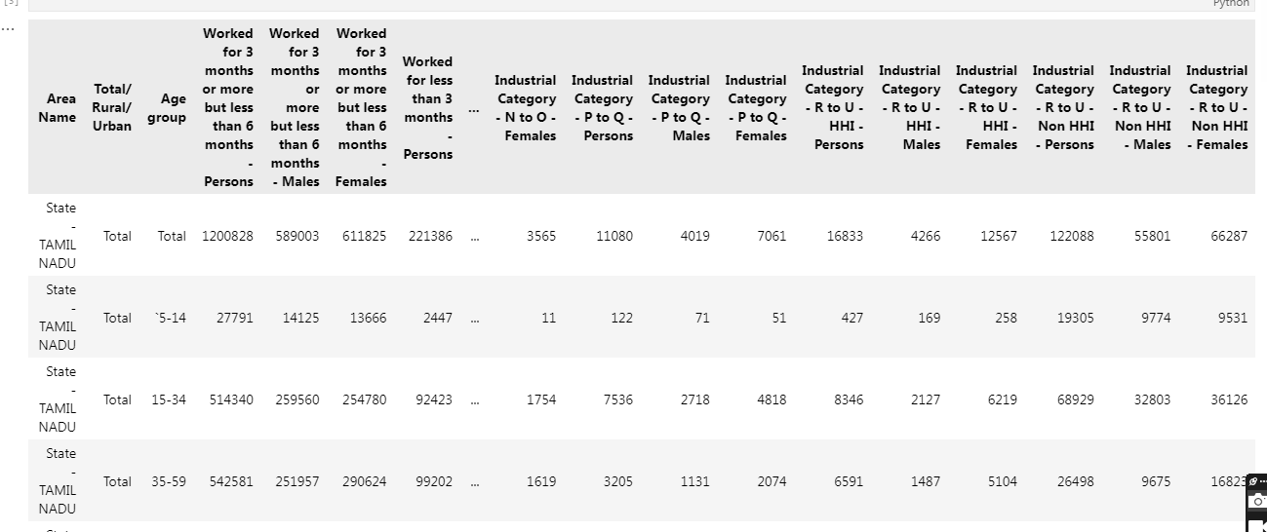
Output

Slide 9
Classified the data in sex & age
data = { Age: [20, 30, 40, None 30, 40, 20, 30, 40). # Adding a missing value Industrial Category: [‘N to 0- Females’, ‘P to Q – Fersons’ “P to Q Females, R to UHHI Pe R to UHHI – Females. R to U-No Sex: [‘Male, Female Male, Female Male’, ‘Female’. Count 100, 200, 120, 80, 150, 60, 90, 130, 50]
} df pd DataFrame(data) #Handling missing values
Df=df dropna() #Print the cleaned data
print(df)

Slide 10
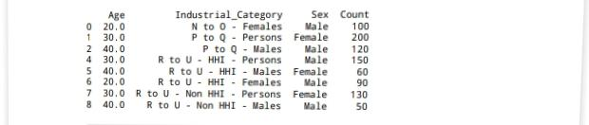
Output:

Slide 11
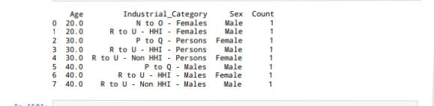
Data aggregation
#Data aggregation agg_data=df groupby([Age Industrial Category”, “Sex”]).size() #Print the aggregate data
Print(agg_data)
Output:

Slide 12
Age distribution plotting point
#Plot Age Distribution plt figure( figsize=(12, 6)) sns barplot(x=Age,y=Count, data= agg_data, hue ‘Sex’) plt.title (‘Age Distribution of Marginal Workers’) plt.xlabel(‘Age’)
plt.ylabel (‘Count’) plt.legend (title=‘Sex’,loc=‘upper right’) plt show()

Slide 13
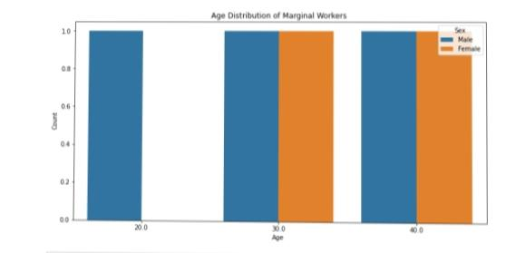
Output

Slide 14
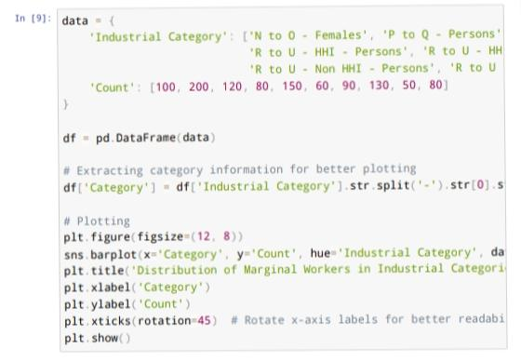
Data category

Slide 15
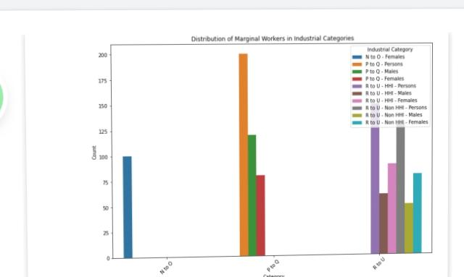
Output

Slide 16
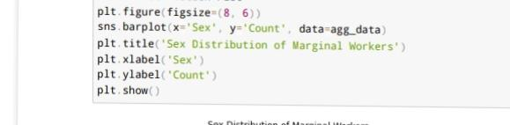
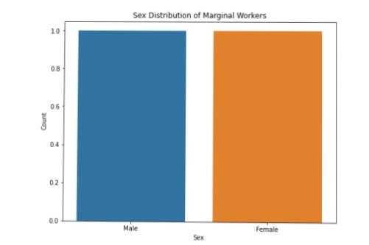
Sex distribution plot

Slide 17
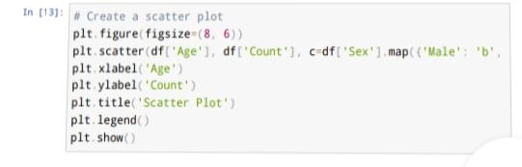
Scatterplot

Slide 18
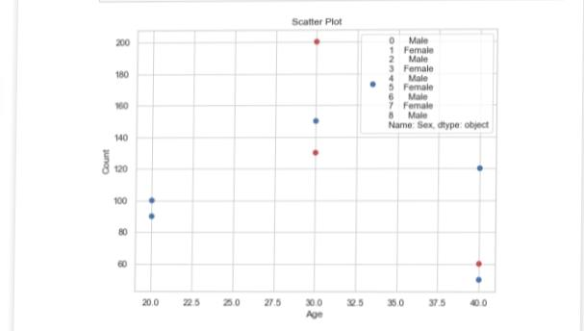
Output

Slide 19
Heatmap
#Create a heatmap
plt.figure (figsize=(10,6)) sns.heatmap(df_encode.Corr(),Annot=true,Camp=‘coolwarm’) plt.tittle('heatmap’)
Plt.show()

Slide 20
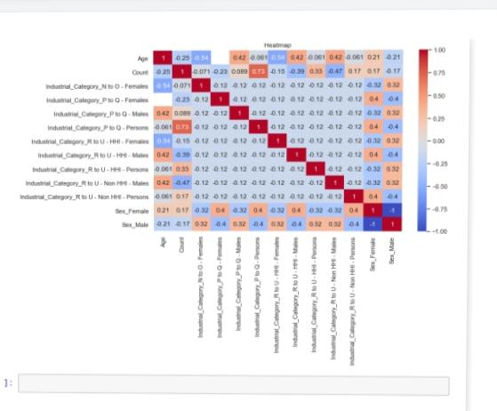
Output

Slide 21
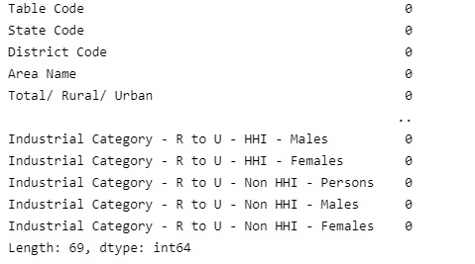
Finding missing value
#find missing values in the dataset df.isnull().
sum(axis=0)

Slide 22
Retrieve and Testing the dataset
# Retrieve training and testing dataset X = df.iloc[:,:-1] Y = df.iloc[:,-1 print(X)

Slide 23
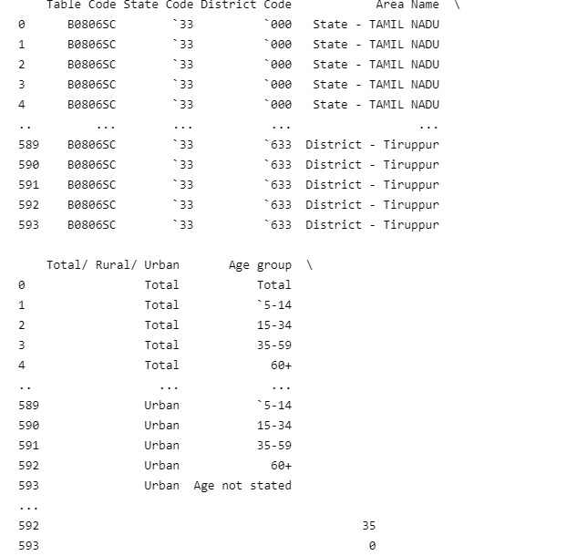
Output

Slide 24
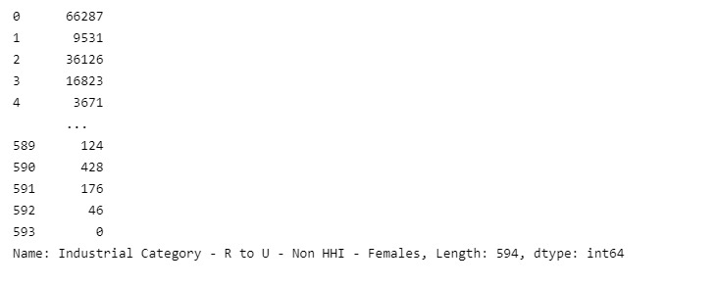
X = df.iloc[:,:-1] Y = df.iloc[:,-1] print(Y

Slide 25
Select relevant Columns For analysis
# Select relevant columns for analysis selected_columns = [‘Age group’, ‘Industrial Category – A – Cultivators – Persons’, ‘Industrial Category – B – Persons’, ‘Industrial Category – C – HHI – Persons’, ‘Industrial Category – D & E – Persons’, ‘Industrial Category – F – Persons’, ‘Industrial Category – G – HHI – Persons’, ‘Industrial Category – H – Persons’, ‘Industrial Category – I – Persons’, ‘Industrial Category – J – HHI – Persons’, ‘Industrial Category – K to M – Persons’, ‘Industrial Category – N to O – Persons’, ‘Industrial Category – P to Q – Persons’, ‘Industrial Category – R to U – HHI – Persons’]

Slide 26
Filter the dataframe
(‘# Filter the DataFrame for marginal workers and selected columns marginal_workers_df = df[df[‘Total/ Rural/ Urban’] == ‘Total’][selected_columns]
# Group by age group and sum the counts for each industrial category age_group_data = marginal_workers_df.groupbyAge group’).sum()

Slide 27
Plotting points
# Plotting plt.figure(figsize=(15, 8)) age_group_data.T.plot(kind=‘bar’, stacked=True) plt.title(‘Distribution of Marginal Workers by Age and Industrial Category’) plt.xlabel(‘Industrial Categories’) plt.ylabel(‘Number of Workers’) plt.legend(title=‘Age Group’) plt.show()

Slide 28
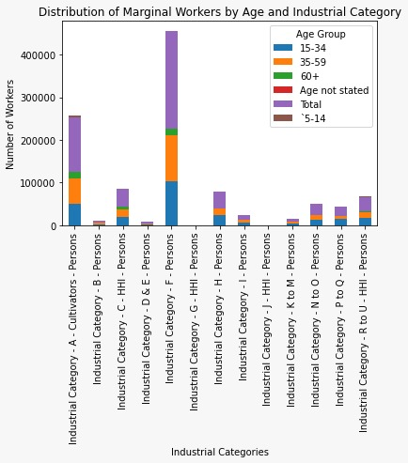
Output:

Slide 29
Conclusion
The given dataset has been successfully analysing and
Preprocessing the data

