Slide 1
ASSESSMENT OF MARGINAL WORKERS IN TAMILNADU
_{Phase3}

Slide 2
Download the data set
Download the dataset for Marginal workers in tamilnadu Using the following link
Dataset link:
https://tn.data.gov.in/catalog/marginal-workers-classified-age-industrial-category-and-sex-census-2011-india-and-states

Slide 3
Insertion the dataset
#import necessary libraries import pandas as pd import numpy as np import matplotlib.pyplot as plt
#loading dataset df= pd.read_csv(“marginal.csv”) df.head()

Slide 4
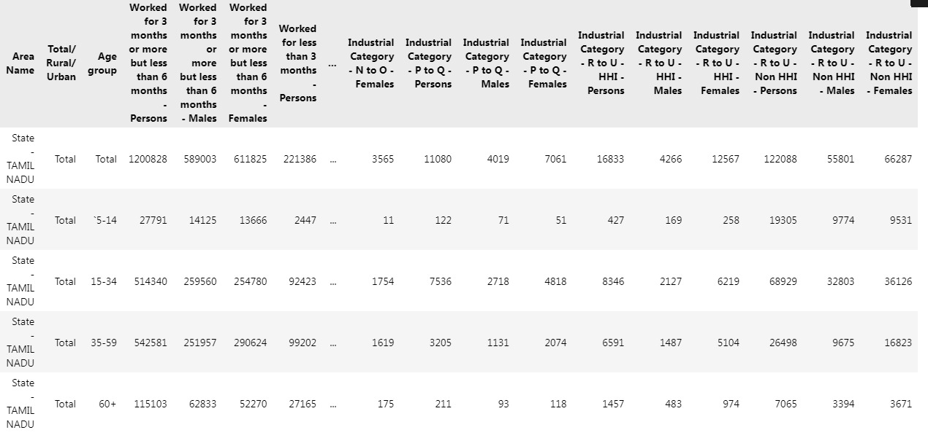
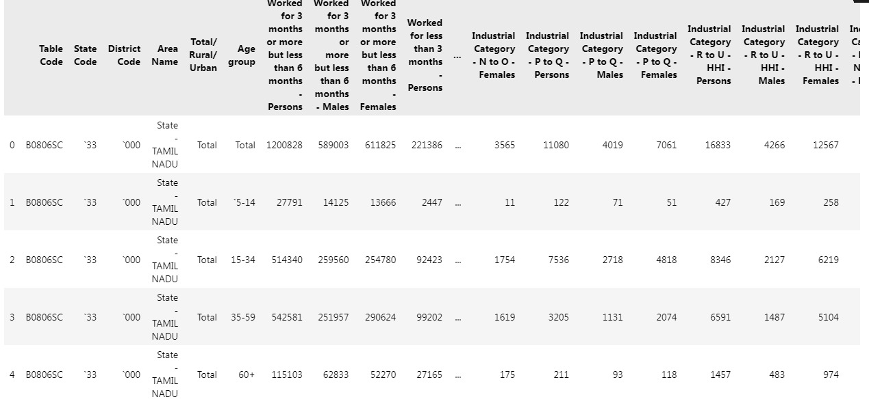
Output

Slide 5
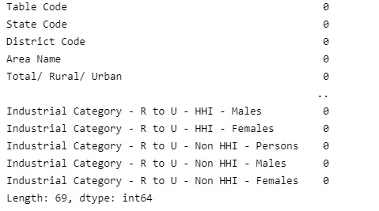
Missing values in dataset
#find missing values in the dataset df.isnull().
sum(axis=0)

Slide 6
Retrieve and Testing the dataset
# Retrieve training and testing dataset X = df.iloc[:,:-1] Y = df.iloc[:,-1 print(X)

Slide 7
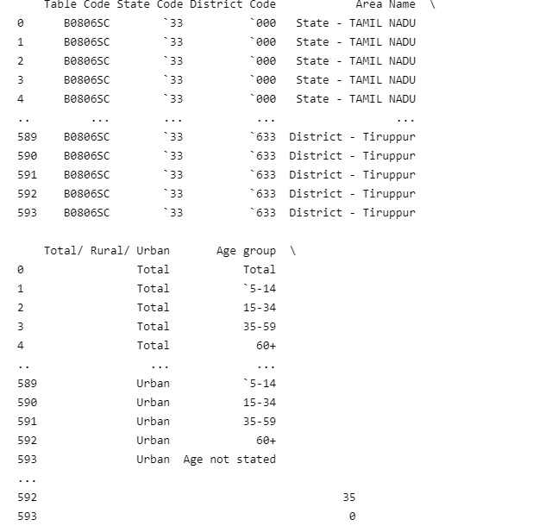
Output

Slide 8
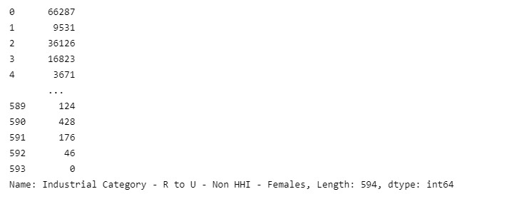
X = df.iloc[:,:-1] Y = df.iloc[:,-1] print(Y)

Slide 9
Select relevant Columns For analysis
# Select relevant columns for analysis selected_columns = [‘Age group’, ‘Industrial Category – A – Cultivators – Persons’, ‘Industrial Category – B – Persons’, ‘Industrial Category – C – HHI – Persons’, ‘Industrial Category – D & E – Persons’, ‘Industrial Category – F – Persons’, ‘Industrial Category – G – HHI – Persons’, ‘Industrial Category – H – Persons’, ‘Industrial Category – I – Persons’, ‘Industrial Category – J – HHI – Persons’, ‘Industrial Category – K to M – Persons’, ‘Industrial Category – N to O – Persons’, ‘Industrial Category – P to Q – Persons’, ‘Industrial Category – R to U – HHI – Persons’]

Slide 10
Filter the dataframe
# Filter the DataFrame for marginal workers and selected columns marginal_workers_df = df[df[‘Total/ Rural/ Urban’] == ‘Total’][selected_columns]
# Group by age group and sum the counts for each industrial category age_group_data = marginal_workers_df.groupby(‘Age group’).sum()

Slide 11
Plotting points
# Plotting plt.figure(figsize=(15, 8)) age_group_data.T.plot(kind=‘bar’, stacked=True) plt.title(‘Distribution of Marginal Workers by Age and Industrial Category’) plt.xlabel(‘Industrial Categories’) plt.ylabel(‘Number of Workers’) plt.legend(title=‘Age Group’) plt.show()

Slide 12
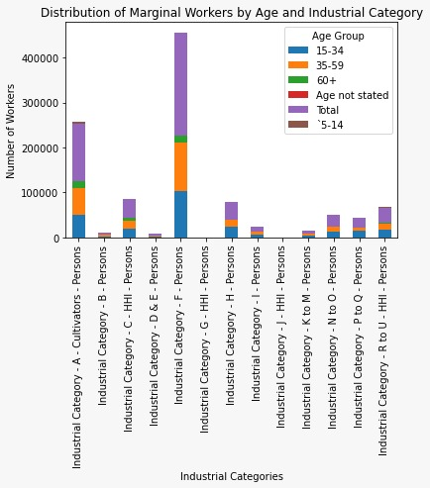
Output:

Slide 13
Conclusion:
Tamil Nadu marginal workers were classified and various processings were done using the given dataset

