Slide 1
Assessment of Marginal Workers In Tamilnadu
Phase4

Slide 2
About the project
Following the given instructions we build our Project
They are:
Perform the demographic analysis Calculate the distribution of marginal workers based on age, industrial category, and se using data aggregation and manipulation Create visualizations
Create visualizations using data visualization libraries (e.g., Matplotlib, Seaborn).

Slide 3
Downloading datasets
The dataset has been download for the given link
The dataset link :
https://tn.data.gov.in/catalog/marginal-workers-classified-age-industrial-category-and-sex-census-2011-india-and-states
Then build and preprocessing the data set

Slide 4
Import the files
Import pandas as pd import matplotlib.pyplot as plt
import seaborn as sns
Replace your data.csv’ with the actual file path df pd.read_csv(“marginal.csv’)

Slide 5
Classified the data in sex & age
data = { Age: [20, 30, 40, None 30, 40, 20, 30, 40). # Adding a missing value Industrial Category: [‘N to 0- Females’, ‘P to Q – Fersons’ “P to Q Females, R to UHHI Pe R to UHHI – Females. R to U-No Sex: [‘Male, Female Male, Female Male’, ‘Female’. Count 100, 200, 120, 80, 150, 60, 90, 130, 50]
} df pd DataFrame(data) #Handling missing values
Df=df dropna() #Print the cleaned data
print(df)

Slide 6
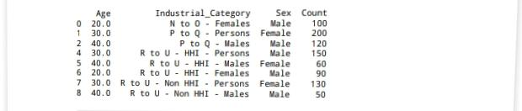
Output:

Slide 7
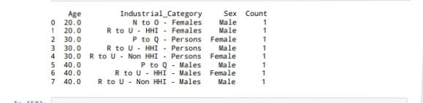
Data aggregation
#Data aggregation agg_data=df groupby([Age Industrial Category”, “Sex”]).size() #Print the aggregate data
Print(agg_data)
Output:

Slide 8
Age distribution plotting point
#Plot Age Distribution plt figure( figsize=(12, 6)) sns barplot(x=Age,y=Count, data= agg_data, hue ‘Sex’) plt.title (‘Age Distribution of Marginal Workers’) plt.xlabel(‘Age’)
plt.ylabel (‘Count’) plt.legend (title=‘Sex’,loc=‘upper right’) plt show()

Slide 9
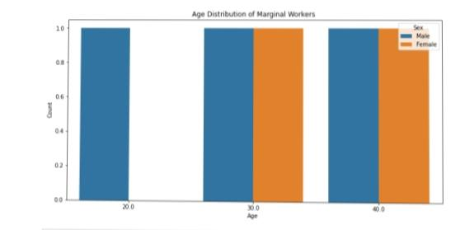
Output

Slide 10
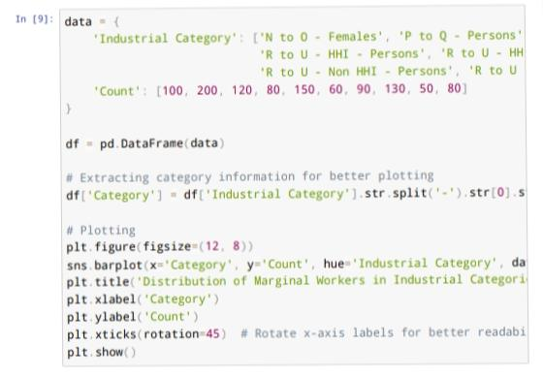
Data category

Slide 11
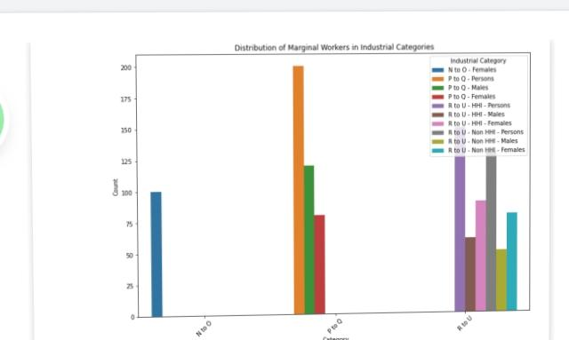
Output

Slide 12
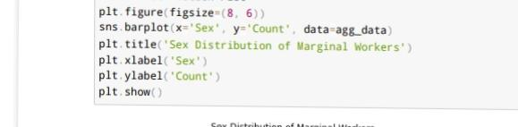
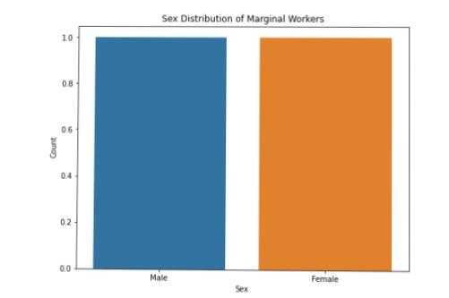
Sex distribution plot

Slide 13
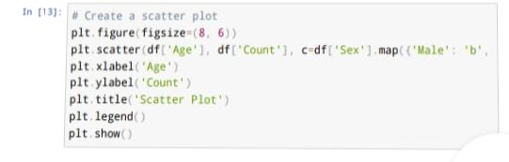
Scatterplot

Slide 14
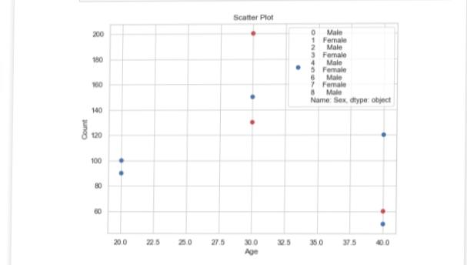
Output

Slide 15
Heatmap
#Create a heatmap
plt.figure (figsize=(10,6)) sns.heatmap(df_encode.Corr(),Annot=true,Camp=‘coolwarm’) plt.tittle('heatmap’)
Plt.show()

Slide 16
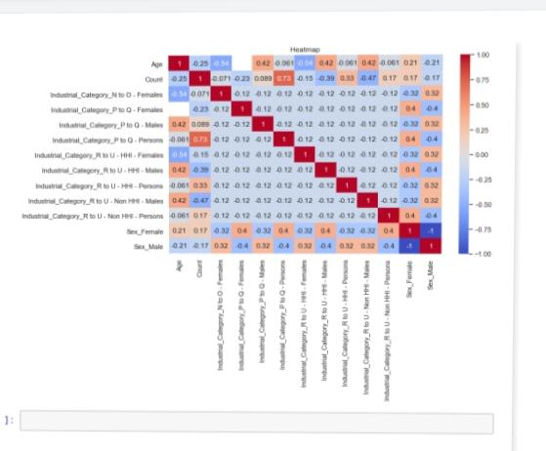
Output

Slide 17
Conclusion
The given dataset has been successfully analysing and
Preprocessing the data

