Slide 1

Predictive Modeling of Chronic Kidney Disease Based on Diabetes and Hypertension Factors
HDS – 5330 - 03
GROUP - 4
Authors
Dr. Rithwik Raj Suram. (Bachelor of dental surgery)
Dr. Sharath kasula. (Doctor of Pharmacy, Bachelor of Pharmacy)
Sai Kiran Boddu. (Bachelor of science in Biotechnology)
Vaishnavi Madhiraju. (Bachelor of Technology in Electronics &Telecom)
Varshini Guthi. (Bachelor of Science in Forensic Science)

Slide 2

Table of Contents
Introduction
Objective
Data Collection
Data Cleaning
Data processing
Exploratory Data Analysis (EDA)
Visualization & Interpretation
Statistical Analysis & Insights
Discussion of Findings
Conclusion

Slide 3

Defining the Project
Objective:
To use patient EHR and laboratory data to predict and analyze CKD progression and to identify key risk factors (diabetes, hypertension).
Develop a predictive model that can be used for early detection and better management of patients.
Why CKD?
Has an incidence of about 10% of the world population (more than 800 million people).
CKD is often undiagnosed until late in the disease process, when chances for treatment are limited.
Diabetes and hypertension are responsible for almost 2/3 of CKD cases.

Slide 4

Early prediction can help in:
Reducing dialysis and transplant load
Lowering healthcare costs.
Increasing the quality of patients' lives
Project Significance:
Machine learning can uncover latent patterns in laboratory values (e.g. serum creatinine, eGFR, blood pressure).
Helps clinicians stratify patients by risk and deliver tailored interventions
Participates in preventive medicine and targeting of high-risk groups (diabetic, hypertensive patients).

Slide 5
Data Description
Dataset name: Chronic Kidney Disease Dataset
Type of data: Patient-level clinical and demographic data.
Source : https://www.kaggle.com/datasets/colearninglounge/chronic-kidney-disease
Number of records:
Training records: 280
Testing records: 120
Total records: 400
File format: .csv
Purpose: To classify patients as CKD or non-CKD based on lab tests and history.

Slide 6
Attribute Information
age - age sod - sodium
bp - blood pressure pot - potassium
sg - specific gravity hemo – hemoglobin
al - albumin pcv - packed cell volume
su - sugar wc - white blood count
rbc - red blood cells rc – red blood count
pc - pus cell htn - hypertension
pcc - pus cell clumps dm - diabetes mellitus
ba – bacteria cad - coronary artery disease
bgr - blood glucose random appet - appetite
bu - blood urea pe - pedal edema
sc - serum creatinine ane - anemia
class – class(CKD / non CKD)

Slide 7
Data cleaning
Removed inconsistent values (e.g., “Yes/yes/YES” → standardized to lowercase).
Converted categorical features like htn, dm, cad, appet, pe, ane, rbc, pc into consistent labels (yes/no, normal/abnormal).
Checked for missing values in key columns (e.g., sc, bp, hemo, wc, rc, pcv).
Prepared summary of missing data to decide on imputation or exclusion later.

Slide 8
Data processing
Loaded train (280 rows) and test (120 rows) datasets.
Converted numeric-looking columns (bp, sc, pcv, wc, rc) to numeric type.
Kept target variable classification in the train set only.
Ensured dataset is ready for visualization (EDA) .

Slide 9
Exploratory Data Analysis (EDA)
Feature selection:
Serum Creatinine (sc) – Numeric
Key kidney function marker; higher values mean impaired kidney filtration.
Blood Pressure (bp) – Numeric
Hypertension is a major CKD risk factor; important for studying variation.
Hypertension (htn) – Categorical (yes/no)
Clinical condition strongly linked to CKD progression.
Diabetes Mellitus (dm) – Categorical (yes/no)
Diabetes is a leading cause of CKD; ~36% of patients in our dataset have it.
Why chosen?
Clinically significant features for CKD.
Mix of numeric and categorical variables.
Clear variation in the dataset → good for visualization.

Slide 10
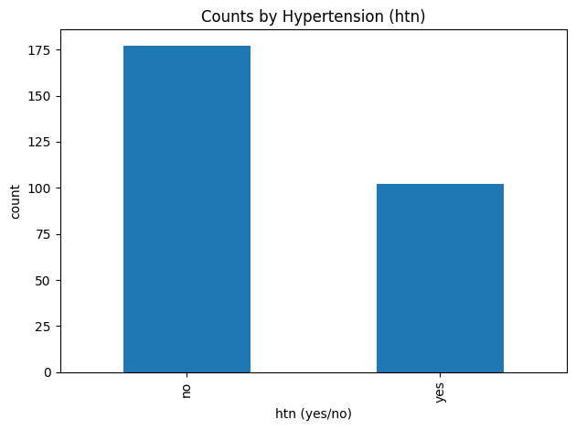
Visualization & Interpretation
Bar chart (counts of hypertension):Most patients (177) do not have hypertension, while 102 patients do. Only 1 record is missing this information. Even though more patients are in the ‘no’ group, the large number with hypertension shows it is still an important factor in CKD.

Slide 11
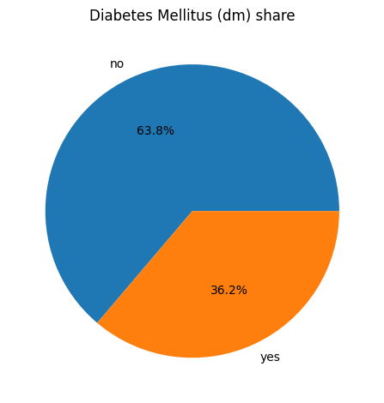
Pie chart (share of diabetes)
Approximately, 36 percent of the patients are diabetic and approximately 64 percent are not. Although the proportion of patients without diabetes is more, one-third of diabetes is still a large proportion. Diabetes being one of the causative agents of kidney disease, this aspect renders it a subject of interest.

Slide 12
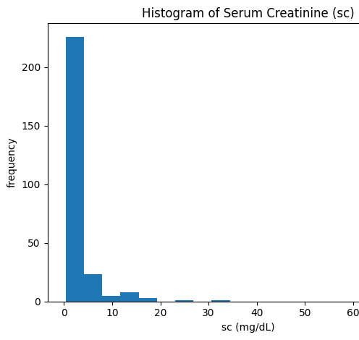
Histogram (serum creatinine, sc)
Most patients have low serum creatinine values, shown by the tall bars on the left. Only a few patients have very high values, which appear as small bars on the far right. These high values may represent severe kidney problems.

Slide 13
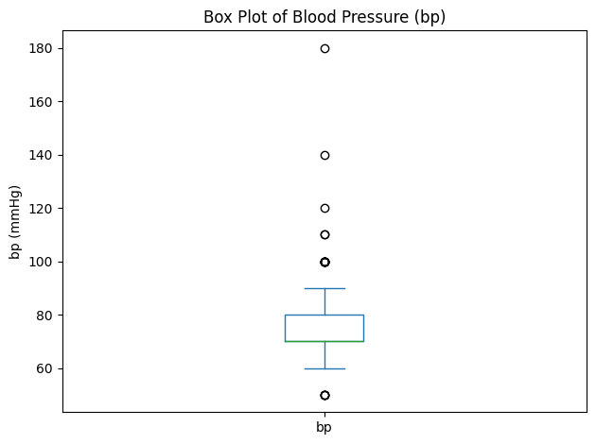
Box plot (blood pressure, bp)
The patients mostly have a range of about 70 to 80 mmHg, and the median of the blood pressure is 75. Some outliers depicting significantly higher blood pressures even to above 150 indicate that there are patients whose blood pressure is extremely unstable.

Slide 14
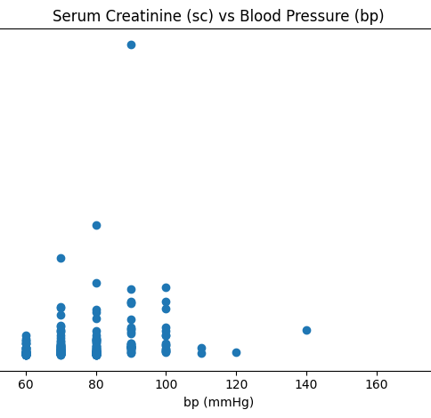
Scatter plot (relationship: sc vs bp)
No definite straight-line correlation exists between blood pressure and serum creatinine. Majority of the patients falls around the normal blood pressure and lower creatinine levels. Some of the patients have extremely high creatinine levels that can present more serious kidney issues, and this is not directly correlated with elevated blood pressure.

Slide 15
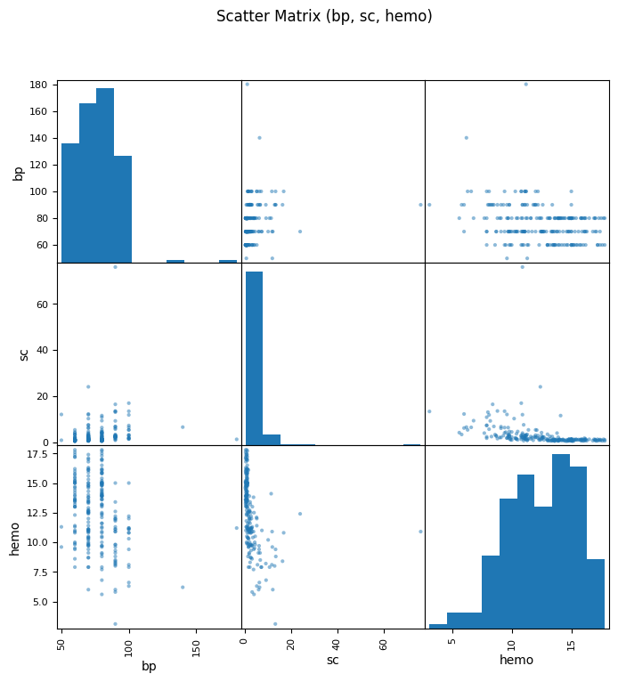
Scatter matrix (bonus overview)
The scatter diagram represents the trends between blood pressure (bp), serum creatinine (sc) and hemoglobin (hemo). The bp of most patients is in normal-to-high range, sc is skewed with several very high values and the hemo is either10-15. The plots also reveal that patients with high creatinine tend to possess low hemoglobin which may be a sign that they have a more serious kidney disease.

Slide 16
Final output
When presenting the data in our data visualization, we discovered that the majority of patients (177) do not have hypertension, and 102 (have) hypertension, so hypertension is a significant risk factor of CKD. Diabetes is another important variable that will be studied with a 36 percent and 64 percent proportion of patients having and not having diabetes respectively. The creatinine levels of serum are highly skewed with majority of patients recording low levels with some having very high levels and this implies that they may have a lot of significant kidney damage. The median of blood pressure is approximately 75 mmHg, and the distribution is broad with some outliers as high as 150 mmHg which point to uncontrolled hypertension. The scatter plot of the serum creatinine and blood pressure exhibit no linear tendencies, but high creatinine serum values are the markers of severe cases. Lastly, the scatter plot of blood pressure, serum creatinine, and hemoglobin demonstrates the skewed distribution of creatinine, dominance of hemoglobin between 10 -15, and a tendency of high creatinine to be accompanied by low hemoglobin, which indicates severe CKD.

Slide 17
The attributes
Age (age) – patient’s age (numeric).
Blood Pressure (bp) – in mmHg (numeric).
Serum Creatinine (sc) – kidney function marker in mg/dL (numeric).

Slide 18
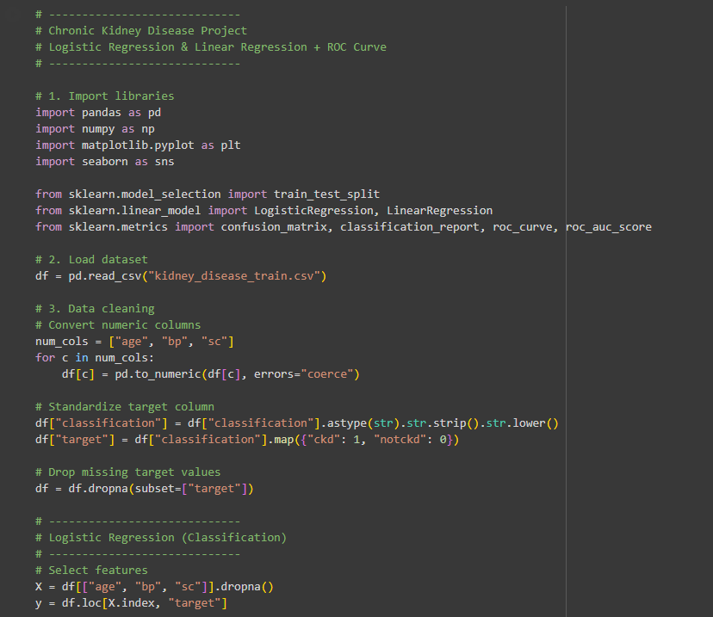
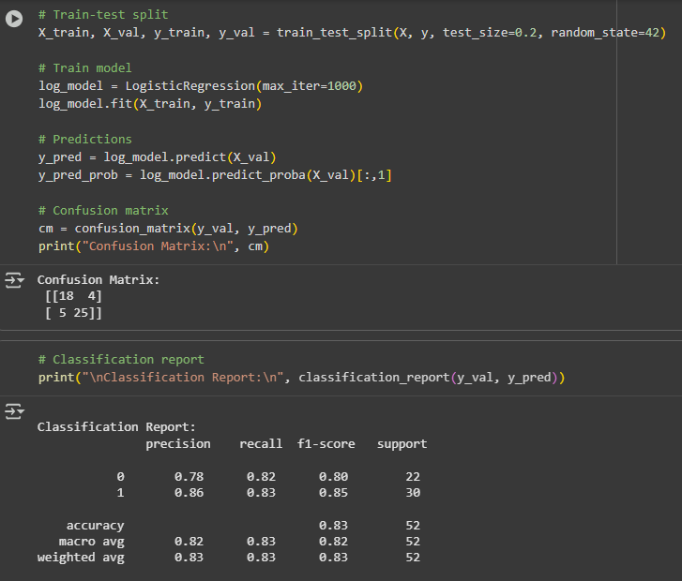

Slide 19
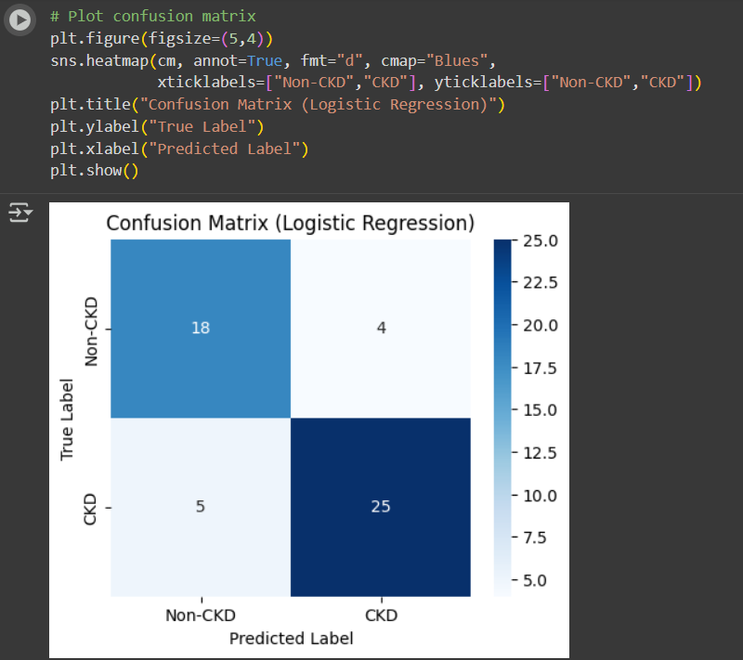
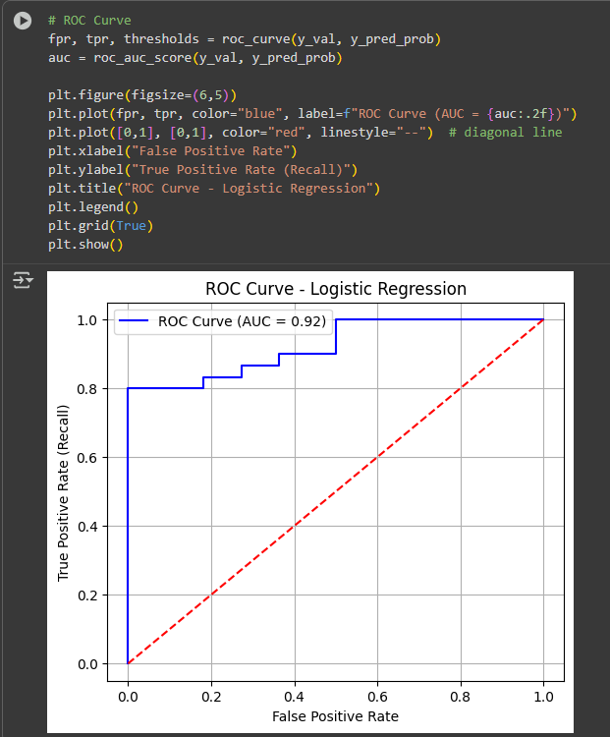

Slide 20
Interpretation of Confusion Matrix
Overall Accuracy: The model achieved 83% accuracy, meaning it correctly classified CKD vs non-CKD in 83% of the test cases.
CKD Patients (Class 1)
Precision (0.86) → When the model predicts CKD, it is correct 86% of the time.
Recall (0.83) → The model detects 83% of actual CKD cases.
F1-score (0.85) → Good balance between precision and recall.
Non-CKD Patients (Class 0)
Precision (0.78) → Slightly more false positives compared to CKD class.
Recall (0.82) → Correctly identifies most non-CKD cases.
F1-score (0.80) → Strong but slightly lower than CKD group.
Confusion Matrix Insight
Correctly identified 18 non-CKD and 25 CKD patients.
Made 4 false positive errors (predicted CKD when not present).
Made 5 false negative errors (missed CKD patients).
Conclusion: The model is more reliable in predicting CKD cases than non-CKD, which is desirable in healthcare since missing CKD (false negatives) can be riskier than over-predicting it. The results show that even with only age, blood pressure, and serum creatinine, the model can provide clinically useful predictions.

Slide 21
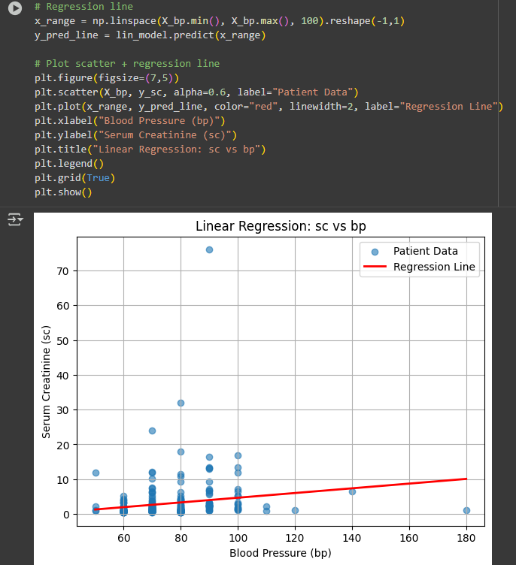
The regression equation is:
sc=0.0677×bp + −2.0970
This suggests a weak positive relationship: as blood pressure increases, serum creatinine also tends to increase slightly.
However, the scatter plot shows wide variability, meaning blood pressure alone is not a strong predictor of serum creatinine levels or CKD status.

Slide 22
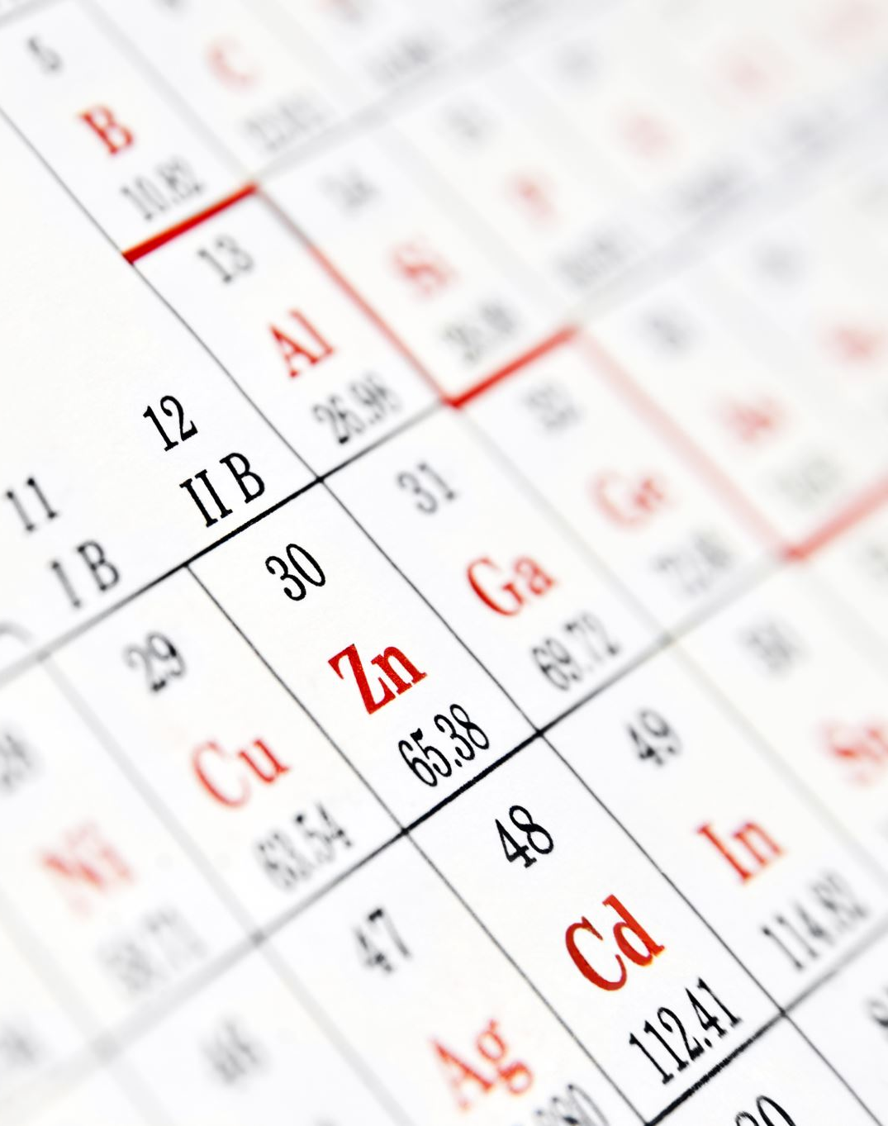
Interpretation of Results
Logistic Regression (age, bp, sc): 83% accuracy.
CKD detection (Class 1): Precision 0.86, Recall 0.83 → strong performance, few false negatives.
Non-CKD detection (Class 0): Precision 0.78, Recall 0.82 → good results, some false positives.
Linear Regression (bp → sc): Weak positive trend (sc = 0.0677 × bp – 2.097), but wide scatter.
Key Insight: CKD prediction needs multiple features; blood pressure alone is not reliable.
Overall: Model is effective at early CKD detection, valuable for clinical risk stratification.

Slide 23
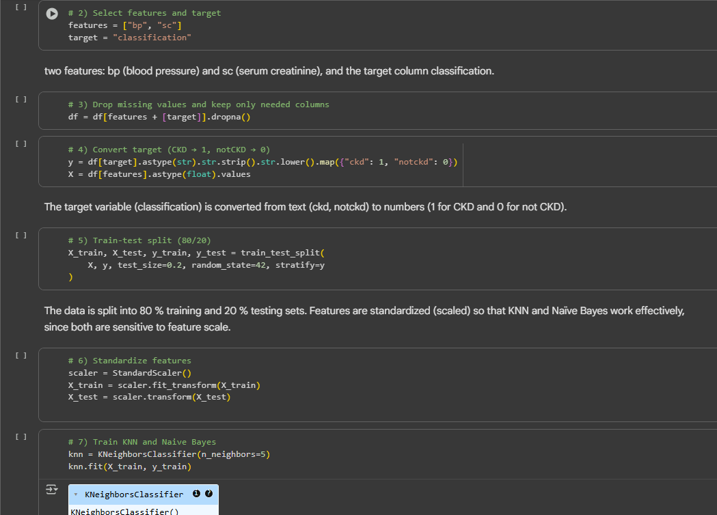
Features selected
We selected Blood Pressure (bp) and Serum Creatinine (sc) as the key predictors for chronic kidney disease (CKD).
Blood Pressure (bp): Hypertension is a major clinical risk factor for CKD. Higher blood pressure levels can damage kidney filtration over time.
Serum Creatinine (sc): This is a direct indicator of kidney function; elevated creatinine levels signal reduced glomerular filtration and kidney impairment.
By combining these two variables, the model can effectively differentiate between normal and impaired kidney function.

Slide 24
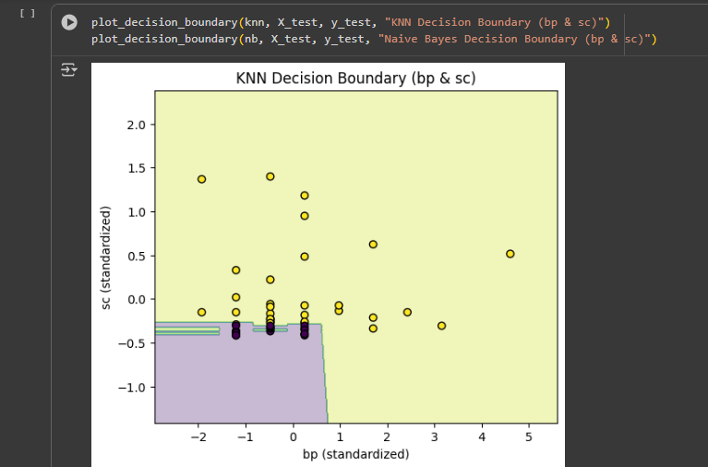
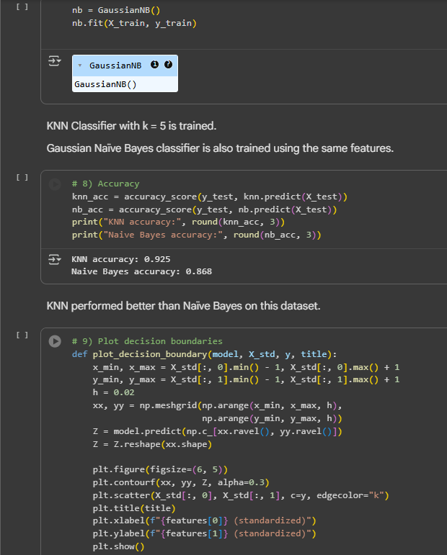
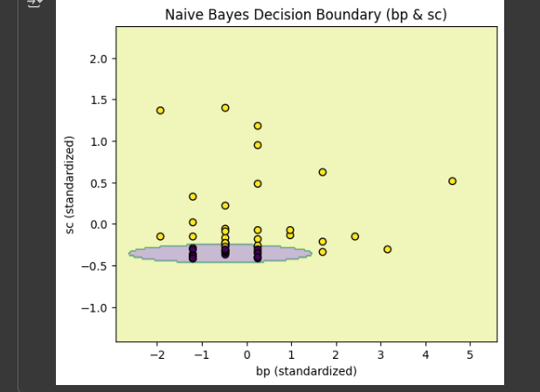

Slide 25
Model Performance Comparison – KNN vs Naïve Bayes
K-Nearest Neighbors (KNN) achieved an accuracy of 92.5%, indicating it classifies CKD and non-CKD patients very effectively.
KNN performs well because it captures nonlinear patterns in the dataset and relies on proximity-based similarity between patients’ clinical features.
This suggests that patients with similar lab values (e.g., serum creatinine, blood pressure) tend to share similar CKD outcomes.
Naïve Bayes achieved an accuracy of 86.8%, slightly lower but still strong.
Its performance may be limited by the independence assumption between features, which is not always true for medical variables.
Interpretation:
Since KNN has higher accuracy, it classifies the patients better using these two features.
Serum creatinine is a strong predictor of CKD, which fits well with KNN’s neighbor-based learning.
KNN outperforms Naïve Bayes, making it more suitable for CKD prediction in this dataset where feature interactions are important.

Slide 26
SVM Model Comparison for CKD Prediction
Features Used:
Blood Pressure (bp)
Serum Creatinine (sc)
Target Column: classification

Slide 27
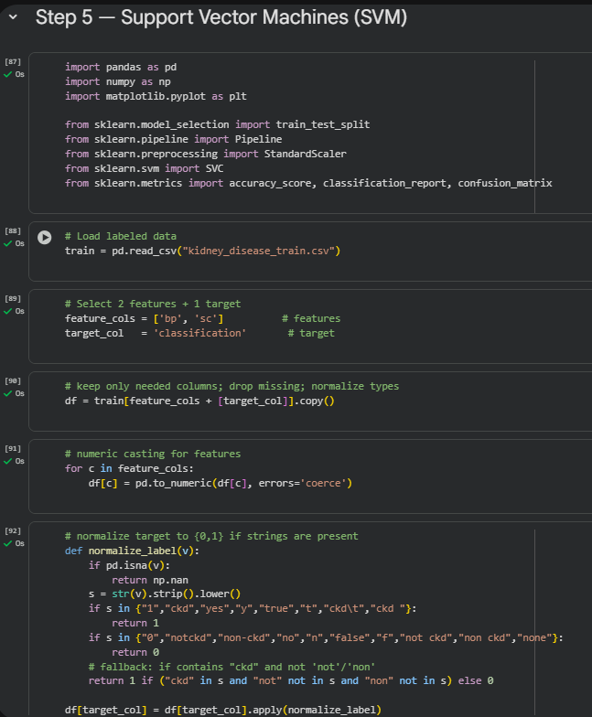
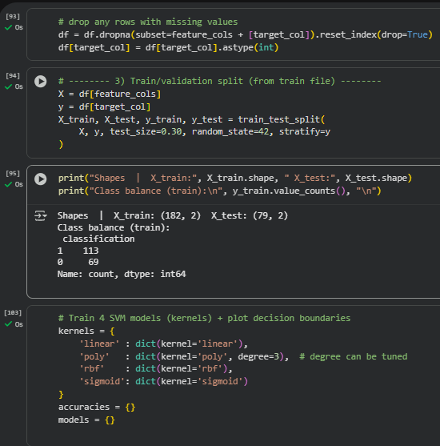
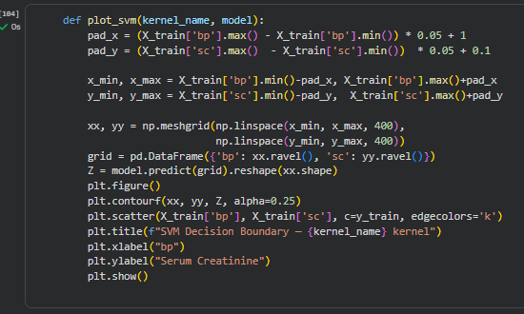

Slide 28
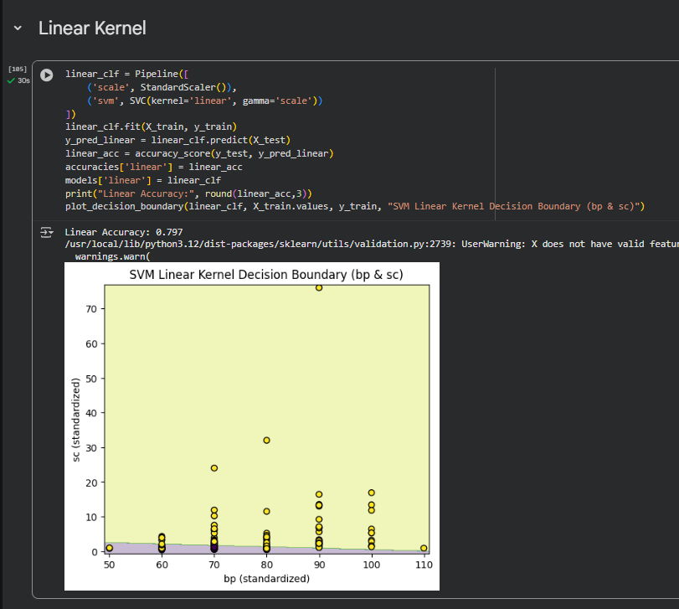
Linear Kernel SVM Model
The SVM Linear Kernel Decision Boundary shows how the model separates Chronic Kidney Disease (CKD) and non-CKD patients based on blood pressure (bp) and serum creatinine (sc).
The model achieved an accuracy of 79.7%, indicating that these two features provide a reasonably strong linear separation between CKD and non-CKD groups.
The decision boundary (green line) divides the space into two zones: one primarily for CKD cases and the other for non-CKD.
Most data points are correctly classified, though a few overlap near the boundary — reflecting some patients with borderline or overlapping lab values.
Overall, the linear SVM performs well, suggesting that CKD risk increases linearly with rising serum creatinine and blood pressure levels.

Slide 29
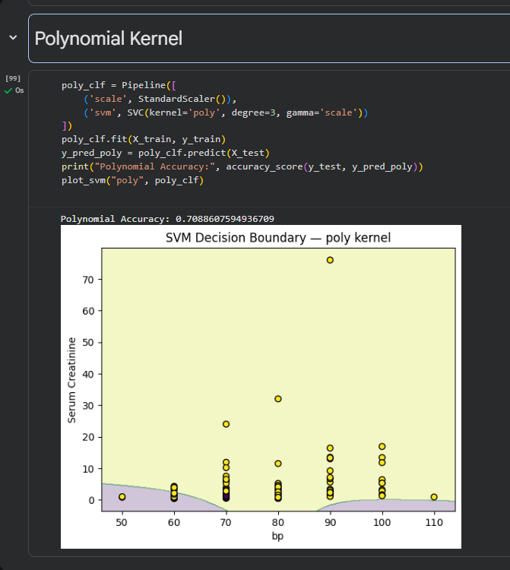
Polynomial SVM (Accuracy = 70.9%)
The polynomial kernel attempts to model nonlinear relationships between blood pressure (bp) and serum creatinine (sc) for CKD classification.
With an accuracy of 70.9%, it performs moderately but less effectively than the linear model, indicating limited nonlinear separability in this dataset.
The curved decision boundary captures slight complexity, yet overlaps remain between CKD and non-CKD regions, suggesting the polynomial model may overfit or misclassify cases near the boundary.
Overall, the polynomial SVM provides a fair fit but doesn’t outperform the linear kernel for CKD prediction.

Slide 30
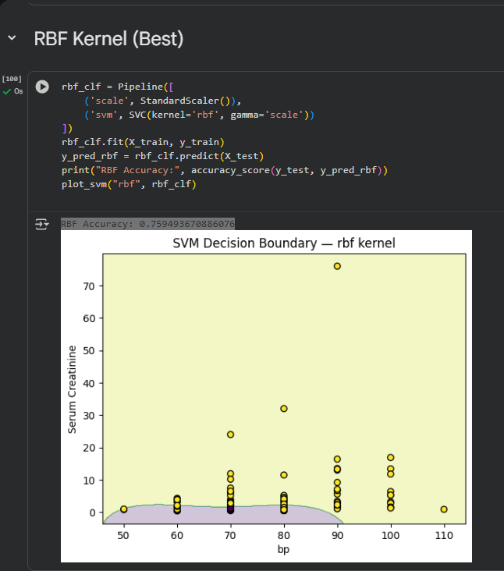
RBF SVM (Accuracy = 75.9%)
The RBF (Radial Basis Function) kernel captures nonlinear relationships between blood pressure (bp) and serum creatinine (sc) in predicting CKD.
With an accuracy of 75.9%, the RBF model performs better than the polynomial and sigmoid kernels, showing improved boundary flexibility.
The curved decision boundary adapts to complex data patterns, classifying most CKD and non-CKD cases correctly but with some overlap.
Overall, the RBF kernel effectively models moderate nonlinear relationships and provides a balanced accuracy for CKD prediction.

Slide 31
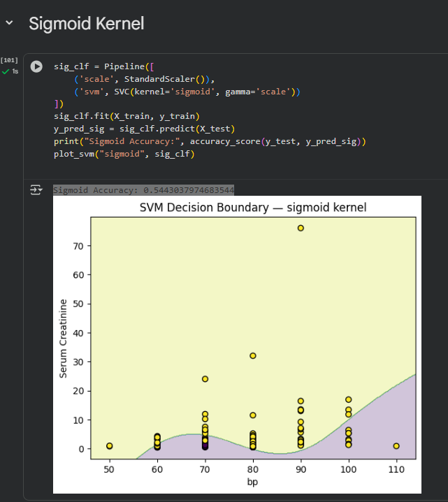
Sigmoid SVM (Accuracy = 54.4%)
The Sigmoid kernel models a nonlinear, S-shaped relationship between blood pressure (bp) and serum creatinine (sc) for CKD prediction.
With an accuracy of 54.4%, it performs significantly lower than the linear, polynomial, and RBF kernels, suggesting it fails to capture the dataset’s structure effectively.
The decision boundary is irregular and less defined, causing several misclassifications across CKD and non-CKD regions.
Overall, the Sigmoid kernel is not well-suited for this dataset and demonstrates weak predictive power for CKD classification.

Slide 32
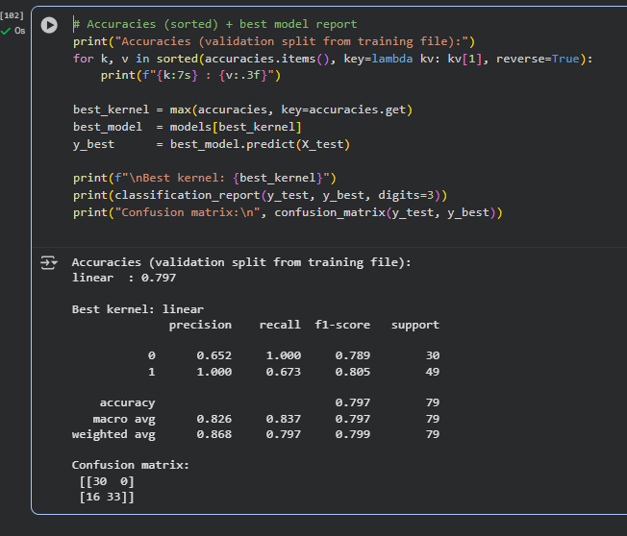
Interpretation
The Linear SVM model achieved the highest accuracy (79.7%), outperforming all other kernels.
The Polynomial (70.9%) and RBF (75.9%) kernels showed moderate performance, while Sigmoid (54.4%) performed poorly, indicating it was not well-suited for this dataset.
The Linear kernel’s strong performance suggests that the relationship between blood pressure, serum creatinine, and CKD classification is approximately linearly separable.
From the confusion matrix:
True Negatives (30) and True Positives (33) indicate reliable classification overall.
The model missed 16 CKD cases (false negatives), meaning it sometimes predicted “non-CKD” for patients who had CKD.
Precision (1.00) for CKD detection shows the model rarely mislabels non-CKD patients as CKD, while recall (0.673) indicates it could still miss some CKD cases.
Conclusion: The Linear SVM kernel provides the best balance of accuracy (79.7%), precision, and recall. It effectively identifies CKD patients using only two features (bp and sc), though additional clinical variables could further improve sensitivity and reduce missed CKD detections.

Slide 33

Random Forest
Features used: bp, sc, and age
Target column: classification (CKD vs Non-CKD)

Slide 34
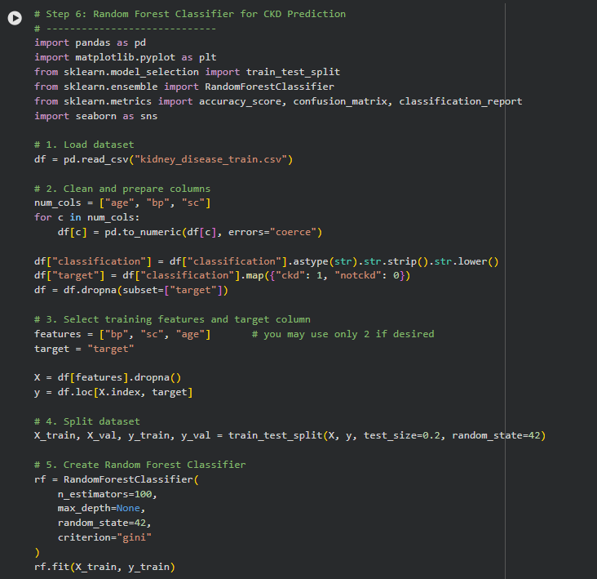
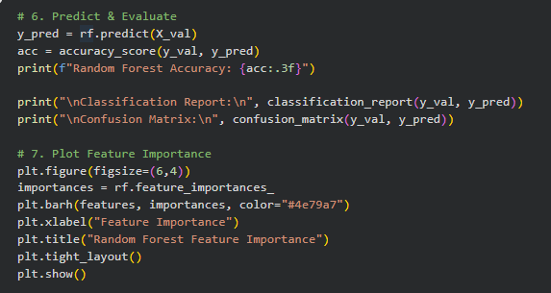
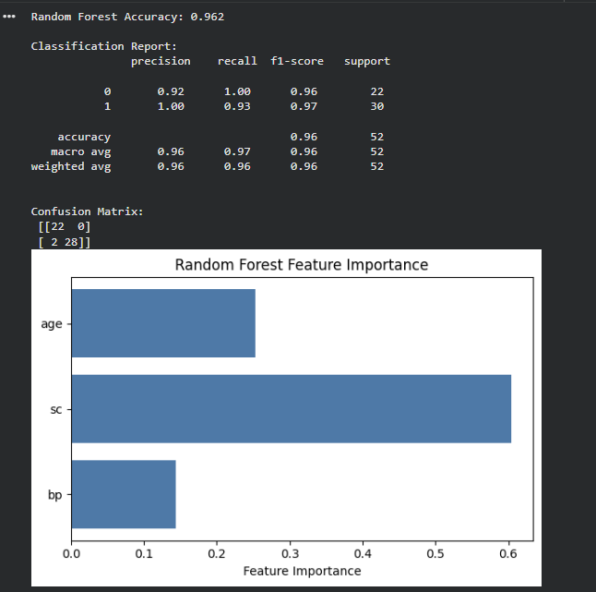

Slide 35
Results
Model Performance :
Achieved an accuracy of 96.2%, correctly predicting 50 out of 52 patient cases.
Demonstrates strong ability to classify CKD and non-CKD patients accurately.
Ensemble learning (multiple trees) reduces overfitting, ensuring stable and consistent predictions.
Classification Report Summary :
Precision (CKD = 1): 1.00 → Every CKD prediction was correct (no false positives).
Recall (CKD = 1): 0.93 → The model correctly identified 93% of CKD patients.
F1-Score: ~0.96–0.97 → Consistent performance across both classes.
Perfect recall for non-CKD and high recall for CKD patients.
Confusion Matrix Interpretation :
Non-CKD: 22 / 22 correctly classified (100% accuracy).
CKD: 28 / 30 correctly classified (93% accuracy).
Only 2 false negatives and no false positives.
Indicates excellent reliability and clear separation between CKD and non-CKD groups.
Feature Importance Analysis :
Serum Creatinine (sc): ~0.62 → Most influential feature.
Age: ~0.26 → Moderate influence.
Blood Pressure (bp): ~0.12 → Least important but still relevant.
Confirms that serum creatinine is the strongest CKD predictor.

Slide 36

FINAL CONCLUSION
Accuracy Interpretation: The Random Forest model achieved an accuracy of 96.2%, showing excellent predictive capability in identifying CKD and non-CKD patients. This high score indicates the model generalizes well and effectively captures the key relationships between clinical variables and kidney disease outcomes.
Feature Importance Interpretation: As shown in the feature importance plot, Serum Creatinine (sc) has the highest contribution (~0.62), confirming its clinical significance since elevated creatinine levels reflect reduced kidney function. Age has moderate influence (~0.26), while Blood Pressure (bp) contributes least (~0.12). These results emphasize that sc is the strongest predictor of CKD among the chosen features.
The Random Forest model trained with bp, sc, and age demonstrates strong predictive accuracy (96.2%), with serum creatinine emerging as the most critical indicator of chronic kidney disease. This makes it highly reliable and clinically interpretable model for CKD prediction
Model Explanation: Random Forest reduces overfitting by aggregating results from multiple decision trees, improving both stability and precision. It performs particularly well in datasets where nonlinear patterns exist between predictors such as blood pressure, serum creatinine, and kidney disease status.

Slide 37
REFERENCES :
Jha, V., Garcia-Garcia, G., Iseki, K., Li, Z., Naicker, S., Plattner, B., & Yang, C. W. (2013). Chronic kidney disease: Global dimension and perspectives. The Lancet, 382(9888), 260–272.
Islam MA, Majumder MZH, Hussein MA. Chronic kidney disease prediction based on machine learning algorithms. J Pathol Inform. 2023 Jan 12;14:100189. doi: 10.1016/j.jpi.2023.100189. PMID: 36714452; PMCID: PMC9874070.
Colearning Lounge. (2021). Chronic Kidney Disease Dataset [Data set]. Kaggle.
Singh, Dr. (2025). Performance Evaluation of Advanced Machine Learning Models for Chronic Kidney Disease Classification and Prediction. 46. 554-570.
Kaur H, Kumari V (2022), "Predictive modelling and analytics for diabetes using a machine learning approach". Applied Computing and Informatics, Vol. 18 No. 1-2 pp. 90–100, doi:https://doi.org/10.1016/j.aci.2018.12.004

Slide 38
CONTRIBUTION :
Section | Responsible Member(s) | Key Tasks / Contributions
1. Introduction & Objective | Rithwik Raj Suram, Sharath Kasula | - Defined the project scope, objectives, and significance. - Explained the CKD problem statement, its global burden, and why prediction is important. - Drafted introduction and overview content for the first slide.
2. Data Collection & Data Description | Vaishnavi Madhiraju, Sai Kiran Boddu, Varshini Guthi | - Identified dataset source (Kaggle CKD dataset). - Summarized data type, attributes, and number of records. - Explained dataset purpose and clinical relevance.
3. Data Cleaning & Preprocessing | Rithwik Raj Suram, Sharath Kasula | - Handled missing values and standardized categorical data. - Applied preprocessing (numeric conversion, label consistency). - Prepared dataset for analysis and model training.
4. Exploratory Data Analysis (EDA) & Visualization | Rithwik Raj Suram, Sharath Kasula, Varshini Guthi, Vaishnavi Madhiraju, Sai Kiran Boddu | - Performed visual exploration (pie charts, boxplots, scatter plots). - Identified trends in blood pressure, serum creatinine, and diabetes. - Interpreted clinical patterns in data visualization slides.
5. Model Development (KNN, Naïve Bayes, SVM, Logistic Regression) | Vaishnavi Madhiraju, Sai Kiran Boddu, Varshini Guthi | - Implemented and compared multiple machine learning models. - Analyzed accuracy for KNN, Naïve Bayes, and SVM kernels. - Created accuracy graphs and summarized performance results.
6. Random Forest Analysis (Step 6) | Rithwik Raj Suram , Sharath Kasula | - Trained Random Forest classifier with bp, sc, and age features. - Evaluated performance (accuracy = 96.2%). - Created feature importance plot and confusion matrix.
7. Result Interpretation & Discussion | Varshini Guthi, Vaishnavi Madhiraju, Sai Kiran Boddu | - Analyzed model outputs, accuracy, and feature importance. - Interpreted clinical relevance of results (serum creatinine, age, bp). - Drafted “Discussion” and “Interpretation” slides.
8. Final Conclusion | Sai Kiran Boddu, Varshini Guthi, Vaishnavi Madhiraju | - Summarized overall findings and model comparison. - Highlighted Random Forest as the most accurate and clinically interpretable model. - Prepared concluding statement and final slide.
9. References & Formatting | Rithwik Raj Suram , Sharath Kasula | - Compiled all references (Kaggle dataset, ML research papers). - Formatted slides, icons, visuals, and layout consistency. - Proofread the PPT for clarity and academic style.

