Slide 1

ADITYA COLLEGE OF ENGINEERING & TECHNOLOGY
Approved by AICTE, Permanently affiliated to JNTUK & Accredited by NAAC Recognized by UGC under the sections 2(f) and 12(B) of the UGC act 1956 Aditya
Nagar, ADB Road –Surampalem 533437, E.G. Dist., A.P.
Presentation on Internship
Notes:
ADITYA COLLEGE OF ENGINEERING & TECHNOLOGY

Slide 2
Deploying a Web Application on Amazon ECS
Submitted by
NAME: R.MADHAVI
ROLL-NUMBER:23MH1A4453
SECTION:III DS-C
Internship Coordinator
Mrs. K. Roja Rani
Department of CSE(DS & IOT)
Notes:
Mrs. K. Roja Rani

Slide 3

Deploying a web applications on Amazon ECS
Prepared in the partial fulfillment of Summer Internship Program on AWS
AT
Under the guidance of
Mrs. Sumana Bethala, APSSDC
Mr. Anil Kumar, APSSDC

Slide 4
Deploying a Web Application on Amazon ECS
Amazon EC2 (Elastic Compute Cloud)
Amazon ECR (Elastic Container Registry)
Amazon ECS (Elastic Container Service)
AWS Fargate (within ECS)
Elastic Load Balancing (Application Load Balancer )
Amazon VPC (Virtual Private Cloud)
AWS IAM (Identity and Access Management)

Slide 5
Problem Statement
Modern web applications require reliable, scalable, and highly available infrastructure.
Manual provisioning and deployment are error-prone and time-consuming.
Challenges:
- Managing compute resources dynamically
- Packaging and containerizing applications correctly
- Scaling with demand
- Simplifying deployment workflows
- Monitoring and maintaining high availability
Goal:
Deploy a web application in a containerized form on AWS, using services like ECS, EC2, ECR, Fargate, and ALB, so that the application is scalable, reliable, and easy to manage.

Slide 6
Solution Overview
Implemented a fully containerized web application hosted on Amazon ECS.
Architecture Highlights:
Docker to containerize the app
Amazon ECR is to Securely stored container images
Amazon ECS to Managed and orchestrated containers
EC2 & Fargate to Ran containers on managed and serverless compute
Application Load Balancer for routing
IAM Roles, VPC, Security Groups ensure secure access and networking

Slide 7
Key Features
1. Containerization: Portable and reproducible builds using Docker
2. Scalability: ECS with Fargate scales based on CPU/memory
3. High Availability: Load balancer distributes traffic
4. Security: IAM, VPC, and security group controls
5. CI/CD Friendly: Easily pluggable with Code Pipeline/Code Build
6. Cost-Effective: Pay for compute only when used (Fargate)

Slide 8
Tools & Technologies
AWS ECS (EC2 + Fargate)
Docker
Amazon ECR
Application Load Balancer
IAM, Security Groups, VPC
EC2 Instances

Slide 9
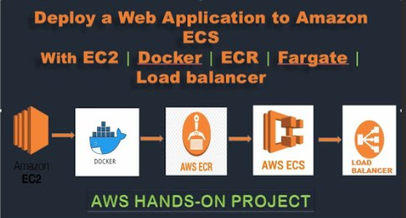
Architecture Diagram

Slide 10
1. Amazon EC2 (Elastic Compute Cloud)
Purpose: Acts as a development/CI environment where you create and build your Docker image.
What Happens Here:
Launch an EC2 instance (Linux/Ubuntu).
Install Docker on EC2.
Write your application code and a Dockerfile.
Build the Docker image locally on EC2.
2. Docker
Purpose: Containerizes your web application for easy deployment.
What Happens Here:
Use Docker to build an image from the application code.
Tag the Docker image for upload to ECR.
3. AWS ECR (Elastic Container Registry)
Purpose: A fully managed Docker container registry.
What Happens Here:
Push the Docker image from EC2 to ECR.
ECR stores and version controls your image for ECS deployments.

Slide 11
4. AWS ECS (Elastic Container Service)
Purpose: Orchestrates the deployment of containerized applications.
What Happens Here:
Create a Task Definition using the image from ECR.
Choose Fargate as the launch type (serverless deployment).
ECS runs your container with the required CPU, memory, and networking settings.
5. Fargate (Launch Type)
Purpose: Serverless compute engine for containers.
What Happens Here:
You don’t manage servers — Fargate provisions infrastructure automatically.
ECS service ensures your application stays running and scalable.
6. Load Balancer (Elastic Load Balancer - ELB)
Purpose: Distributes incoming traffic to ECS tasks.
What Happens Here:
Set up an Application Load Balancer (ALB).
ALB routes traffic to your running containers behind the scenes.
Ensures high availability and fault tolerance.

Slide 12
Learnings and Outcomes
Understood ECS launch types: EC2 vs Fargate
Hands-on with Docker, ECR, and ALB configuration
Importance of IAM roles and networking setup
Troubleshooting deployment issues
Learned how to automate multi-step cloud deployments

Slide 13
Conclusion & Next Steps
Conclusion:
Successfully deployed a production-grade web application on AWS ECS with full container orchestration and traffic management.
Next Steps:
Automate using Code Pipeline
Implement HTTPS with ACM
Explore service discovery and auto-scaling

Slide 14
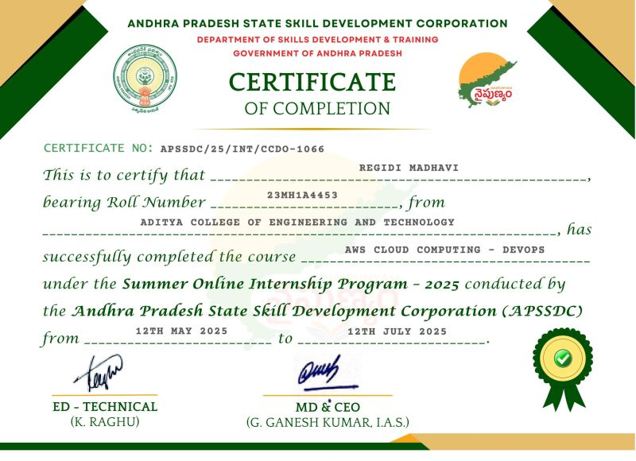
INTERNSHIP COMPLETION CERTIFICATE

Slide 15


