Slide 1
Sales Performance Analysis Dashboard
Using Power BI & SQL
By: Madhu Bogi

Slide 2
Abstract
This project analyzes sales data using SQL for data extraction and Power BI for visualization. The dashboard highlights key metrics such as total sales, profit, regional performance, category distribution, and monthly trends to support business decision-making.

Slide 3
Tools & Technologies Used
• SQL - Data extraction and filtering
• Power BI - Dashboard design & visualization
• Dataset - Sample Sales Data

Slide 4
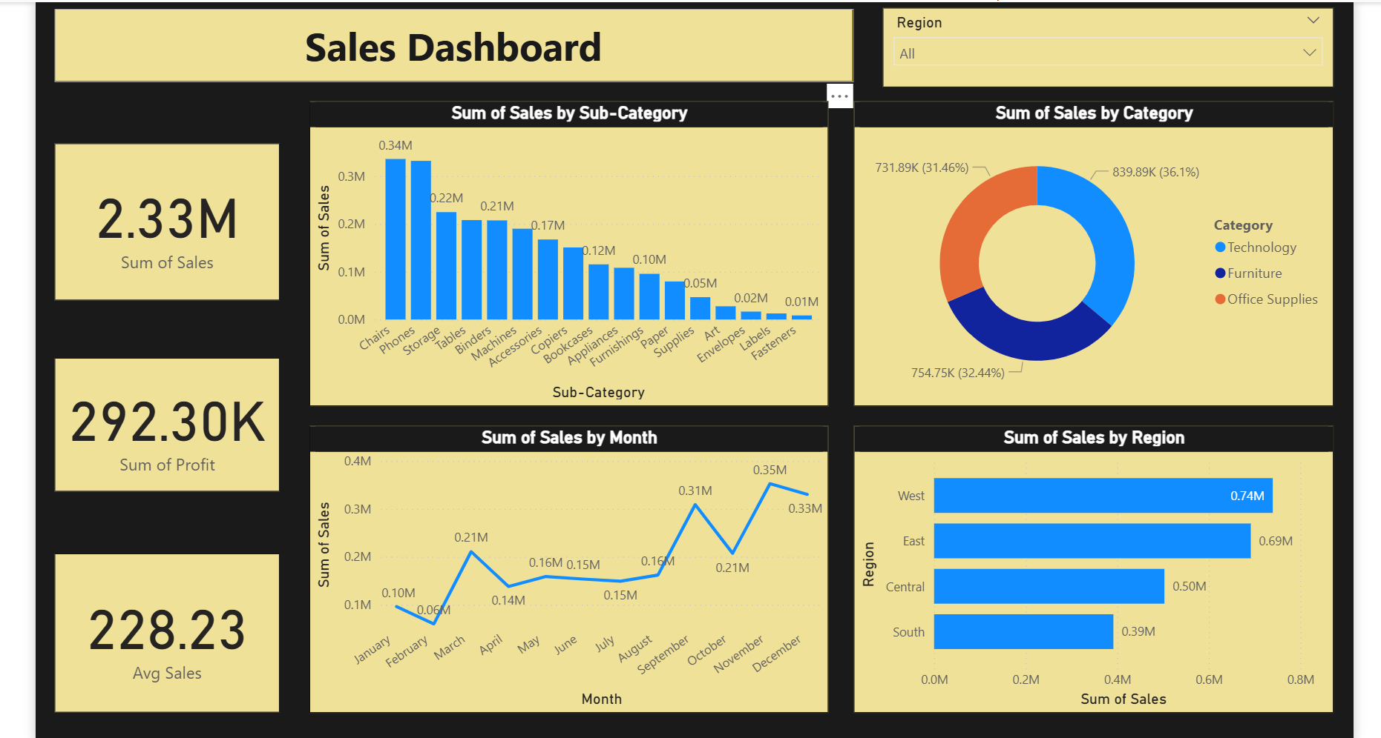
Sales Dashboard Overview

Slide 5
Key Insights
• Total Sales ~ 2.33M indicates strong performance.
• Highest sales from Technology category.
• Chairs & Phones are top selling sub-categories.
• Sales peak during October - December.
• West region contributes the highest sales.

Slide 6
Conclusion
The dashboard enables effective business insights and strategic planning. Power BI enhances visualization while SQL ensures accurate data sourcing.

