Slide 1
LIVE
↗
RevenueOS
AUTONOMOUS REVENUE INTELLIGENCE
From First Message
to Closed Deal.
No dropped balls. No forgotten follow-ups. No missed revenue.
AWS Hackathon 2026
Track 2 · Autonomous Business Unit
14 AWS Services
Zero Fake Integrations

Slide 2
The Problem
Sales teams don't lose deals because their product is bad.
They lose deals because of dropped balls.
💬
📂
💳
🔕
Message ignored
Proposal forgotten
Payment link missing
Follow-up never happens
Lead asks for pricing on Slack. Nobody responds for 3 days.
The proposal sits in a folder. Never sent. Deal goes cold.
Customer is ready to buy. Nobody created the link.
Rep forgets to follow up. Competitor wins the deal.
Every dropped ball = lost revenue. Every single day. For every sales team.

Slide 3
The Solution
RevenueOS
A customer sends one message. RevenueOS handles everything else.
👁 Watches
🧠 Understands
⚡ Acts instantly
Real Slack messages
& voice calls
Intent, urgency,
sentiment, risk
Email + payment link
+ proposal PDF
🔔 Notifies
🔁 Follows up
🛡 Self-corrects
Rich Slack notification
to your team
Automatic follow-up
if customer goes quiet
Retries failures,
escalates if needed
The human goes from DOING the work → to WATCHING it get done.

Slide 4
Live Demo
Watch it work. In real time.
MOMENT 1 · Slack to Actions
MOMENT 2 · Voice Call Intelligence
Partner types in #revenue-alerts on phone
Press mic button on dashboard
Dashboard card appears — NEW → ANALYZED
Speak a 30-second sales call live
Bedrock: intent + urgency + sentiment + risk
Transcript appears word-by-word in real time
3 actions fire simultaneously:
Bedrock analyses the full call:
✉ Real email arrives in inbox
🎯 Sentiment + deal stage + risk
$ Real Stripe payment link generated
✅ Action items extracted
📄 Real proposal PDF presigned URL
📅 Follow-up auto-scheduled
Slack notification fires in #revenue-alerts
Call summary emailed + Slacked instantly
MOMENT 3 · Self-Correction — Follow-up timer hits zero. Second email fires automatically. Nobody touched anything.

Slide 5
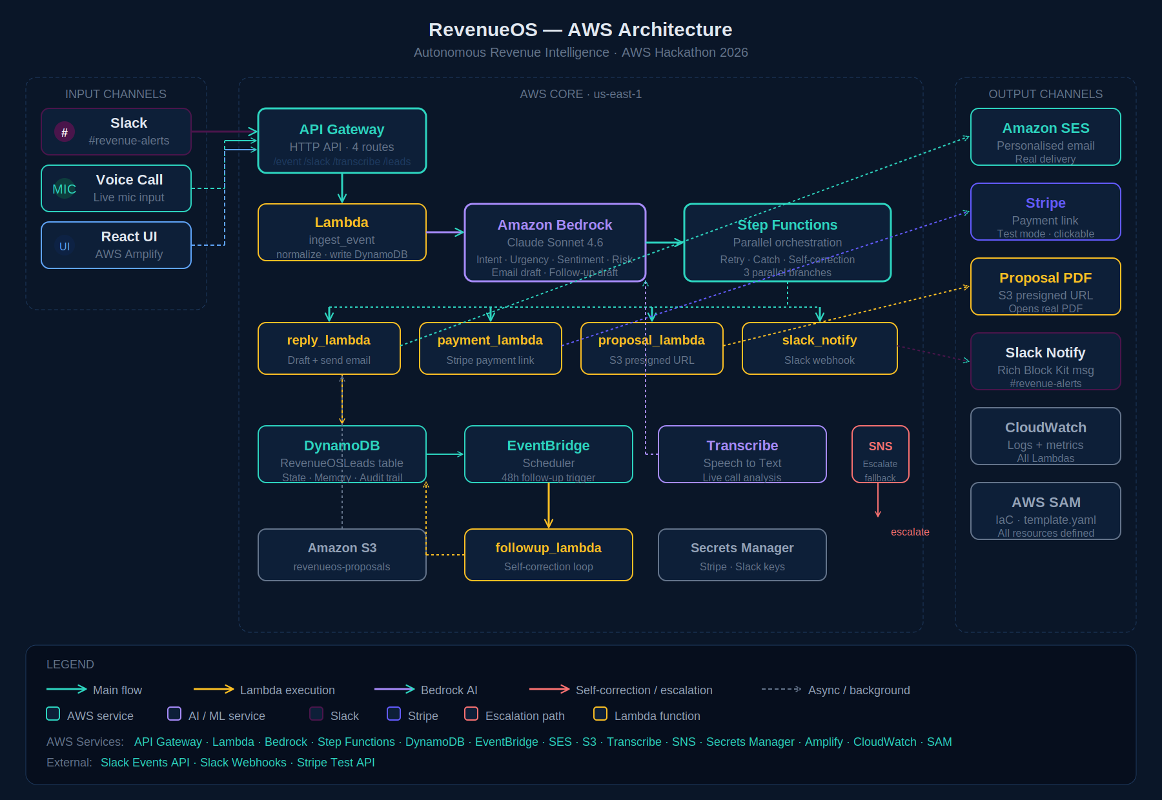
Architecture
14 AWS Services. 3 External Integrations. Zero Fake Integrations.

Slide 6
Evaluation Criteria
How RevenueOS scores on every dimension.
Orchestration Depth
10/10
Intent Detection
9/10
· 5 Snyco tool categories: Communication, Payments, Productivity, Calendar, AI
· Claude Sonnet 4.6 extracts 4 dimensions: intent, urgency, sentiment, revenue_risk
· 3 parallel Lambda actions per lead via Step Functions
· Natural language understood — not keyword matching
· Full sales lifecycle: outbound → inbound → post-call
· Voice call: implicit commitments detected ('I'll send that over')
· Slack + SES + Stripe + S3 + Bedrock + Transcribe all real
· Context-aware: prior conversation history loaded before each analysis
Self-Correction
10/10
UX & Impact (RPE)
10/10
· Step Functions: retry 3x with exponential backoff on every action
· 1 rep handles 500 leads/month vs 50 manually — 10x output
· Catch blocks route failures to fallback_lambda → alternate channel
· 300 hours/month returned to selling, not coordinating
· EventBridge: 48h no-reply triggers automatic follow-up (different angle)
· Real-time dark dashboard — mission control feel
· SNS escalation: human alerted with full context as last resort
· Live demo: Slack → email + Stripe + PDF in under 15 seconds

Slide 7
Revenue Per Employee — Redefined
Same team. 10x output.
Before RevenueOS
With RevenueOS
Leads handled / rep / month
50
500
Hours spent on coordination
3h per deal
0h
Response time to hot lead
Hours
Seconds
Dropped follow-ups
Common
Zero
Post-call action items
Manual notes
Auto-extracted + executed
10x
300h
15s
0
Output per rep
Saved per month
Response time
Dropped balls

Slide 8
Built on AWS
Every service is AWS-native. This is a production architecture.
Amazon Bedrock
AWS Step Functions
AWS Lambda
Claude Sonnet 4.6 — intent detection, email drafting, call analysis
Parallel orchestration, retry logic, self-correction catch blocks
10 functions — ingest, analyze, reply, payment, proposal, notify, fallback, followup, transcribe, leads
Amazon Transcribe
API Gateway
Amazon DynamoDB
Live speech-to-text — real-time voice call intelligence
HTTP API — 4 routes, CORS enabled, Slack event subscriptions endpoint
Single-table design — lead state, conversation history, audit trail
Amazon SES
Amazon S3
Amazon EventBridge
Real personalised email delivery — drafts written by Bedrock
Proposal PDF storage — presigned URLs generated per request
Scheduler — automatic 48h follow-up trigger, no human needed
AWS Secrets Manager
Amazon SNS
AWS Amplify
Stripe + Slack credentials — never hardcoded
Escalation alerts — fires when all self-correction attempts fail
React frontend hosting — HTTPS, live URL, one-command deploy
External Integrations (all real): Slack Events API · Slack Incoming Webhooks · Stripe Test API

Slide 9
↗
RevenueOS
AUTONOMOUS REVENUE INTELLIGENCE
From first message
to closed deal.
No dropped balls. No forgotten follow-ups. No missed revenue.
Built in 3 hours
Powered by AWS
Ready for production
AWS Hackathon 2026 · Track 2 — Autonomous Business Unit

