Slide 1

IMAGE CLASSIFICATION USING DEEP-LEARNING
Project carried out by
RA1511018010203 – Madhu Korada
RA1511018010180 – Mullapudi Sree Pavan Teja
Under the guidance of
Dr. R. Senthilnathan
Assistant Professor / Department of Mechatronics

Slide 2
Objectives Achieved
Acquiring dataset of five fruits containing 150 images each.
Creating structured data and augmenting the obtained data to increase the robustness of the network.
Augmentation
Deep networks need large amount of training data to achieve good performance. To build a powerful image classifier using very little training data, image augmentation is usually required to boost the performance of deep networks. Image augmentation artificially creates training images through different ways of processing or combination of multiple processing, such as random rotation, shifts, shear and flips, etc.
We have performed image augmentation based on flipping of image and intensity change.

Slide 3
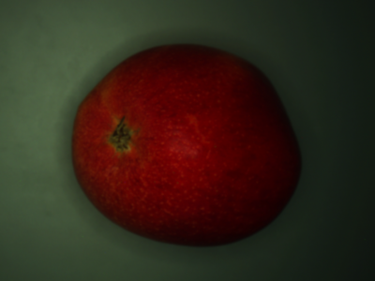
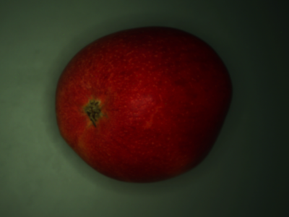
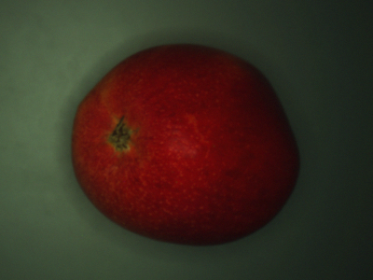
Image Augmentation Results
Normal Image
Vertically Flipped Image
Intensity Augmented Image

