Slide 1
CAPSTONE PROJECT
A Presentation by MADHUMATHY K
December 15,2020

Slide 2
BUSINESS PROBLEM
There is a groceries contractor in one of the boroughs of Toronto (Scarborough). This contractor provides places such as: Different types of Restaurants, Bakery, Breakfast Spot, Brewery and Café with fresh and high-quality groceries. The contractor wants to build a warehouse for the groceries it buys from villagers and farmers inside the borough, so that they will support more customers and also bring better "Quality of Service" to the old customers.
For example, if the warehouse is close to those old and famous restaurants, then the vegetables and other groceries would be delivered to the restaurant in the right time and there would be no delay so the restaurant cooks can start their job from the morning and the Quality of Service will be high and this contractor will gain more reputation and income.

Slide 3
DATA REQUIRED
GEO DATA
1- We will need geo-locational information about that specific borough and the neighborhoods in that borough. We specifically and technically mean the latitude and longitude numbers of that borough. We assume that it is "Scarborough" in Toronto. This is easily provided for us by the contractor, because the contractor has already made up his mind about the borough. The Postal Codes that fall into that borough (Scarborough) would also be sufficient fo us. I fact we will first find neighborhoods inside Scarborough by their corresponding Postal Codes
[Postal Code] [Neighborhood(s)] [Neighborhood Latitude] [Neighborhood Longitude] [Venue] [Venue Summary] [Venue Category] [Distance (meter)]

Slide 4
FOURSQUARE DATA
2- We will need data about different venues in different neighborhoods of that specific borough. In order to gain that information we will use "Foursquare" locational information. By locational information for each venue we mean basic and advanced information about that venue. For example there is a venue in one of the neighborhoods. As basic information, we can obtain its precise latitude and longitude and also its distance from the center of the neighborhood. But we are looking for advanced information such as the category of that venue and whether this venue is a popular one in its category or maybe the average price of the services of this venue.
https://foursquare.com

Slide 5
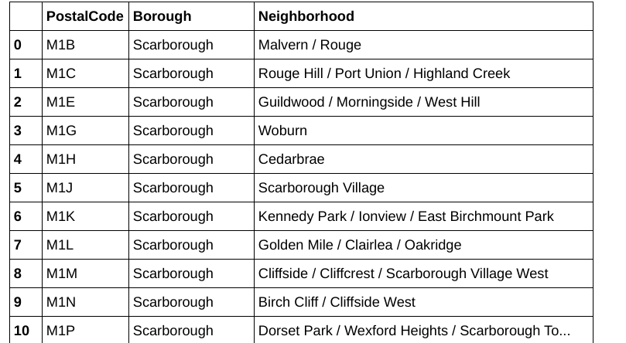
DERIVE THE NEIGHBOURS OF TORONTO
By scraping the data from the wikipedia find the data set about the toronto
url=’https://en.wikipedia.org/wiki/List_of_postal_codes_of_Canada:’

Slide 6
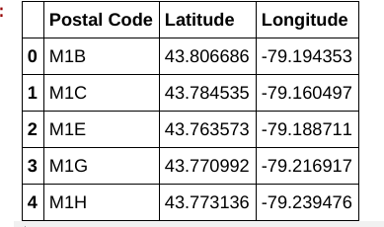
Collect Geospatial data
Collect the longitude and latitude of the data from the spatial data
url=”http://cocl.us/Geospatial_data”

Slide 7
Using Foursquare to collect data
Use your client_ id and client_data and version to obtain the data
url = 'https://api.foursquare.com/v2/venues/explore?client_id={}&client_secret={}&ll={},{}&v={}&radius={}&limit={}'.format(CLIENT_ID, CLIENT_SECRET, latitude_scar, longitude_scar, VERSION, radius, LIMIT)

Slide 8
Using K-means for clustering and segmenting the data
Here we cluster neighborhoods via K-means clustering method. We think that 5 clusters is enough and can cover the complexity of our problem. After clustering we will update our dataset and create a column representing the group for each neighborhood.
from sklearn.cluster import KMeans

Slide 9
Decision Making and Reporting Results
.
Now, we focus on the centers of clusters and compare them for their "Total Restaurants" and their "Total Joints". The group which its center has the highest "Total Sum" will be our best recommendation to the contractor. {Note: Total Sum = Total Restaurants + Total Joints + Other Venues.} This algorithm although is pretty straightforward yet is strongly powerful.
Now, we focus on the centers of clusters and compare them for their "Total Restaurants" and their "Total Joints". The group which its center has the highest "Total Sum" will be our best recommendation to the contractor. {Note: Total Sum = Total Restaurants + Total Joints + Other Venues.} This algorithm although is pretty straightforward yet is strongly powerful.

Slide 10
Results
Based on this analysis, the best recommended neighborhood will be:
{'Neighborhood': 'Agincourt',
'Postal Code': 'M1S',
'Neighborhood Latitude': 43.7942003,
'Neighborhood Longitude': -79.26202940000002

Slide 11


