Slide 1
Risk and Return

Slide 2
After studying Chapter 5, you should be able to:
Understand the relationship (or “trade-off”) between risk and return.
Define risk and return and show how to measure them by calculating expected return, standard deviation, and coefficient of variation.
Discuss the different types of investor attitudes toward risk.
Explain risk and return in a portfolio context, and distinguish between individual security and portfolio risk.
Distinguish between avoidable (unsystematic) risk and unavoidable (systematic) risk and explain how proper diversification can eliminate one of these risks.
Define and explain the capital-asset pricing model (CAPM), beta, and the characteristic line.
Calculate a required rate of return using the capital-asset pricing model (CAPM).
Demonstrate how the Security Market Line (SML) can be used to describe this relationship between expected rate of return and systematic risk.
Explain what is meant by an “efficient financial market” and describe the three levels (or forms) to market efficiency.

Slide 3
Risk and Return
Defining Risk and Return
Using Probability Distributions to Measure Risk
Attitudes Toward Risk
Risk and Return in a Portfolio Context
Diversification
The Capital Asset Pricing Model (CAPM)
Efficient Financial Markets

Slide 4
Defining Return
Income received on an investment plus any change in market price, usually expressed as a percent of the beginning market price of the investment.
D_{t} + (P_{t} - P_{t-1} )
R =
P_{t-1}

Slide 5
Return Example
The stock price for Stock A was $10 per share 1 year ago. The stock is currently trading at $9.50 per share and shareholders just received a $1 dividend. What return was earned over the past year?

Slide 6
Return Example
The stock price for Stock A was $10 per share 1 year ago. The stock is currently trading at $9.50 per share and shareholders just received a $1 dividend. What return was earned over the past year?
$1.00 + ($9.50 - $10.00 )
R =
= 5%
$10.00

Slide 7
Defining Risk
The variability of returns from those that are expected.
What rate of return do you expect on your investment (savings) this year?
What rate will you actually earn?
Does it matter if it is a bank CD or a share of stock?

Slide 8
Determining Expected Return (Discrete Dist.)
n
R = Σ ( R_{i} )( P_{i} )
R is the expected return for the asset,
R_{i} is the return for the i^{th} possibility,
P_{i} is the probability of that return occurring,
n is the total number of possibilities.
i=1

Slide 9
How to Determine the Expected Return and Standard Deviation
Stock BW
R_{i} P_{i} (R_{i})(P_{i})
-.15 .10 -.015
-.03 .20 -.006
.09 .40 .036
.21 .20 .042
.33 .10 .033
Sum 1.00 .090
The expected return, R, for Stock BW is .09 or 9%

Slide 10
Determining Standard Deviation (Risk Measure)
n
σ = Σ ( R_{i} - R )²( P_{i} )
Standard Deviation, σ, is a statistical measure of the variability of a distribution around its mean.
It is the square root of variance.
Note, this is for a discrete distribution.
i=1

Slide 11
How to Determine the Expected Return and Standard Deviation
Stock BW
R_{i} P_{i} (R_{i})(P_{i}) (R_{i} - R )²(P_{i})
-.15 .10 -.015 .00576
-.03 .20 -.006 .00288
.09 .40 .036 .00000
.21 .20 .042 .00288
.33 .10 .033 .00576
Sum 1.00 .090 .01728

Slide 12
Determining Standard Deviation (Risk Measure)
n
σ = Σ ( R_{i} - R )²( P_{i} )
σ = .01728
σ = .1315 or 13.15%
i=1

Slide 13
Coefficient of Variation
The ratio of the standard deviation of a distribution to the mean of that distribution.
It is a measure of RELATIVE risk.
CV = σ / R
CV of BW = .1315 / .09 = 1.46

Slide 14
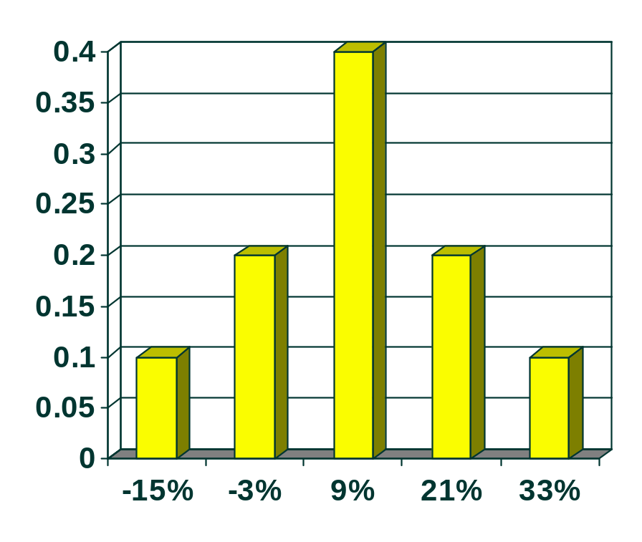
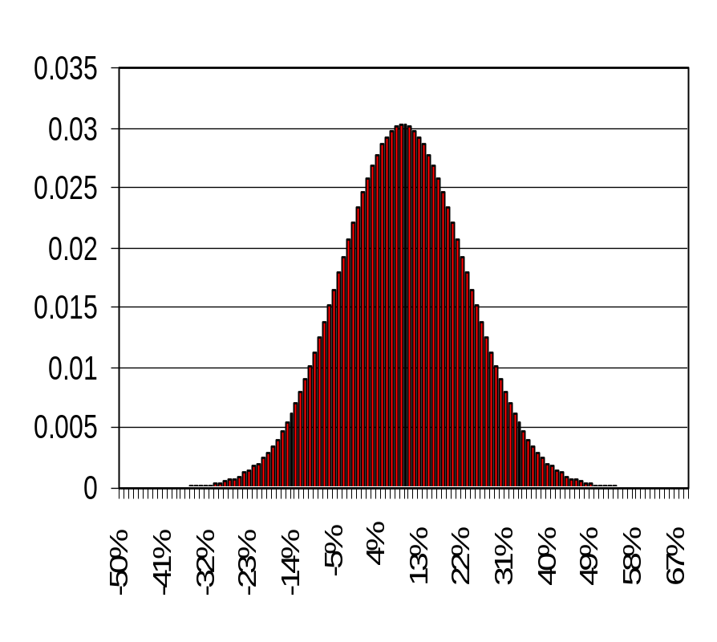
Discrete vs. Continuous Distributions
Discrete Continuous

Slide 15
Determining Expected Return (Continuous Dist.)
n
R = Σ ( R_{i} ) / ( n )
R is the expected return for the asset,
R_{i} is the return for the ith observation,
n is the total number of observations.
i=1

Slide 16
Determining Standard Deviation (Risk Measure)
n
σ = Σ ( R_{i} - R )²
( n )
Note, this is for a continuous distribution where the distribution is for a population. R represents the population mean in this example.
i=1

Slide 17
Continuous Distribution Problem
Assume that the following list represents the continuous distribution of population returns for a particular investment (even though there are only 10 returns).
9.6%, -15.4%, 26.7%, -0.2%, 20.9%, 28.3%, -5.9%, 3.3%, 12.2%, 10.5%
Calculate the Expected Return and Standard Deviation for the population assuming a continuous distribution.

Slide 18
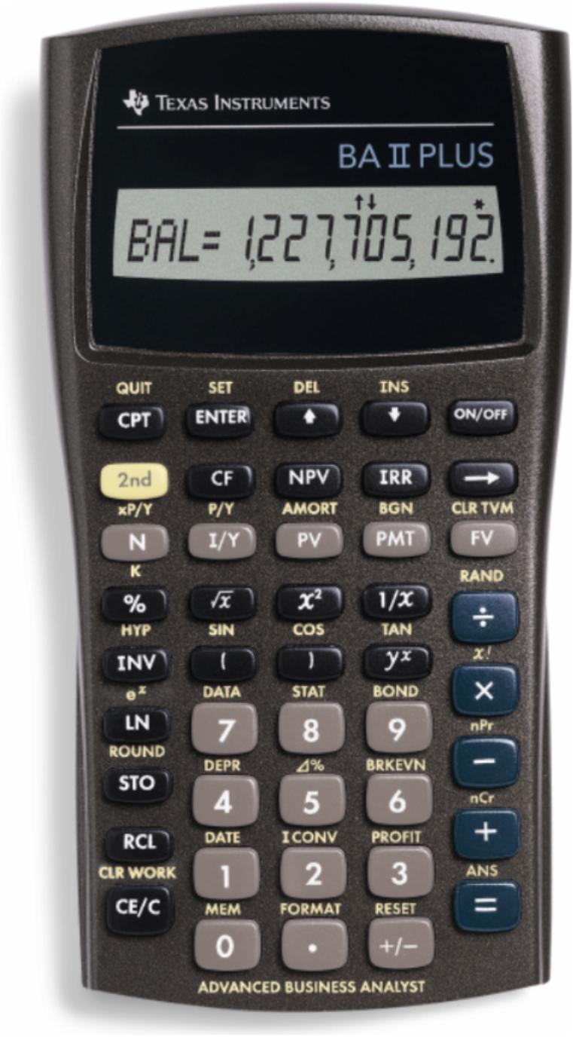
Let’s Use the Calculator!
Enter “Data” first. Press:
2nd Data
2nd CLR Work
9.6 ENTER ↓ ↓
-15.4 ENTER ↓ ↓
26.7 ENTER ↓ ↓
Note, we are inputting data only for the “X” variable and ignoring entries for the “Y” variable in this case.

Slide 19
Let’s Use the Calculator!
Enter “Data” first. Press:
-0.2 ENTER ↓ ↓
20.9 ENTER ↓ ↓
28.3 ENTER ↓ ↓
-5.9 ENTER ↓ ↓
3.3 ENTER ↓ ↓
12.2 ENTER ↓ ↓
10.5 ENTER ↓ ↓

Slide 20
Let’s Use the Calculator!
Examine Results! Press:
2nd Stat
↓ through the results.
Expected return is 9% for the 10 observations. Population standard deviation is 13.32%.
This can be much quicker than calculating by hand, but slower than using a spreadsheet.

Slide 21
Risk Attitudes
Certainty Equivalent (CE) is the amount of cash someone would require with certainty at a point in time to make the individual indifferent between that certain amount and an amount expected to be received with risk at the same point in time.

Slide 22
Risk Attitudes
Certainty equivalent > Expected value
Risk Preference
Certainty equivalent = Expected value
Risk Indifference
Certainty equivalent < Expected value
Risk Aversion
Most individuals are Risk Averse.

Slide 23
Risk Attitude Example
You have the choice between (1) a guaranteed dollar reward or (2) a coin-flip gamble of $100,000 (50% chance) or $0 (50% chance). The expected value of the gamble is $50,000.
  Mary requires a guaranteed $25,000, or more, to call off the gamble.
  Raleigh is just as happy to take $50,000 or take the risky gamble.
  Shannon requires at least $52,000 to call off the gamble.

Slide 24
Risk Attitude Example
What are the Risk Attitude tendencies of each?
Mary shows “risk aversion” because her “certainty equivalent” < the expected value of the gamble.
Raleigh exhibits “risk indifference” because her “certainty equivalent” equals the expected value of the gamble.
Shannon reveals a “risk preference” because her “certainty equivalent” > the expected value of the gamble.

Slide 25
Determining Portfolio Expected Return
m
R_{P} = Σ ( W_{j} )( R_{j} )
R_{P} is the expected return for the portfolio,
W_{j} is the weight (investment proportion) for the j^{th} asset in the portfolio,
R_{j} is the expected return of the j^{th} asset,
m is the total number of assets in the portfolio.
j=1

Slide 26
Determining Portfolio Standard Deviation
m
m
σ_{P} = Σ Σ W_{j} W_{k} σ_{jk}
W_{j} is the weight (investment proportion) for the j^{th} asset in the portfolio,
W_{k} is the weight (investment proportion) for the k^{th} asset in the portfolio,
σ_{jk} is the covariance between returns for the j^{th} and k^{th} assets in the portfolio.
j=1
k=1

Slide 27
Tip Slide: Appendix A
Slides 5-28 through 5-30 and 5-33 through 5-36 assume that the student has read Appendix A in Chapter 5

Slide 28
What is Covariance?
σ _{jk} = σ _{j} σ _{k} r _{jk}
σ_{j} is the standard deviation of the j^{th} asset in the portfolio,
σ_{k} is the standard deviation of the k^{th} asset in the portfolio,
r_{jk} is the correlation coefficient between the j^{th} and k^{th} assets in the portfolio.

Slide 29
Correlation Coefficient
A standardized statistical measure of the linear relationship between two variables.
Its range is from -1.0 (perfect negative correlation), through 0 (no correlation), to +1.0 (perfect positive correlation).

Slide 30
Variance - Covariance Matrix
A three asset portfolio:
Col 1 Col 2 Col 3
Row 1 W₁W₁σ_{1,1} W₁W₂σ_{1,2} W₁W₃σ_{1,3}
Row 2 W₂W₁σ_{2,1} W₂W₂σ_{2,2} W₂W₃σ_{2,3}
Row 3 W₃W₁σ_{3,1} W₃W₂σ_{3,2} W₃W₃σ_{3,3}
σ_{j,k} = is the covariance between returns for the j^{th} and k^{th} assets in the portfolio.

Slide 31
Portfolio Risk and Expected Return Example
You are creating a portfolio of Stock D and Stock BW (from earlier). You are investing $2,000 in Stock BW and $3,000 in Stock D. Remember that the expected return and standard deviation of Stock BW is 9% and 13.15% respectively. The expected return and standard deviation of Stock D is 8% and 10.65% respectively. The correlation coefficient between BW and D is 0.75.
What is the expected return and standard deviation of the portfolio?

Slide 32
Determining Portfolio Expected Return
W_{BW} = $2,000 / $5,000 = .4
W_{D} = $3,000 / $5,000 = .6
R_{P} = (W_{BW})(R_{BW}) + (W_{D})(R_{D})
R_{P} = (.4)(9%) + (.6)(8%)
R_{P} = (3.6%) + (4.8%) = 8.4%

Slide 33
Determining Portfolio Standard Deviation
Two-asset portfolio:
Col 1 Col 2
Row 1 W_{BW} W_{BW} σ_{BW,BW} W_{BW} W_{D} σ_{BW,D}
Row 2 W_{D} W_{BW} σ_{D,BW} W_{D} W_{D} σ_{D,D}
This represents the variance - covariance matrix for the two-asset portfolio.

Slide 34
Determining Portfolio Standard Deviation
Two-asset portfolio:
Col 1 Col 2
Row 1 (.4)(.4)(.0173) (.4)(.6)(.0105)
Row 2 (.6)(.4)(.0105) (.6)(.6)(.0113)
This represents substitution into the variance - covariance matrix.

Slide 35
Determining Portfolio Standard Deviation
Two-asset portfolio:
Col 1 Col 2
Row 1 (.0028) (.0025)
Row 2 (.0025) (.0041)
This represents the actual element values in the variance - covariance matrix.

Slide 36
Determining Portfolio Standard Deviation
σ_{P} = .0028 + (2)(.0025) + .0041
σ_{P} = SQRT(.0119)
σ_{P} = .1091 or 10.91%
A weighted average of the individual standard deviations is INCORRECT.

Slide 37
Determining Portfolio Standard Deviation
The WRONG way to calculate is a weighted average like:
σ_{P} = .4 (13.15%) + .6(10.65%)
σ_{P} = 5.26 + 6.39 = 11.65%
10.91% = 11.65%
This is INCORRECT.

Slide 38
Summary of the Portfolio Return and Risk Calculation
Stock C Stock D Portfolio
Return 9.00% 8.00% 8.64%
Stand.
Dev. 13.15% 10.65% 10.91%
CV 1.46 1.33 1.26
The portfolio has the LOWEST coefficient of variation due to diversification.

Slide 39
Diversification and the Correlation Coefficient
Combination
E and F
SECURITY E
SECURITY F
INVESTMENT RETURN
TIME
TIME
TIME
Combining securities that are not perfectly, positively correlated reduces risk.

Slide 40
Total Risk = Systematic Risk + Unsystematic Risk
Total Risk = Systematic Risk + Unsystematic Risk
Systematic Risk is the variability of return on stocks or portfolios associated with changes in return on the market as a whole.
Unsystematic Risk is the variability of return on stocks or portfolios not explained by general market movements. It is avoidable through diversification.

Slide 41
Total Risk = Systematic Risk + Unsystematic Risk
Factors such as changes in nation’s
economy, tax reform by the Congress,
or a change in the world situation.
STD DEV OF PORTFOLIO RETURN
Unsystematic risk
Total
Risk
Systematic risk
NUMBER OF SECURITIES IN THE PORTFOLIO

Slide 42
Total Risk = Systematic Risk + Unsystematic Risk
Factors unique to a particular company
or industry. For example, the death of a
key executive or loss of a governmental
defense contract.
STD DEV OF PORTFOLIO RETURN
Unsystematic risk
Total
Risk
Systematic risk
NUMBER OF SECURITIES IN THE PORTFOLIO

Slide 43
Capital Asset
Pricing Model (CAPM)
CAPM is a model that describes the relationship between risk and expected (required) return; in this model, a security’s expected (required) return is the risk-free rate plus a premium based on the systematic risk of the security.

Slide 44
CAPM Assumptions
1. Capital markets are efficient.
2. Homogeneous investor expectations over a given period.
3. Risk-free asset return is certain (use short- to intermediate-term Treasuries as a proxy).
4. Market portfolio contains only systematic risk (use S&P 500 Index or similar as a proxy).

Slide 45
Characteristic Line
EXCESS RETURN
ON STOCK
Narrower spread
is higher correlation
Rise
Run
Beta =
EXCESS RETURN
ON MARKET PORTFOLIO
Characteristic Line

Slide 46
Calculating “Beta” on Your Calculator
Time Pd. | Market | My Stock
1 | 9.6% | 12%
2 | -15.4% | -5%
3 | 26.7% | 19%
4 | -.2% | 3%
5 | 20.9% | 13%
6 | 28.3% | 14%
7 | -5.9% | -9%
8 | 3.3% | -1%
9 | 12.2% | 12%
10 | 10.5% | 10%
The Market and My Stock returns are “excess returns” and have the riskless rate already subtracted.

Slide 47
Calculating “Beta” on Your Calculator
Assume that the previous continuous distribution problem represents the “excess returns” of the market portfolio (it may still be in your calculator data worksheet -- 2nd Data ).
Enter the excess market returns as “X” observations of: 9.6%, -15.4%, 26.7%, -0.2%, 20.9%, 28.3%, -5.9%, 3.3%, 12.2%, and 10.5%.
Enter the excess stock returns as “Y” observations of: 12%, -5%, 19%, 3%, 13%, 14%, -9%, -1%, 12%, and 10%.

Slide 48
Calculating “Beta” on Your Calculator
Let us examine again the statistical results (Press 2nd and then Stat )
The market expected return and standard deviation is 9% and 13.32%. Your stock expected return and standard deviation is 6.8% and 8.76%.
The regression equation is Y=a+bX. Thus, our characteristic line is Y = 1.4448 + 0.595 X and indicates that our stock has a beta of 0.595.

Slide 49
What is Beta?
An index of systematic risk.
It measures the sensitivity of a stock’s returns to changes in returns on the market portfolio.
The beta for a portfolio is simply a weighted average of the individual stock betas in the portfolio.

Slide 50
Characteristic Lines and Different Betas
EXCESS RETURN
ON STOCK
Beta > 1
(aggressive)
Beta = 1
Each characteristic
line has a
different slope.
Beta < 1
(defensive)
EXCESS RETURN
ON MARKET PORTFOLIO

Slide 51
Security Market Line
R_{j} = R_{f} + β_{j}(R_{M} - R_{f})
R_{j} is the required rate of return for stock j,
R_{f} is the risk-free rate of return,
β_{j} is the beta of stock j (measures systematic risk of stock j),
R_{M} is the expected return for the market portfolio.

Slide 52
Security Market Line
R_{j} = R_{f} + β_{j}(R_{M} - R_{f})
Risk
Premium
R_{M}
Required Return
R_{f}
Risk-free
Return
β_{M} = 1.0
Systematic Risk (Beta)

Slide 53
Security Market Line
Obtaining Betas
  Can use historical data if past best represents the expectations of the future
  Can also utilize services like Value Line, Ibbotson Associates, etc.
Adjusted Beta
  Betas have a tendency to revert to the mean of 1.0
  Can utilize combination of recent beta and mean
    2.22 (.7) + 1.00 (.3) = 1.554 + 0.300 = 1.854 estimate

Slide 54
Determination of the Required Rate of Return
Lisa Miller at Basket Wonders is attempting to determine the rate of return required by their stock investors. Lisa is using a 6% R_{f} and a long-term market expected rate of return of 10%. A stock analyst following the firm has calculated that the firm beta is 1.2. What is the required rate of return on the stock of Basket Wonders?

Slide 55
BWs Required Rate of Return
R_{BW} = R_{f} + β_{j}(R_{M} - R_{f})
R_{BW} = 6% + 1.2(10% - 6%)
R_{BW} = 10.8%
The required rate of return exceeds the market rate of return as BW’s beta exceeds the market beta (1.0).

Slide 56
Determination of the Intrinsic Value of BW
Lisa Miller at BW is also attempting to determine the intrinsic value of the stock. She is using the constant growth model. Lisa estimates that the dividend next period will be $0.50 and that BW will grow at a constant rate of 5.8%. The stock is currently selling for $15.
What is the intrinsic value of the stock? Is the stock over or underpriced?

Slide 57
Determination of the Intrinsic Value of BW
Intrinsic
Value
$0.50
=
10.8% - 5.8%
=
$10
The stock is OVERVALUED as the market price ($15) exceeds the intrinsic value ($10).

Slide 58
Security Market Line
Stock X (Underpriced)
Direction of
Movement
Direction of
Movement
Required Return
R_{f}
Stock Y (Overpriced)
Systematic Risk (Beta)

Slide 59
Determination of the Required Rate of Return
Small-firm Effect
Price / Earnings Effect
January Effect
These anomalies have presented serious challenges to the CAPM theory.

