Slide 1



INNOVATION AND DESIGN THINKING
HOSPITAL MANAGEMENT
SYSTEM
G MADHUMITHA 221801030
S MADHUVANTHIY 221801031

Slide 2


TABLE OF CONTENT
Problem Statement
Objectives
Abstract
Introduction
Literature Survey
Existing System
Drawbacks of Existing System
Proposed System
System Architecture
List of Modules
Conclusion
References

Slide 3

PROBLEM STATEMENT
Hospitals struggle with managing patient records, appointments, billing, and resources due to outdated or manual systems. This leads to errors, delays, and inefficiencies in healthcare services. A centralized and automated Hospital Management System (HMS) is needed to improve accuracy, streamline operations, and enhance patient care.

Slide 4


OBJECTIVES
Efficient Patient Management – Maintain digital records and appointments.
Automated Billing – Streamline payments and insurance processing.
Electronic Health Records (EHR) – Securely store and manage patient data.
Inventory Management – Track medicines and medical supplies.
Doctor & Staff Scheduling – Optimize duty assignments and availability.
Resource Utilization – Manage hospital beds, rooms, and equipment.
Data Security – Ensure privacy and compliance with healthcare regulations.
Reporting & Analytics – Generate insights for better decision-making.

Slide 5

ABSTRACT
The Hospital Management System (HMS) is a software solution that helps hospitals manage their daily operations efficiently. It automates tasks like patient registration, appointment scheduling, billing, medical records, inventory management, and staff allocation, reducing errors and delays caused by manual processes.
HMS ensures secure data management, minimizes paperwork, and provides real-time reports for better decision-making. With an easy-to-use interface and role-based access, it improves coordination between doctors, nurses, and administrators. It also helps hospitals follow healthcare regulations, leading to better efficiency and improved patient care.

Slide 6
INTRODUCTION
The Hospital Management System (HMS) is a software that helps hospitals manage daily tasks efficiently. It automates patient registration, appointments, billing, medical records, and inventory tracking, reducing errors and delays.
With electronic health records (EHR), automated billing, and real-time reporting, HMS ensures secure data management and smooth hospital operations. It also helps in managing beds, medical supplies, and staff schedules, improving efficiency and patient care.

Slide 7
LITERATURE SURVEY
S.NO | AUTHOR NAME | PAPER TITLE | JOURNAL | YEAR
01 | Anjlya Agustin, Rapotan Hasibuan | Evaluation of the Application of Hospital Management Information System by Using the HOT-Fit Method | Malahayati International Journal of Nursing and Health Science | 2023
02 | Erhauyi Meshach Aiwerioghene, Janice Lewis, David Rea | Maturity Models for Hospital Management: A Literature Review | International Journal of Healthcare Management | 2024
03 | Vidya Karunia Moerti | Evaluation of Hospital Management Information Systems Using the HOT-FIT Method: Literature Review | Health Information Management Study Program, Department of Health | 2023

Slide 8
EXISTING SYSTEM
Multi HMS by Code Aristos – Multi-hospital management with patient records, billing, and appointments.
Smart Hospital by QDOCS – User-friendly system for managing appointments, patients, and billing.
InfyHMS – Feature-rich HMS with 65+ modules for hospital automation.
DocPulse – Secure HMS for clinics and hospitals covering appointments, billing, and patient records.
MocDoc HMS – Online HMS that streamlines hospital operations.

Slide 9
LIMITATIONS OF EXISTING SYSTEM
Time-Consuming and Error-Prone – Manual processes lead to delays, mistakes, and inefficiencies.
Lack of Real-Time Data Access – Delayed updates in patient records affect decision-making and treatment.
Difficulty in Managing Hospital Resources – Inefficient tracking of beds, staff, and medical supplies.
Limited Scalability – Hard to expand or integrate new departments and branches.
Security and Privacy Risks – Vulnerable to data breaches, unauthorized access, and loss of patient information.

Slide 10
PROPOSED SYSTEM
The proposed Hospital Management System (HMS) is a digital solution designed to automate and streamline hospital operations. It replaces manual processes with a centralized and integrated system, improving efficiency, accuracy, and patient care.
Key Features:
Automated Patient Management – Quick registration, appointment booking, and digital medical records.
Real-Time Data Access – Doctors and staff can access updated patient records anytime.
Resource Optimization – Efficient tracking of hospital beds, staff, and medical supplies.
Secure and Compliant – Ensures data security and follows healthcare regulations like HIPAA.
Billing and Inventory Management – Reduces errors in payments and stock tracking.

Slide 11
ADMIN MODULE
Admin Module The Admin Module serves as the control center of the entire system.
Administrators have comprehensive access to user management, including the ability to
add, update, or remove both patient and doctor profiles. This module also allows the admin
to review and monitor system activity, generate reports on appointments and system usage,
and manage schedules or availability settings globally. The administrator ensures that the
platform functions smoothly and that data remains consistent and secure across all
modules.

Slide 12
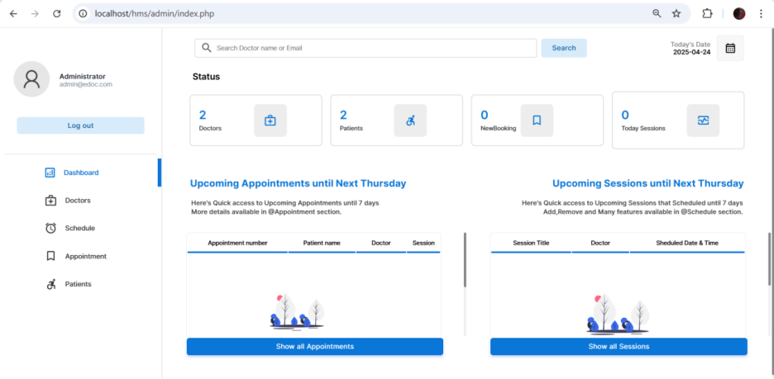
ADMIN MODULE

Slide 13
DOCTOR MODULE
In the Doctor Module, medical professionals can manage their profiles, set their available days and time slots, and view the list of booked appointments. Doctors can accept, reschedule, or reject appointments based on their availability. Additionally, this module provides a space for doctors to view patient queries and respond accordingly, improving communication and patient satisfaction. Doctors can also review their past appointment history and manage their consultation slots dynamically.

Slide 14
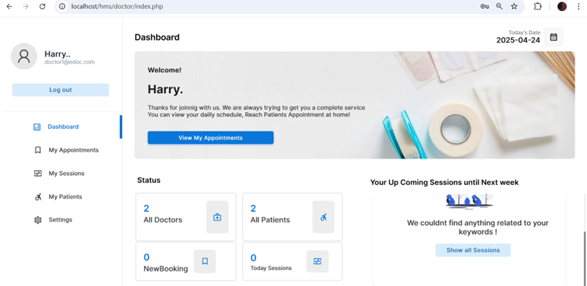
DOCTOR MODULE

Slide 15
PATIENT MODULE
The Patient Module enables patients to register on the platform, log in securely, and access a user-friendly dashboard. They can browse the list of doctors filtered by specialization, location, or availability, and book appointments in real time. Patients can also manage their personal profiles, check appointment status, cancel or reschedule bookings, and view their history of consultations. This module ensures that patients have full control over their interactions with healthcare providers through an intuitive interface.

Slide 16
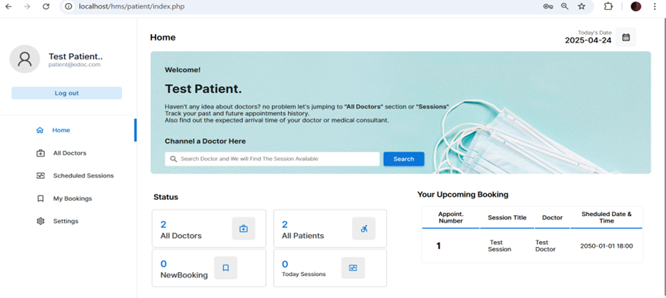
PATIENT MODULE

Slide 17
APPOINTMENT SCHEDULE MODULE
This module handles the real-time appointment booking mechanism. It cross-references doctor availability with patient preferences and confirms slots dynamically. It prevents double bookings and notifies both doctors and patients upon confirmation, cancellation, or rescheduling. This module is crucial to ensuring smooth workflow and avoids clashes by checking the current status of appointments in the database. The scheduling engine also manages buffer times, slot durations, and availability blocks efficiently.

Slide 18
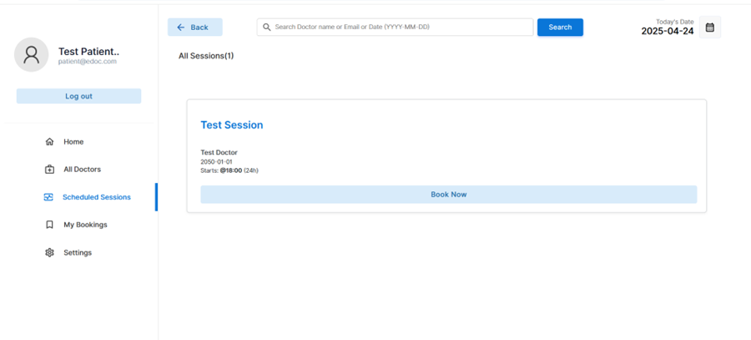
APPOINTMENT SCHEDULE MODULE

Slide 19
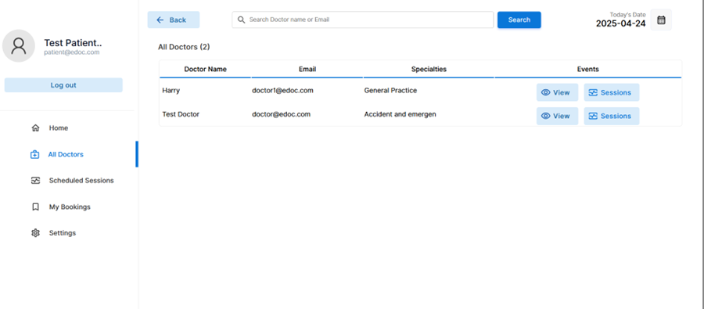
APPOINTMENT SCHEDULE MODULE

Slide 20
REGISTRATION & LOGIN MODULE
The Login and Registration Module provides a secure gateway to access the system. New users can sign up by entering their credentials and personal details. This module handles role-based registration, assigning different privileges to patients, doctors, and administrators. Passwords are encrypted to maintain security, and role validation ensures that users only access functionalities relevant to their roles. The module also supports login sessions, password recovery, and profile verification for enhanced user management.

Slide 21
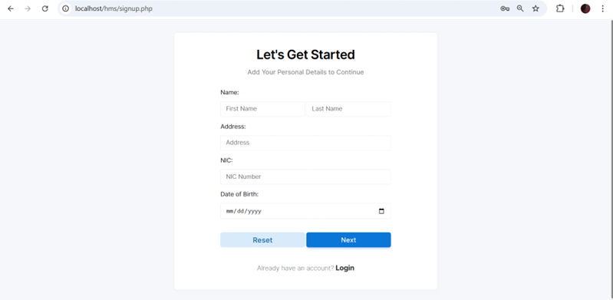
REGISTRATION & LOGIN MODULE
REGISTRATION MODULE

Slide 22
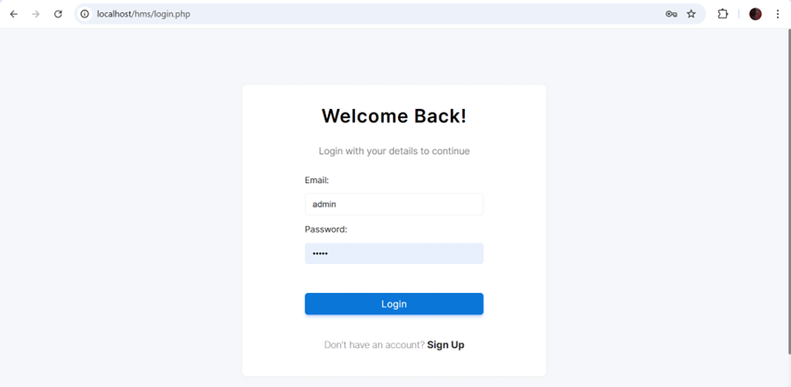
REGISTRATION & LOGIN MODULE
LOGIN MODULE

Slide 23
OUR PROJECT RESULT

Slide 24
OUR PROJECT RESULT

Slide 25
CONCLUSION
The Doctor Appointment System is a user-friendly, role-based web platform designed to modernize healthcare scheduling. It enables patients to easily register, search for doctors, and book appointments online—reducing front desk load and wait times. Doctors can manage schedules and patient info efficiently, while admins oversee operations and user management. The system improves coordination, reduces errors, and enhances transparency. Its modular architecture supports future features like telemedicine and online payments, making it a scalable and future-ready healthcare solution.

Slide 26
REFERENCE
[1] Shanika Wickramasinghe, “Choosing the Best Web Application Architecture”, October 6, 2020. [Online], Available: https://crowdbotics.com/posts/blog/how-to-choose-the-bestarchitecture-for-your-web-application/
[2] Chandrapal Singh, “Fundamentals Of Web Application Architecture”, July 14, 2020. [Online], Available: https://www.appventurez.com/blog/web-application-architecture
[3] Omer Imran Malik, “What is Sensitive Data Exposure Vulnerability & How to Avoid It?” August 12, 2019. [Online], Available: https://securiti.ai/blog/sensitive-data-exposure/
[4] Eugene Makieiev, “How to Create a Modern Web Application Architecture?” January 7, 2021. [Online], Available: https://integrio.net/blog/modern-web-application-architecture
[5] Google developer’s guide, “About PageSpeed Insights” September 21, 2020. [Online], Available: https://developers.google.com/speed/docs/insights/v5/about [Accessed March 19, 2021].

Slide 27
THANK YOU

