Slide 1
AIR AND VENTILATION

Slide 2
OBJECTIVES
Central objective
At the end of the class students will gain knowledge on air pollution and able to apply this knowledge in practice with positive attitude
Specific objective
Students will be able to
Define air pollution
List down the sources of air pollution
Describe the prevention and control of air pollution

Slide 3

AIR
AIR

Slide 4
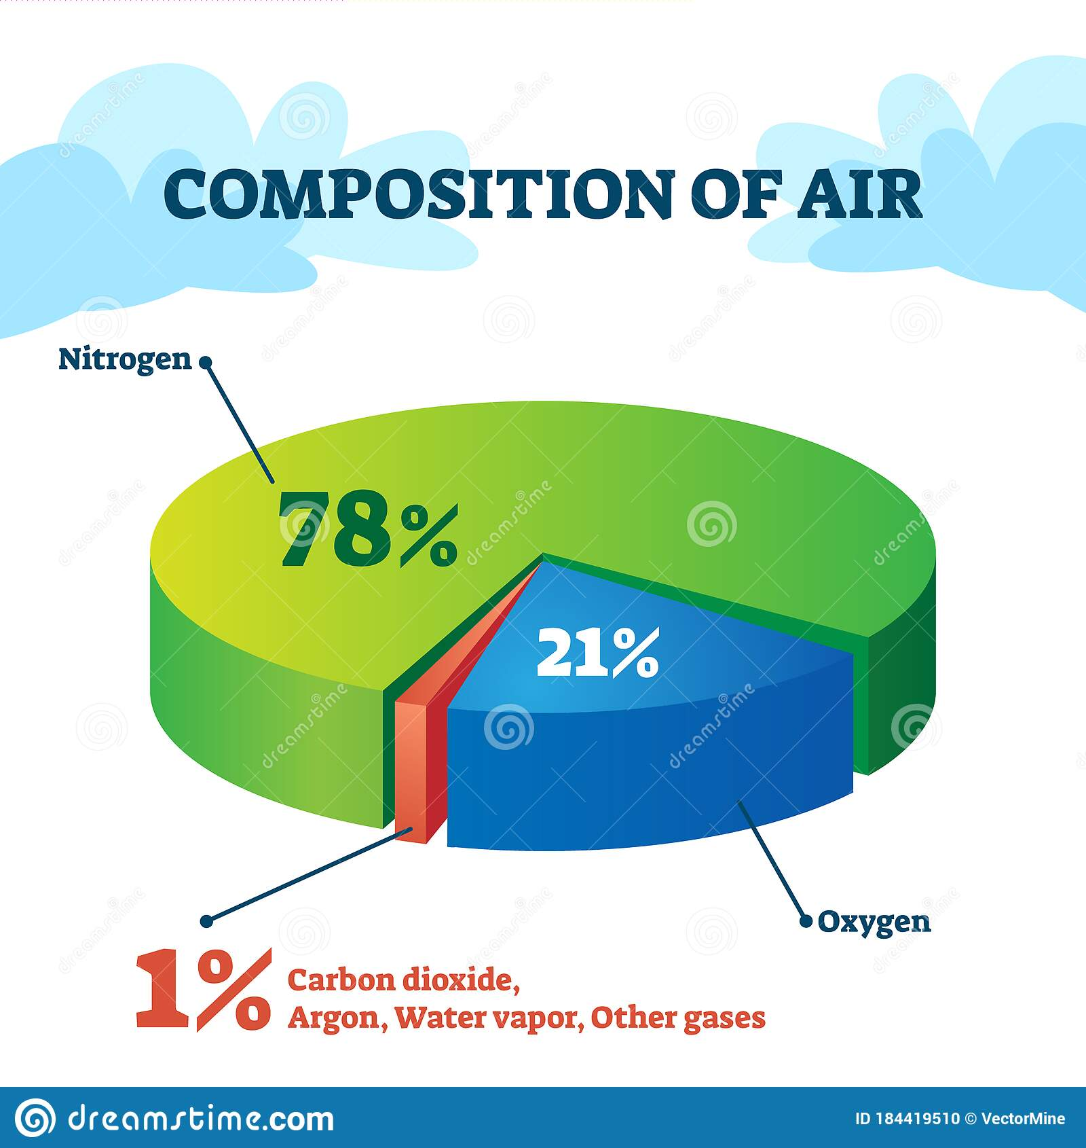

Slide 5
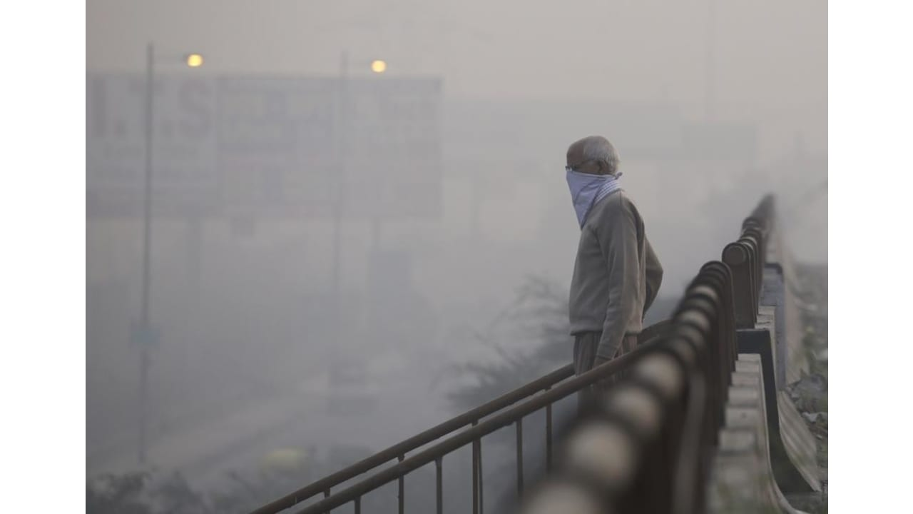
IMPURE AIR

Slide 6
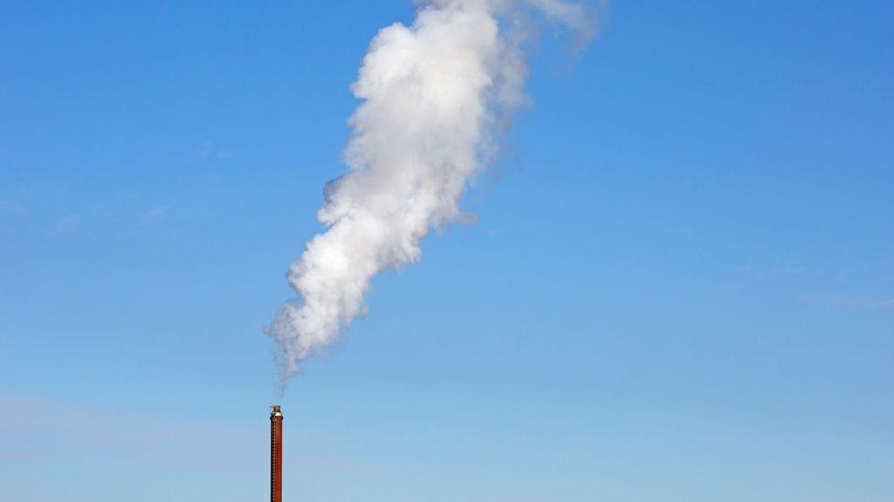
Air is rendered impure by
(1) Respiration of men and animals (2) Combustion of coal, gas, oil, etc. (3) Decomposition of organic matter and (4) Trade, traffic and manufacturing processes which give off dust, fumes, vapours and gases.

Slide 7
Air is cleaned by certain self-cleansing mechanisms which operate in nature
(1) Wind: Wind dilutes and sweeps away the impurities by its movement. Because of wind movement, impurities did-not accumulate in any one place; (2) Sunlight : The atmospheric temperature and sunlight play their own part by oxidizing impurities, and killing bacteria (3) Rain : It cleanses the atmosphere by removing the suspended and gaseous impurities (4) Plant life : The green plants utilize the carbon dioxide and generate oxygen

Slide 8
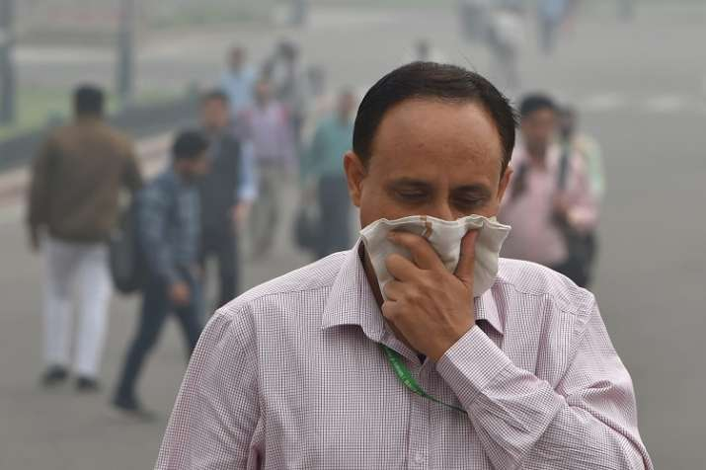
DISCOMFORT
Discomfort is a subjective sensation which people experience in ill-ventilated and crowded rooms. For a long time it was believed to be due to increased carbon dioxide and decreased oxygen, resulting from respiration.

Slide 9
Air Pollution Air said to be polluted when physical and biological agents are present in it to such an extent that they become harmful to man. Pollution of external atmosphere by chemical agents and smoke is a growing menace in large industrial towns. More than 100 pollutants arising from different sources are added into the air every day.
Basic definition Air pollutants may be either emitted into the atmosphere or formed within the atmosphere itself.

Slide 10
Primary air pollutants Primary air pollutants are those that are emitted into the atmosphere from a source such as a factory chimney or exhaust pipe, or through suspension of contaminated dusts by the wind.
Secondary air pollutants Secondary air pollutants are those formed within the atmosphere itself. They arise from chemical reactions of primary pollutants, possibly involving the natural components of the atmosphere, especially oxygen and water..
Notes:
ifferent types of secondary pollutants include:
example of secondary air pollutants Ozone (O₃)Sulfuric acid and nitric acid (component of acid rain)

Slide 11
Gaseous air pollutants Gaseous air pollutants are those present as gases or vapours, Gaseous air pollutants are readily taken into the human respiratory system, although if water-soluble, they may very quickly be deposited in the upper respiratory tract and not penetrate to the deep lung.
Particulate air pollutants Particulate air pollutants comprise material in solid or liquid phase suspended in the atmosphere. Such particles can be either primary or secondary and cover a wide range of sizes.
Notes:
Carbon Monoxide. ...
3 Ozone and Gaseous Photochemical Oxidants. ...
4 Nitrogen Oxides. ...
5 Volatile and Semi-volatile Organic Compounds. ...
6 Ammonia.
2)Particulates, or particulate matter (PM), refer to any mixture of solid particles or liquid droplets that remain suspended in the atmosphere for appreciable time periods. Examples of particulates are dust and salt particles, and water and sulphuric acid droplets.

Slide 12
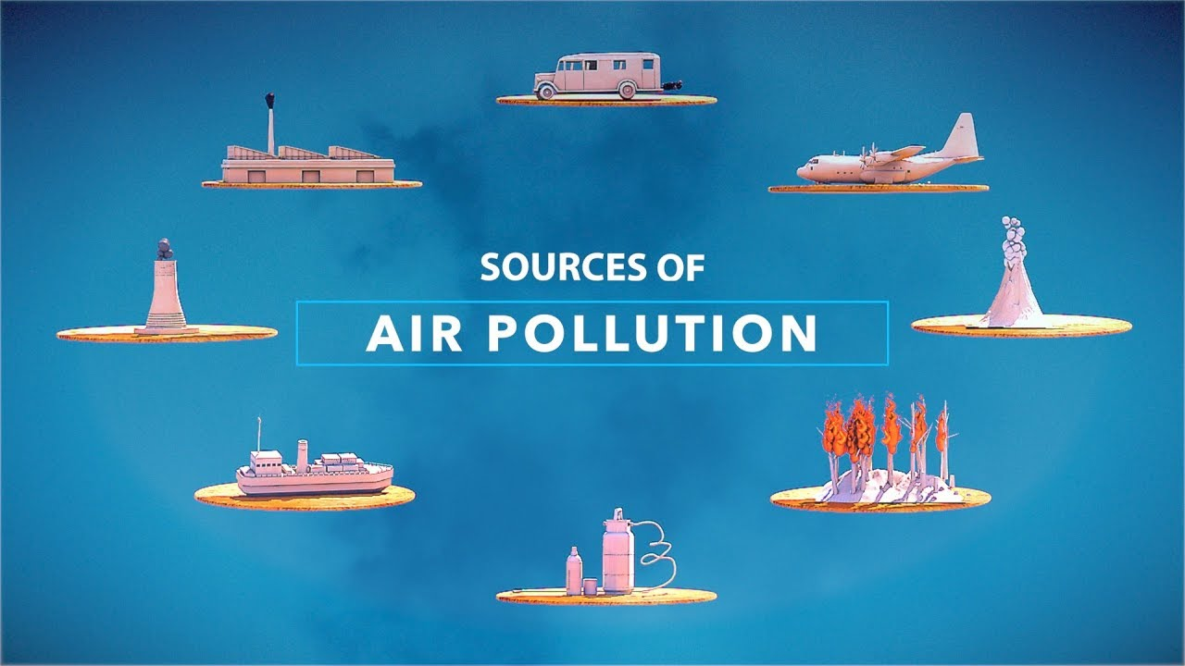

Slide 13
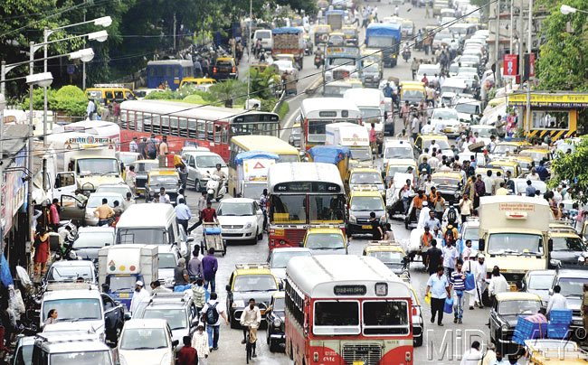
AUTOMOBILES

Slide 14
1.AUTOMOBILES
Motor vehicles are a major source of air pollution throughout the urban areas. They emit hydrocarbons, carbon monoxide, lead, nitrogen oxides and particulate matter. In strong sunlight, certain of these hydrocarbons and oxides of nitrogen may be converted in the atmosphere into "photochemical" pollutants of oxidizing nature. In addition, diesel engines, when misused or badly adjusted are capable of emitting black smoke and malodorous fumes.
Notes:
The photochemical oxidants are secondary air pollutants formed by the action of sunlight on nitrogen oxides and reactive hydrocarbons, 2) Black exhaust smoke can appear when the vehicle is burning too much fuel.

Slide 15
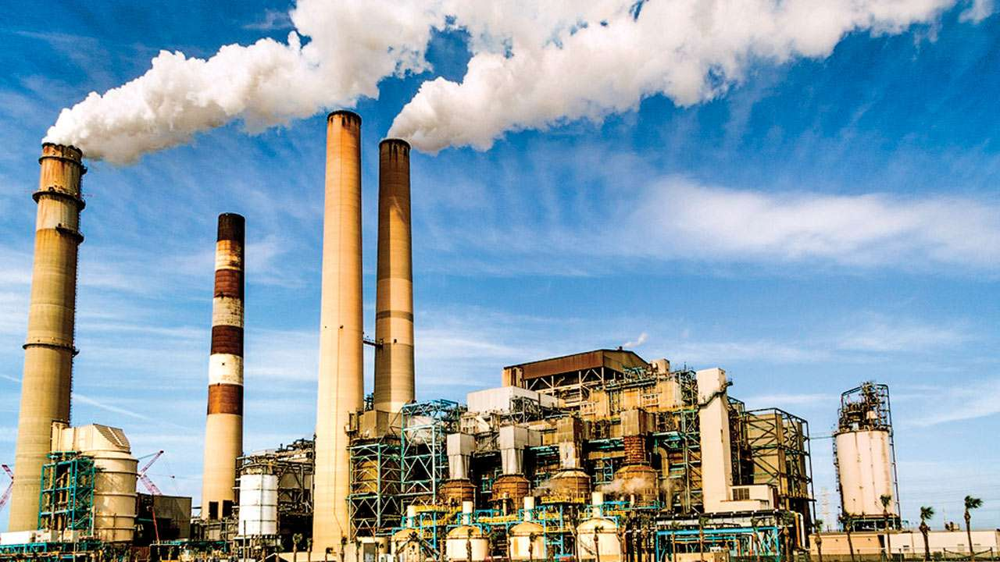
INDUSTRIES

Slide 16
Industries emit large amounts of pollutants into the atmosphere. Combustion of fuel to generate heat and power produces smoke, sulphur dioxide, nitrogen oxides and fly ash. Petrochemical industries generate hydrogen fluoride, hydrochloric acid and organic halides. Many industries discharge carbon monoxide, carbon dioxide, ozone, hydrogen sulphide and sulphur dioxide. Industries discharge their wastes from high chimneys at high temperature and high speed.
2.INDUSTRIES

Slide 17
3.DOMESTIC SOURCES
Domestic combustion of coal, wood· or oil is a major source of smoke, dust, sulphur dioxide and nitrogen oxides.
4.SMOKE
The most direct and important source of air pollution affecting the health of many people is tobacco smoke.

Slide 18
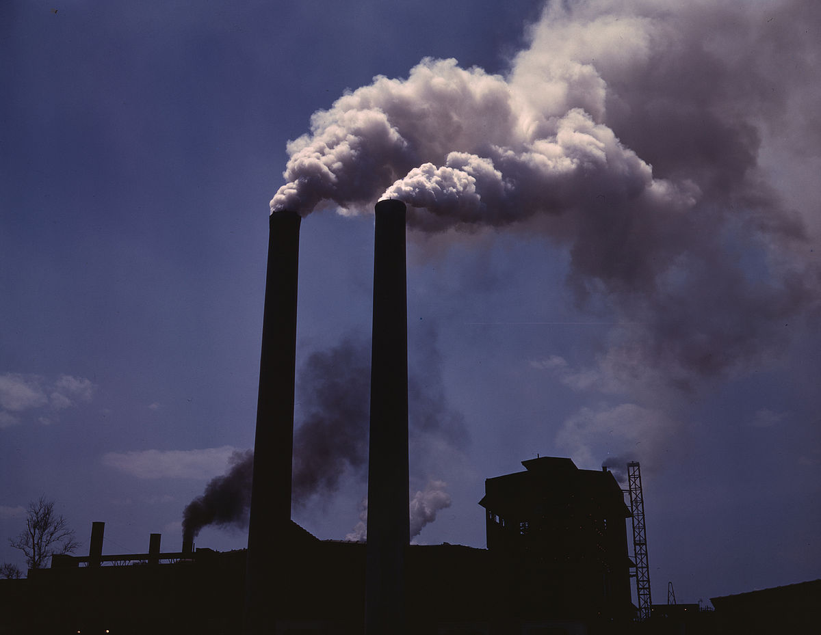
PREVENTION AND CONTROL
OF AIR POLLUTION

Slide 19
1.Containment That is, prevention of escape of toxic substances into the ambient air. Containment can be achieved by a variety of engineering methods such as enclosure, ventilation and air cleaning. A major contribution in this field is the development of "arresters" for the removal of contaminants.
2.Replacement That is, replacing a technological process causing air pollution, by a new process that does not. Increased use of electricity, solar power generation, natural gas, and central heating in place of coal have greatly helped in smoke reduction.
Notes:
Ambient air is typically 78% nitrogen and 21% oxygen.

Slide 20
3. Dilution Dilution is valid so long as it is within the self -cleaning capacity of the environment. For example, some air pollutants are readily removed by vegetation. The establishment of "green belts" between industrial and residential areas is an attempt at dilution.
Notes:
A green belt is a policy and land-use zone designation used in land-use planning to retain areas of largely undeveloped, wild, or agricultural land surrounding or neighboring urban areas. 2) The Clean Air Act of 1970 set out for the United States a basic, yet ambitious, objective to reduce pollution to levels that protect health and welfare.

Slide 21
4.Legislation
Air pollution is controlled in many countries by suitable legislation, e.g., Clean Air Acts. Legislation covers such matters as height of chimneys, powers to local authorities to carry out investigations, research and education concerning air pollution, creation of smokeless zones and enforcement of standard for ambient air quality. To decrease the nuisance of air pollution, the Government of India have enacted "The Air (Prevention and Control of Pollution) Act" in 1981

Slide 22
International action To deal with air pollution on a world-wide scale, the WHO has established an international network of laboratories for the monitoring and study of air pollution. The network consists of two international centres at London and Washington, three centres at Moscow, Nagpur and Tokyo and 20 laboratories in various parts of the world . These centres will issue warnings of air pollution where and when necessary.

Slide 23
ASSIGNMENT
Write a note on role of community health nurse in prevention and management of air pollution

Slide 24
Reference
K.PARK, (2008)“Essential Of Community Health Nursing”, Banarsidas Bhanot Publishers, 26th edition.
NEELAM KUMARI,(2011)“A textbook of community health nursing –II”First Edition, S vikas & Company Medical publisher.

