Slide 1

Food Love
Muralidhar Reddy Seelam
MadhuBabu
Sai Chandra Reddy
Naveen

Slide 2
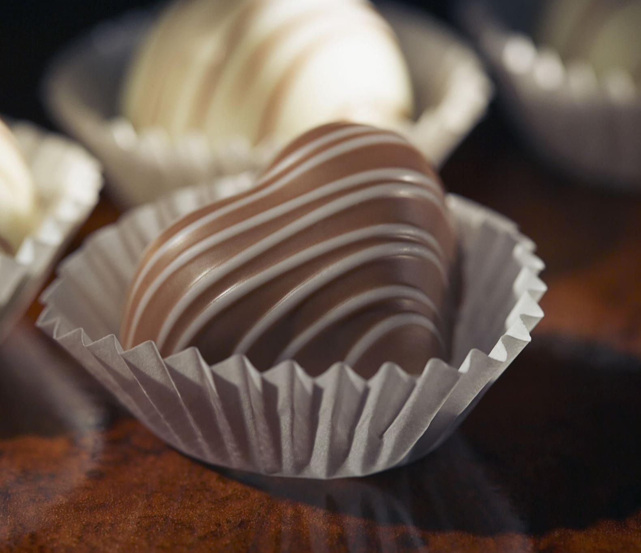
Introduction
Food Love is an online food service web application which helps customers to order food in online with internet.
This website allows customers to select the food they like and chef’s special by browsing in online without visiting the restaurant physically.

Slide 3
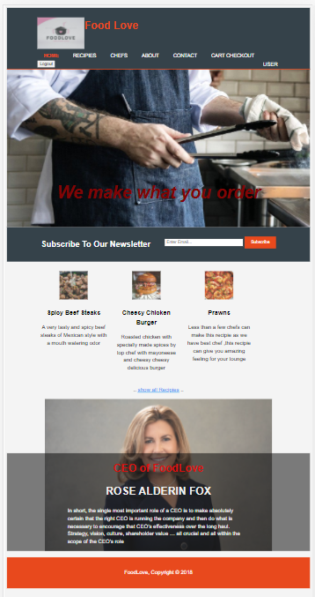
Food Love Website
The website has following navigation:
Home page
Recipe's page
Chef’s
About
Contact
Cart Checkout
Users
Sign up

Slide 4

Languages Used
HTML
CSS
Java Script
Selenium

Slide 5

Software Technologies and interfaces Used
Visual Studio Editor
Fire Base
GitHub

Slide 6
Test Scenario’s Covered
Login
Sign up
Logout
Newsletter subscription
Navigation
Cart Checkout

Slide 7
Login Credentials
Email Id: marali@gmail.com
Password: 123456

Slide 8
Advantages
Customers can easily order food in online by saving time and effort.
Website is User-friendly
Easy Payment option

Slide 9

Thank You

