Slide 1

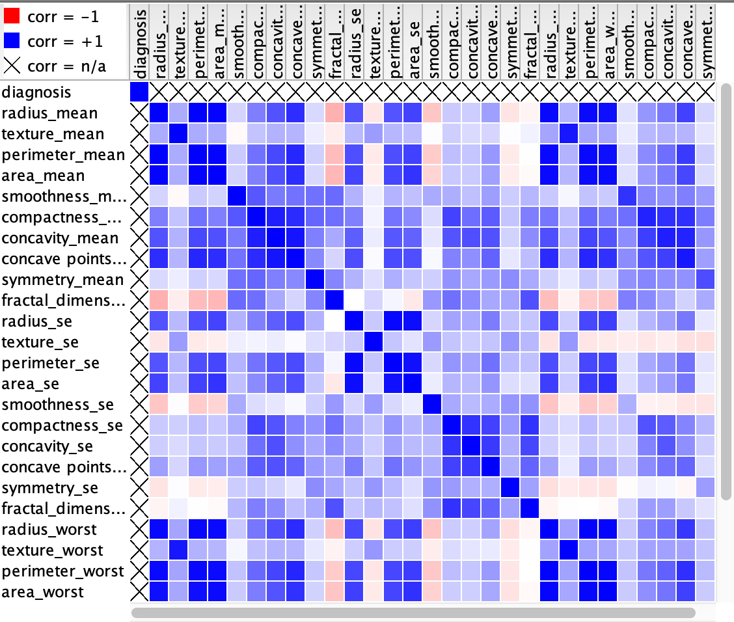
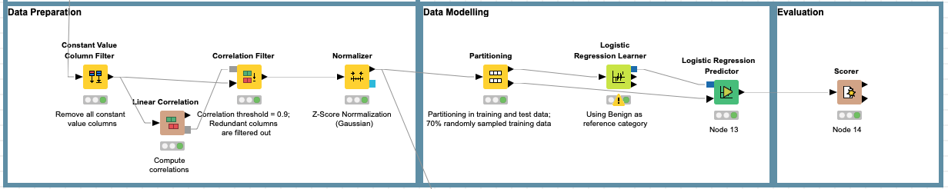
Group 7: Breast Cancer
Gesa Götte, Himanshi Bajaj, Robert Friedrich Ritter, Madhu
Challenge
Dataset
Predict whether a patients cancer is
Benign or Malignant
Wisconsin Diagnostic Breast Cancer (WDBC):
In total 569 instances in the dataset
32 attributes having Id, Diagnosis and 10 real-valued features.
For the cell nucleus, each of the 10 real-valued feature (e.g. texture, smoothness, ..) was used to generate its mean, standard derivation and worst case value (→ 30 real-valued features in total)
Data Understanding & Preparation
There were no null or missing values in the data
One variable that was constant for all instances was excluded
Many attributes were correlated, Linear correlation is used to find out the highly correlated features as shown in figure 2
Correlation filter is used to filter out highly correlated /redundant features (with a cut-off of r ≥ 0.9)
All 30 real-valued features were then z-score normalized
Figure 1: Frequency of the real diagnosis
Figure 2: Correlation Matrix of the 30 features
Data Modelling
Logistic Regression Model
used with all 30 pre-processed features as input for prediction
using benign as reference category
model was learned on 70% randomly sampled training data
performance validated on the remaining 30% validation set.
Logistic Regression Predictor
Our classification model
Logistic Regression Learner
Result & Conclusion
The Logistic Regression Model has scored 96.5% accuracy
Error rate is 4.196% with 6 wrongly classified
Sensitivity is 91.8% and Precision is 98.2%
In other words:
The trained Logistic Regression Model was able to predict 96% of the diagnosis right
91.8% of the malignant diagnosis were detected, i.e. in practice 8.9% of true malignant cancers would wrongly be classified as benign
If malignant cancer was diagnosed, it is truly malignant with a certainty of 98.2%
 | True: M | True: B
Predicted: M | 56 | 5
Predicted: B | 1 | 109
Figure 3: Confusion Matrix of the predictions for malignant and benign cancer on the validation data
Knime-Workflow

