Slide 1
RISING WATERS
Flood Prediction System
Machine-learning-powered flood risk assessment
TEAM MEMBERS
Ijji Madhu Venkat | Team Lead
23PA1A0586@vishnu.edu.in
Bathula Sushma Reddy | Member
23PA1A0525@vishnu.edu.in
Nadikota Varshith Raj | Member
23PA1A05G5@vishnu.edu.in
Kavuri Veera Venkata Jagadeesh | Member
24PA5A0513@vishnu.edu.in
Chandrakala Kombathula | Member
kombathulachandrakala05@gmail.com
Project Presentation

Slide 2
1. Problem Statement and Objectives
Problem
Proposed Objective
Floods can cause loss of life, property damage, and disruption. Manual weather analysis can be slow and difficult to access.
Build an easy-to-use web application that predicts flood risk from weather observations and supports early decision-making.
Key objectives
• Accept temperature, humidity, cloud cover, and rainfall values.
• Classify the result as Flood or No Flood.
• Display a clear probability percentage.
• Store predictions for history and review.
2/6

Slide 3
2. Proposed Solution and Workflow
1
→
2
→
3
→
4
→
5
User Login
Weather Input
ML Prediction
Result
History
User registers or logs in.
Enter five meteorological values.
Model processes the input.
Flood label and probability are shown.
Prediction is stored for review.
Architecture
Browser UI → Flask backend → preprocessing and scaler → trained ML model → database and result page
3/6

Slide 4
3. Technology Stack and Machine Learning
Frontend
Backend
Data and ML
HTML5, CSS3, Jinja templates, responsive pages
Python, Flask, Flask-SQLAlchemy, Werkzeug
Pandas, NumPy, scikit-learn, XGBoost, serialized model artifact
Model comparison
Algorithm | Approx. accuracy
Decision Tree | 85%
Random Forest | 91%
KNN | 88%
XGBoost | 96.55%
Selected model
XGBoost was selected based on the documented evaluation accuracy of 96.55%.
4/6

Slide 5
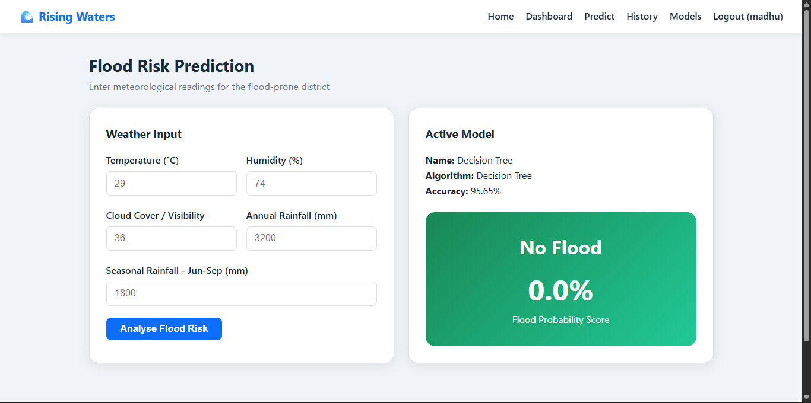
4. Application Features and Output
Application features
• Secure login and registration
• Weather input form
• Active model information
• Flood probability result
• Prediction history
• Dashboard monitoring
Sample output
The supplied screen displays a No Flood result with a 0.0% flood probability for the entered test values.
5/6

Slide 6
5. Results, Future Scope and Links
Results
Future scope
Project links
• Prediction workflow implemented in Flask
• Model comparison completed
• Database history supported
• Responsive interface available
• Cloud deployment completed
• Live weather API integration
• Location-based risk maps
• Email or mobile alerts
• Regional model retraining
• Production monitoring and audit logs
GitHub:
github.com/madhu967/Rising-Waters
Live demo:
rising-waters-flood-prediction-52lc.onrender.com
Thank you
Rising Waters - Flood Prediction System
6/6

