Slide 1
Digital Clock
Micro It Project
Name:M.Madhavi

Slide 2
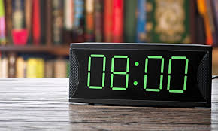

Slide 3
Introduction to Digital Clocks
Displays time using numerical digits.
Commonly shows hours, minutes, and seconds.
Can operate in 12-hour or 24-hour formats.
It is electronic device.

Slide 4
Working Principle
Uses quartz oscillator for time accuracy.
Electronic circuits count pulses from the oscillator.
Microcontroller converts counts into readable time.

Slide 5
Features of Digital Clocks
Backlighting for visibility in the dark.
Alarm and snooze functionality.
Date and temperature display in advanced models.

Slide 6
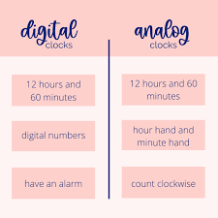
Types of Clocks

Slide 7
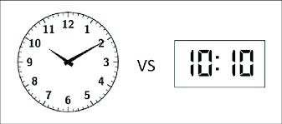

Slide 8
Advantages of Digital Clocks
Easy to read and understand.
High accuracy with minimal maintenance.
Multifunctional and customizable
Often lower maintenance.
Versality.
Cost effective.

Slide 9
Applications of Digital Clocks
Homes and offices.
Public transportation systems.
Embedded in electronic devices like smartphones.

Slide 10
Conclusion
Digital clocks offer precise and accessible timekeeping.
Widely adopted across various sectors.
Essential part of modern life.

Slide 11


