Slide 1
Fruit Freshness Detection
“Classification of Tomato Fruit Using Yolo-V5 and Convolutional Neural Network Models” by Quoc-Hung Phan, Van-Tung Nguyen, Chi-Hsiang Lien, The-Phong Duong, Max Ti-Kuang Hou and Ngoc-Bich Le.
Published Date: February, 9th 2023
Presenting by: Madhubala Mantena (01202076)
Bhuvanesh Marineni (01239560)
L. V. Sai Charan Kothapalli (01217416)

Slide 2
Contents:
Motivation
Problem Statement
Research Work
Literature Survey
DataSet
Methodology & Flow
Reasons for choosing the algorithms
Challenges
Future Scope
Conclusion
References

Slide 3
Motivation:
Detecting fruit freshness is an essential responsibility in the food sector, as it ensures that customers obtain high-quality and safe goods.
The need for an effective solution to fruit rotting is urgent, as it affects both farmers and consumers, leading to some problems.
Traditional methods of fruit quality evaluation, such as manual inspection, are time-consuming, subjective, and prone to errors.
Therefore, there is a need for a more objective and automated method of fruit quality assessment.
Notes:
Additionally, the ability to detect the freshness of fruits can help improve supply chain management

Slide 4
Problem Statement:
The problem statement is to accurately classify the ripeness of fruits and classify fresh or spoiled based on their visual features.
The system aims to overcome the limitations of traditional methods of fruit quality evaluation and provide an objective and automated method for fruit quality assessment.
Notes:
The problem statement of fruit freshness detection is to develop a reliable and accurate automated system that can assess the freshness and quality of fruits. The system must be able to differentiate between fresh and stale fruits based on their physical appearance, such as color, texture, and shape, and provide a quantitative measure of their freshness.

Slide 5
Research Work:
Older research used limited feature extraction techniques that may not capture all relevant information about fruit quality parameters.
Limited camera resolution in older research works may have affected the accuracy of image processing algorithms for fruit quality evaluation.
Older research works lacked a rigorous validation process, which could have compromised the reliability and generalizability of the proposed methods.

Slide 6
Literature Survey:
“DeepFruits: A Fruit Detection System Using Deep Neural Networks” by Inkyu Sa, Zongyuan Ge, Feras Dayoub, Ben Upcroft, Tristan Perez, and Chris McCool.
“FRUIT FRESHNESS DETECTION USING CNN APPROACH” by Aniket Harsh , Kishan Kumar Jha , Shashwat Srivastava , Abhinav Raj , Raghav S.
"Improved Classification Approach for Fruits and Vegetables Freshness Based on Deep Learning”by Mukhriddin Mukhiddinov and Azamjon Muminov and Jinsoo Cho in 2022.
“Classification of Tomato Fruit Using Yolov5 and Convolutional Neural Network Models” by Quoc-Hung Phan, Van-Tung Nguyen, Chi-Hsiang Lien, The-Phong Duong, Max Ti-Kuang Hou and Ngoc-Bich Le.
Notes:
where they use Region -based CNN for the fruit detection in the fields. used a technique to increase the accuracy and perfection of the fruit freshness detection
here they used YOLOv4 model for detection of fruit freshness
uses the YOLOV5 model for detection of fruit freshness and we chose to opt this method for our project.
In the above all research papers they detected the freshness of the tomato

Slide 7
DATASET:
We have considered three types of images for the model. Oranges, Apples and Bananas.
Our data set has 10,908 images for training the model where 13,614 images for testing the model out of which there are images of rotten fruits as well as fresh fruits.
This dataset can be used to train and test machine learning models for fruit classification.
The inclusion of both fresh and rotten fruit images allows for a more comprehensive evaluation of the model's performance.
This dataset provides a valuable resource for researchers and practitioners interested in developing and evaluating fruit classification models, with potential applications in areas such as food quality control and automated sorting systems.
Dataset link: https://www.kaggle.com/datasets/sriramr/fruits-fresh-and-rotten-for-classification

Slide 8
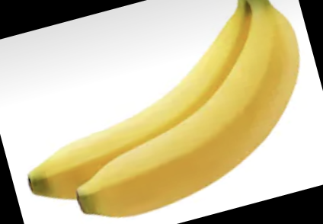
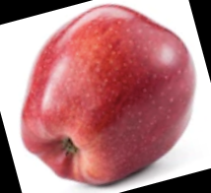
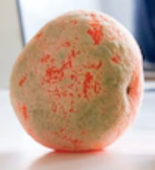
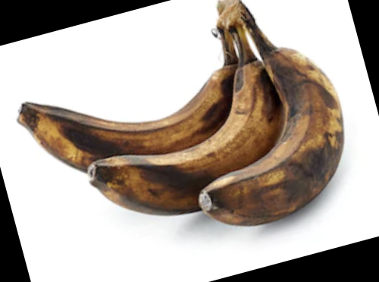
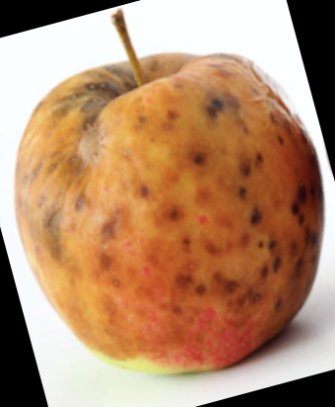
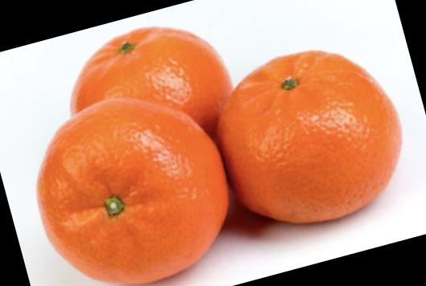
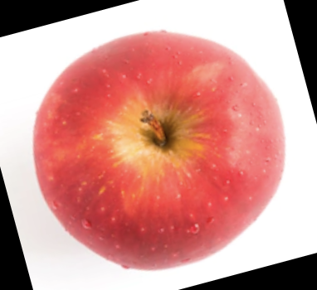
Dataset

Slide 9
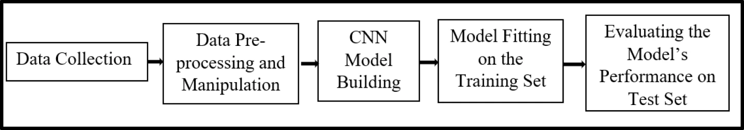
Methodology:

Slide 10
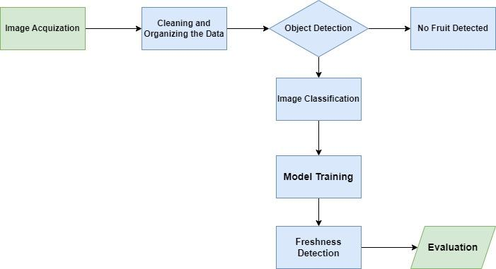
In detail flow chart:

Slide 11
Image Acquisition:
To perform freshness detection on fruits, we obtain images of the fruits and upload them to the model we have trained for this purpose.
The model is designed to analyze the images and calculate the degree of freshness of the fruits based on certain features.
Image Cleaning:
We can use some sort of Image filter like Gaussian filter or Median filter for reducing the noise of the images and smoothing the images.

Slide 12
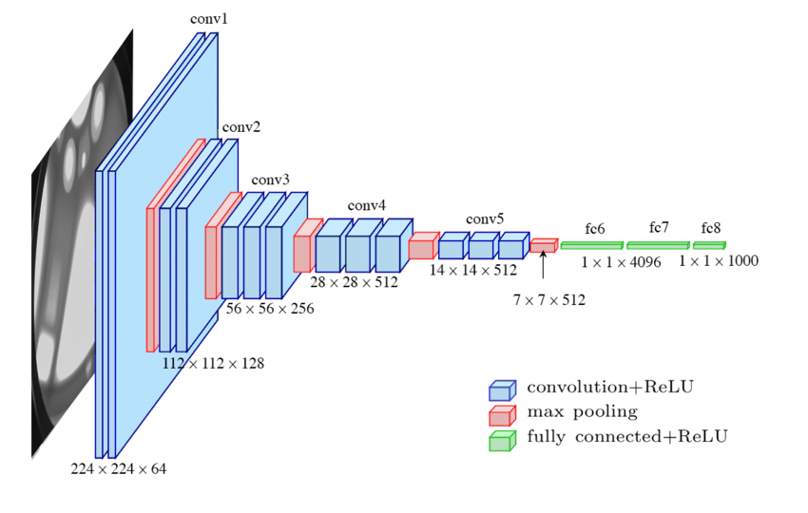
Image Classification:
We have decided to use the VGG16 model for the purpose of image classification. The architecture of this model is presented below.

Slide 13
The VGG16 model takes as input an RGB image with dimensions of 224 x 224 x3. After the input layer, the model comprises of the following operational blocks:
Convolution layer followed by Rectified Linear Unit (ReLu) activation
Max pooling layer
Fully connected layer followed by ReLu activation
This sequence of operations is repeated multiple times in the VGG16 architecture, with each iteration consisting of one or more convolutional layers followed by a pooling layer and a fully connected layer. The final output layer of the model is typically a softmax layer that outputs class probabilities for the input image.

Slide 14
Why VGG16?
Although there are more advanced CNN architectures like ResNet50, InceptionV3 etc. We chose to use the VGG16.
ResNet50 is a more advanced CNN architecture than VGG16, with deeper layers and skip connections to help address the problem of vanishing gradients. However, ResNet50 may be overkill for simpler image classification tasks, and may require more training data and computational power to fine-tune.
And the same goes with the VGG19 which has 19 layers and is advanced than VGG16 and even the performance is higher, it might be overfit to the smaller datasets. As we have the limited data for training purpose we chose VGG16.
Apart from those the main reasons that forced me choose the VGG16 is:
Simplicity
Speed
Model size

Slide 15
Model Training:
The model is trained using various libraries available in python.
The most important among them are :
TensorFlow
Keras
OpenCV (cv2)
Scikit-learn(sklearn)
numpy

Slide 16
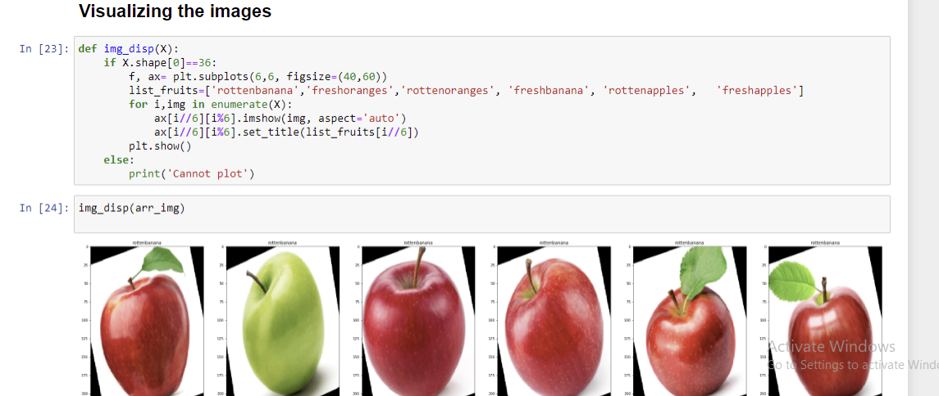
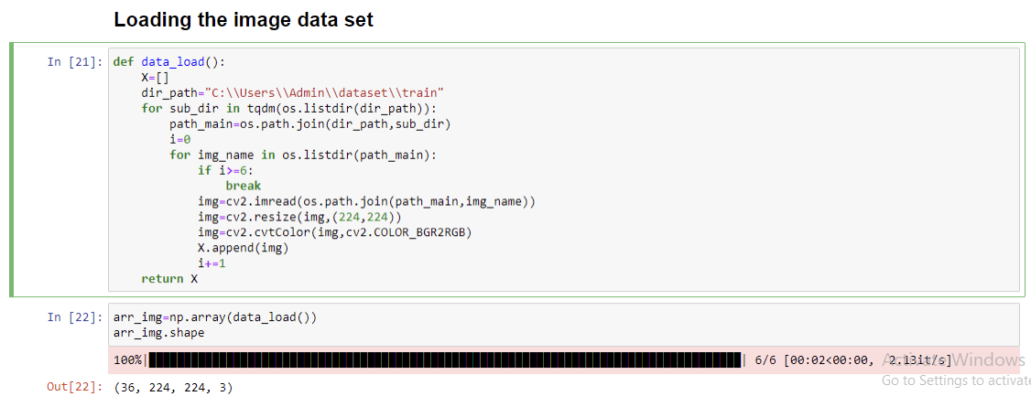

Slide 17
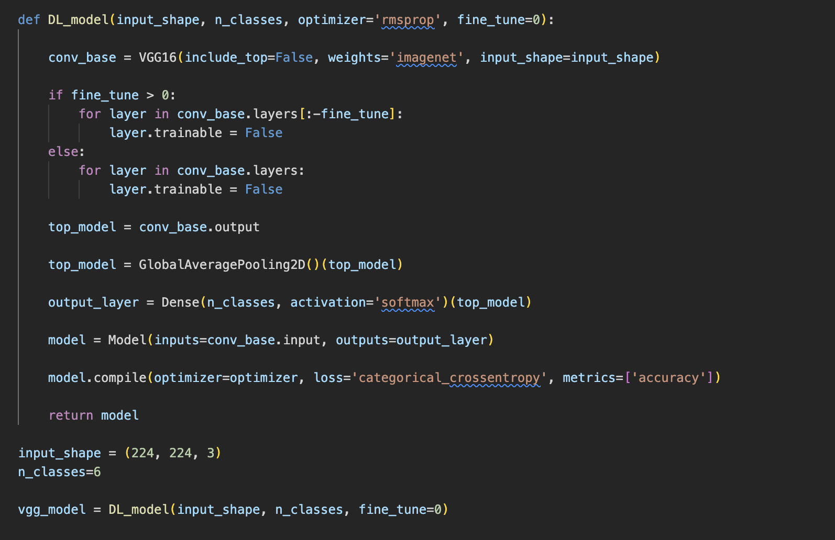
Training the model:

Slide 18
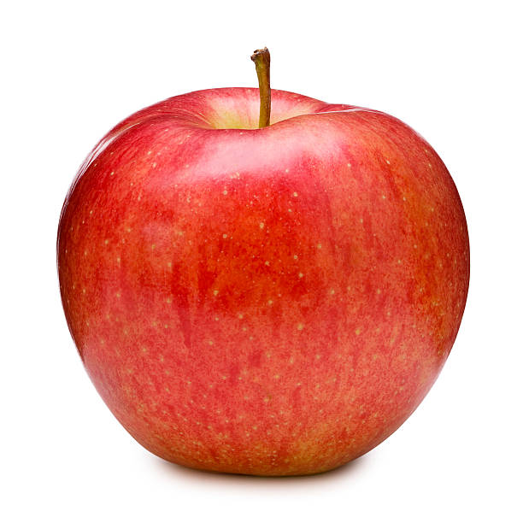
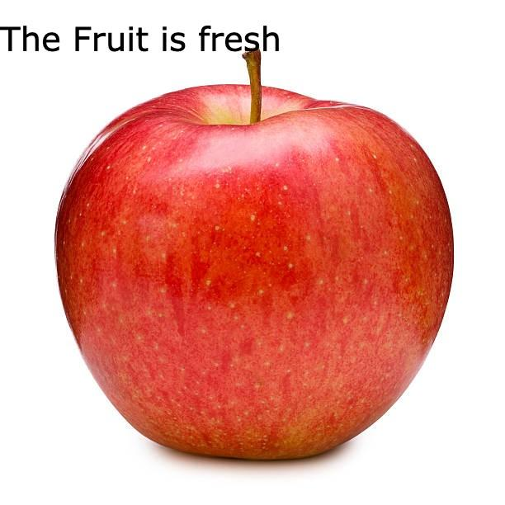
Detection & Evaluation:
The sample results of the output is shown below.
For Fresh Fruit:
Input: Output: Output:

Slide 19
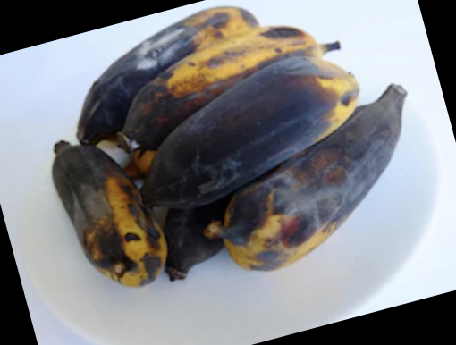
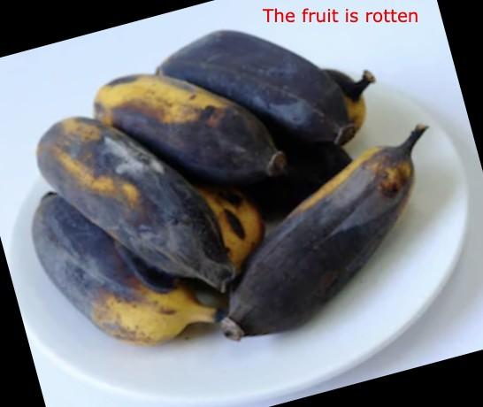
For Rotten Fruit:
Input: Output:

Slide 20
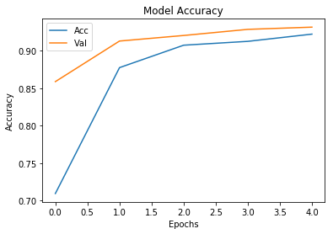
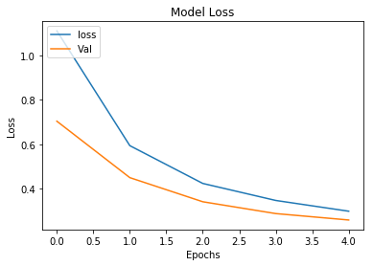
Visualizing the performance of the model

Slide 21
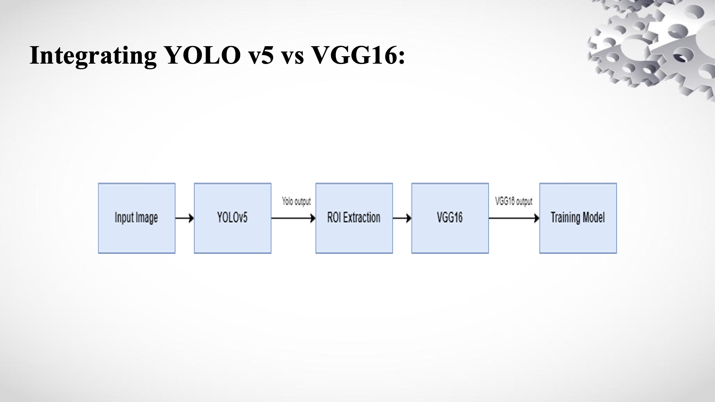

Slide 22
Challenges:
Color and Lighting Variations.
Texture variations.
Limited dataset.

Slide 23
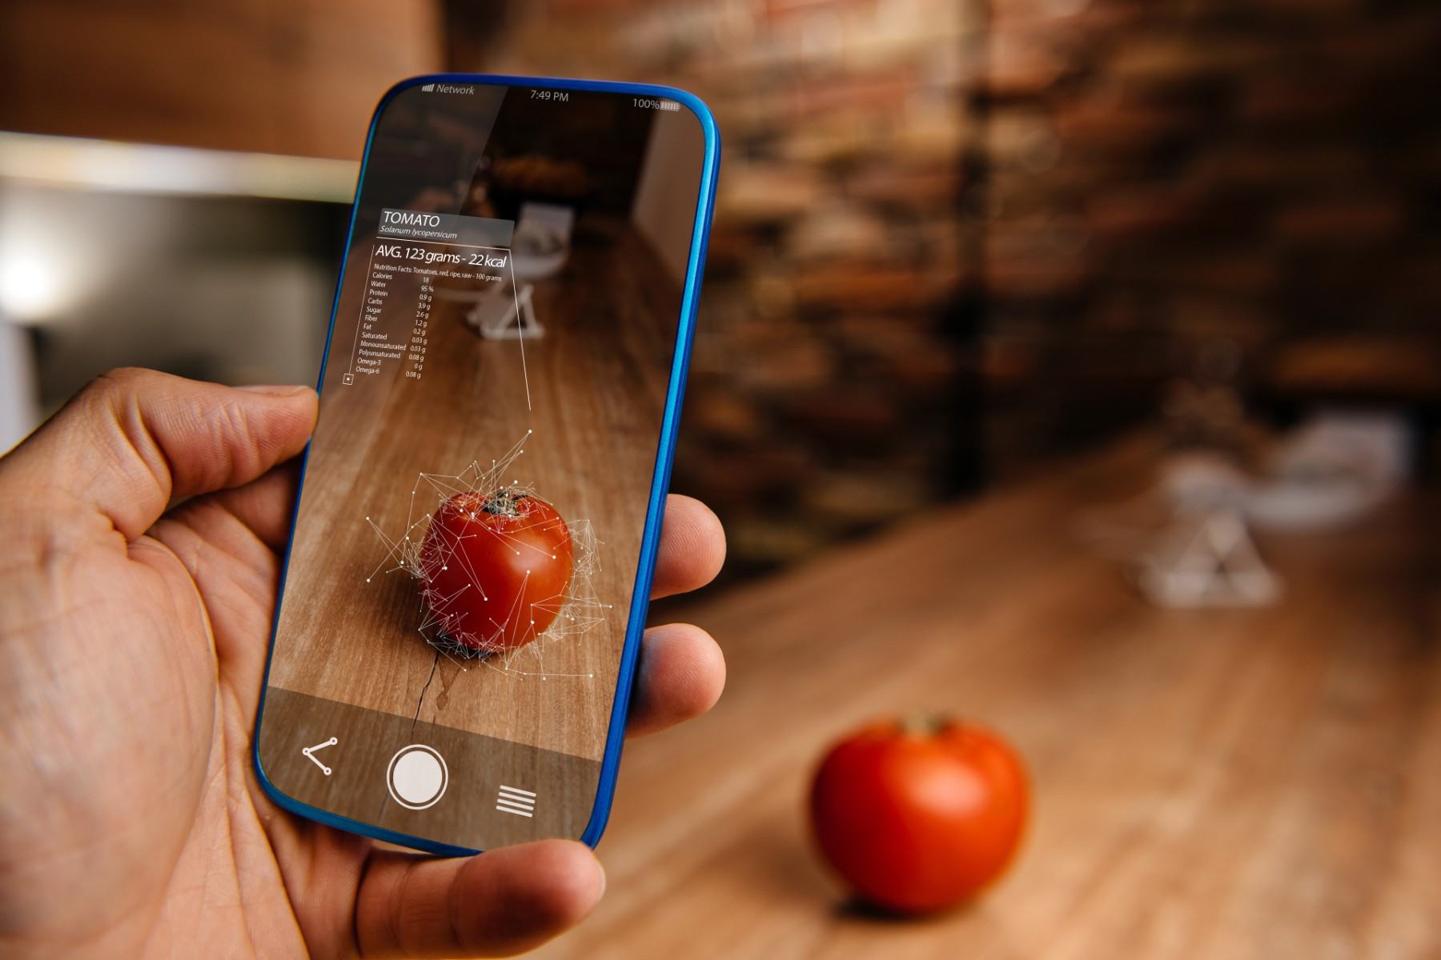
Future Scope & Analysis:
Our project is intended to be launched as a mobile application, designed to allow users to scan fruits using their smartphones to determine their freshness levels.
This feature enables users to conveniently check if the fruit is good, spoiled, or at risk of spoiling, and make informed purchasing decisions.

Slide 24
Conclusion:
In conclusion, a fruit freshness detection system capable of reliably classifying fruits depending on their freshness condition has been constructed using OpenCV and Python. Using OpenCV image processing tools, the important characteristics from the dataset have been extracted, and machine learning models have been trained to categorize fruits depending on their freshness condition. The hyperparameters of the model have been fine-tuned to maximize its performance and improve its fruit freshness detection accuracy.

Slide 25
References:
https://www.mdpi.com/2223-7747/12/4/790/pdf
https://www.mdpi.com/1424-8220/22/21/8192
https://www.irjmets.com/uploadedfiles/paper/volume2/issue_6_june_2020/1554/1628083042.pdf
https://www.ncbi.nlm.nih.gov/pmc/articles/PMC5017387/
https://www.irjet.net/archives/V7/i5/IRJET-V7I51254.pdf
https://www.researchgate.net/publication/368377088
https://www.kaggle.com/datasets/sriramr/fruits-fresh-and-rotten-for-classification

Slide 26
Thank You!

