Slide 1
KNN
K- nearest neighbours

Slide 2
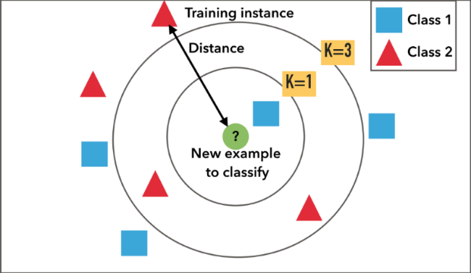

Slide 3
STEPS TO DO IN KNN
The k-nearest neighbor algorithm is imported from the scikit-learn package.
Load data and clean it.
Create feature and target variables.
Split data into training and test data.
Generate a k-NN model using neighbors value k.
Measure distance and sort it in ascending order.
Train or fit the data into the model.
Predict the future.

Slide 4
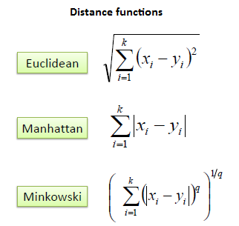

Slide 5
Traditionally, KNN uses euclidean distances to calculate distance between two instances,but we could use other formulae too.
The algorithms can be visualized using color maps.
KNN python code would explain how to do this ML algorithm easily and effectively.

Slide 6
THANK YOU!

