Slide 1


Early Cancer Detection using Predictive Analytics
Group 11
Astha Jain
Divya L
Madhu Bandru
Ryner Menezes
Sudharshan Rao B

Slide 2
Agenda
Objective
Project Life cycle
Predictive modelling METHODOLOGY
Why NON-LINEAR MODELS?
Model parameters and TRAINING
Performance Evaluation AND COMPARISON
Improving MODEL PERFORMANCE
Challenges and Limitations

Slide 3

Objective
Apply data modeling techniques to clinical data obtained using a novel blood test called CancerSEEK with relevant features to help identify cancer in early stages.

Slide 4
Project Life Cycle Summary
Business Problem
To identify the cancer in early stages, we apply data modeling techniques to clinical data obtained using a novel blood test called CancerSEEK with relevant features.
Data Acquisition
The critical tables for our analysis are
Data Preprocessing
Removal of strings from numerical values in the table containing protein biomarkers
EDA
Modelling and Tuning
Model evaluation metrics
Mutations identified in plasma
Mutations identified in primary tumor
Protein Biomarkers Measured
Data transformation to maintain a uniform unit of measurement
Extract insights to compare concentration of protein biomarkers
Draw comparisons and identify key protein biomarkers and their concentration
Extract key features from the above analysis
Prediction models to be considered are binary classification and multi-classification
Specificity
Machine Learning Algorithm - Random Forest
Deep Learning Algorithm – feed forward neural network.
Accuracy
Sensitivity
Recall
Precision
AUC
CAPSTONE STAGE I
CAPSTONE STAGE II

Slide 5

PREDICTIVE MODELLING
Step I: Predicting if a person is cancer positive or negative (binary classification)
It can be used to detect if the cancer is present given the concentration of the 8 key protein biomarkers. The output for this model is a binary class which can take either ‘positive’ or ‘negative’ values. Positive indicates that cancer is present on the test instance and negative means there is no cancer
Step 2: Localization of cancer (multi-classification)
with 8 classes for localization of cancer, which means the type of cancer is detected, out of eight common cancers - ovary, liver, esophagus, pancreas, stomach, colorectal, lung, and breast cancer. The output will take only a single value from the above 8 classes.

Slide 6
Initial inputs for stage 1
Input Field | Input Field Type
OmegaScore | Continuous
CA-125 (U/ml) | Continuous
CEA (pg/ml) | Continuous
CA19-9 (U/ml) | Continuous
Prolactin (pg/ml) | Continuous
HGF (pg/ml) | Continuous
OPN (pg/ml) | Continuous
Myeloperoxidase (ng/ml) | Continuous
TIMP-1 (pg/ml) | Continuous

Slide 7
INPUTS FOR MODEL stage II
Variable Name | Variable Type
Sex | Nominal
OmegaScore | Continuous
AFP (pg/ml) | Continuous
Angiopoietin-2 (pg/ml) | Continuous
AXL (pg/ml) | Continuous
CA-125 (U/ml) | Continuous
CA 15-3 (U/ml) | Continuous
CA19-9 (U/ml) | Continuous
CD44 (ng/ml) | Continuous
CEA (pg/ml) | Continuous
CYFRA 21-1 (pg/ml) | Continuous
DKK1 (ng/ml) | Continuous
Endoglin (pg/ml) | Continuous
FGF2 (pg/ml) | Continuous
Follistatin (pg/ml) | Continuous
Galectin-3 (ng/ml) | Continuous
G-CSF (pg/ml) | Continuous
GDF15 (ng/ml) | Continuous
HE4 (pg/ml) | Continuous
Variable Name | Variable Type
HGF (pg/ml) | Continuous
IL-6 (pg/ml) | Continuous
IL-8 (pg/ml) | Continuous
Kallikrein-6 (pg/ml) | Continuous
Leptin (pg/ml) | Continuous
Mesothelin (ng/ml) | Continuous
Midkine (pg/ml) | Continuous
Myeloperoxidase (ng/ml) | Continuous
NSE (ng/ml) | Continuous
OPG (ng/ml) | Continuous
OPN (pg/ml) | Continuous
PAR (pg/ml) | Continuous
Prolactin (pg/ml) | Continuous
sEGFR (pg/ml) | Continuous
sFas (pg/ml) | Continuous
SHBG (nM) | Continuous
sHER2/sEGFR2/sErbB2 (pg/ml) | Continuous
sPECAM-1 (pg/ml) | Continuous
TGFa (pg/ml) | Continuous
Thrombospondin-2 (pg/ml) | Continuous

Slide 8
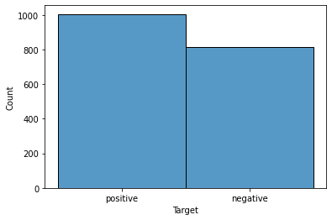
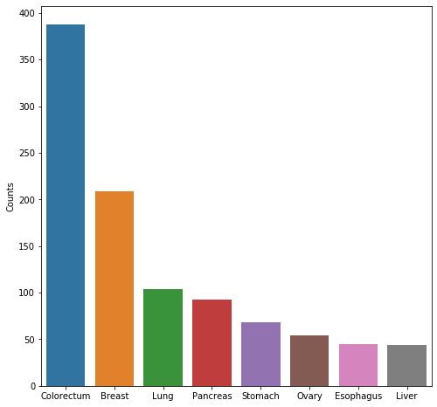
Target Distribution
Distribution of Target Variable for Binary Classification
Distribution of Target Variable for Multi-Class Classification

Slide 9
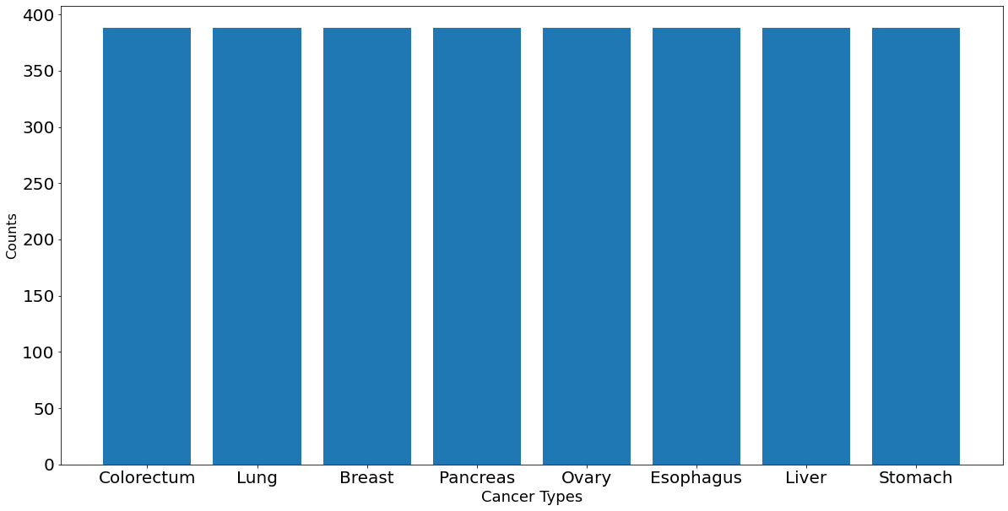
Over Sampling
Skewed samples were oversampled on the threshold of maximum instances available which is of ‘colorectum’ cancer (388 instances, 38.6% of total instances).
For adjusting the class (8 tumor types) distribution over sampling is performed on the original dataset.
RandomOverSampler(random_state=42)

Slide 10
Model Descriptions
To build cancer detection models , we consider it as a supervised learning task from the machine learning perspective. Therefore, we have selected a range of multiclass supervised learning algorithms:
1. Machine Learning Algorithm - Random Forest
2. Deep Learning Algorithm – feed forward neural network
Original shape of dataset: (1817, 54)
After removing Target feature and other features with no or less correlation shape of the dataset : (1817, 41)
For Binary we have considered 9 major features and target feature indicating presence of cancer or not. (shape – 1817 rows, 9 columns)
For Multiclass we have considered 41 features which includes all protein biomarkers (39) along with “Gender” and “omega score”. We have dropped all rows of ‘normal’ or healthy individuals. (1005 rows , 41 columns)
We have used the method ‘Mutual Information’ which calculates the information gain each feature adds in predicting the target variable. Higher the value, more important the feature for the target prediction.
75% Train data, 25% Test data is allocated for both the classifications. We do not use stratified sampling here since for some type of cancers the data points are less in number and hence, we let the sampling be random.

Slide 11
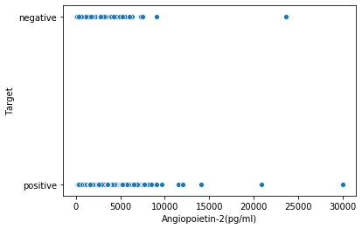
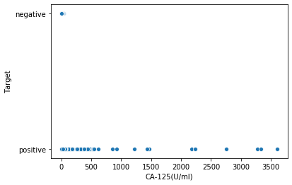
Why Non-linear classification?
With reference to the scatter plot, the data appears to be non-linear
Linear models such as Logistic regression cannot be used for this type of data
Hence, we have chosen a tree-based model – random forest to start out with our analysis. Since random forest generalizes better than decision tree and works well with non-linear data
For deep learning, since the problem here is a very typical supervised learning task with well-crafted input features. Therefore, we have adopted the deep feedforward neural networks for both binary classification and Multiclass classification problem.

Slide 12

BINARY CLASSIFICATION – base line model
Binary Classifier – Deep Learning :
Input layer - 9 input features
One hidden layers :
- Activation function RELU
- kernel_initializer='random_normal'
output layer - sigmoid neuron (Threshold: 0.5)
Parameters
- optimizer ='adam',loss='binary_crossentropy'
Binary Classifier - Random Forest:
Shape of Train data: (1362, 9), (1362,1)
n_estimators = 100 and n_jobs = -1
Output: An array of classes (‘positive’, ‘negative’) for 455 instances.

Slide 13
Binary classification model – evaluation Metrics
 | Sensitivity | Specificity
Deep Learning | 0.8972 | 0.8425
Random forest | 0.9146 | 0.8947

Slide 14
Feature selection
We used SFS to extract the best features with accuracy
List of features extracted
AFP(pg/ml)
DKK1(ng/ml)
G-CSF(pg/ml)
GDF15(ng/ml)
HE4(pg/ml)
Mesothelin(ng/ml)
OPG(ng/ml)
sFas(pg/ml)
TGFa(pg/ml)

Slide 15
Binary classification model – evaluation Metrics
 | Sensitivity | Specificity
Deep Learning | 0.8972 | 0.8425
Random forest (initial features) | 0.9146 | 0.8947
Random forest (SFS features) | 0.9756 | 0.9473

Slide 16
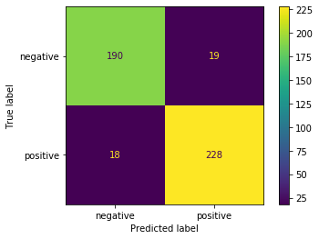
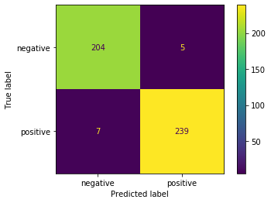
Confusion matrix for binary CLASSIFICATION
Base line features
SFS extracted features

Slide 17
MULTICLASS – base line model
Multi Classifier - Random Forest:
Shape of Train data: (753, 41), (753, 1)
Applied over sampling technique
RandomOverSampler(random_state=42)
n_estimators = 100 and n_jobs = -1
Output: An array of classes (‘ovary’, ‘liver’, ‘esophagus’, ‘pancreas’, ‘stomach’, ‘colorectal’, ‘lung’, and ‘breast’)
Multi Classifier – Deep Learning :
Input layer - 41 features
Three hidden layers:
- Activation function RELU
Output layer - softmax activation function
Parameters
- loss = 'categorical_crossentropy' , optimizer = 'adam'

Slide 18
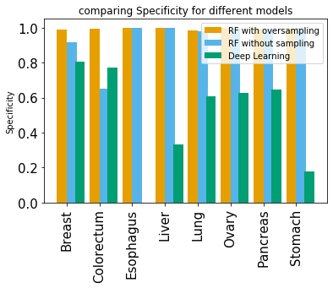
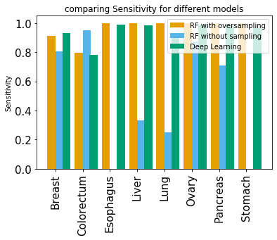
Multi-classification : Evaluation Metrics
We have used sensitivity and specificity as our primary metrics to calculate the efficiency of the model.
For cancer prediction both true positives and true negatives need to be predicted accurately and for the multi classification problem of localizing cancer, it is important to predict the right type of cancer.

Slide 19
Random forest – hyper parameter tuning
GridSeachCV parameters
Grid_params = { 'max_depth': [10, 15, 16, 17, 18, 19, 20,25,30], 'min_samples_split': [2, 3, 4, 5, 6], 'n_estimators': [100, 150, 200, 250, 300] }
Optimal parameter extracted
max_depth=18
min_samples_split=4,
n_estimators=250

Slide 20
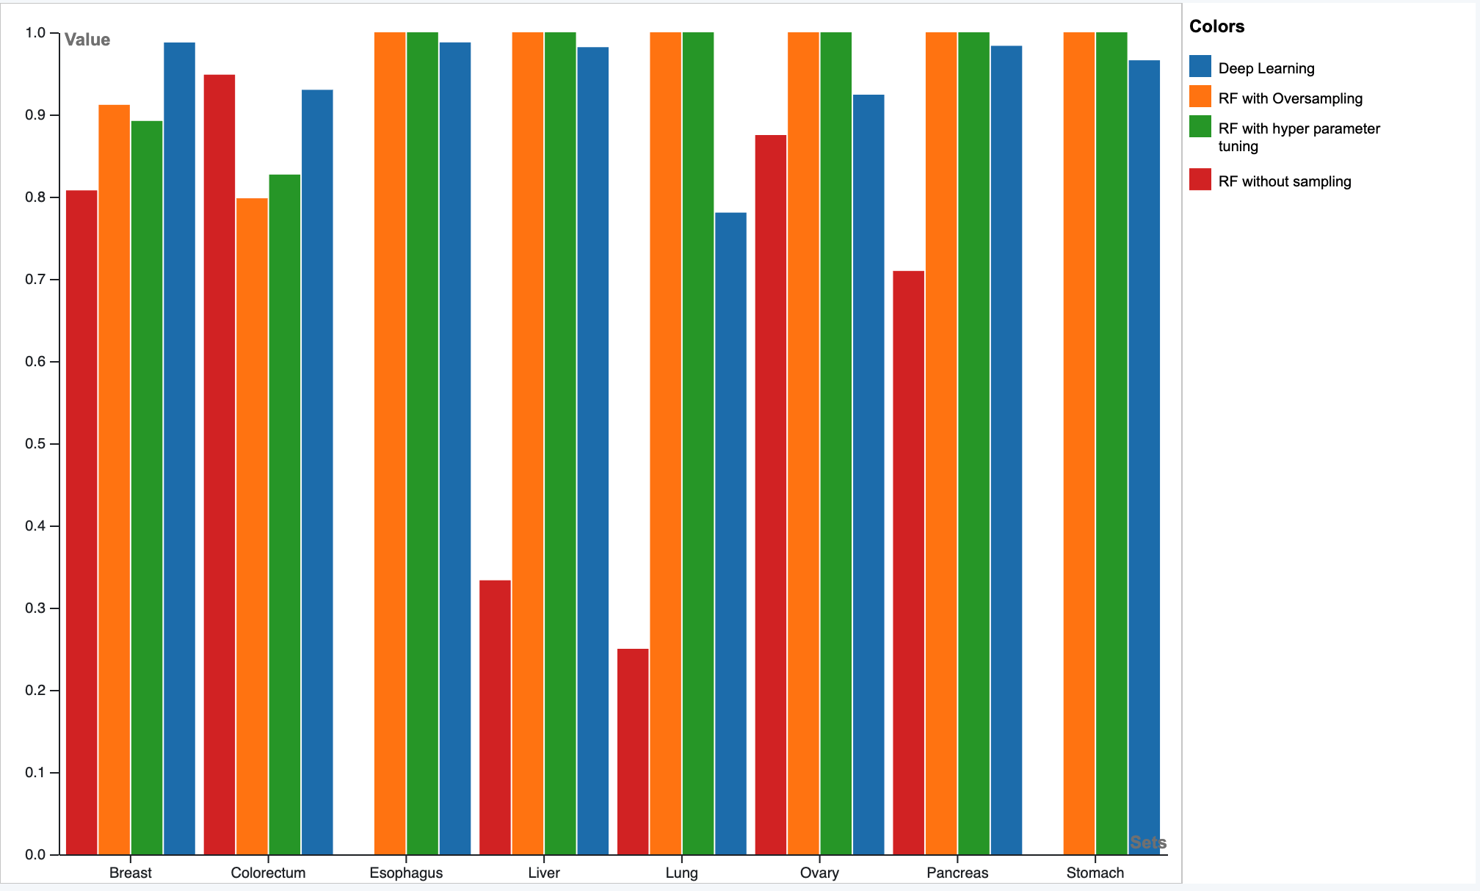
Comparison of model performance
SENSITIVITY

Slide 21
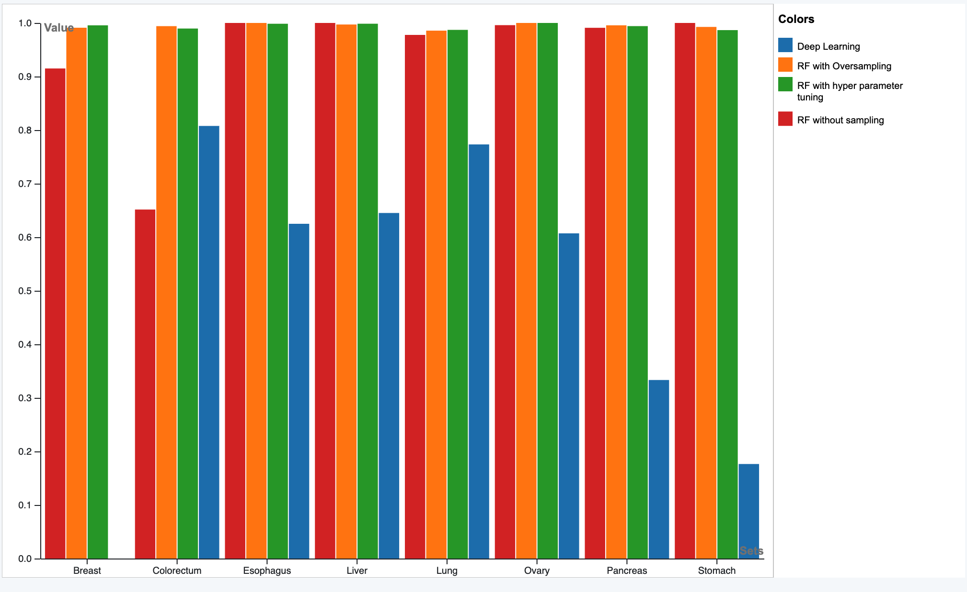
Comparison of model performance
SPECIFICITY

Slide 22
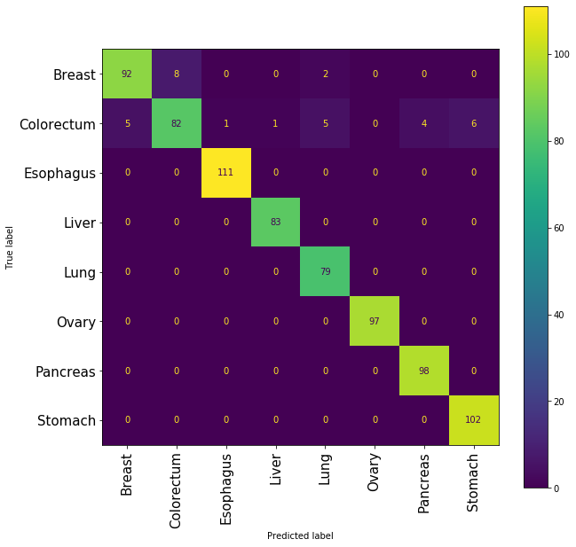
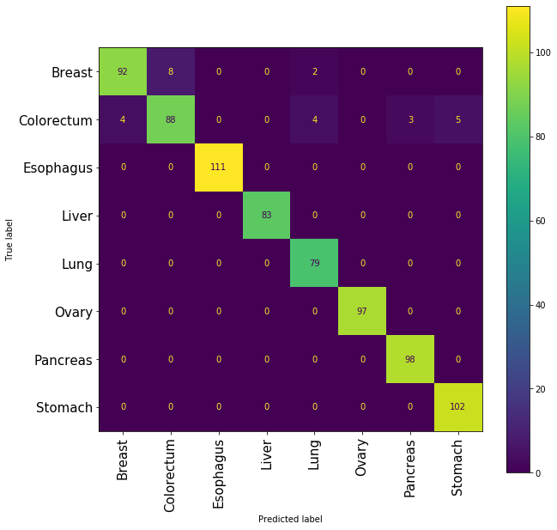
Confusion matrix for random forest with oversampling
Before Parameter Tuning
After Parameter Tuning

Slide 23
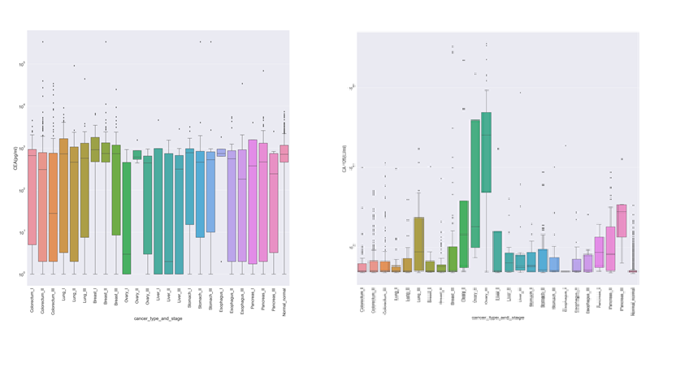
Challenges & Limitations
Even after hyperparameter tuning the it is difficult to improve the scores for colorectum and breast cancer – both cancer types have the same key protein – CEA but not a distinct distribution.
The best performing model is random forest but is difficult to analyze explainability of the model since it is an ensemble learning model.
There is no separate validation set.

Slide 24

Thank You
Any Questions?

