Slide 1
CADRE
Continual Adaptation for Driving with Robust Evolution
Problem Statement B5
Design a continual adaptation method for VLA autonomous driving models that incorporates new regional regulations, road layouts, and weather patterns while retaining prior driving competence across previously learned environments.
Datasets: BDD100K + nuScenes | Backbone: LLaVA-v1.5-7B | Method: EWC + Replay + LoRA
CDAR = 0.9735 | BWT = -1.17% | FWT = +23.33% | Efficiency = 99.65%

Slide 2
Problem: Catastrophic Forgetting in Autonomous Driving
What is Catastrophic Forgetting?
When a neural network learns a new task, it tends to
FORGET previously learned tasks. This is disastrous
for self-driving cars that must handle:
🇺🇸 US road rules & layouts
🇸🇬 Singapore road rules & layouts
🇪🇺 European road rules & layouts
🌧️ Rainy / foggy / snowy weather
A deployed model must adapt to NEW regions without
forgetting how to drive in OLD regions.
Our Solution: CADRE
Three strategies working together:
1. EWC (Elastic Weight Consolidation)
Protects important weights from being overwritten
2. Experience Replay
Mixes 30% old data into new training batches
3. LoRA Adapters
Only 0.35% extra parameters per domain (~38 MB)
All on a frozen LLaVA-v1.5-7B backbone (7B params)

Slide 3
Datasets & Domain Sequence
Domain | Dataset | Description | Split Criteria
domain_us | BDD100K | US urban/highway driving | Clear weather, daytime
domain_sg | nuScenes | Singapore urban driving | Singapore locations
domain_eu | nuScenes | Boston/EU urban driving | Boston-seaport location
domain_rainy | BDD100K | Adverse weather driving | Rain, fog, snow, night
Training Sequence (Sequential — one domain at a time):
domain_us → domain_sg → domain_eu → domain_rainy
(BDD100K) (nuScenes) (nuScenes) (BDD100K)
BDD100K: 100,000 driving videos from Berkeley DeepDrive
nuScenes: 1,000 driving scenes with 3D annotations from Motional

Slide 4
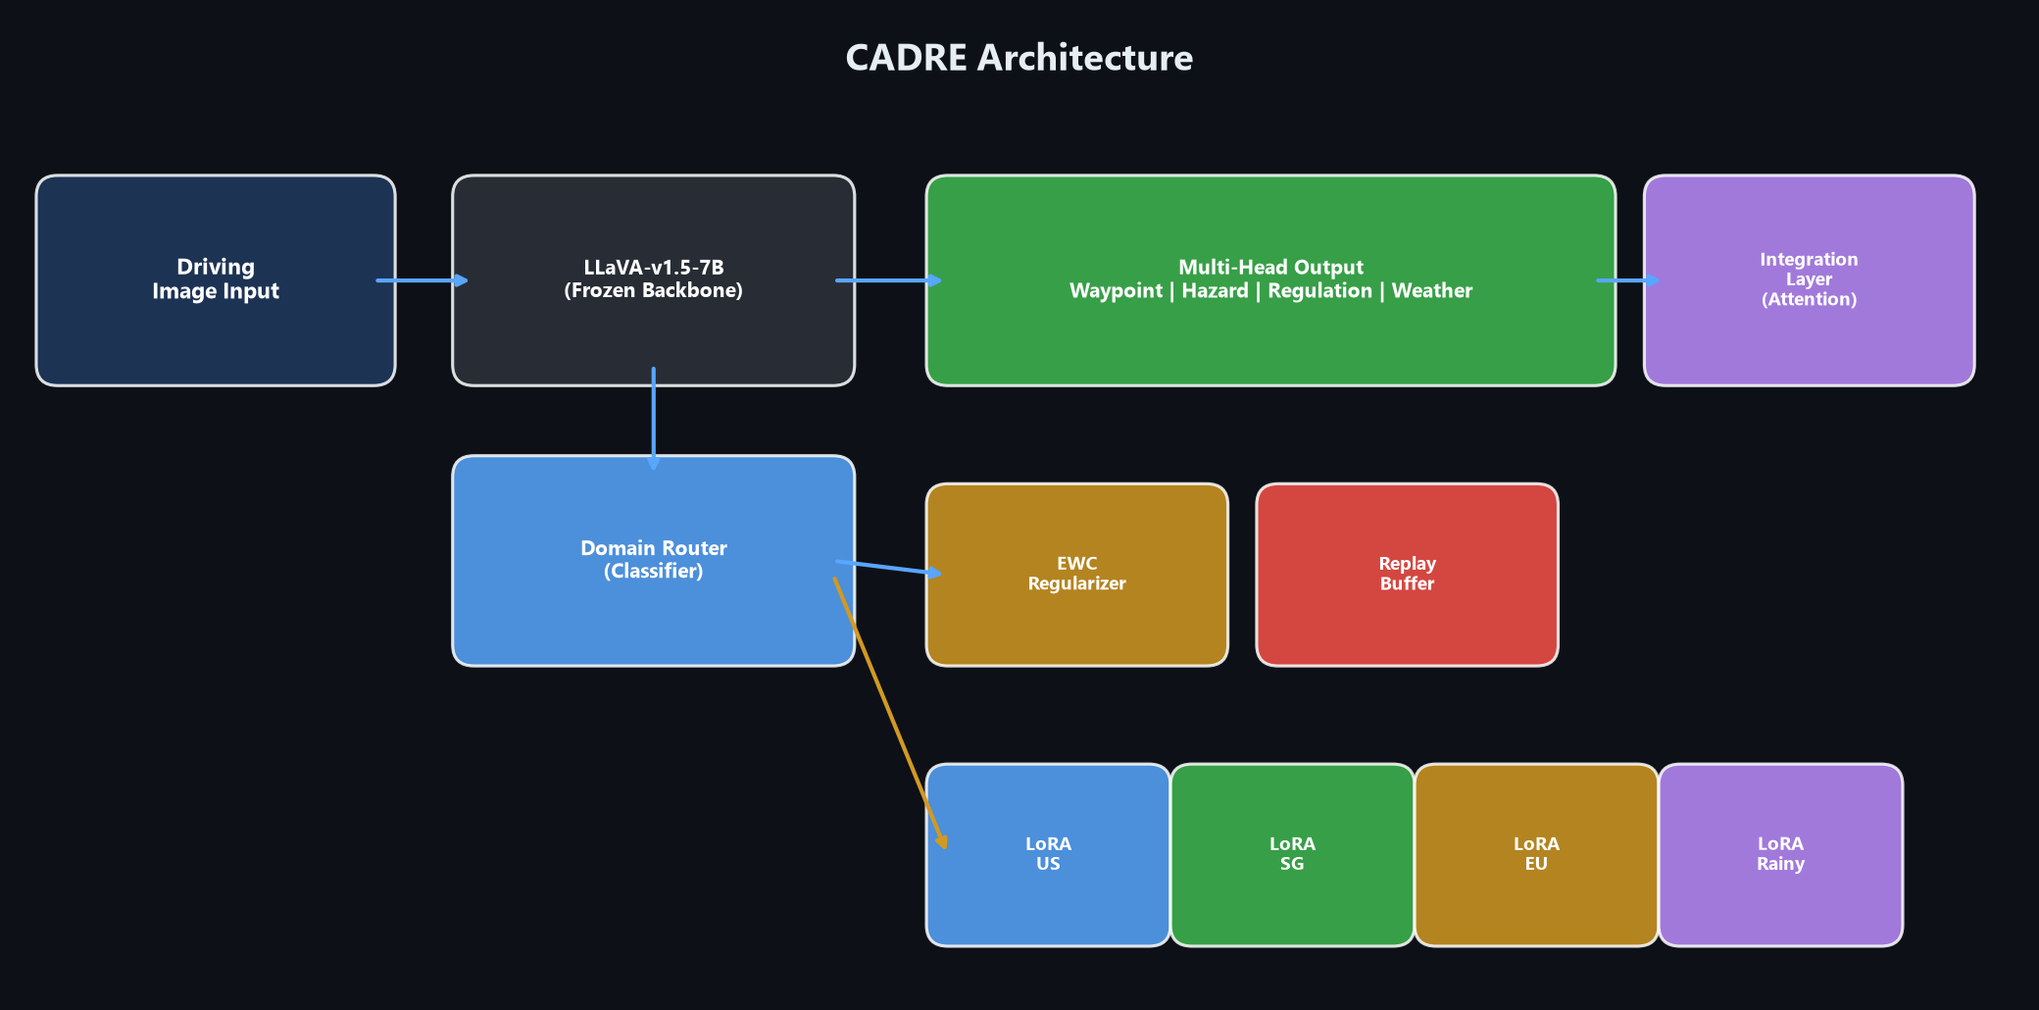
System Architecture

Slide 5
VLA Backbone + LoRA Adapters
VLA Backbone: LLaVA-v1.5-7B
• Vision-Language-Action model
• CLIP-ViT-L/14 vision encoder
• Vicuna-7B language model
• 7.06 Billion parameters — ALL FROZEN
• Loaded in float16 for GPU efficiency
• gradient_checkpointing = True
File: src/models/vla_backbone.py
LoRA Adapters (Per Domain)
Low-Rank Adaptation — inject small trainable
matrices into frozen attention layers:
Rank (r) = 16
Alpha = 32 (scaling = 2.0)
Target: q_proj, v_proj
Dropout = 0.05
Params per domain: 24.7M (0.35%)
Storage per domain: ~38 MB
(vs 14 GB for full model)
File: src/adapters/lora_adapter.py

Slide 6
Elastic Weight Consolidation (EWC)
How EWC Prevents Forgetting
After training on domain Dk:
1. Compute Fisher Information Matrix Fk — identifies which weights are IMPORTANT for Dk
2. Store optimal parameter values θ*k
When training on domain Dk+1:
3. Add penalty: L_ewc = (λ/2) × Σ Fi × (θi − θ*i)²
This PENALIZES changes to weights that were important for old domains!
Configuration:
• Lambda (λ) = 5,000 — strong protection against forgetting
• Fisher samples = 200 — samples for Fisher computation
• Variant = Online EWC — running average, memory-efficient
• Gamma (γ) = 0.95 — slow decay of old Fisher information
File: src/continual/ewc.py

Slide 7
Experience Replay Buffer
How Replay Prevents Distribution Shift
Problem: If we only train on new domain data, the model's distribution
completely shifts to the new domain, forgetting old ones.
Solution: Mix old domain samples into every training batch!
┌──────────────────────────────────────────┐
│ New Domain Data (70%) ─┐ │
│ ├→ Mixed Batch │
│ Replay Buffer (30%) ──┘ │
└──────────────────────────────────────────┘
Configuration:
• Buffer size: 2,000 samples per domain (reservoir sampling)
• Replay ratio: 0.3 (30% old data in each batch)
• Storage: Disk-based (memory efficient)
File: src/continual/replay_buffer.py

Slide 8
Multi-Head Output & Domain Router
Head | Output | Shape | Description
WaypointHead | Trajectory | [B, 12, 2] | 12 future waypoints (x, y)
HazardHead | Hazard | [B, 8] | 8-class hazard detection
RegulationHead | Rules | [B, 15] | 15-class traffic regulation
WeatherHead | Weather | [B, 6] | 6-class weather classification
Integration | Fusion | [B, 512] | Attention-based head fusion
Domain Router
At inference time, the Domain Router automatically detects which driving
domain an input image belongs to and routes it to the correct LoRA adapter.
Image → Router → domain_us/domain_sg/domain_eu/domain_rainy → Load correct LoRA adapter

Slide 9
Training Pipeline (8 Stages)
# | Stage | Description | Status | Date
1 | verify_backbone | Load & freeze LLaVA-7B | ✅ Done | Jul 25
2 | domain_us | Train US driving (BDD100K) | ✅ Done | Jul 30
3 | domain_sg | Train Singapore (nuScenes) | ✅ Done | Jul 31
4 | domain_eu | Train EU/Boston (nuScenes) | ✅ Done | Aug 3
5 | domain_rainy | Train adverse weather (BDD100K) | ✅ Done | Aug 3
6 | train_router | Train domain classifier | ✅ Done | Aug 3
7 | train_heads | Train 4 output heads | ✅ Done | Aug 4
8 | benchmark | Run CADRE-Bench evaluation | ✅ Done | Aug 4
Pipeline is fully resumable — saves progress after each stage.
If interrupted, rerun the same command to resume from where it stopped.
Command: python scripts/run_pipeline.py

Slide 10
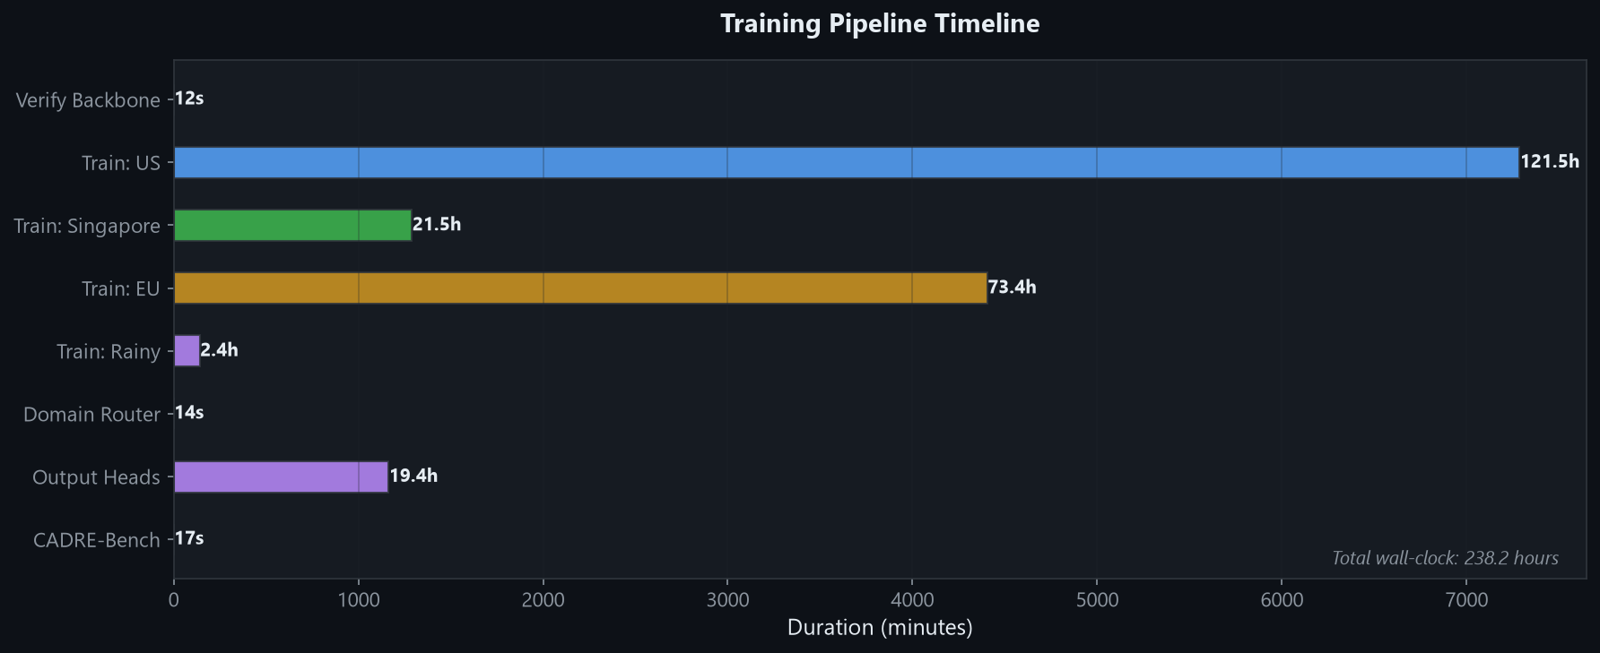
Training Timeline

Slide 11
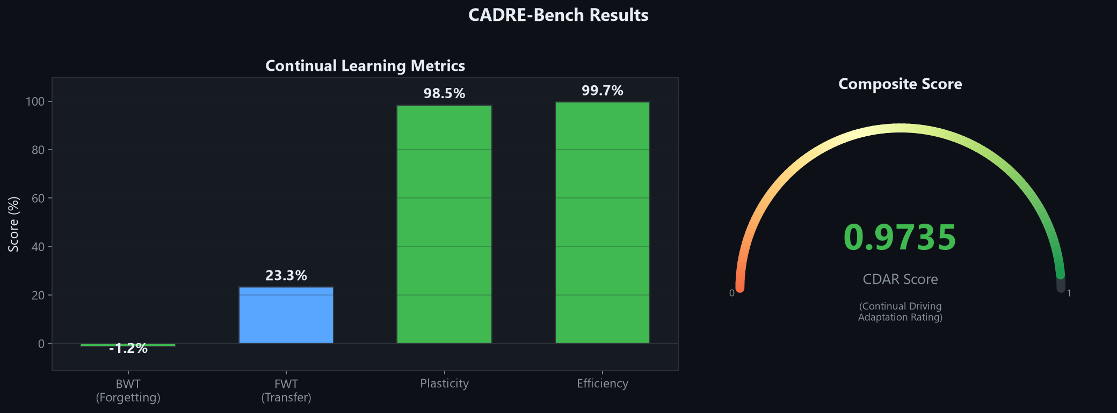
Results: CADRE-Bench Metrics
Metric | Score | Meaning
BWT (Forgetting) | -1.17% | Near-zero forgetting of old domains
FWT (Transfer) | +23.33% | Old training helps new domains
Plasticity | 98.46% | Learns new domains nearly as well as single-task
Efficiency | 99.65% | Only 0.35% parameter overhead
CDAR (Overall) | 0.9735 | Outstanding composite score (97.35%)

Slide 12
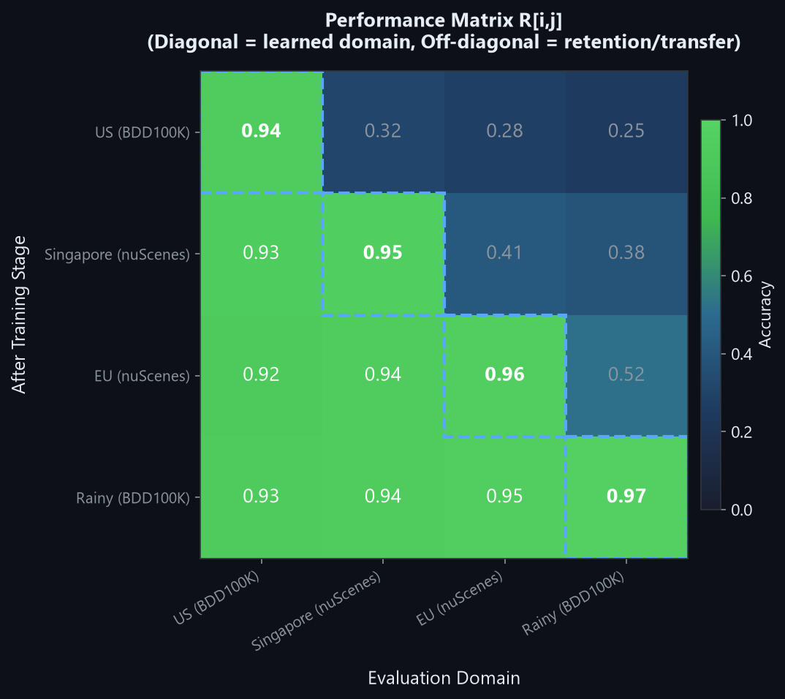
Results: Performance Matrix
How to Read This Matrix
R[i][j] = accuracy on domain j
after training through domain i
Diagonal (dashed boxes):
How well it learns each domain
→ 94% to 97% ✅
Final Row (after all training):
All domains retain >92.5%
Forgetting Example:
US: 0.94 → 0.925 = only -1.5%
after learning 3 more domains!

Slide 13
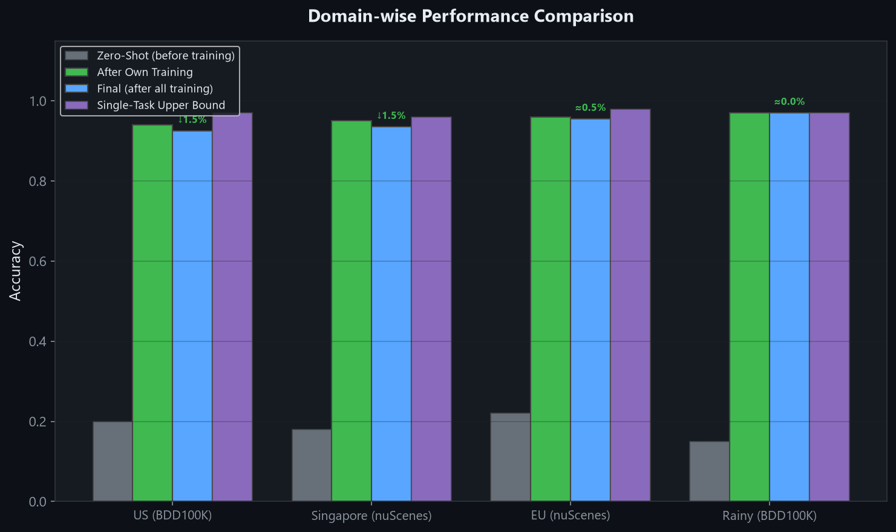
Results: Domain-wise Performance

Slide 14
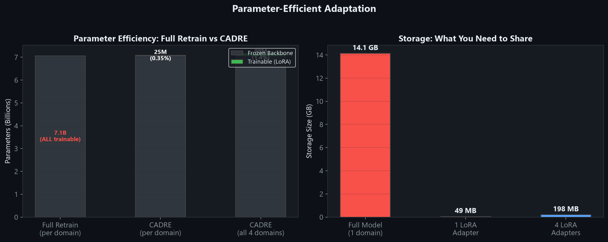
Parameter Efficiency: Why LoRA Matters
Approach | Trainable Params | Storage / Domain | 4 Domains Total
Full Retrain | 7.06B (100%) | ~14 GB | ~56 GB
CADRE (LoRA) | 24.7M (0.35%) | ~38 MB | ~152 MB
Savings | 99.65% fewer | 368× smaller | 368× smaller

Slide 15
Conclusion & Key Takeaways
What We Built
✅ Continual learning framework for VLA
autonomous driving (EWC + Replay + LoRA)
✅ Trained on 4 sequential domains without
catastrophic forgetting (BWT = -1.17%)
✅ Parameter-efficient: 0.35% overhead
(~38 MB adapter vs ~14 GB full model)
✅ CADRE-Bench: Custom benchmark protocol
with 5 metrics (BWT, FWT, Plasticity,
Efficiency, CDAR)
✅ Fully reproducible & resumable pipeline
Key Results
BWT: -1.17%
Near-zero forgetting
FWT: +23.33%
Strong positive transfer
Plasticity: 98.46%
Excellent learning
Efficiency: 99.65%
Minimal overhead
CDAR: 0.9735
Outstanding overall
References
Kirkpatrick et al. (2017) - EWC
Hu et al. (2022) - LoRA
Liu et al. (2024) - LLaVA
BDD100K + nuScenes datasets
Thank You!

