Slide 1
PROJECT 17 • SLIDE 1 OF 5
Motivation: Automating Neural Network Architecture Design
• The Human Engineering Bottleneck: Designing breakthrough deep architectures (ResNet, EfficientNet) historically required months of expert intuition and trial-and-error exploration.
• Combinatorial Space Explosion: Even for a compact 3-layer CNN, choosing channels, kernels, activations, and residual skips yields over 46,000 candidate network configurations.
• The NAS Paradigm Shift: Formulate network generation as an optimal decision process where a recurrent agent proposes topologies and learns from empirical validation rewards.

Slide 2
PROJECT 17 • SLIDE 2 OF 5
Methodology: Autoregressive Controller & Policy Gradient
• Micro Search Space: Per layer choices: Filters {16, 32, 64}, Kernel {3x3, 5x5}, Activation {ReLU, LeakyReLU, GELU}, Residual Skip {0, 1}. Total decisions = 12 categorical tokens.
• RNN Controller Architecture: 1-layer LSTM cell generating architectural tokens sequentially with shared embeddings.
• Policy Gradient Optimization: Trained via REINFORCE with an Exponential Moving Average (EMA) baseline (b) to reduce gradient variance: Grad J(theta) = Sum Grad log P(a) * (R - b).

Slide 3
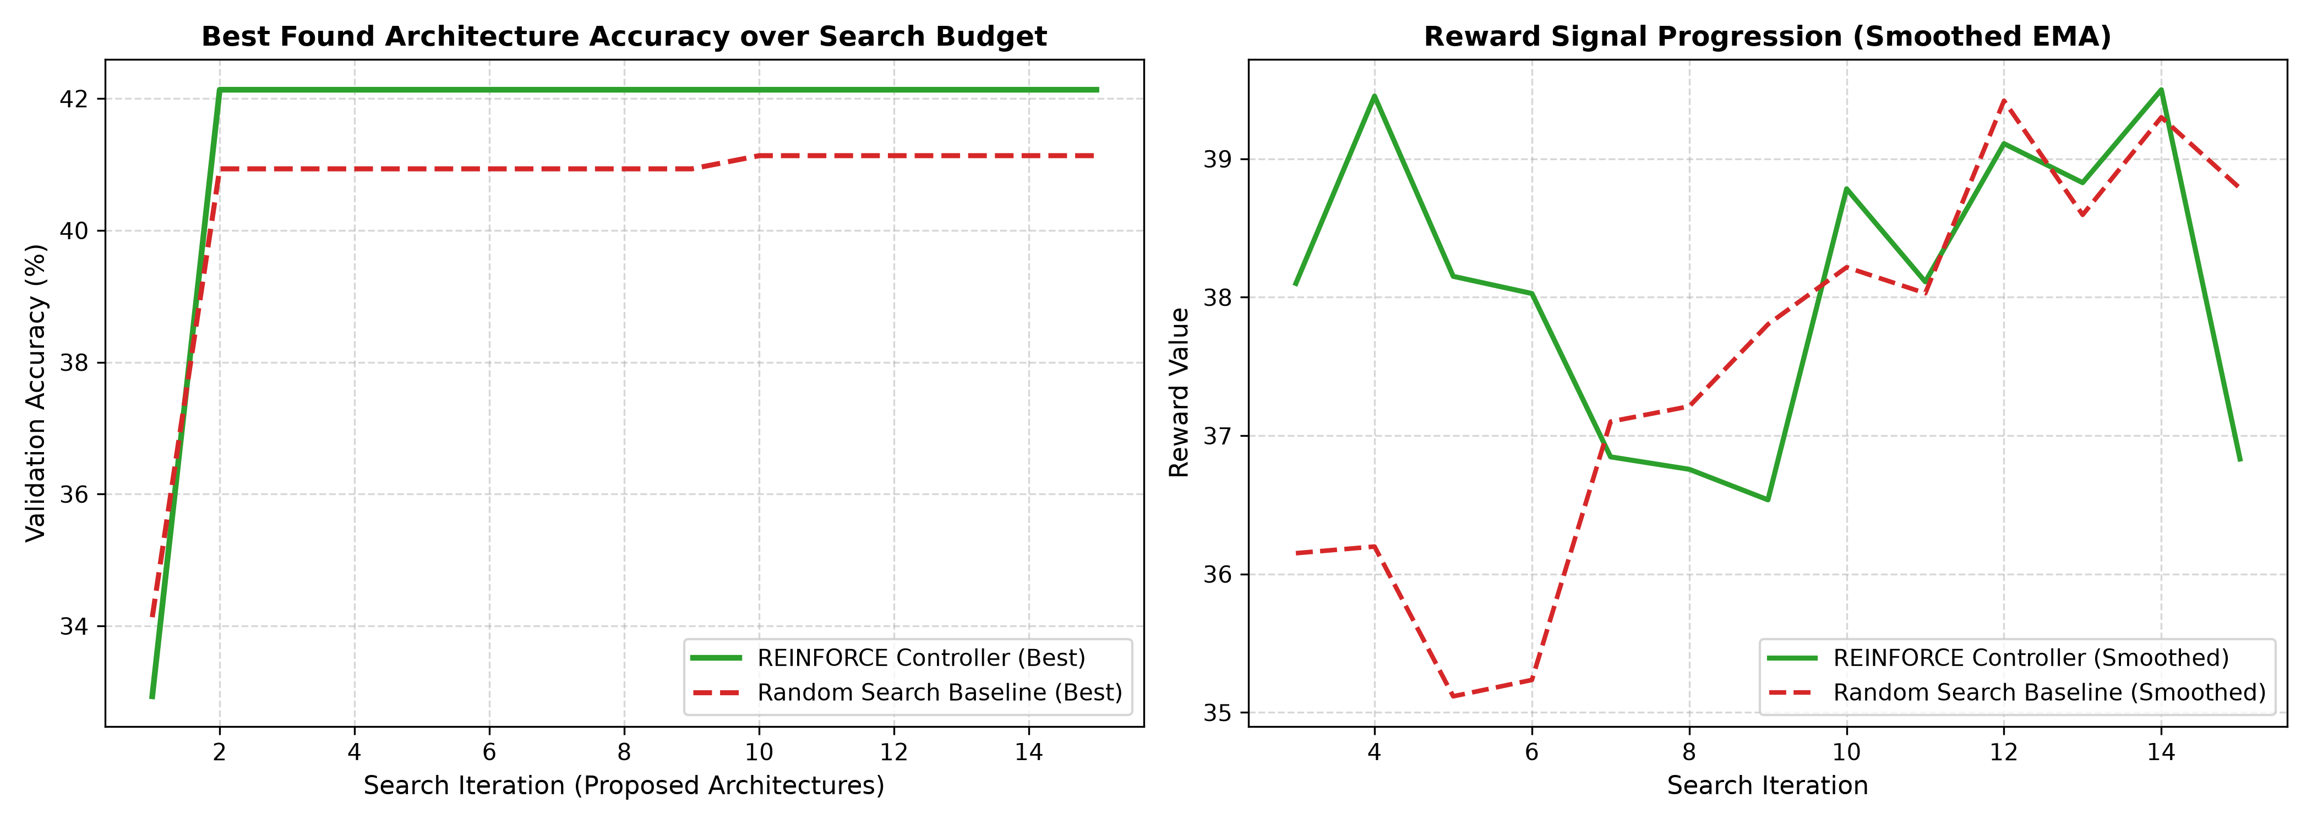
PROJECT 17 • SLIDE 3 OF 5
Empirical Results: Discovered Topologies vs. Random Search
• Accuracy Benchmark: REINFORCE Controller discovered a 42.13% validation accuracy architecture (Reward: 37.72), outperforming Uniform Random Search (41.13%, Reward: 37.48).
• Discovered Inductive Biases: The controller consistently learned to favor progressive channel scaling (64 -> 16 -> 32), LeakyReLU non-linearities, and residual skip connections.
• Best Discovered Topology: L0: 64f (5x5, LeakyReLU, Res) | L1: 16f (3x3, LeakyReLU) | L2: 32f (5x5, GELU, Res).

Slide 4
PROJECT 17 • SLIDE 4 OF 5
Limitations & Failure Modes of NAS
• The Proxy-Task Evaluation Gap: Candidate networks are evaluated for few epochs on reduced subsets for rapid feedback. Top proxy performers do not always rank identically when trained to asymptotic convergence.
• Compute Cost Without Weight Sharing: Training each child candidate from scratch consumes substantial compute. One-shot supernet approaches (e.g., DARTS, ENAS) share weights to overcome this bottleneck.
• Non-Convex Combinatorial Landscape: Different topological permutations can yield nearly identical validation performance, creating a rugged reward surface.

Slide 5
PROJECT 17 • SLIDE 5 OF 5
Societal Impact, Green AI & Ethics
• Environmental Footprint of Large NAS: Industrial-scale NAS can consume hundreds of GPU years. Developing sample-efficient micro-controllers and surrogate benchmarks is critical for sustainable, green AI.
• Democratization of Custom Edge AI: Enables domain specialists (medical imaging, robotics, IoT) to automatically synthesize compact models tailored for specific edge hardware constraints.
• Algorithmic Auditability: Automated architecture generation must be accompanied by interpretability audits to verify that discovered networks do not exhibit hidden failure modes.

