Slide 1
Capstone of Madhumita Duvvuri
Statistics & Modeling
Coding with Performance on Big Data
Communicating Results for Decision-Making
Venn Diagram of Data Science Skills

Slide 2
Contribution of Competitor’s Article
Stock return predictability and the adaptive markets hypothesis: Evidence from century-long US data.
Article portrays strong evidence of time varying return predictability of the DJIA - Dow Jones Industrial Average index from 1900 to 2009. Return predictability is found to be driven by changing market conditions
Article discusses about:
Time-varying stock return predictability
Returns are driven by changing market conditions
Explores the implications of AMH:
Degree of market efficiency fluctuates over time.
Degree of market efficiency depends on market conditions.
Predicted returns are consistent with the implication of adaptive market hypothesis (AMH).
Stock returns are highly related to market volatility and economic fundamentals.
Assumes that market is weak-form of EMH and states that asset returns cannot be predicted accurately using the past prices.
Regression Analysis was performed on the measures of return predictability.
The article uses the following statistical tests to compute measures of return predictability:
Automatic variance ratio test (testing weak-form of efficiency of financial markets)
Automatic portmanteau test (testing the auto-correlation of returns which are subject to unknown forms of heteroskedasticity)
Generalized spectral test (both linear and non-linear dependence are tested)

Slide 3
Description of Your Contribution
AIM: Test efficient market hypothesis in a semi-strong efficient market using stock prices, fundamental and technical factors of U.S. Stock market data. The tests are performed on different industries of the market to draw conclusions on the consistency of the predicted stock returns.
Neural Networks are considered as one of the foremost methodologies used in performing complicated pattern recognition and non-linear forecasting tasks across many applications and domains.
The non-linear regularities of the economic market can be extracted by applying this technique to our data which is an economic time series.
Decoding these previously undetected regularities in stock price movement will be lead to earning profits from investing.
Hence a multivariate time series analysis is used to analyze the behaviour of time-dependent stock price data and forecast returns based on the history of variation of this data.
Efficient market hypothesis (EMH) states that it is not always possible to outperform the market consistently.
EMH stated by economist Eugene Fama :
“The stock prices follow a random walk theory and cannot be predicted based on their past behaviour.”
Forecasting returns in an evolving economic system requires that the prediction rules adapt to these changes continuously.
Implementing a hybrid approach of using neural networks with time series analysis addresses the fundamental problems by predicting a time series with inconsistent regularities.

Slide 4
Data Source and Content
Financial Data collection is an on-going and recursive process.
Data considered for analysis is stock market data of U.S. Stock market from 2011 to 2016 which includes:
a) daily closing prices,
b) volume,
c) fundamental factors (revenue, earnings per share, market capital and etc.) and
d) technical factor ( RSI – Relative Strength Index : momentum indicator)
QUATERLY DATA ACCUMULATION
Fundamental factors are captured from financial statements which are released at the end of every quarter for a fiscal year.
Financial statements are a combination of both profit and loss statement and balance sheet.
P&l statement or income statement has factors which help us to identify the performance and profitability of a company for a fiscal year.
Balance Sheet has indicators which help us understand the financial status of each company.
DAILY DATA ACCUMULATION
Market capital is the company’s market value of it’s outstanding shares. Based on the company’s market capitalization it’s stocks are classified into small cap, mid cap and large cap stocks.
Our analysis uses the stock market data of the U.S. market from the year 2011.
Unlike the article we are using the daily closing prices of an exchange traded fund (ETF) of small cap stocks and large cap stocks (SP500).
RSI is computed based on these prices for each stock.

Slide 5
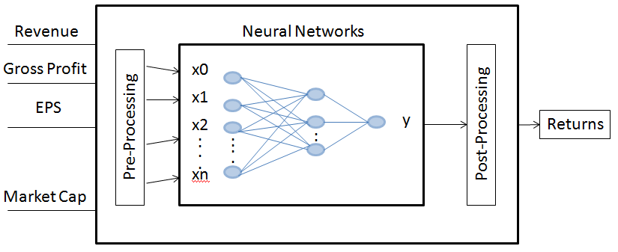
Your Method
Techniques Implemented
Neural network model - an intelligent data mining technique which is used in pattern recognition problems like stock price predictions.
ARMA or autoregressive moving average model - applied to time series data and commonly used as an estimation model in simulation forecasting of asset prices. These models are used to predict future values for a given time series data.
Proposed Model
A four layered neural network using back propagation learning algorithm to train the network.
one input layer, two hidden layers and one output layer.
Moving average modelling on weights from neural networks is done.
Returns predicted using the predicted weights in a neural network equation.
Input to a neural network should be normalized first.
Initially frequency of the model chosen is quarterly.
For each quarter from 2011 to 2014 stock data is considered as train data and from 2015 as test data for modelling the neural networks
Neural Network Model is run for each sector in the train data.
Time series analysis is performed on the weights from each neural network model.
Weights for the future quarters are predicted using time series model.
Using the predicted weights, compute the expected returns of all the stocks.
Stocks are ranked according to expected returns and divided into 5 groups.

Slide 6
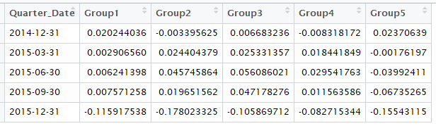
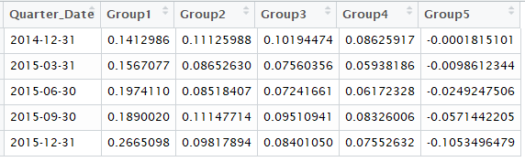
Quantitative Results 1
Actual Returns (Log)
Calculations
Notation | Description
P_{t} | Stock Price
R_{t} | Return = (P_{t} /P_{t-1}) – 1
t | Time
Predicted Returns (Log)

Slide 7
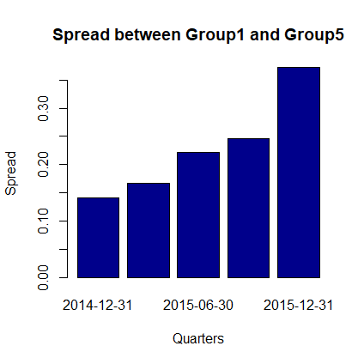
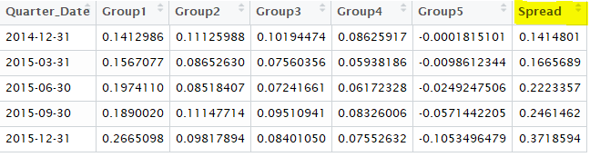
Quantitative Results 2
Spread between the performance of Group 1 and Group 5 (Expected Returns).

Slide 8
Discussion: Comparison With Your Competitor
Competitor’s Results
Your Results
Based on the regression metrics used they find evidence that:
return predictability fluctuates over time and is highly governed by changing market conditions.
during a market crash, no return predictability is prominently evident, mostly because of the extreme degree of associated uncertainty.
inflation, risk-free rates and stock market volatility influence stock market predictability over a period of time.
Based on the overall forecasted values we can say that the expected return of stocks have shown a positive trend in all the quarters.
The spread between the performance of group 1 and group 5 has increased for every quarter.
On the whole the averages depict a huge volatility in stock price movements.
Deducted that predicted returns are dependent on the publically available information or market conditions which proves that markets are semi-strong form efficient.

Slide 9
Performance on Big Data: Time Measurements
Time for each operation: The complete analysis took about 55 minutes and the time for each operation is mentioned below.
Data Load (240 seconds)
Data Preparation (123 seconds)
Neural Networking modelling (45 minutes)
In Traditional Neural Network Modelling it took about 60 minutes for each model to run. Now each model takes about 5 minutes when we use Threshold and Stepmax parameters in ‘neuralnet’ function and also by running the models in a loop.
Time Series Analysis (5 seconds)
Predicting Returns for future quarters (120 seconds)
Ranking and grouping of stocks (15 seconds)

Slide 10
Conclusion
Combining Neural Networks and Time-Series Analysis the stocks in the market were categorized into well-performed and poorly performed in the market.
Investors who use this modelling technology should be able to improve their analysis choosing the best investment alternatives based on better predictions.
To further validate the proposed technique in investment analysis, we need to perform qualitative and quantitative tests on our data, considering different time periods and different industries or sectors.
With the many advantages, investors and researchers should seriously consider the application of neural network and time-series techniques to investment analysis.

Slide 11
Quiz for Your Classmates
What statistical method was used?
What programming tool was used?
What scientific contribution was made?
What idea could be useful for your project?

