Slide 1

Competitor Article
Madhumita Duvvuri
MS – Data Science

Slide 2
Title
My project is based on testing market efficiency in a semi-strong efficient market using the closing prices of U.S. Stock market data.
Competitor article chosen:
“ Stock return predictability and the adaptive market hypothesis: Evidence from century-long U.S. data”
- Jae H. Kim, Abdul Shamsuddin and Kian-Ping Lim

Slide 3
About Article
Paper discusses about:
Time-varying stock return predictability
Returns are driven by changing market conditions
Predicted returns are consistent with the implication of adaptive market hypothesis (AMH).
Stock returns are highly related to market volatility and economic fundamentals.

Slide 4
About Article ....
States that market is weak-form of EMH and asset returns cannot be predicted accurately using the past prices.
Article explores the implications of AMH:
Degree of market efficiency fluctuates over time.
Degree of market efficiency depends on market conditions.

Slide 5
Technique – Our Study
Stock market in many scenarios follows semi-strong form of EMH – which means that the stock prices fully reflect all available information and no investor gains an abnormal profit.
Our study includes
computation of the expected returns using all the publically available stock information and past prices.
Investability of the model achieved.

Slide 6
Data - Article
The article uses the DJIA (Dow Jones Industrial Average) index, daily from January 1900 to June 2009.
Index is calculated as a price-weighted average of 30 blue chip stocks or component stocks.
Blue chip stocks are stocks of well established companies or market leaders which drive the stock market.

Slide 7
Data – Our study
Our analysis uses the stock market data of the U.S. market from the year 2000.
Unlike the article we are using the daily closing prices of an exchange traded fund (ETF) of small cap stocks and large cap stocks (SP500).
Added to this dataset we will be using the yield curve rates from U.S. Treasury.

Slide 8
Method
The article uses the following statistical tests to compute measures of return predictability:
Automatic variance ratio test (testing weak-form of efficiency of financial markets)
Automatic portmanteau test (testing the auto-correlation of returns which are subject to unknown forms of heteroskedasticity)
Generalized spectral test (both linear and non-linear dependence are tested)

Slide 9
Method – Flow Chart
Test
Test
Return Predictability
Linear Dependency
Linear and Non-Linear Dependency
Automatic Variance Ratio
General Spectral Test
Automatic Portmanteau Test
Statistical Test Results
Regression Analysis**
**Regression Analysis – whether stock return predictability depends on market conditions

Slide 10
Regression Analysis
Regression Analysis was conducted on the measures of return predictability of stocks.
Sequential testing of market efficiency was not taken into consideration
Statistical significance of return predictability at monthly frequency is tested using results from the various tests.

Slide 11
Empirical Results
Time-varying return predictability(RP) – Using AVR and AQ statistics the hypothesis of RP is rejected and markets are not efficient for whole period.
RP and market conditions – Regression on AVR and AQ statistics (with economic variables of market), suggests higher return predictability during economic crises.
Results from empirical study on weak-form of efficient markets imply that market conditions play a major role in predicting the returns of stocks.

Slide 12
Analysis from Article
Markets are considered to follow weak-form of EMH.
Degree of return predictability of the U.S. stock market fluctuates over time – evidence of AMH.
Inflation, risk-free rates and stock market volatility – factors influencing stock returns.
Empirical evaluation of AMH is done using century long U.S. stock market data.

Slide 13
Our Approach
Predicting returns using publically available data on stock prices and also past prices over a period is time-dependent.
We use a multivariate time series to study the behaviour of stocks and forecast the returns of a stock in the market.
All the factors which can be considered to forecast the returns are available on the financial statements of a company.
Financial statements are publically released by the company for a fiscal year.
- balance sheet,
- income statement and
- cash flow statement.

Slide 14
Our Approach .....
Assumption in time series analysis: relationship among variables is linear
Temporal variables exhibit irregularities and it is not possible to predict accurately.
Non-linear modelling and Factor Analysis are best suited for temporal data.
Neural Networks Factor Model is used as a non-linear forecasting technique.
This model can capture non-linearity and non-normality of a high dimensional dataset.

Slide 15
Neural Networks
NN’s receive a large number of inputs/factors (stock data information) and return the expected outputs.
Neuron
x
W1
w2
y
x1
Expected Output
Inputs
x2
x3
Output Layer
Input Layer
Hidden Layer

Slide 16
Data Analysis
Visualizations are created using quarterly data on U.S. stock market from 2011 to 2015.
The company with highest market capitalization.
Closing prices (quarterly) - Apple’s stock through 5 years.
Earnings per Share
P/E ratio (price / earnings per share)
Apache Zepplin and R Interpreter were used to load the data

Slide 17
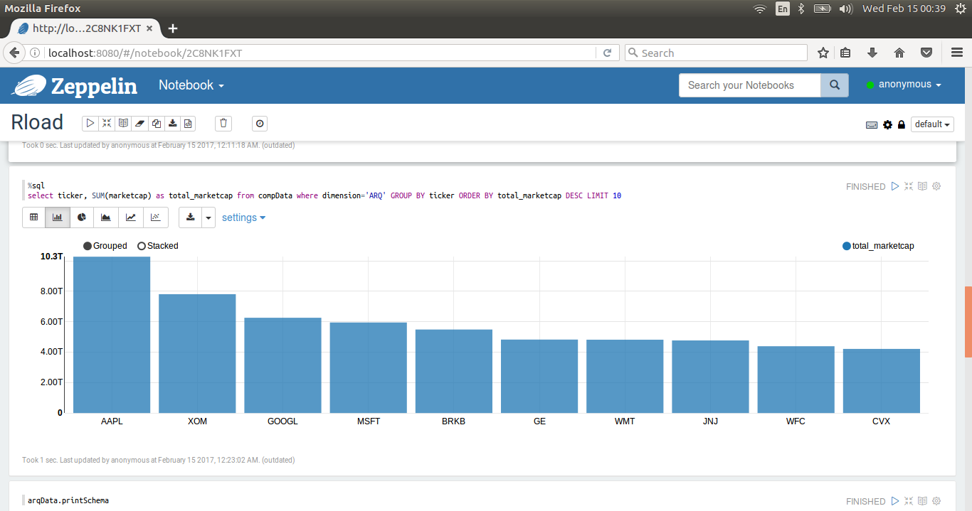
Data Analysis
Used Apache Zepplin to create interactive data visualization

Slide 18
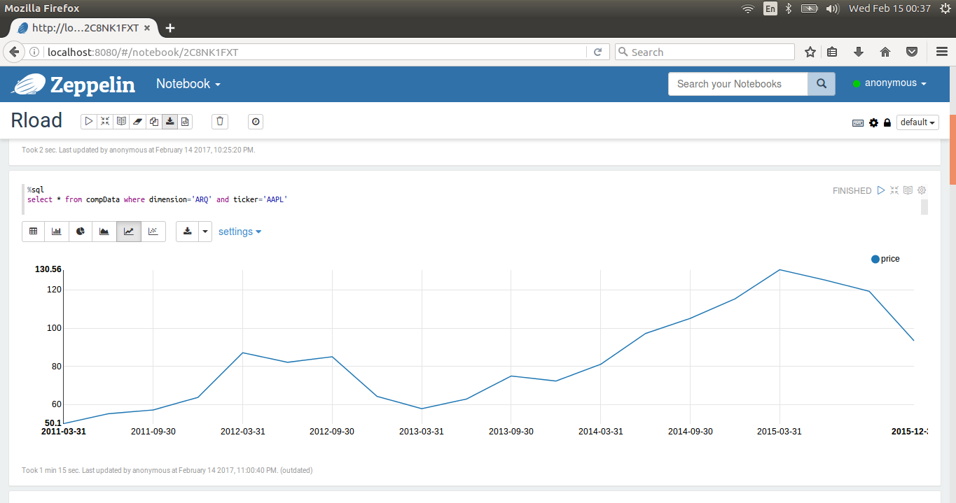
Data Analysis
Used Apache Zepplin to create interactive data visualization

Slide 19
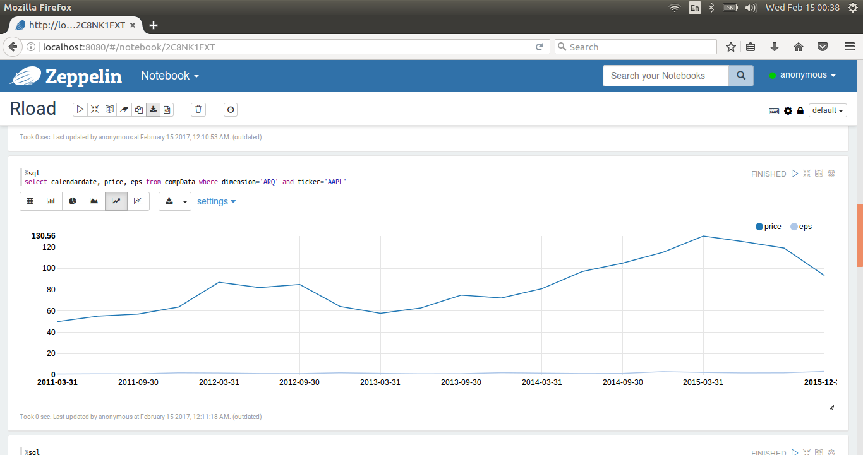
Data Analysis
Used Apache Zepplin to create interactive data visualization

Slide 20
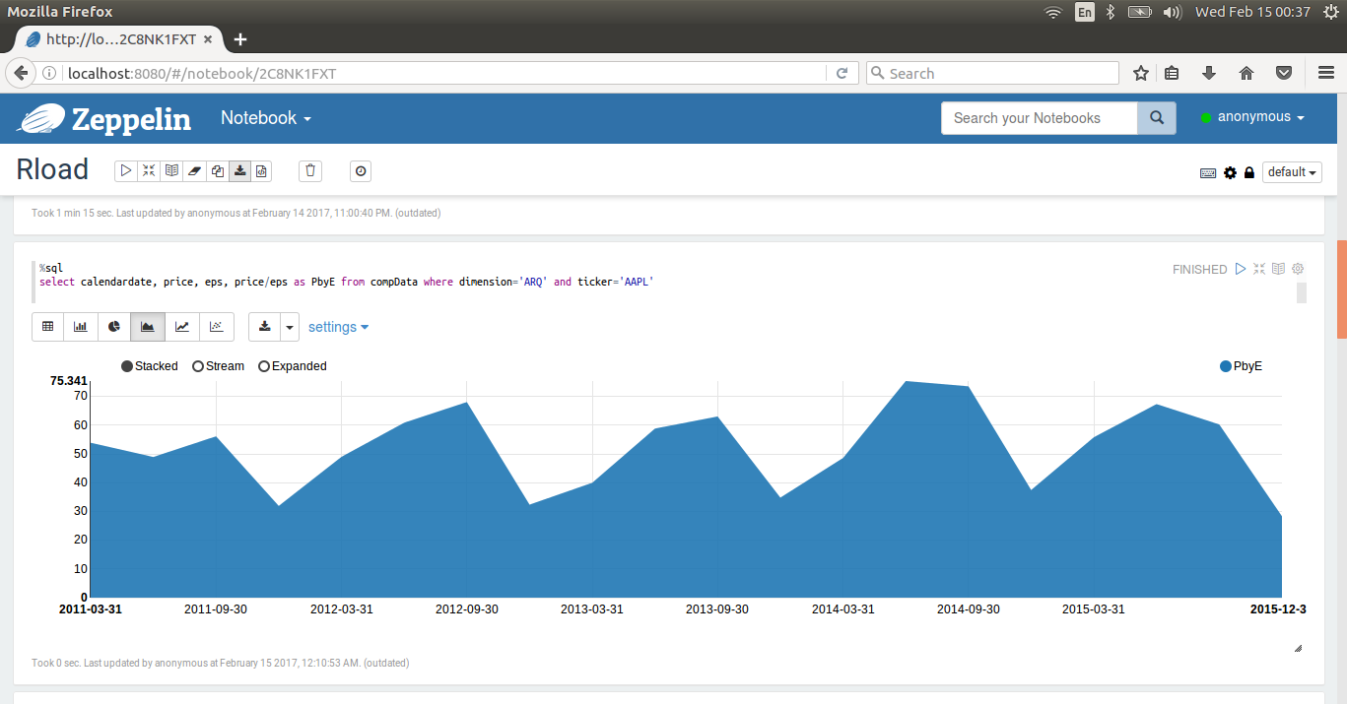
Data Analysis
Used Apache Zepplin to create interactive data visualization

Slide 21
Comparison
Competitor Article | Capstone Project
Assumed market is weak-form of efficient market hypothesis (EMH) | Test for semi-strong form of efficient market hypothesis (EMH)
Test for evidence of AMH (adaptive market hypothesis) in return predictability | Computing expected returns for testing market hypothesis.
Used DJIA index i.e. Index created for 30 blue chip stocks (large cap stocks) for century-long U.S. stock market data | Using daily closing prices of exchange traded fund (ETF) of both small and large cap stocks from the year 2000
Regression Analysis : AVR, AQ and Generalized spectral test | Neural Networks and Factor Models

