Slide 1

Proposal
Madhumita Duvvuri
MS – Data Science

Slide 2
Novel Contribution
The aim of this analysis is to test efficient market hypothesis in a semi-strong efficient market using the closing prices of U.S. Stock market data.
Relate these tests based on different sectors of industry to draw conclusions on the consistency of the predicted stock prices based on each sector.
Stock return prediction is done using a hybrid model of neural networks and time series modelling.

Slide 3
Novel Contribution
Efficient market hypothesis (EMH) states that it is not always possible to outperform the market consistently.
EMH stated by economist Eugene Fama :
“The stock prices follow a random walk theory and cannot be predicted based on their past behaviour.”
The term “efficiency” in EMH means that the markets can quickly absorb any new information available on the industry, company, value of the company, economy and can impound this information accurately into stock prices.

Slide 4
Novel Contribution
Neural Networks are considered as one of the foremost methodologies used in performing complicated pattern recognition and non-linear forecasting tasks across many applications and domains.
The non-linear regularities of the economic market can be extracted by applying this technique to our stock market data which is an economic time series.
Decoding these previously undetected regularities in stock price movement (like day-to-day or month-to-month fluctuations of stock prices) will be lead to earning profits from investing.

Slide 5
Novel Contribution
Predicting stock prices is based on many factors like
- fundamental factors
- technical indicators
- macro economic factors
These factors have values which change over a period of time.
Hence a multivariate time series analysis is used to analyze the behaviour of time-dependent stock price data and forecast returns based on the history of variation of this data.

Slide 6
Novel Contribution
Predicting stock price returns in an economic system is subject to change continuously.
For forecasting such values the prediction rules change vigorously and hence learning algorithm and prediction system must adhere to these changing rules.
Hence a hybrid approach of using neural networks with time series analysis addresses the fundamental problems by predicting a time series with inconsistent regularities.

Slide 7
Work by Competitors
Stock return predictability and the adaptive markets hypothesis: Evidence from century-long US data.
- This study provides strong evidence of time varying return predictability of the DJIA - Dow Jones Industrial Average index from 1900 to 2009. Return predictability is found to be driven by changing market conditions
- Regression Analysis was performed on the measures of return predictability.
Financial modelling using Gaussian process models.
- Gaussian process (GP) models are one of the emerging non-parametric Bayesian models and in this paper they tested the GP model’s applicability to financial data.
- GP model is fitted to daily data from U.S. commodity markets.

Slide 8
Work by Competitors
The empirical risk–return relation: A factor analysis approach.
- Dynamic factor analysis was performed on large datasets having economic information like volatility, risk premium and returns.
- Conclusions were drawn based on the volatility of excess stock market returns and a positive conditional risk return correlation.
Stock market prediction system with modular neural networks.
- This study discusses the buying and selling time predictions on Tokyo Stock Exchange.
- The prediction system was made up of several neural networks based on various technical and fundamental factors.

Slide 9
Work by Competitors
USA S&P 500 stock market dynamism exploration with moving window and artificial intelligence approach.
- This paper proposes an approach to use artificial immune algorithm, fuzzy theorem, support vectors and seasonal moving window to explore stocks for USA S&P 500 stock indexes.
Economic prediction using neural networks: The case of IBM daily stock returns.
- This study reports the results of using neural network modelling and learning techniques to decode the regularities in the price movement of IBM daily stock returns.

Slide 10
Data
Financial Data accumulation is a recursive and an on-going process.
Data considered for analysis is stock market data of U.S. Stock market.
Initial part of analysis is done on the fundamental factors from financial statements.
Later technical indicators, macro economic factors, difference or first and second derivative information is incorporated in the analysis

Slide 11
Data
Financial statements are a combination of both profit and loss statement and balance sheet.
P&l statement or income statement has factors which help us to identify the performance and profitability of a company for a fiscal year.
Balance Sheet has indicators which help us understand the financial status of each company.
There are three forms of financial statements a company releases quarterly and annually.
Balance Sheet | Comprises of Assets, Liability and Equity
Income Statement | Reports Company’s Performance
Cash Flow Statement | Presents Operating, Investing and Financing Activities

Slide 12
Data
The dataset chosen has 20 fundamental factors from the indicators in the financial statements issued by a company.
Fundamental Factors
Revenues | Net Income
Cost of Revenue | Earnings before Tax
Gross Profit | Earnings per Basic Share
Selling, General and Administrative Expense | Profit Margin
Earnings Before Interest & Taxes (EBIT) | Total Assets
Gross Margin | Current Assets
SGNA as % of Revenues* | Current Liabilities
EBIT Margin* | Current Ratio
Interest Expense | Working Capital
Income Tax Expense | Capital Expenditure

Slide 13
Data
The final dataset has quarterly data with information of 5500 stocks approximately.
The daily closing prices, trading volume and the daily US Treasury yield curve rates for each stock will be added in the later part of the analysis.
The daily yield curve rates are available on the Data and Charts Centre of treasury.gov which coordinates with the U.S. Department of the Treasury.
Explanatory Variables
Notation | Description
P_{t} | Stock Price
p_{t} | log P_{t}
R_{t} | Return = (P_{t} /P_{t-1}) – 1
r_{t} | Return from ‘risk free’ investment
R_{t} – r_{t} | Excess return
Some explanatory variables are added for the purpose of analysis.
The calculation for returns is shown in the table.

Slide 14
Data
Market capital is the company’s market value of it’s outstanding shares. Based on the company’s market capitalization it’s stocks are classified into small cap, mid cap and large cap stocks.
Small Cap Stocks – Market Cap between $300 million and $2billion
Large Cap Stocks – Market Cap higher than $5 billion
Our dataset has two other files which contains daily closing prices of exchange trading fund (ETF). One ETF tracks 2000 companies with small cap stocks and other tracks the SP500 i.e. Large cap stocks.

Slide 15
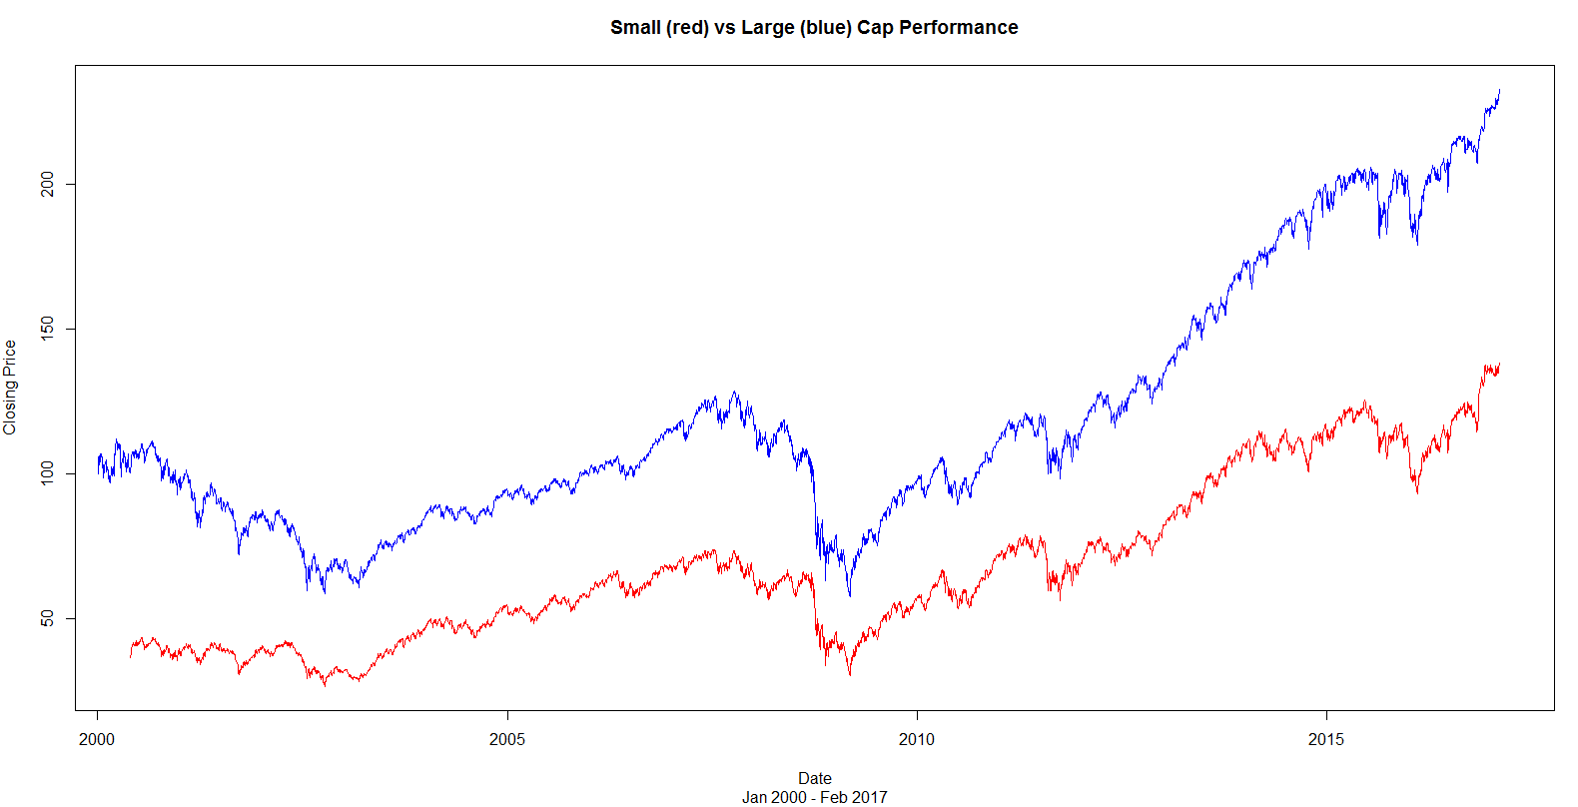
Data
Performance of small cap vs large cap stocks is shown in the graph below (red – small cap and blue – large cap).

Slide 16
Method – Neural Networks
Neural network model - an intelligent data mining technique which is used in pattern recognition problems like stock price predictions.
Non-parametric, non-linear, data driven model which uses learning algorithms to map the past values (past prices and trading volume information) of a time series.
Use a neural network was initially inspired from the nervous system of human beings.

Slide 17
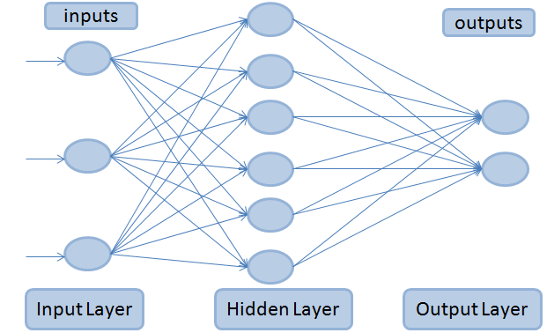
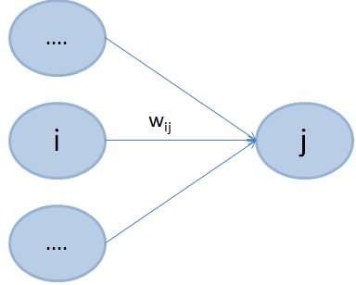
Method – Neural Networks
A feed forward multi layer perceptron (MLP) neural network is considered to forecast the stock price returns.
The MLP neural network consists of three layers:
Input layer
Hidden layer
Output layer
Every layer has number of units which receive and transmit signals (or outputs) to the next set of units on other layers. These connections are measured by weights ( w_{ij} ).

Slide 18
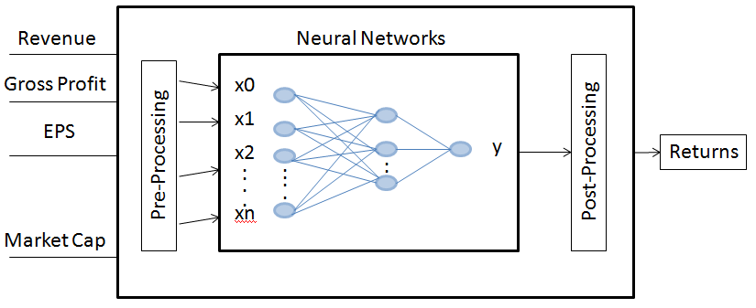
Method – Neural Networks
Forecasting expected returns using the asset price data of U.S. stock market consists of many neural networks that learn the relationship between economical and technical factors.
The goal is to predict daily returns and quarterly returns of the all the stocks available.
Figure below gives the basic architecture of our prediction system. It converts all the given factors (technical and economic) into a space pattern which are taken as the input to the neural network.

Slide 19
Method – Time Series Analysis
ARMA or autoregressive moving average model - applied to time series data and commonly used to calculate and estimate the Value at Risk (VAR).
VAR - an estimation model used in simulation forecasting of asset prices.
ARMA models are used to predict future values for a given time series data.
Forecasting future stock prices is based on the past prices and volume information which can be converted to a time series data.

Slide 20

Method – ARMA model
ARMA models both autoregressive (AR) and moving average (MA) terms. Noted by ARMA(p,q) with p being autoregressive terms and q being moving average terms.
Where ϕ is the parameter of the AR model, θ is the parameter of the MA model and ε is the error term.

Slide 21
Method – Proposed Model
A four layered neural network using back propagation learning algorithm to train the network.
- the input layer, two hidden layers and an output layer.
Input to a neural network should be normalized first.
Initially frequency of the model chosen is quarterly.
For each quarter from 2011 to 2014 stock data is considered as train data and from 2015 as test data for modelling the neural networks
Time series analysis is used to predict weights from neural networks.
Using predicted weights compute the expected returns of all the stocks.

Slide 22
Method – Pseudo code
Pseudo Code for the proposed model
Read quarterly data file into arq_data
Assign ((P_{t} /P_{t-1}) – 1) to returns
Initialize arq_data_factors to required factors from arq_data
Generate 15 subsets for each date from arq_data_factors
Normalize the data in the subsets
Initialize var to 1
While var less than or equal to 15
Generate neural network model for date subset
Process expected returns using predict()
Add expected returns to the subset
Plot the neural network model for each date subset

Slide 23
Method – Pseudo code
Pseudo Code for the proposed model
Compute the weights from each neural network model
Initialize weights_matrix to weights
Initialize var1 to 1
While var1 less than or equal to 15
Generate time series model for each weight
Process forecasted_weights using predict()
Add forecasted_weights to weights_predict
Compute expected returns using new weights_predict

Slide 24
Method
Data driven methodologies are considered to be the best way to handle the real time prediction problems.
Use of such models on stock market data makes it is highly reliable to forecast the returns and make some useful conclusions on the investments made.
Neural networks being a data driven approach (with learning and training of the models based on the available data), makes it very robust to deal with the uncertainty of data.
NN are highly capable in dealing with machine learning challenges and pattern recognition.

