Slide 1
GKE Google Kubernetes Engine

Slide 2
GKE
Google Kubernetes Engine (GKE) provides a managed environment for deploying, managing, and scaling your containerized applications using Google infrastructure. GKE clusters are powered by the Kubernetes open source cluster management system.
Kubernetes (K8s):
K8s is an open-source system for automating deployment, scaling, and management of containerized applications.
Containers:
A container is a standard unit of software that packages up code and all its dependencies so the application runs quickly and reliably from one computing environment to another.

Slide 3
What to Expect in Certification
Hosting Options - GKE VS Others ( Compute engine , App Engine , App Engine Flex , Cloud Function , Cloud Run)
Correct use of various Kubernetes workloads
Correct use of Kubernetes and gcloud commands

Slide 4
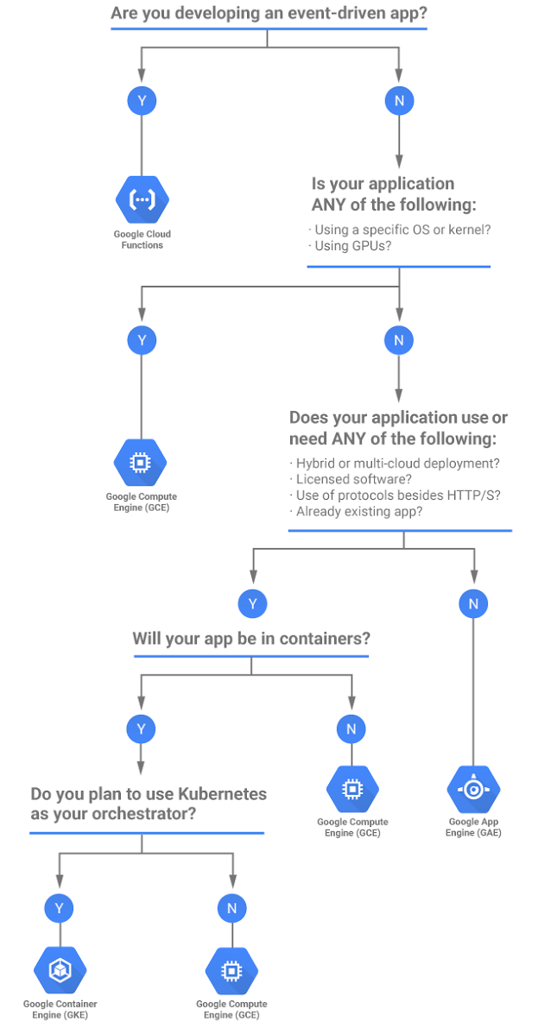
Hosting Options – Flow chart
Use GKE- when you have
Containerized workload
Want to use K8s as orchestrator
Want flexibility in using languages and runtimes
Want more control for your workloads
Want to manage your the cluster ( else use cloud run)

Slide 5
GKE Kubernetes on Google Cloud - Features
Automatic upgrades
Node pools
Automatic scaling
Node auto repair
Node Customization – also using preemptable node
Google cloud load balancing
Logging and monitoring

Slide 6
K8s Workloads
- Pods
Deployments - Replica set
Services
Stateful Sets
Daemon sets
Horizontal pod scaler

Slide 7
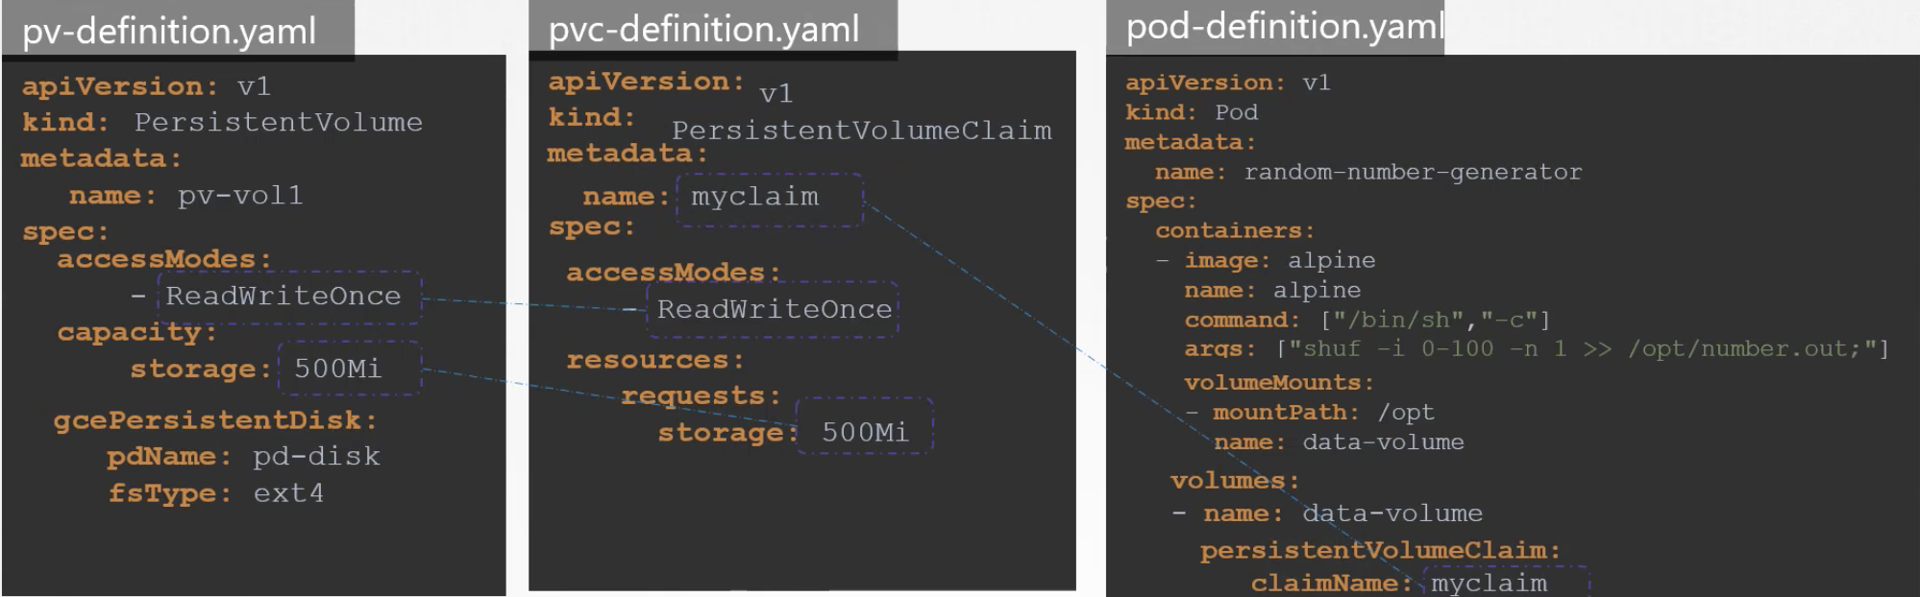
Storage
Kubernetes storage abstractions provide filesystem and block-based storage to Pods.
Volumes
Persistent Volumes
Storage classes

Slide 8
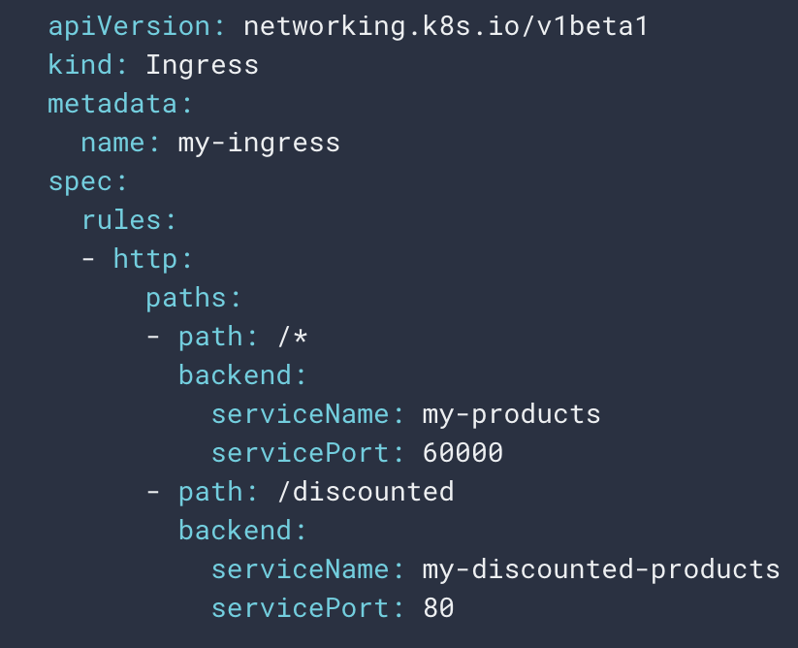
Services & Ingress
Service exposed the pods externally and provides inbuilt loadbalancing
Types of services
ClusterIP
NodePort
Loadbalancer
ExternalName - map a Service to a DNS name , Accessing third party service
Headless – DNS records for pods, no cluster IP
Ingress resource and ingress controller

Slide 9
Security
Two Types of Authentication
User accounts
Google Account
Google Cloud Service account
Service accounts
To configure more granular access to Kubernetes resources at the cluster level or within Kubernetes namespaces there is Role-Based Access Control (RBAC).

Slide 10
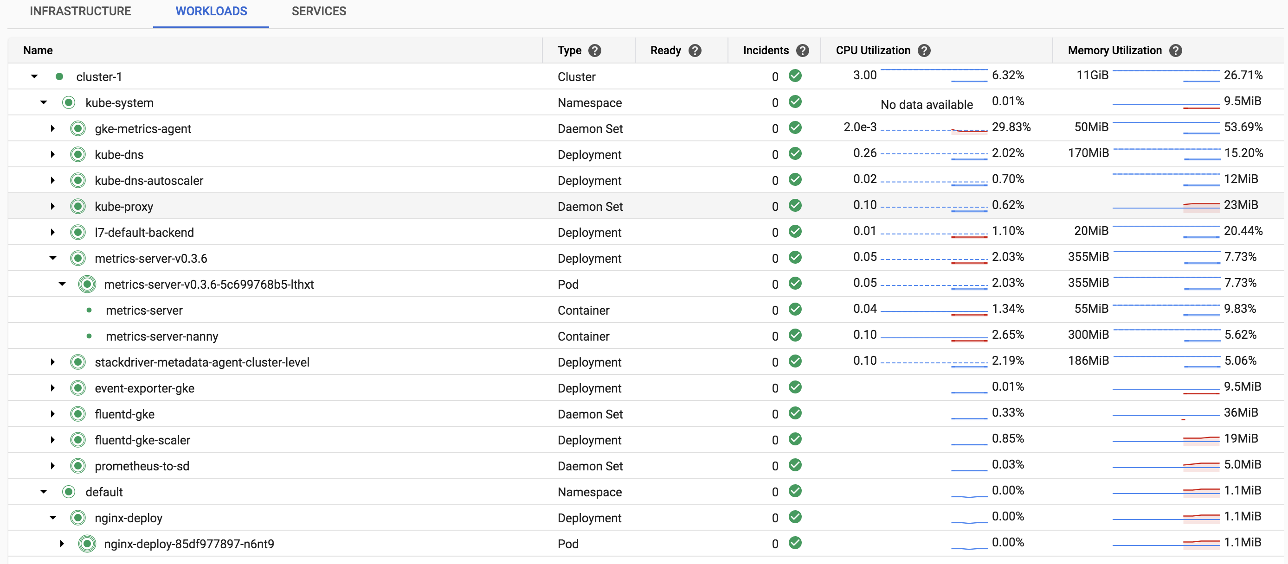
Logging and monitoring
Key Points
Kubernetes Engine Monitoring is enabled by default and provides a monitoring dashboard specifically tailored for Kubernetes.
User can control whether or not Cloud Logging collects application logs.
It provides a dashboard customized for GKE clusters
Support of Prometheus monitoring

Slide 11
Kubectl Commands Reference-
https://kubernetes.io/docs/reference/kubectl/cheatsheet/

