Slide 1
BUSINESS DATA ANALYSIS – NYSE DATA
NAME – MADHURYA K.
DATE - 09/22/2022

Slide 2
AGENDA – ANALYSIS on my Research Questions wrt nyse dataset
Q1) WHAT IS THE MEAN GROWTH RATE FOR ALL THE GISC SECTORS FROM 2012 – 2016?
Q2) WHAT IS THE AVERAGE REVENUE OF IT CONSULTING SERVICE SECTOR VS OVERALL SECTORS FROM 2012-2015?
Q3) WHAT IS THE TOTAL MAXIMUM REVENUE GENERATED BY EVERY IT CONSULTING SERVICE SECTOR VS OVERALL SECTORS FROM 2012-2016 ?

Slide 3
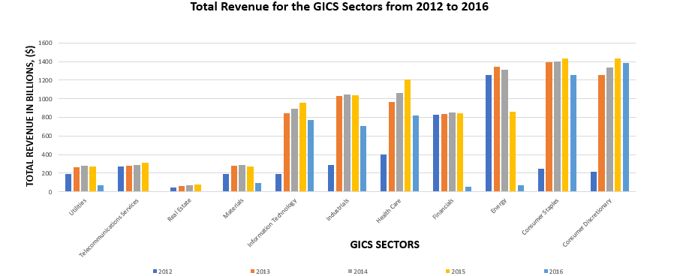
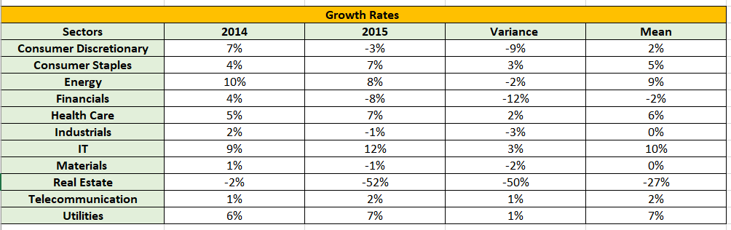
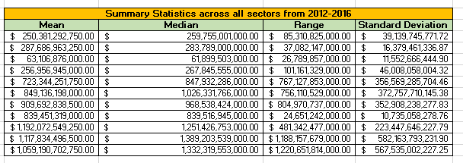
WHAT IS THE MEAN GROWTH RATE FOR ALL THE GISC SECTORS FROM 2012 – 2016?
1. The Real Estate Sector has seen a vast decline from 2% in the year 2014 to 52% in 2015 as obtained from Table 1. The negative values shows a decrease in the growth rates. The standard deviation obtained is about 223 billion with a range of nearly 481 billion which is significantly high and the median obtained is about 61 billion for the same. The mean growth rate captured is about 27%. There has been also a huge decline in the revenue which aligns to the statistics obtained for the same as seen from the graph. This sector has not been able to garner a lot of revenue which could be due to recession leading to a drop in investing for the same.
2. The remaining sectors that did decently well includes Energy with a mean growth rate of 9%, HealthCare with 6%,IT with 10%, Telecommunication and Utilities with 2% and 7% with standard deviation of about 223 billion, 352 billion, 16 billion and 39 billion respectively. So, for an investor looking out for a place for investment can invest in the any of the following areas.
3. The Financial sector has the lowest standard of deviations at 4.8 billion this suggests that costs are calm, and the investments made are somewhat safe as it is associated with low risks and is lesser volatile and stable market.
Table 1 – Growth Rates across the sectors Table 2- Summary Statistics across the GICS Sectors

Slide 4
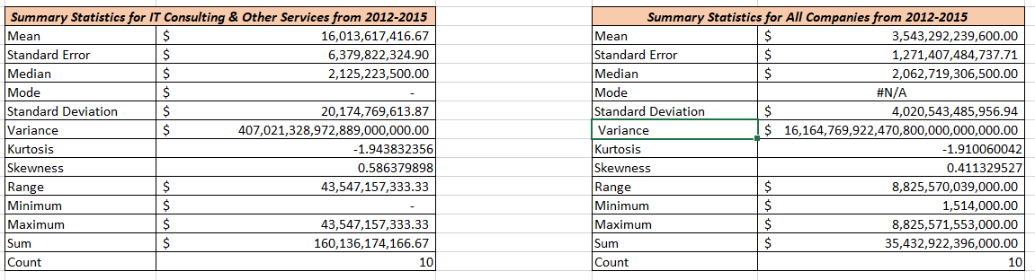
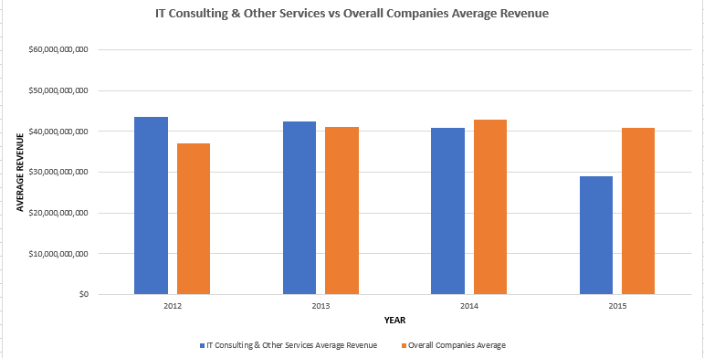
WHAT IS THE AVERAGE REVENUE OF IT CONSULTING SERVICE SECTOR VS OVERALL SECTORS FROM 2012-2015?
As we can analyze from the visualization and the tables; it can be interpreted that the highest maximum average revenue was garnered by the year 2012 and the lowest was in 2015. The overall average highest value is observed in the year 2014 which was nearly 42 billion. The mean obtained for this sector was close to 16 billion when compared to the overall companies average value which was higher. The same goes in the case for standard deviation, variance, median and range values. All the values obtained from the overall companies seem to be higher than the IT sector. There has been a gradual drop from the year 2012 to 2015 in the IT sector.

Slide 5
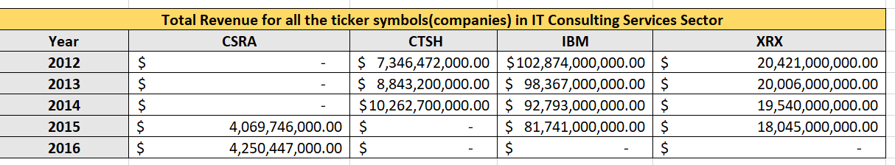
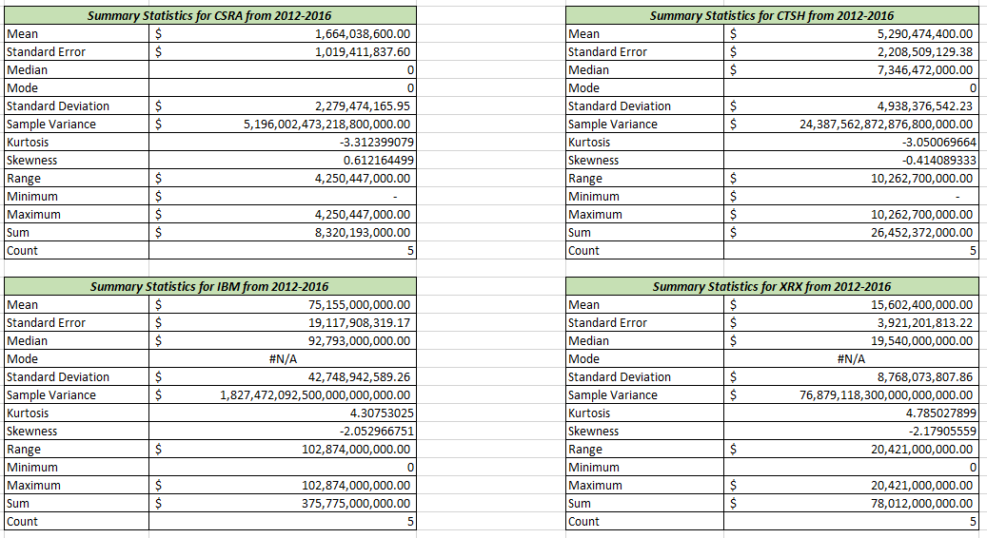
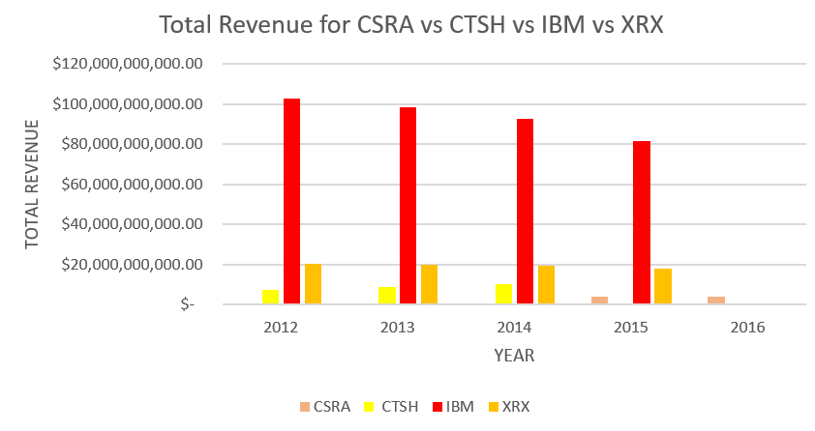
QUESTION 3- WHAT IS THE TOTAL MAXIMUM REVENUE generated BY EVERY IT CONSULTING SERVICE SECTOR VS OVERALL SECTORS FROM 2012-2016 ?
It can be highlighted from the visualization and the table that the max revenue was generated by the International Business Machines (IBM) in the year 2012 and in comparison, to the subsequent consecutive years it remains stable and the highest all throughout with a slow gradual decrease. The second highest company to be mentioned is CSRA Inc (System Research and Applications) followed by Cognizant Technology Solutions and last but not the least Xerox Holdings Corporation. IBM has got the highest mean, standard deviation, median with 75 billion and 42 billion, 92 billion and a range of 102 billion respectively which could be a risk for investment.

Slide 6
Takeaways
1. Generally speaking, the stock market rises gradually over time. The volatility factor is any departure from a predicted trend in a stock's price, whether upwards or downwards. It is the measure of standard deviation between returns from the market. Investors are always alarmed by volatility. The wise investor seeks a predictable, steady market with low volatility and stock prices that move as anticipated.
2. The lesser the standard deviation, the less volatile the costs are, and the investor can invest with a lower risk and the higher the volatility ; the riskier it is to invest.
3. For an investor who isn’t sure as to where to invest, investments can be made accordingly based on the investment analysis in order to diversify their portfolio.

