Slide 1

Responsive Web Design with Flexbox and CSS Grid

Slide 2
Responsive Design
Defined by three characteristics
Flexible grid-based layout
Media queries (CSS3)
Images that resize
References:
https://alistapart.com/article/responsive-web-design/

Slide 3
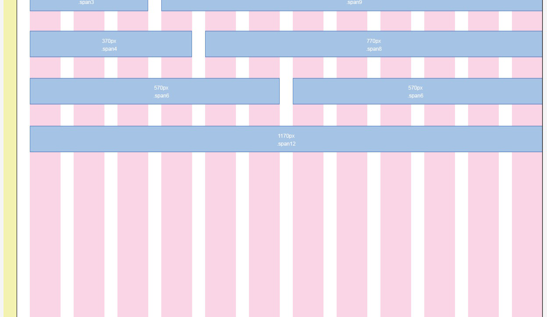
Grid-based layout

Slide 4

Images that resize
• Images should change size, based on screen resolution
• Today’s solutions include <picture>, sizes, and srcset, part of HTML spec

Slide 5

Browser reports screen resolution
Based on current width,
serve a stylesheet with
layout for that width
• No JavaScript involved
PS – media queries go beyond screen size!
• Aspect-ratio
• orientation
CSS Media Queries

Slide 6



Consider
these
guiding
principles
GRID-BASED
LAYOUT
IMAGES THAT
RESIZE
MEDIA QUERIES

