Slide 1

MACSE698 | DISSERTATION-1 | FINAL REVIEW
Tail-Sensitive Leakage Assessment for ML-KEM
Combining Extreme Value Theory with Deep Learning-Based Profiled Attacks
Presented by
G Madhusudan
Reg. No. 25MCY0001
Under the guidance of
Dr. Jeyanthi N
Professor Grade 1, SCORE
M.Tech Cyber Security | Department of Cyber Security and Intelligent Systems | School of Computer Science Engineering and Information Systems, VIT Vellore | 28 October 2026
Notes:
Introduce yourself, the guide and the title. One line: the project measures how ML-KEM implementations leak through EM emanations, using classic leakage statistics, extreme value theory and deep-learning profiled attacks, and tests every attack on independent recordings.

Slide 2
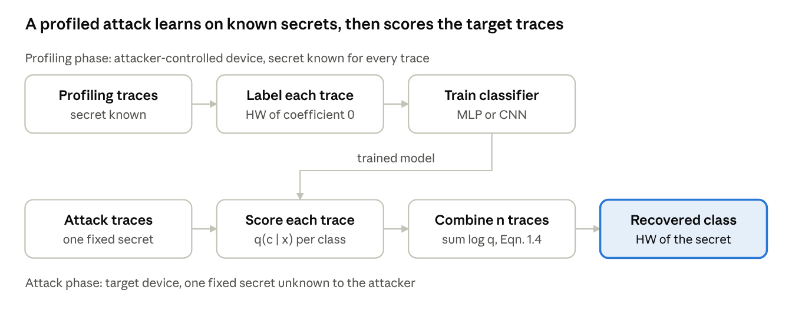
ML-KEM is secure on paper, but devices leak
ML-KEM (FIPS 203, Aug 2024) is the NIST post-quantum key-encapsulation standard derived from CRYSTALS-Kyber; its security rests on Module-LWE.
Implementation leakage: power and EM emanations depend on the data processed, so secrets can be recovered without breaking the mathematics.
Profiled attacks learn the leakage on a device with known secrets, then attack the victim's traces; deep networks dominate this setting (Picek et al., 2023).
This work: EM leakage of three ML-KEM implementations (Ledger Donjon dataset) assessed with leakage statistics, extreme value theory and deep-learning profiled attacks.
Profiled side-channel attack workflow (report Fig. 1.1)
Central idea
Security hinges on extremes (one leaking sample, one misleading trace), yet standard evaluation tools are built around averages.
Notes:
ML-KEM is being deployed now in browsers and libraries. Mathematical security is not implementation security. The dataset was recorded on an STM32F407 Cortex-M4 with a near-field EM probe.

Slide 3



Motivation: three weaknesses in current practice
Fixed detection thresholds
Arbitrary point counts
Misleading evaluation
TVLA's |t| > 4.5 is applied independently at thousands of correlated samples; on this dataset it raises false alarms under repeated checking (Feretzakis & Papaspyridis, 2026).
Attacks keep a fixed number of points of interest, such as the top 50. The base paper used fixed TVLA filtering on an unprotected target only (Chinbat et al., 2025).
Non-uniform class priors make guessing entropy report false success (Rousselot et al., 2026); networks are over-confident; validation-only results hide cross-session failure.
Missing: a data-driven rule for how many points carry real leakage, and attack results checked on independent recordings.
Notes:
Three observations led to the work. Emphasise that extreme value theory has been used for software timing side channels (Baez et al., 2025) but not to choose leaking points in an EM attack, in the works reviewed.

Slide 4
Objectives and research questions
Objectives
Research questions
1
Hamming-weight leakage assessment (t-test, SNR) on all three implementations
RQ1
Where, and how strongly, do the three implementations leak the HW of secret coefficient 0?
2
GPD tail cut-off for points of interest versus a fixed top-50 rule
RQ2
Does a GPD tail cut-off pick fewer points than top-50, and at what accuracy cost?
3
CNN profiled attacks evaluated on fixed-key attack traces
4
Verify ground truth and trace-label pairing at every stage
RQ3
How accurate are MLP and CNN attacks with K = 50, 100, 150 points on validation, test and attack data?
5
Maximum-accuracy attack under a leakage-free protocol; find the minimum points
RQ4
When a model that does well on validation data fails on attack data, what is the cause?
6
Evaluate on the complete attack sets and diagnose any failure
Notes:
Objective numbers match Table 8.1 in the report. Each research question is answered on the conclusion slide.

Slide 5
Literature survey: 18 papers from 2023 onwards
01
Deep learning dominates
02
Fixed point-selection rules
03
Detection calibration is open
DL profiled attacks are the main profiling method and reach high accuracy on unprotected Kyber (Picek et al., 2023; Chinbat et al., 2025; Ravi et al., 2023).
POI selection uses average-case statistics such as TVLA filtering; no attack paper models the tail of the leakage statistic.
|t| > 4.5 misbehaves under repeated checking; SNR distribution derived (des Noes, 2024); trace-wide corrections ignore correlation.
04
Metrics under scrutiny
05
EVT not used for EM leakage
06
Masked targets rarely studied
Non-uniform priors cause false GE success; uncalibrated networks are over-confident (Rousselot et al., 2026; Nouraniboosjin & Ganji, 2024).
Applied to timing side channels and permutation p-values (Baez et al., 2025; Peschel et al., 2026), not to EM leakage statistics.
Few masked evaluations (Dubrova et al., 2023; Ganesh et al., 2024); second-order CPA breaks mkm4 in about 200 traces.
Notes:
Five papers come from the Review 2 survey; the rest are recent work on leakage detection, attack metrics and EVT. Full merits and demerits are in Table 2.1.

Slide 6
Base paper and the gaps this work closes
Aspect | Chinbat et al. (2025) | This work
Target | FPGA Kyber NTT, power traces | ML-KEM base multiplication, Cortex-M4, EM traces
Protection | Unprotected only | Two unprotected + one first-order masked
POI selection | TVLA, fixed rule | Top-50 vs GPD cut-off; training-only weighted SNR
Evaluation | Validation accuracy | Validation, test split, full attack sets, prior-aware
Best result | 96.64% accuracy | ref 94.77% validation, 94.65% attack set
G1
POI count fixed by rule
GPD cut-off; K sweep
G2
Validation-only results
Test split + full attack sets
G3
Misleading priors
Baseline, null model, prior correction
G4
Over-confident models
Temperature scaling
G5
Session shift undiagnosed
Drift check, expected-HW diagnosis
G6
Masked target rare
mkm4 with share positive control
G7
Ground truth unaudited
Integrity audit, label fix
Notes:
The base paper found that filtering speeds training without loss of accuracy. This work tests that claim with a data-driven filter on independent attack data. G1 to G7 map to Table 2.3.

Slide 7
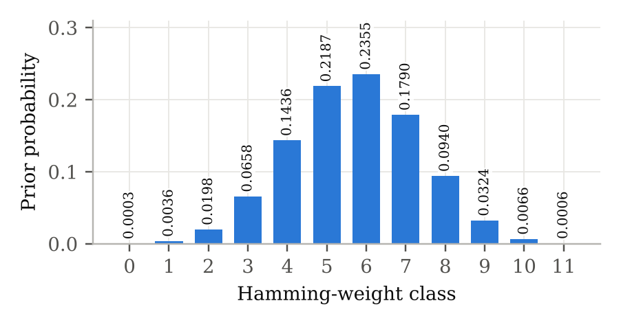
Dataset: Ledger Donjon ML-KEM EM traces
Implementation | Protection | Profiling | Attack | Samples | Fixed secret (HW)
pqm4 | None | 200,000 | 200,000 | 20,000 | 679 (HW 6)
ref | None | 100,000 | 100,000 | 13,000 | 1026 (HW 2)
mkm4 | 1st-order masking | 100,000 | 100,000 | 10,000 / share | 1681 (HW 5)
HW class prior over values mod 3329 (report Fig. 1.2)
800,000
12
23.6%
traces analysed (all files)
Hamming-weight classes of coefficient 0
majority baseline (HW 6 prior 0.2355)
Why the baseline matters
Always guessing HW 6 is already 23.6% accurate, so every model is judged against this, not against 1/12 = 8.3%.
Captured with a near-field EM probe on an STM32F407 (ARM Cortex-M4). Each trace covers one base multiplication r = a × b; the secret is operand a (pqm4, ref) or b split into two shares (mkm4).
Notes:
The dataset ships with no labels and no split; both were derived here. Trace lengths in the files differ from the dataset paper's summary table.

Slide 8




Techniques used in the pipeline
Leakage statistics
Extreme value theory
Welch's t-test between HW ≤ 6 and HW > 6 (TVLA level |t| > 4.5) and the class-weighted SNR across the 12 HW classes, streamed over full profiling sets.
Excesses of |t| over u (98th percentile) fitted with a Generalised Pareto Distribution; each sample scored by −log₁₀ of its survival probability.
Deep-learning attack
Prior-aware evaluation
MLP and CNN trained on profiling traces output q(c | x); n attack traces are combined by summing log-probabilities.
Accuracy vs the 23.6% baseline, guessing entropy, success rate, prior correction log q − log π, temperature calibration.
Notes:
GPD survival: P(Y > y | X > u) = (1 + ξy/σ)^(−1/ξ). ξ > 0 heavy tail, ξ = 0 exponential, ξ < 0 bounded. Prior correction removes n·log π(c), which otherwise pulls decisions toward common classes.

Slide 9
System architecture: three layers, nine modules
Data layer
Stages 1–2, 10
DataLoader
chunked .npy loading
GroundTruthVerifier
secret and pairing audit
Labeller
HW of coefficient 0
Assessment layer
Stages 3–6, 11.2
LeakageAssessor
streaming t-test and SNR
TailModeller
GPD fits, tail scores
POISelector
top-K, EVT cut-off
Attack layer
Stages 7–9, 11
FeatureBuilder
windows, standardise, drift
ModelTrainer
MLP, CNN, 3 seeds, calibration
AttackEvaluator
accuracy, GE, SR, prior fix
Google Colab + Drive; 10,000-trace streaming chunks for 8 GB sets; NVIDIA L4 GPU for Stage 11. Highlighted: EVT component.
Notes:
Design rule: no number used to make a decision may come from the data on which that decision is later judged. Stage 11 enforces it fully. UML use case and component diagrams are in the report, Figs. 4.3 and 4.4.

Slide 10
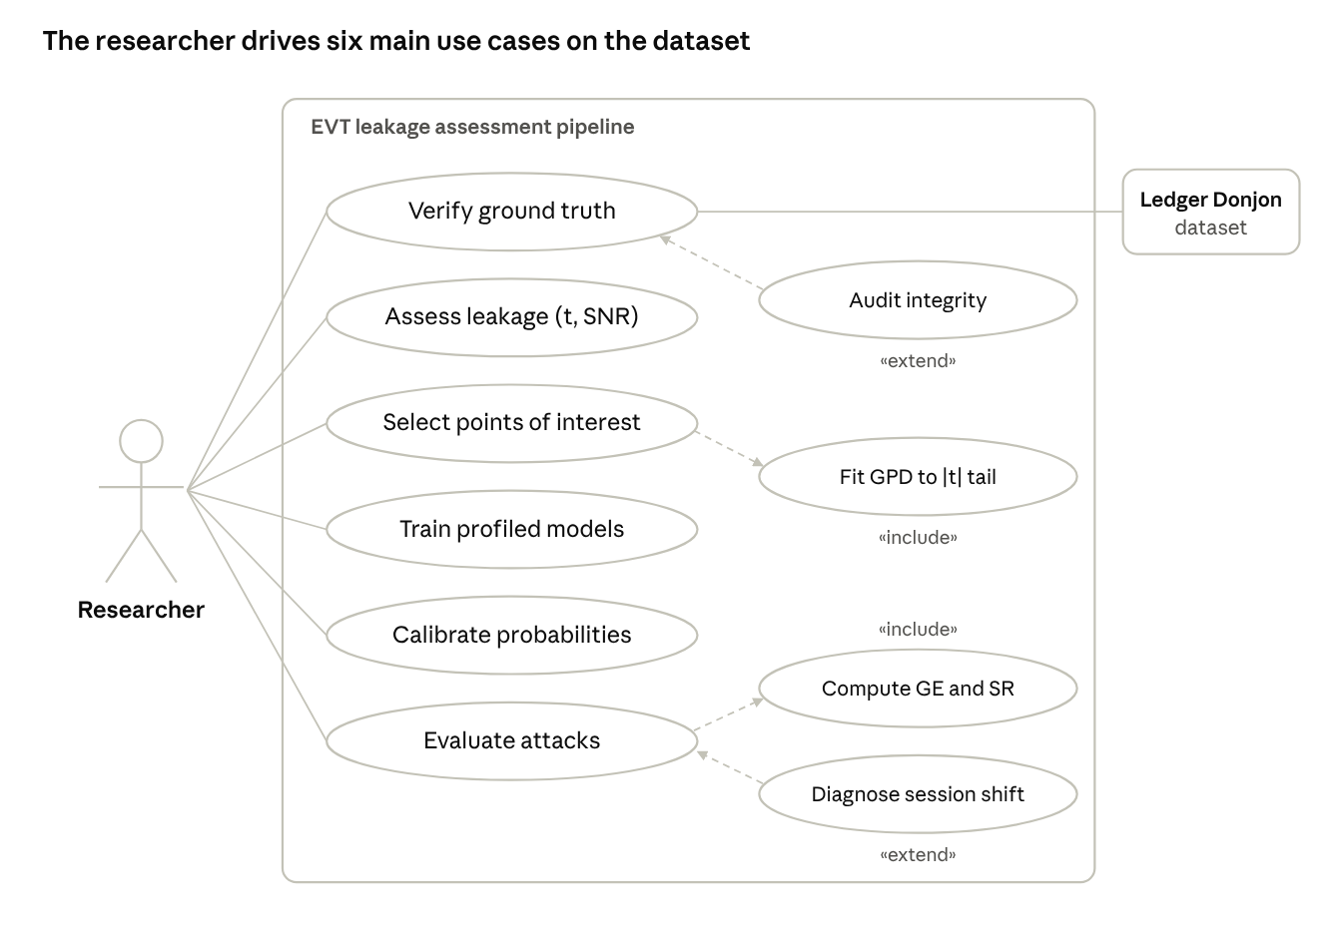
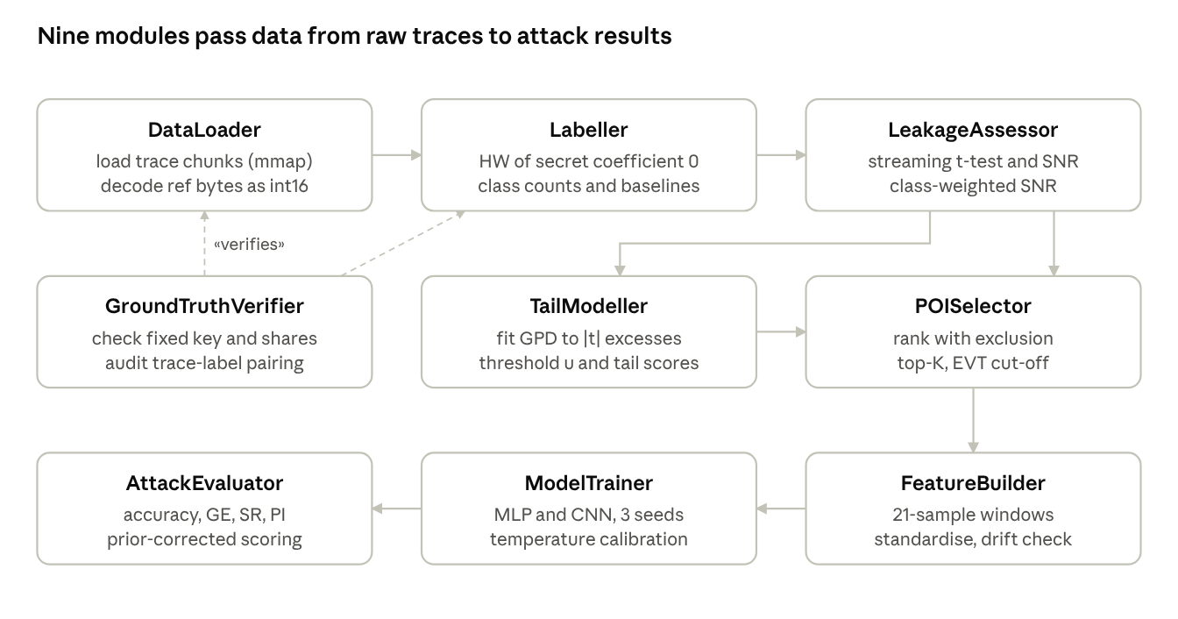
UML design: use cases and components
Component diagram (report Fig. 4.4): nine modules pass data from raw traces to attack results
GroundTruthVerifier checks the loader and labeller
TailModeller (EVT) feeds POISelector
FeatureBuilder → ModelTrainer → AttackEvaluator
Use-case diagram (report Fig. 4.3): the researcher drives six use cases; GPD fitting is included in point selection, the integrity audit extends ground-truth checks
Notes:
Use-case view: one actor, the researcher, with six main use cases. Fit GPD is included in point selection; Audit integrity extends ground-truth verification; Compute GE and SR is included in attack evaluation; Diagnose session shift extends it. Component view: the nine modules of the architecture on the previous slide and how data flows between them.

Slide 11
Project timeline: 11 stages, three reviews
Review 1
July 2026
Review 2
7 Oct 2026
Final review
28 Oct 2026
Future work
beyond this report
1 Dataset setup
2 Ground truth
3 Baseline leakage
4–6 POIs, GPD cut-off
7–8 CNN training
9 Attack evaluation
10 Integrity audit
11 Max-accuracy attack
C1 calibrated threshold
C2 tail tests
C3 EVT on evidence
C4 generalisation
Dissertation period: 6 July 2026 to 3 November 2026. All stages 1–11 completed.
Notes:
After Review 2, the extensions C1 to C4 were placed behind Stage 11, because a credible leakage-free attack baseline had to exist first. Stage 11 was limited to K = 50, 100 and 150.

Slide 12




Stages 1–2 and 10: ground truth and integrity audit
Secret operand found
Fixed secret coefficient 0
In the fixed-key set mult_a has 1 unique row in 200 while mult_b varies, so a is the secret; coefficient 0 explains the strongest leakage.
pqm4
679
HW 6 (majority class)
ref byte encoding
ref metadata is raw bytes; read as little-endian int16, 100% of values lie in [0, q) versus 5.5% big-endian.
ref
1026
HW 2 (prior 1.98%)
Masked shares checked
b0 + b1 mod q equals the stored unmasked key; each share has its own 10,000-sample window.
mkm4
1681
HW 5
Stage 10 audit
Masked labels were misaligned with traces; rebuilt from paired share files and Stages 4–9 recomputed. pqm4 and ref passed unchanged.
Notes:
The public operand also leaks: at ref sample 6039, |t| is 66.9 against b[0] but only 6.05 against a[0]. The pqm4 secret in the majority class makes the pqm4 attack easy to fool, which becomes important later.

Slide 13
Stage 3: unprotected code leaks, masking holds
168.39
pqm4 max |t| at sample 183, SNR 1.1352
55.19
ref max |t| at sample 7917, SNR 0.2739
3.20
masked secret: below 4.5, no first-order leakage
262.83
positive control: share b0 alone leaks strongly
Notes:
Streaming SNR and Welch t-test over 200,000 pqm4 and 100,000 ref and masked traces. Relabelling the masked traces by share b0 gives |t| = 262.83, SNR 1.083 at sample 516, so the null result for the secret is not an insensitive test.

Slide 14
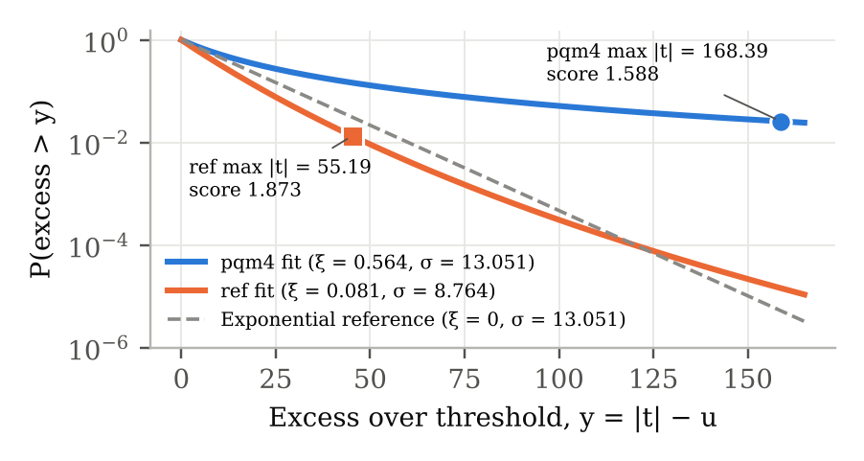
Stages 4–6: GPD tail cut-off for points of interest
GPD fit (tail 0.02) | pqm4 | ref
Threshold u (98th pct of |t|) | 9.676 | 9.964
Shape ξ / scale σ | 0.564 / 13.051 | 0.081 / 8.764
Samples above u | 400 of 20,000 | 260 of 13,000
Max EVT score | 1.588 | 1.873
Points: top-50 → EVT | 50 → 27 (−46%) | 50 → 15 (−70%)
Fitted GPD survival curves of the |t| tail (report Fig. 6.1)
The score keeps the |t| ranking, so only u decides the stopping point.
The 20-sample exclusion lets each leakage peak give one point, hence 27 and 15.
mkm4: no separation from the bulk, so 50 → 50 (0% cut).
ξ is unstable across tail fractions (pqm4 0.59–1.16), so it is reported, not used as evidence.
Worked example (pqm4): y = 168.39 − 9.676 = 158.71; 1 + ξy/σ = 7.859; survival 0.0259; score −log₁₀(0.0259) = 1.588.
Notes:
ref's strongest sample scores higher than pqm4's (1.873 vs 1.588) though its |t| is three times smaller, because ref's near-exponential tail thins faster. The cut-off is a data-driven stopping rule, not a calibrated detection threshold.

Slide 15
Stages 7–9: CNN arms and first attack evaluation
Null-corrected advantage Δ on the first 10,000 attack traces
ref top-50 / EVT
real information about HW 2
+7.3576 / +6.3712
pqm4 top-50 / EVT
moves toward HW 5: success came from the prior
−0.4534 / −0.5068
mkm4 top-50 / EVT
noise level, as expected
−0.0197 / +0.0155
Same 4,716-parameter CNN for both arms; mkm4 values are about 23.5%, the majority-class rate.
Guessing entropy saturated for pqm4 because its secret is the majority class, so a null model was needed.
Notes:
EVT arms lost 0.2 (pqm4) and 3.6 (ref) points of validation accuracy with 46% and 70% fewer points. pqm4 accuracy fluctuated between about 21% and 31% across epochs, so the 0.2-point gap is within noise. The pqm4 Δ was the first sign of the problem diagnosed in Stage 11.8c.

Slide 16
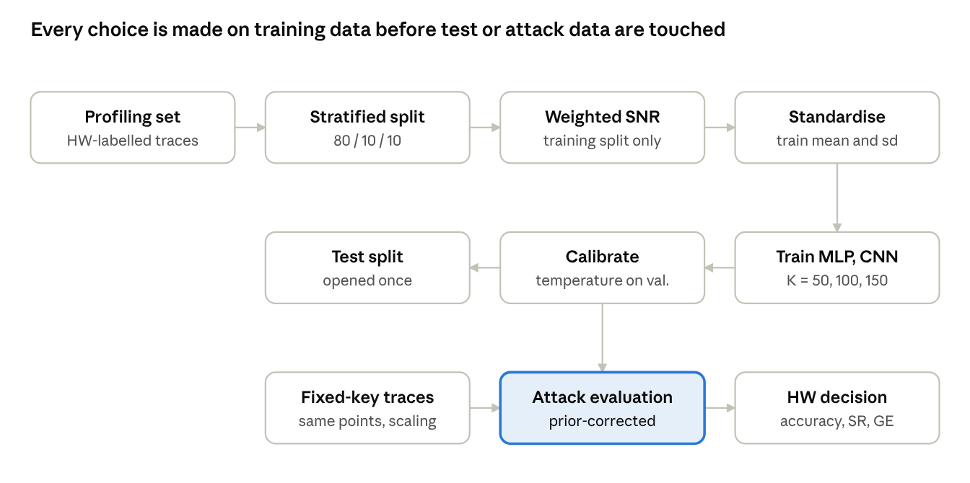
Stage 11: leakage-free maximum-accuracy protocol
MLP
Flatten K × 21 → Dense 256 → 128 → 64 → 12 logits; batch norm, ReLU, dropout 0.3
312,524 parameters at K = 50
CNN
Same 1-D filters on every 21-sample window (32, 64, 128) → Dense 256 → 128 → 12 logits
499,980 parameters; conv part only 52,736
Stage 11 data flow (report Fig. 4.2): every choice is made on training data before test or attack data are touched
80/10/10 split · K = 50, 100, 150 · 3 seeds · temperature calibration · prior-corrected scoring
Notes:
Fixes three Stage 7–9 weaknesses: selection on the full profiling set, raw inputs, single training run. Adam 1e-3, batch 512, up to 100 epochs, early stopping, ReduceLROnPlateau, no class weights; prior removed at attack time. NVIDIA L4 GPU.

Slide 17
Validation accuracy: 50 points are enough
94.1–94.8%
ref CNN: four times the 23.37% baseline; seed spread < 0.5 points
39.1–39.6%
pqm4: 1.68× the 23.61% baseline; extra points add noise
+43.7 pts
ref vs Stage 8 (50.45% → 94.13%); pqm4 +8.2 (31.42% → 39.61%)
Notes:
The CNN beats the MLP on ref by 4 to 8 points because ref leakage spreads over neighbouring samples (7917, 7957, 7996) that shared filters combine. pqm4 has one dominant point (sample 183), so the MLP is as good as the CNN there. K = 50 answers the 'how few points' question.

Slide 18
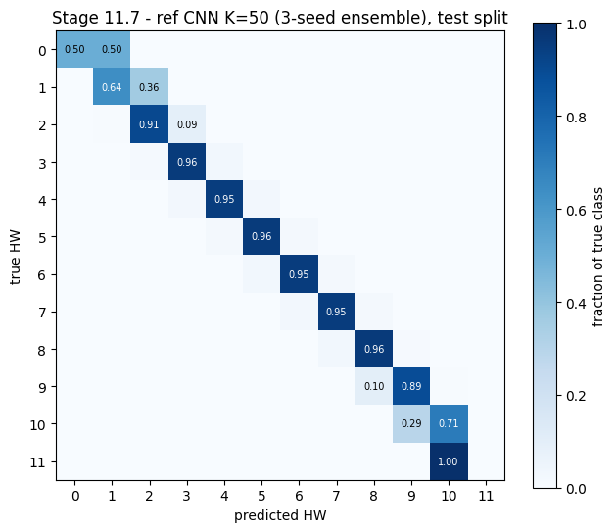
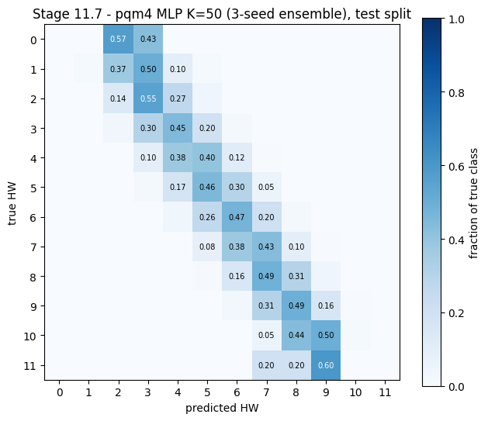
Untouched test split confirms validation
90.5%
ref attacked class HW 2 (K = 50); HW 2–9 at 89–96%
47.4%
pqm4 attacked class HW 6; HW 5–7 at 43–47%
ref CNN, K = 50 (3-seed ensemble)
pqm4 MLP, K = 50 (3-seed ensemble)
Errors fall on neighbouring classes. pqm4 predictions are pulled toward the common middle classes, as expected with weak evidence and an unequal prior. HW 0, 1, 10 and 11 have too few test traces (as few as 2) to interpret.
Notes:
The test split was opened once, after all model and K choices. Results agree with validation, so the validation split was not over-used.

Slide 19
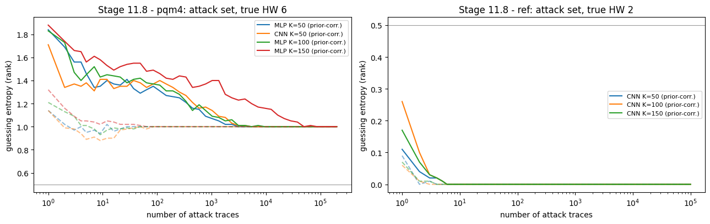
Full attack sets: ref succeeds, pqm4 fails
ref CNN, K = 50 (100,000 traces)
pqm4 MLP, K = 50 (200,000 traces)
94.65%
attack accuracy
0.892
success, 1 trace
1
trace to GE < 0.5
32.38%
attack accuracy
0.237
success, 1 trace
0
success, 100 traces
Decision HW 2 = true class; 10 traces always succeed.
Every chunk and model decides HW 5; true HW 6 ranks second.
A success rate that falls as traces are added means the pqm4 attack is consistently biased toward a wrong answer, not merely weak.
Guessing entropy on the full attack sets (report Fig. 7.4)
Notes:
Single-trace accuracy for pqm4 drops from 47.4% on same-class test traces to 32.4% on attack traces. With prior correction the ranking locks onto HW 5 within about 3,000 traces at K = 50 and about 50,000 at K = 150.

Slide 20
Stage 8 versus Stage 11 on the full attack sets
Large, real ref gain
≈26% → 94.7%; traces for GE < 0.5 fall from 4 to 1.
Prior correction rescued old ref
Plain scoring picks HW 3; corrected scoring finds HW 2 within 4 traces.
EVT cut-off cost nothing on ref
15 points need the same 4 traces; SR at 10 traces 0.909 vs 0.897.
pqm4 closer, not solved
True class rises from rank 2–6 to rank 1; decision still HW 5.
Notes:
Plain scoring sums log-probabilities (Eqn. 1.4); corrected scoring removes the prior (Eqn. 1.6). The old ref models had learned real information about HW 2, but the prior hid it, the failure mode described by Rousselot et al. (2026).

Slide 21
Why pqm4 fails: a recording-session shift
Not the model
Profiling traces of value 679 are read as about HW 6 (5.89, 6.15, 5.92).
Not the value
Bit model places 679 at the 57th percentile of difficulty (R² 0.683).
The session
Attack traces read as HW 5.27; attack drift 0.120 vs 0.0058 on validation (21×), equal in leaky and noise windows, spread unchanged (0.98).
Notes:
For ref all four numbers agree within 0.1 and its drift is small (0.0288, about 4× validation). For pqm4 a broad level shift of 0.12 standard deviations affects leaky and non-leaky windows alike, which points to changed recording conditions. A better model on profiling data alone cannot fix it; it needs matching sessions or domain adaptation, which was not attempted.

Slide 22
Conclusion: answers to the research questions
RQ1
pqm4 and ref leak strongly (peaks at samples 183 and 7917); the masked implementation does not leak the secret at first order.
Contributions
Audited assessment of all three implementations, with the dataset corrections it needs
Empirical test of a GPD tail cut-off: 46–70% fewer points
Leakage-free attack: 94.65% single-trace accuracy, HW class from one trace (ref)
Diagnosed cross-session failure (pqm4)
Prior effects demonstrated on an ML-KEM dataset
RQ2
GPD cut-off keeps 27 and 15 points instead of 50, costing 0.2 and 3.6 points of validation accuracy; the stopping point depends on the tail fraction.
RQ3
ref CNN 94.1–94.8% and pqm4 MLP 39.1–39.6% validation, little change from K = 50 to 150; ref holds on test and attack sets, pqm4 on the test split only.
RQ4
The pqm4 failure is a shift between profiling and attack recording sessions, not the model or the secret value.
Notes:
Recommendations for evaluators: report results on independent attack recordings and check drift; report a majority baseline and null model and remove the prior; select points on the training split only; calibrate probabilities before using them.

Slide 23
Limitations and future work
Limitations
Future work
One coefficient (0) and one leakage model (HW); a class is recovered, not a key
One secret per attack set; pqm4 diagnosis rests on 12 exact-value traces
pqm4 session shift diagnosed, not corrected
Unequal seeds for a few configurations; no ablation of Stage 11 changes
EVT cut-off depends on the tail fraction; no declustering
Masked implementation analysed at first order only
C1
Calibrated detection threshold from the trace-wide maximum under no leakage
C2
Tail-sensitive class tests beyond the mean
C3
EVT applied to per-trace attack evidence
C4
All 256 coefficients and a second public dataset
+
Domain adaptation for pqm4; second-order attack on mkm4
Notes:
C1 to C4 were the extension phases planned after Review 2 and deferred behind Stage 11. Per-bit labels or the value itself are alternative leakage models suggested by the pqm4 bit weights.

Slide 24
Key references
Magazin, A. A., & Abdellatif, K. M. (2026). Open EM side-channel dataset for ML-KEM (Kyber) implementations. IACR ePrint 2026/1851.
National Institute of Standards and Technology. (2024). Module-lattice-based key-encapsulation mechanism standard (FIPS 203).
Chinbat, M., Wu, L., Zhang, X., Yang, Y., & Wei, M. (2025). Comparative deep learning-based side-channel analysis of an FPGA-based CRYSTALS-Kyber NTT accelerator. Cryptography, 9(4), 64.
Feretzakis, G., & Papaspyridis, A. (2026). The price of peeking: Anytime-valid leakage detection on ML-KEM EM traces. arXiv:2609.33597.
Rousselot, N., Heydemann, K., Masure, L., Migairou, V., & Strullu, R. (2026). Is it really broken? The failure of DL-SCA scoring metrics under non-uniform priors. IACR ePrint 2026/338.
Nouraniboosjin, S., & Ganji, F. (2024). Too hot to be true: Temperature calibration for higher confidence in NN-assisted side-channel analysis. IACR ePrint 2024/071.
des Noes, M. (2024). Distribution of signal to noise ratio and application to leakage detection. IACR TCHES, 2024(2), 384–402.
Murphy, C., Tawn, J. A., & Varty, Z. (2023). Automated threshold selection and associated inference uncertainty for univariate extremes. arXiv:2310.17999.
Picek, S., Perin, G., Mariot, L., Wu, L., & Batina, L. (2023). SoK: Deep learning-based physical side-channel analysis. ACM Computing Surveys, 55(11), 1–35.
Ravi, P., Jap, D., Bhasin, S., & Chattopadhyay, A. (2023). Machine learning based blind side-channel attacks on PQC-based KEMs: A case study of Kyber KEM. ICCAD 2023, 1–7.
Full list of 20 references (APA 7) in Chapter 9 of the report.
Notes:
Selected references most used in the talk.

Slide 25
Thank You
Questions and discussion
G Madhusudan | 25MCY0001 | Guide: Dr. Jeyanthi N
Tail-Sensitive Leakage Assessment for ML-KEM | MACSE698 Final Review | VIT Vellore
Notes:
Thank the panel and the guide; invite questions.

