Slide 1
Case Study: Continuous Integration & Deployment for NodeJS using GCP

Slide 2

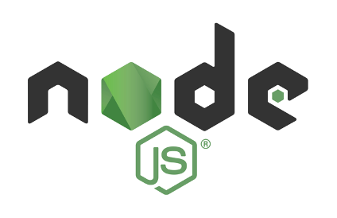



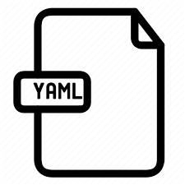


Project Summary
CI/CD Implementation for
Projects in
By Using
Salient Features
Tools
Implemented totally on the cloud
Triggers build with in no time of code commit
Using google Kubernetes for deployment
Sonar cloud for static code analysis report
Shorter time for deployment in production
Jira integration with bitbucket
CI SERVER: google cloud build
CONTAINER REPOSITORY: google container repository
PACKAGE MANAGER: npm
DEPLOYMENT TOOLS : google Kubernetes engine , google cloud build
CODE COVERAGE AND SECURITY ANALYSIS : SonarQube scanner
CODE QUALITY: Sonar cloud
UNIT TESTING : Lint/Jest
CONTENERAZATION TOOL: docker
PROJECT MANAGEMENT TOOL: Jira
SMTP TOOLS: google cloud functions
Can set testing and production environments with ease
Build frequency
On demand
Scheduled
Polling
Nightly build
Highlights
One file to automate ci/cd
Notes:
Delphi

Slide 3
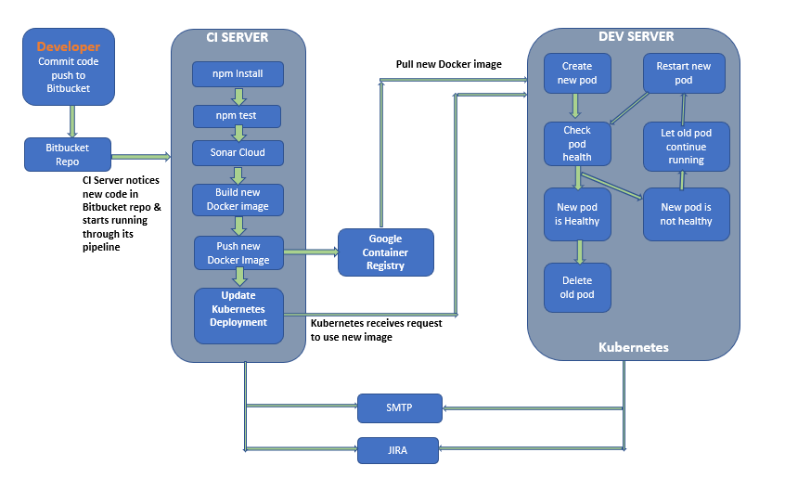

CI/CD USING GCP
Problem Statement
Implementing a ci/cd pipeline for NodeJS project using GCP adding Smtp and Jira
Every tools is cloud based
DevOps deployment with minimal investment
End-to-end automation of activities
Cloud code-coverage report
SMTP services
Minimal time to deploy in production
Challenges
SonarQube to Sonar Cloud
Time to trigger builds
Deployment
Difficult to setup ci/cd
Achieved

Slide 4









Measure of Performance
Average build time reduction
Time taken for locally implemented ci/cd
60%
Average time to onboard subsequent projects
2 – 4 Weeks
Vector Cast Test time reduction
45%
Depending on the complexity
CAN Test Time
Number of projects running on CI – BA pipeline
60%
5
Other Benefits:
Implemented DevOps pipeline reporting for accurate project monitoring
Code quality improved as code and test coverage was benchmarked
Compiler warning reduction by 10%
Implemented end to end traceability from Requirement till flashing firmware to device

Slide 5



Way forward…
Discussion between Key Stakeholder from both organization
Identifying Areas of Engagement
Validating Business and presenting Commercial Proposal
Proposal Review and Approval for Project Kick-off

