Slide 1

EXPLORATORY DATA ANALYSIS USING SQL
(ON MUSIC)
P.MADHU KALYAN

Slide 2
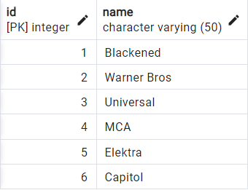
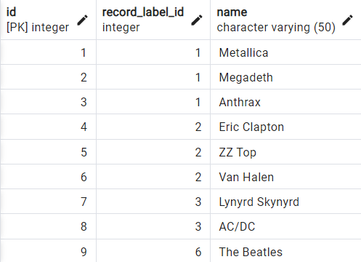
For getting all records
SELECT * FROM record_label ;
SELECT * FROM artist ;
Note : This Is Sample Output Data

Slide 3
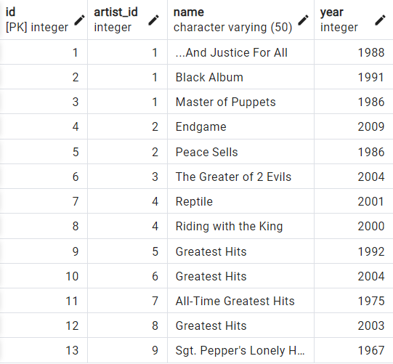
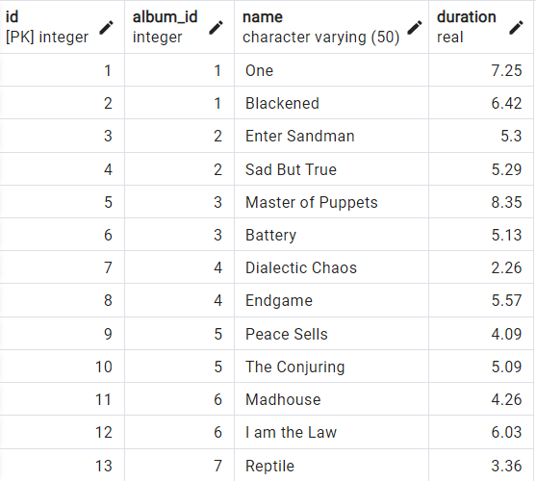
For getting all records
SELECT * FROM album ;
SELECT * FROM song ;
Note : This Is Sample Output Data

Slide 4
--List all artists for each record label sorted by artist name?
SELECT ar.name AS artist_name,
rl.name AS record_lable_name
FROM record_label rl
JOIN artist ar ON rl.id = ar.record_label_id
ORDER BY ar.name;

Slide 5
--Which record labels have no artists?
SELECT rl.name AS record_lable_name
FROM record_label rl
LEFT JOIN artist ar
ON rl.id=ar.record_label_id
WHERE ar.name IS NULL;

Slide 6
--List the number of songs per artist in descending order?
SELECT ar.name AS artist_name,
COUNT(*) AS number_of_songs
FROM artist a
JOIN album al ON ar.id = al.artist_id
JOIN song so ON al.id = so.album_id
GROUP BY ar.name
ORDER BY number_of_songs DESC;

Slide 7
--List the number of songs per artist in descending order?
SELECT ar.name AS artist_name,
COUNT(*) AS number_of_songs
FROM artist ar
JOIN album al ON ar.id = al.artist_id
JOIN song so ON al.id = so.album_id
GROUP BY ar.name
ORDER BY number_of_songs desc;

Slide 8
--Which artists have recorded songs longer than 5 minutes, and if so, how many songs were recorded?
SELECT ar.name AS artist_name,
COUNT(*) AS number_of_songs
FROM artist ar
JOIN album al ON ar.id = al.artist_id
JOIN song so ON al.id = so.album_id
WHERE so.duration > 5
GROUP BY ar.name
ORDER BY number_of_songs;

Slide 9
--- For each artist and album how many songs were less than 5 minutes long?
SELECT ar.name AS artist_name,
COUNT(*) AS number_of_songs
FROM artist ar
JOIN album al ON ar.id = al.artist_id
JOIN song so ON al.id = so.album_id
WHERE so.duration > 5
GROUP BY ar.name
ORDER BY number_of_songs;

Slide 10
--In which year or years were the most songs recorded?
SELECT al.year,
COUNT(*) AS number_of_songs
FROM album al
JOIN song so ON al.id = so.album_id
GROUP BY al.year
ORDER BY number_of_songs desc
LIMIT 1;

Slide 11
--List the artist, song,album name,and year of the top 5 longest recorded songs?
SELECT ar.name AS artist_name,
al.name AS album_name,
so.name AS song_name,
al.year AS year_recorded,so.duration
FROM artist ar
JOIN album al ON ar.id = al.artist_id
JOIN song so ON al.id = so.album_id
ORDER BY so.duration DESC
LIMIT 5;

Slide 12
--What is the max number of recorded albums across all the years?
WITH cte AS
(SELECT year,COUNT(year) AS count_year
FROM album
GROUP BY year)
SELECT MAX(count_year) AS max_number_of_album_recorded_per_year_for_all_years
FROM cte;

Slide 13
--In which year (or years) were the most (max) number of albums recorded, and how many were recorded?
SELECT year,
COUNT(*) AS max_number_of_albums_recorded
FROM album
GROUP BY year
HAVING COUNT(*) = (SELECT MAX(cnt)
FROM ( SELECT year,
COUNT(year) AS cnt
FROM album
GROUP BY year ) AS temp);

Slide 14
--List the total duration of all songs recorded by each artist in descending order.
SELECT ar.name AS artist_name,
ROUND(SUM(so.duration)::DECIMAL,2)
AS total_duration_of_all_songs
FROM artist ar
JOIN album al ON ar.id = al.artist_id
JOIN song so ON al.id = so.album_id
GROUP BY ar.name
ORDER BY total_duration_of_all_songs DESC;

Slide 15
--Display a table of all artists, albums, songs and song duration,all ordered in ascending order by artist, album and song.
SELECT ar.name AS artist_name,al.name AS
album_name,so.name AS song_name,so.duration
FROM artist ar
JOIN album al ON ar.id = al.artist_id
JOIN song so ON al.id = so.album_id
ORDER BY artist_name , album_name , song_name;

Slide 16
--- List the top 3 artists with the longest average song duration, in descending with longest average first.
SELECT ar.name AS artist_name, ROUND(AVG(so.duration)::DECIMAL,2) AS avg_song_duration
FROM artist ar
JOIN album al ON ar.id=al.artist_id
JOIN song so ON al.id=so.album_id
GROUP BY ar.name
ORDER BY avg_song_duration DESC
LIMIT 3;

Slide 17
--- Which artists did not release an album during the decades of the 1980's and the 1990's?
SELECT DISTINCT(ar.name) AS artist_name
FROM artist ar
LEFT JOIN album al ON ar.id=al.artist_id
AND al.year >= '1980' AND al.year<= '1990’
WHERE al.year IS NULL;

Slide 18
--- Which artists did release an album during the decades of the 1980's and the 1990's?
SELECT DISTINCT(ar.name) AS artist_name
FROM artist ar
JOIN album al ON ar.id=al.artist_id
WHERE al.year BETWEEN '1980’ AND '1990’;

Slide 19
Thanks

