Slide 1
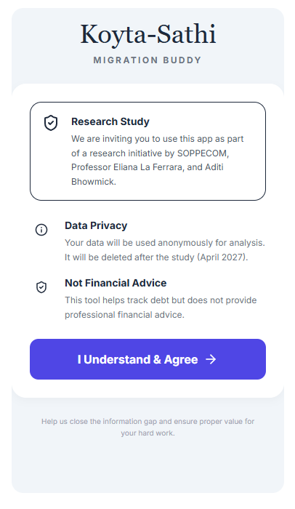
Intro screen

Slide 2
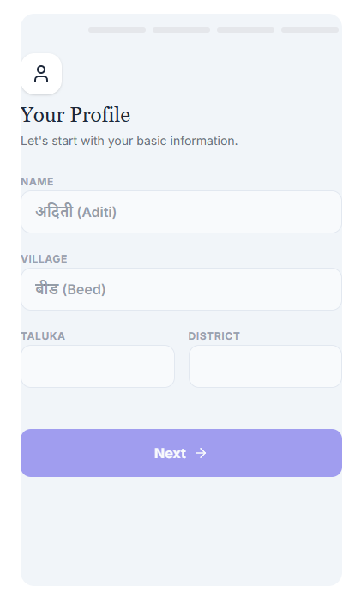
Onboarding screen

Slide 3
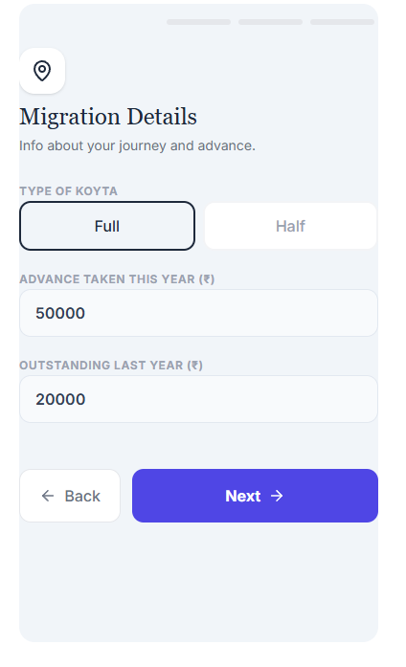
Onboarding screen

Slide 4
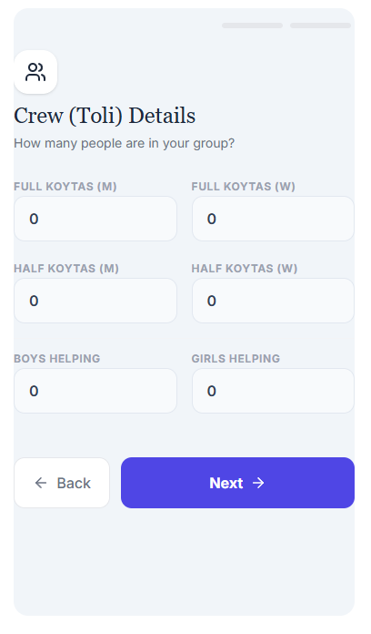
Toli details screen

Slide 5
Toli details screen

Slide 6
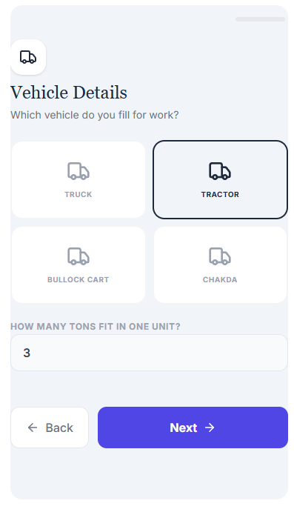
Vehicle details screen

Slide 7
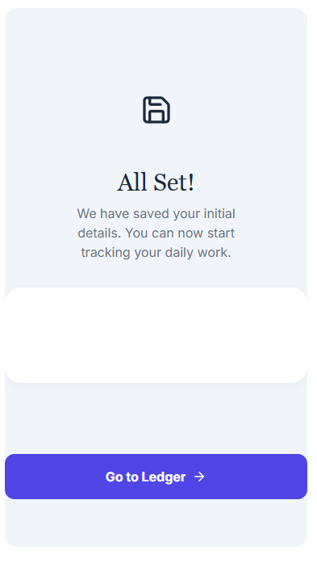
Transition screen

Slide 8
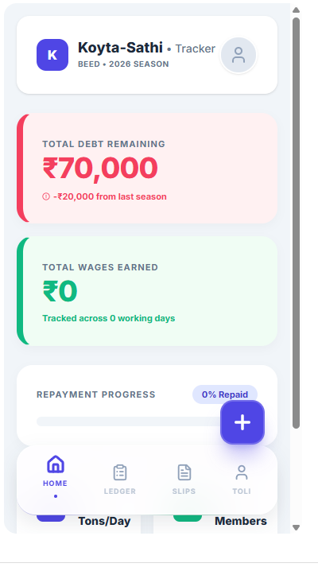
Tracker dashboard

Slide 9
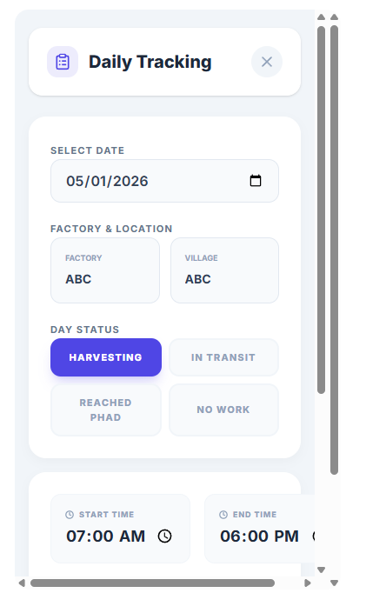
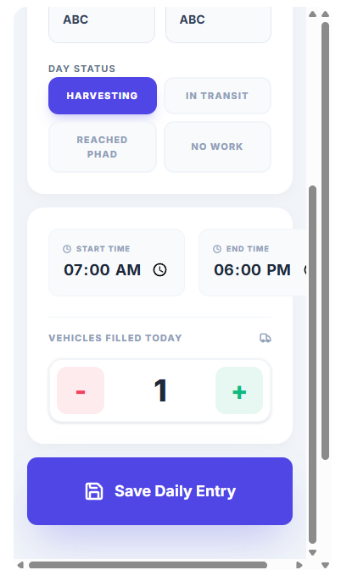
Add daily update by clicking “+” on dashboard

Slide 10
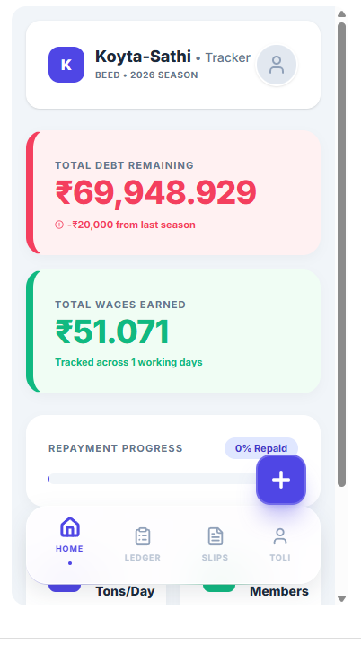
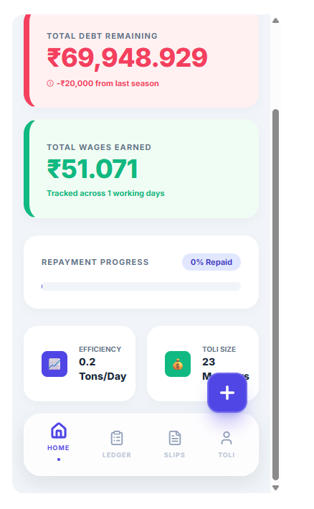
Dashboard updated “automatically”

Slide 11
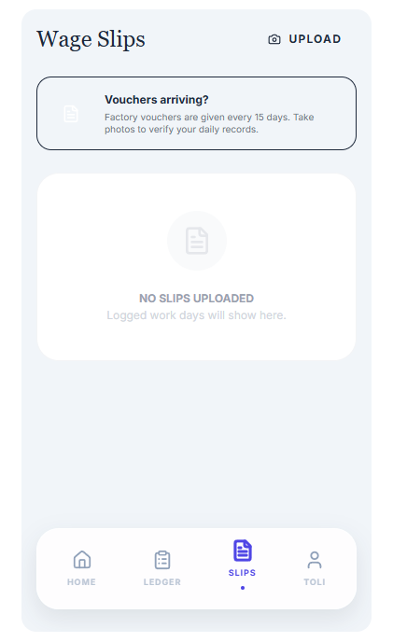
Note the slips option via which can upload slips once a month

Slide 12
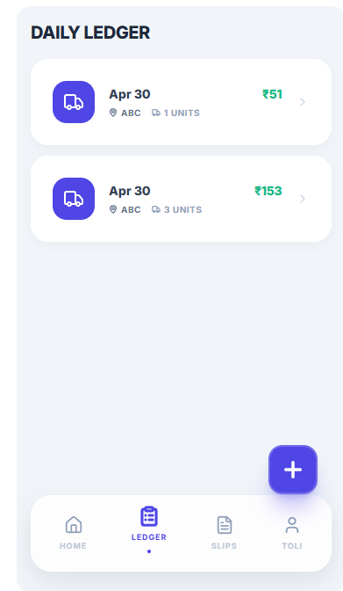
This is what the ledger screen looks like as you keep updating daily

Slide 13
Back end algo to convert vehicles filled into daily wages – we can modify as needed
Wage Calculation Algorithm
The algorithm I implemented follows the logic outlined below:
Total Group (Toli) Earnings:
The Rate per Ton is determined by vehicle type (e.g., ₹366.01 for Tractors, ₹408.41 for Trucks) based on the 2024 rates provided in SOPPECOM document.
The Tons per Vehicle is what the user specifies during the setup (e.g., 3.5 tons for a tractor).
Individual Household (Koyta) Earnings:
We use a weighted count for the group size: Full Koytas count as 1.0, and Half Koytas count as 0.5.
Example: If a Toli has 8 Full Koytas and 4 Half Koytas, the total earnings are divided by 10.0.
Remaining Debt: This allows the worker to see instantly how much of their debt is cleared after every single vehicle they load

Slide 14
Features to be added – not in mockup yet
Allow workers to also provide details on how many tolis (half and full) worked each day
Allow workers to download the final ledger as a pdf that they can save on their phone

