Slide 1
Summary
Fatalities by Nature of flights
Breakup of various phases of flight
Air fatalities from year 2000 onwards
Visual Comparison of volume of domestic / international flights in US
Worst top 100 air accidents
Road for Air fatality comparison

Slide 2
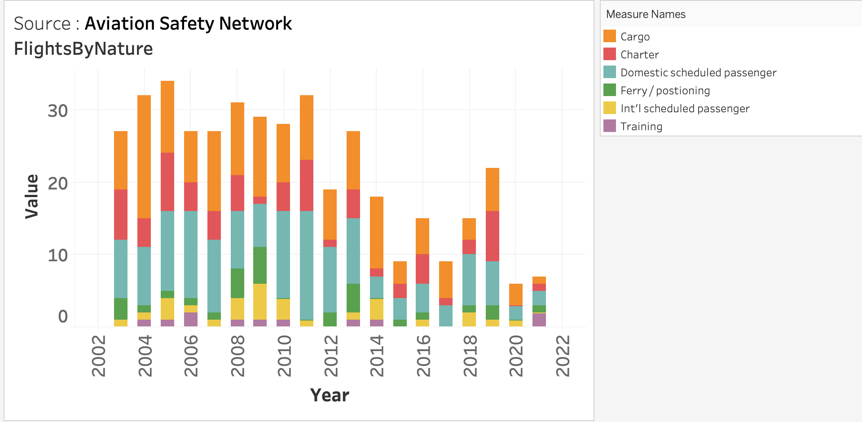
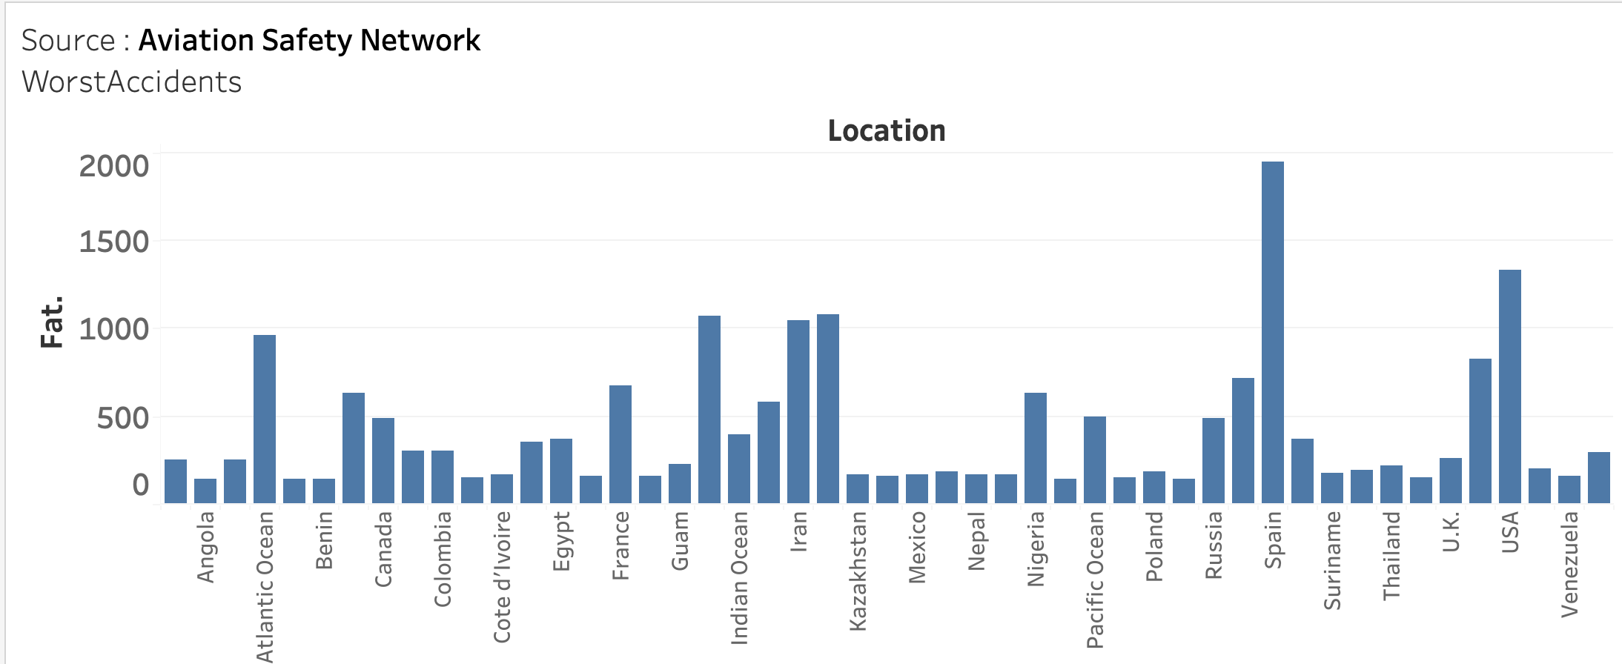
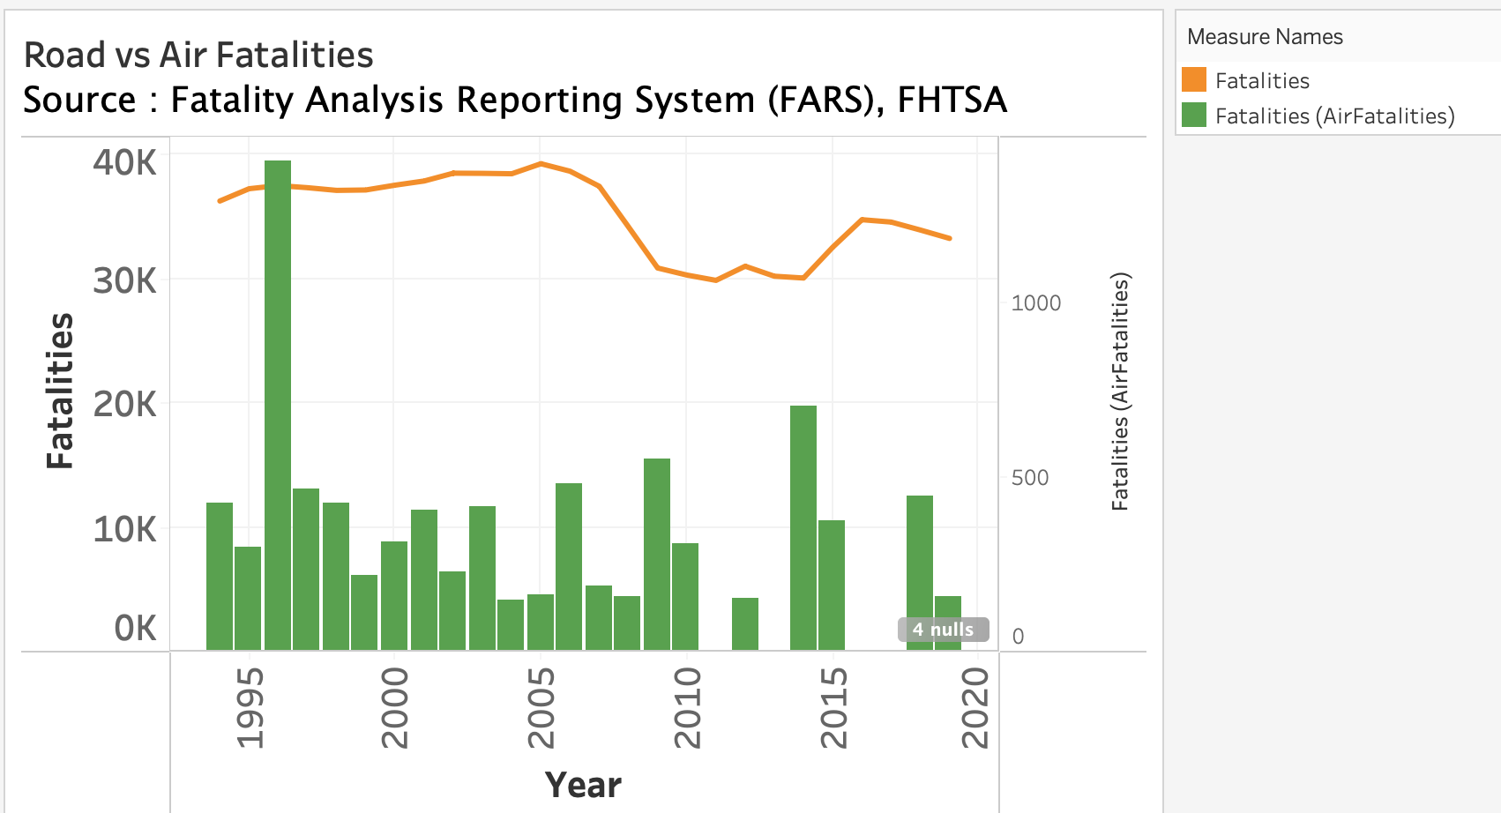
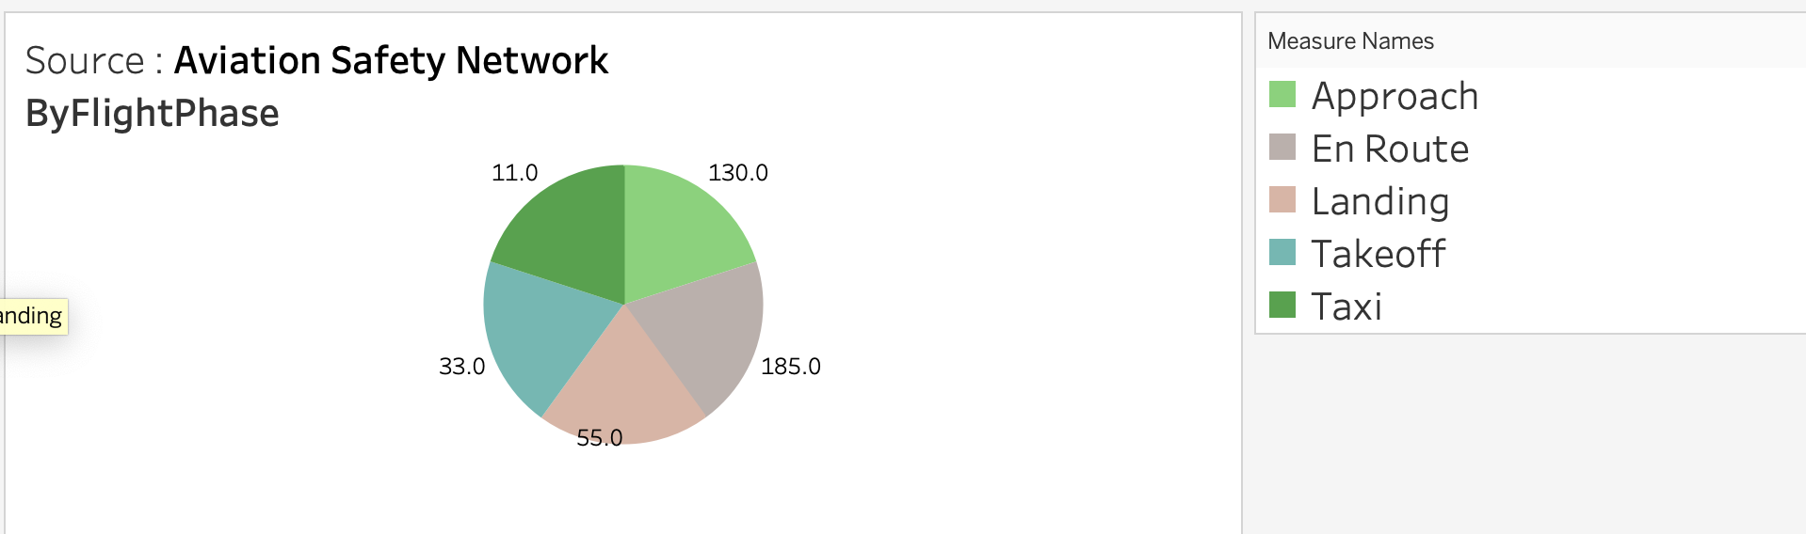
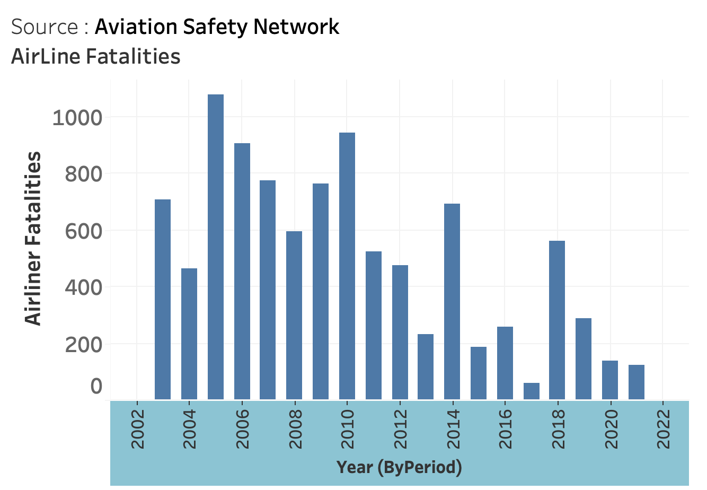
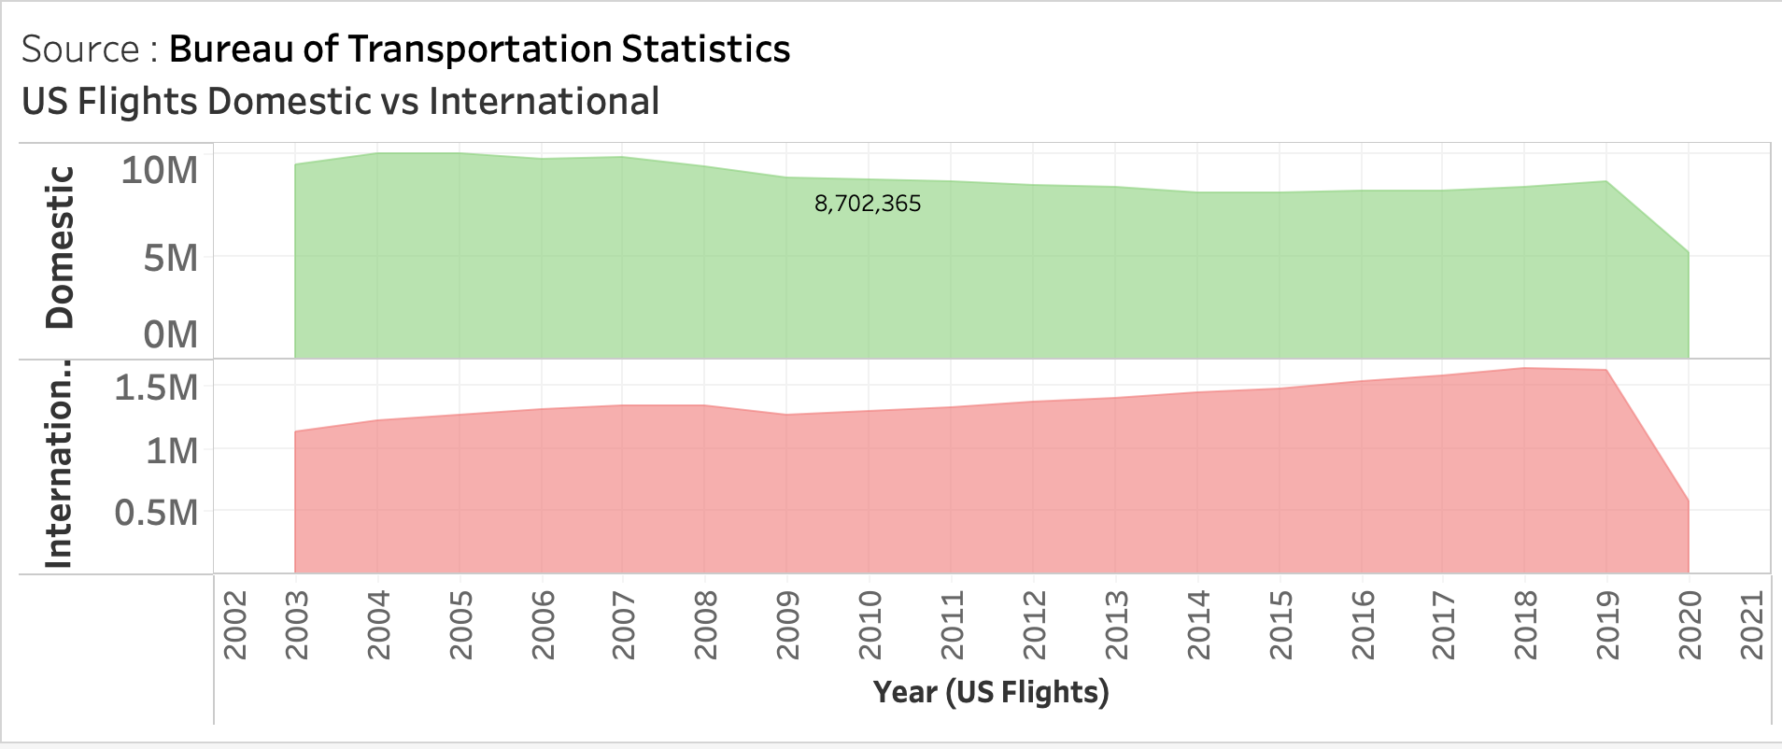
Dashboard

Slide 3
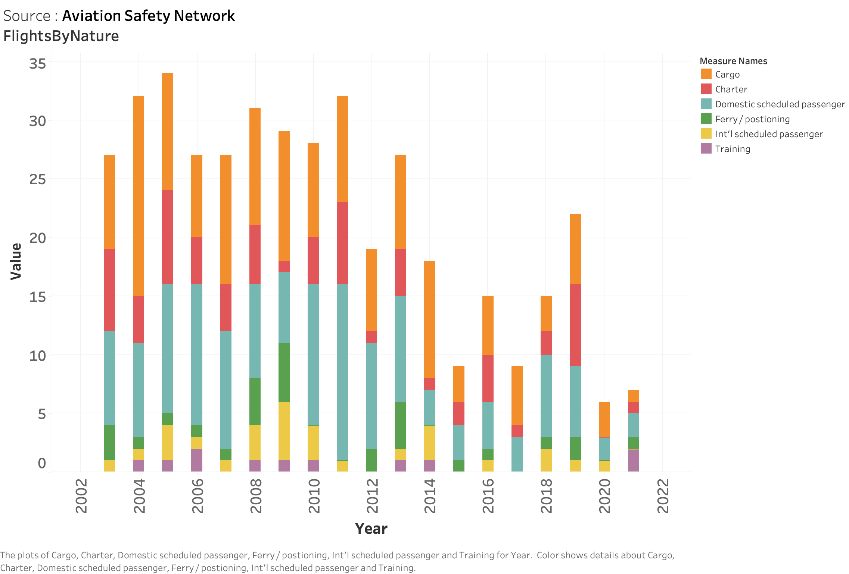

Slide 4
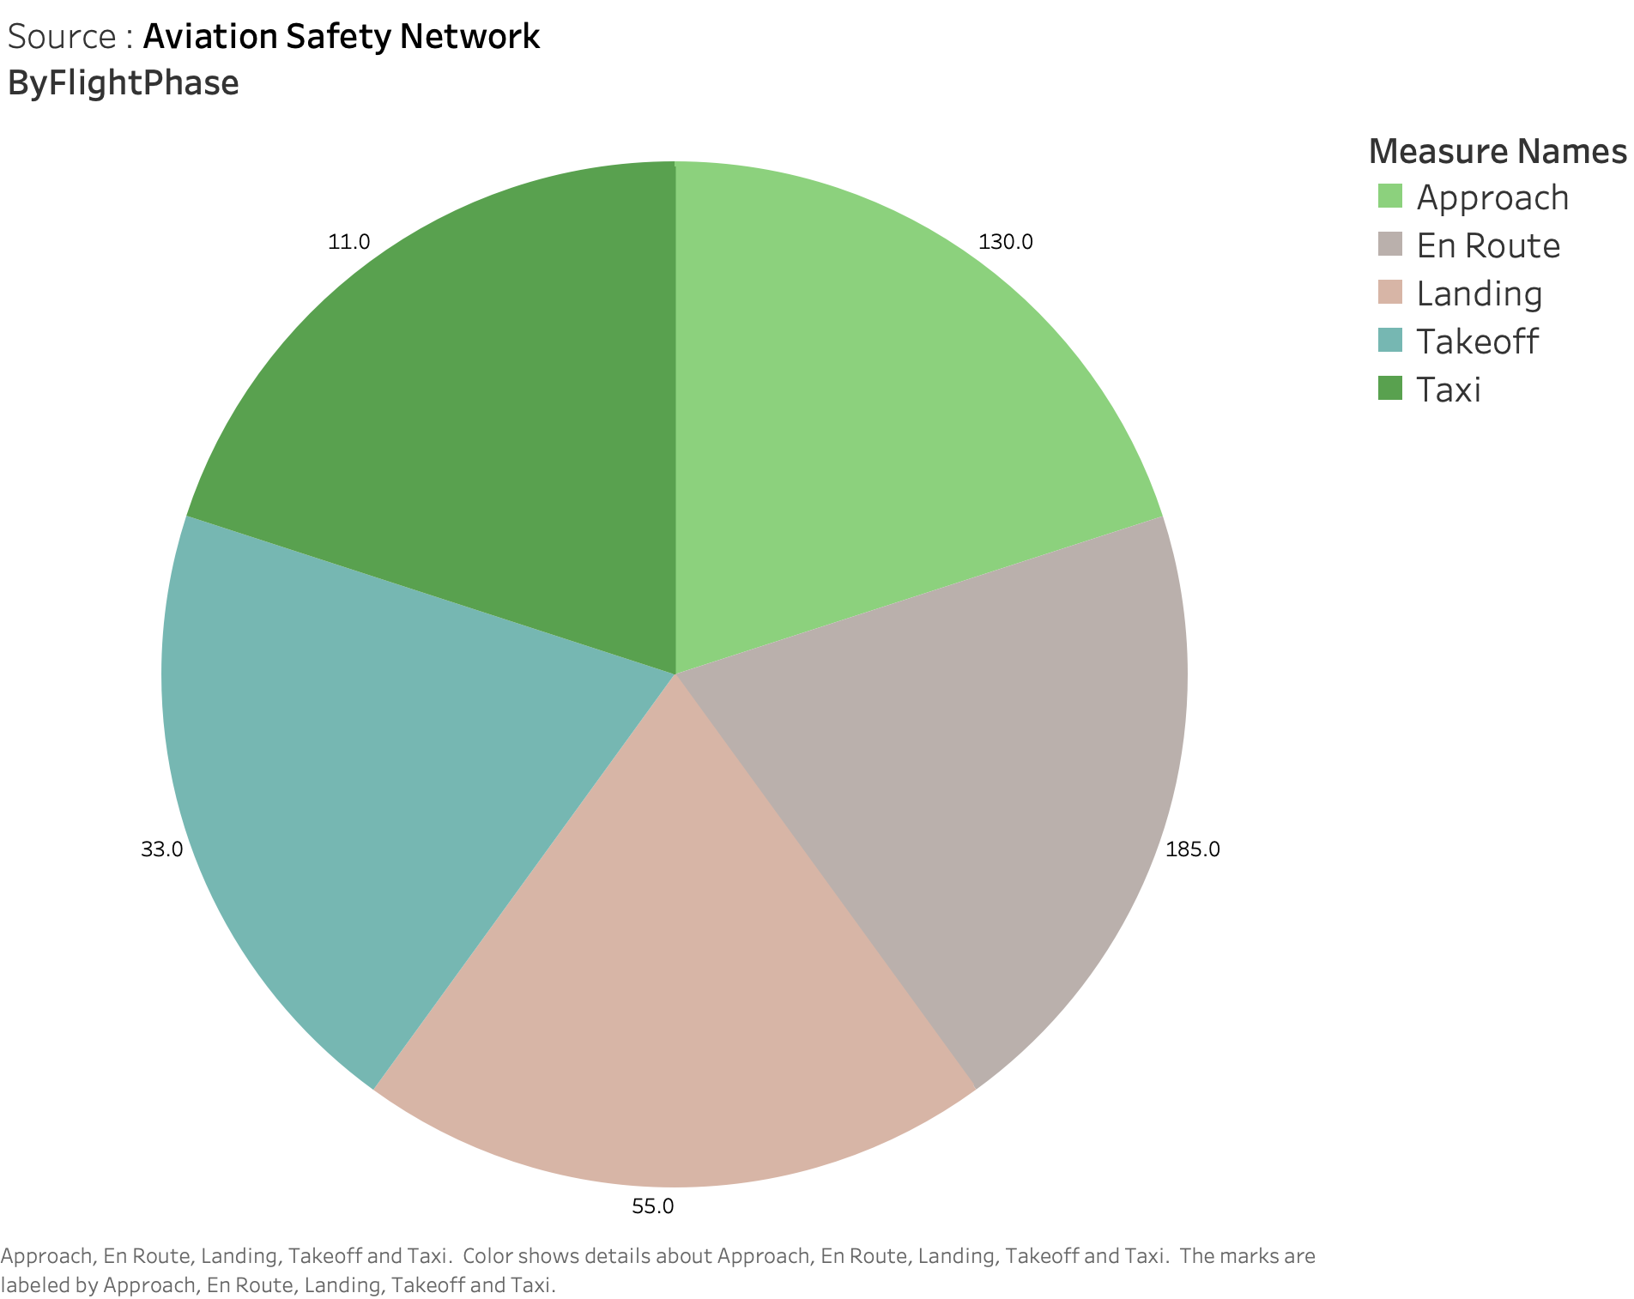

Slide 5
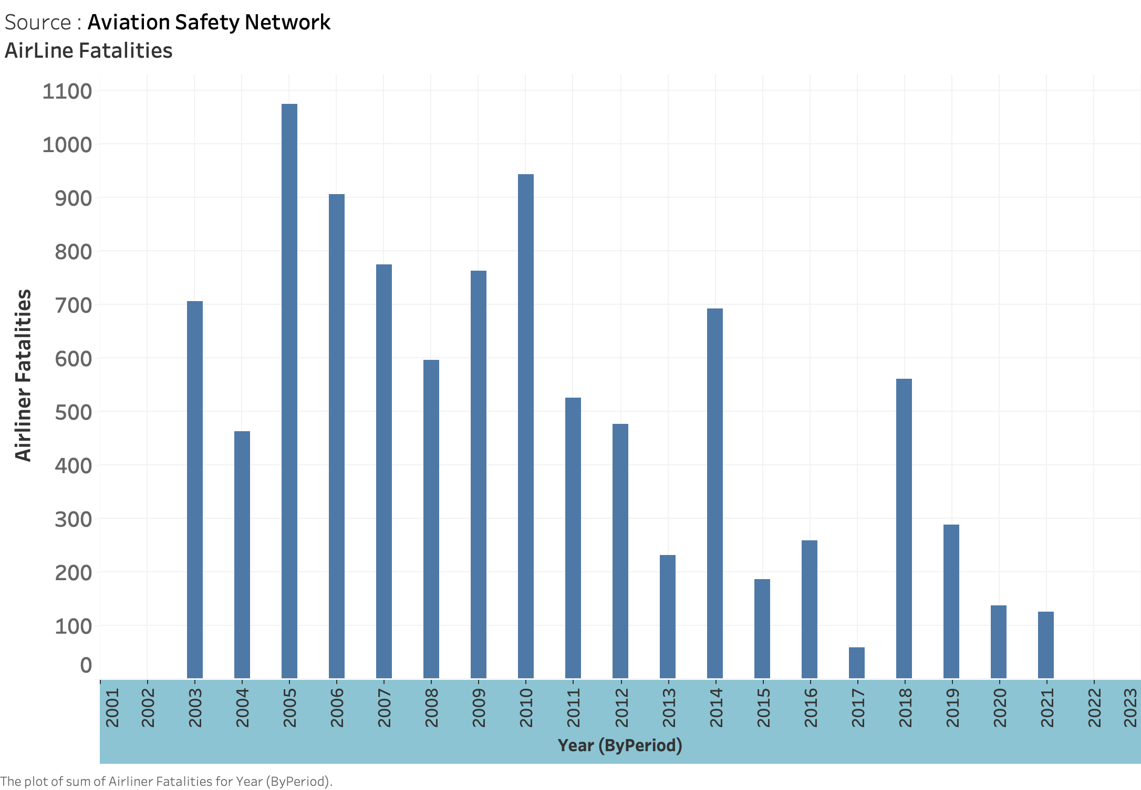

Slide 6
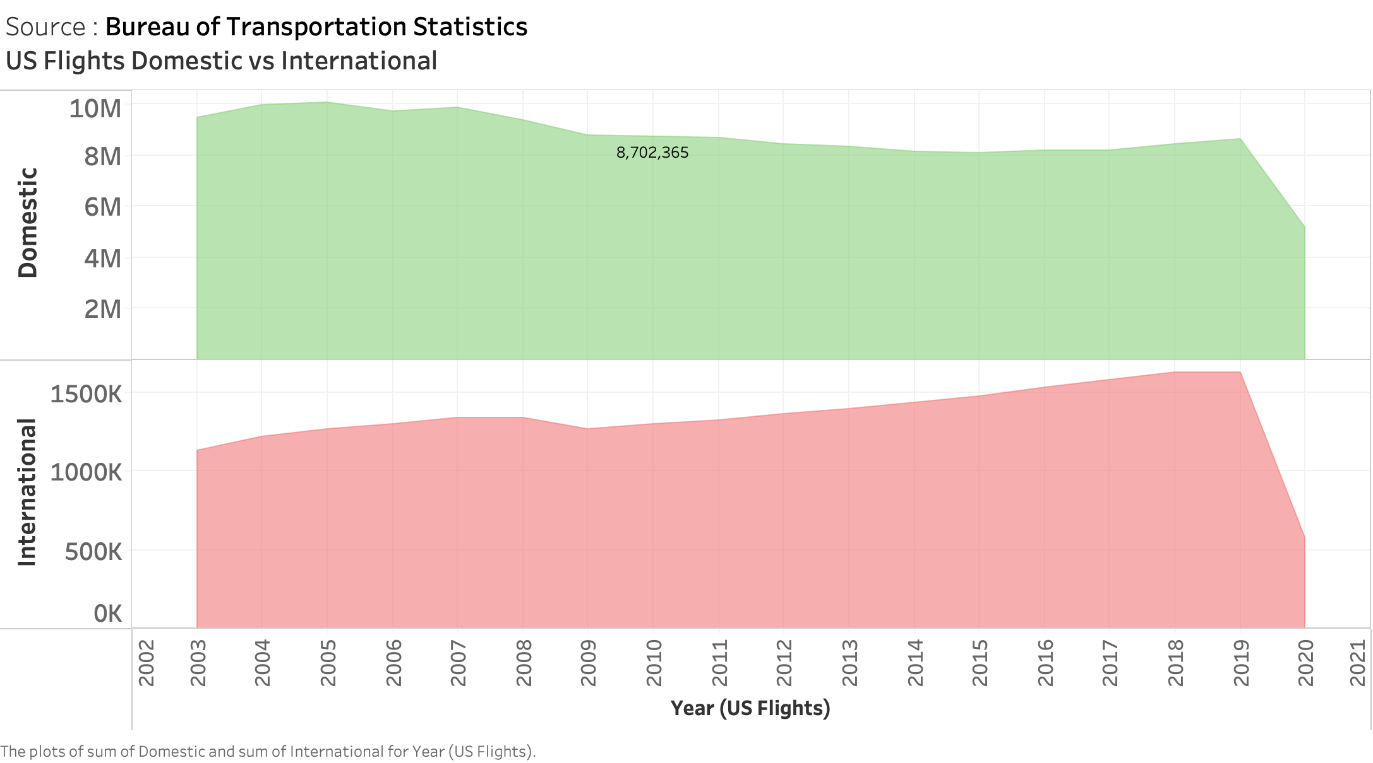

Slide 7
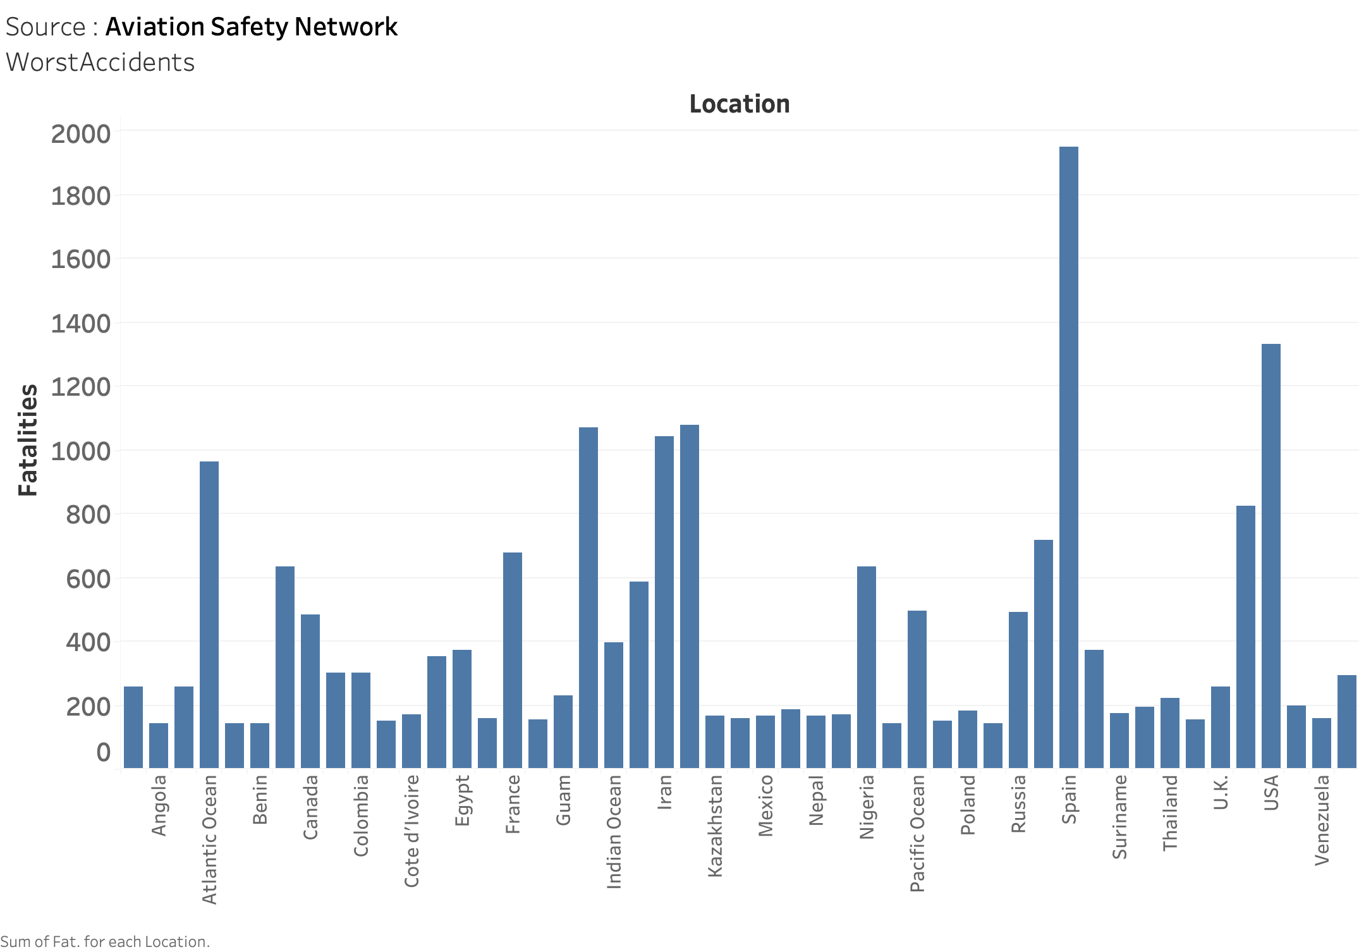

Slide 8
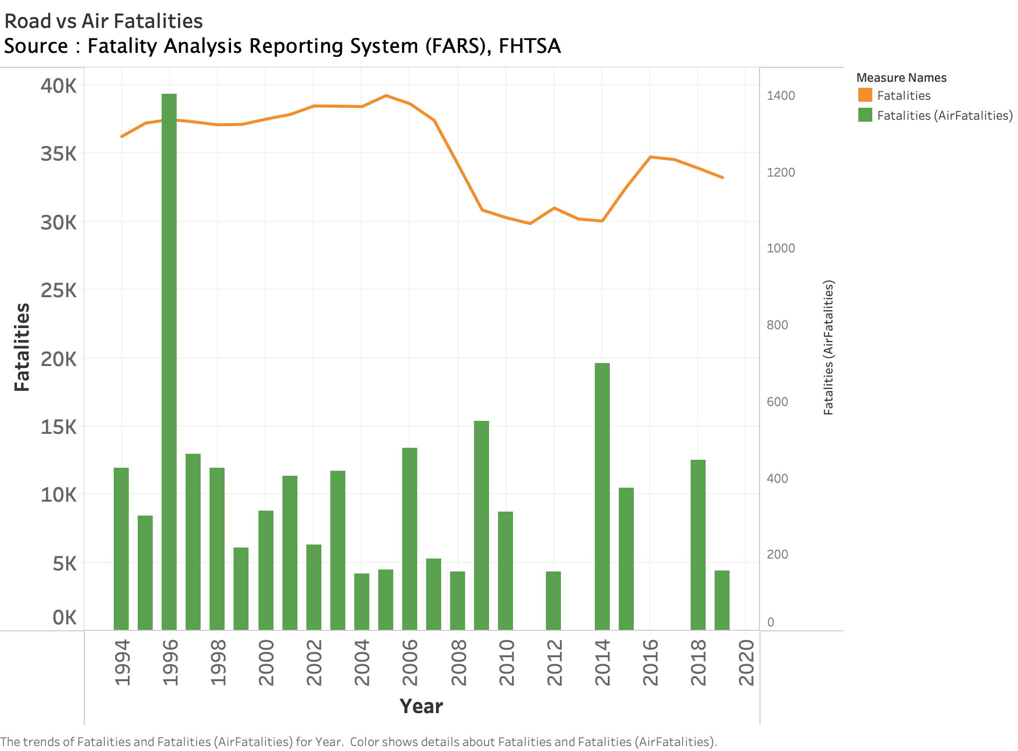

Slide 9
Reference
https://aviation-safety.net/statistics/
https://www.transtats.bts.gov/Data_Elements.aspx?Data=1
https://www-fars.nhtsa.dot.gov/Trends/TrendsGeneral.aspx

