Slide 1
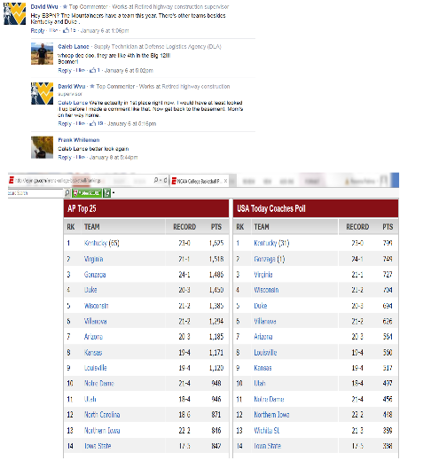
MarchMadness Twitter Data
Kristin Baker
Madhukar Ganesh Chatra
Anusha Iyer
Rowena Palima

Slide 2
What and Why ?
We will be looking at Twitter data of the top five teams of the ACC Mens conference: Virginia, Notre Dame, Louisville, Duke, and North Carolina
Number or tweets for each teams
Look at correlation between sentiments in Tweets and team performance
-Predict which team will win the ACC Championship game and move on to the March Madness tournament

Slide 3
Design and Implementation Considerations
Twitter Rate Limit for REST API, Streaming - we will only be going with data that we get for free
Twitter data is only a sample of the whole Twitter data
Relational Database vs NoSQL data storage
Analysis on the fly, and later (on historical data)

Slide 4
Knowns
Data we will be looking at at the outset: ID, text, timestamp, place, urls, hashtags
Data will only be a small percent subset of the whole data population
Affin lexicon for the Sentiment Analysis
Tools of Trade: Python, Java, MongoDB, Excel, JSON, JSON CSV converter

Slide 5
Unknowns
If the data sample is representative of the whole population regarding the ACC Conference; Firehose can be used for a fee
Other data that we might need to revisit and analyze later, hence need to go back to the NoSQL data store to have another look

Slide 6
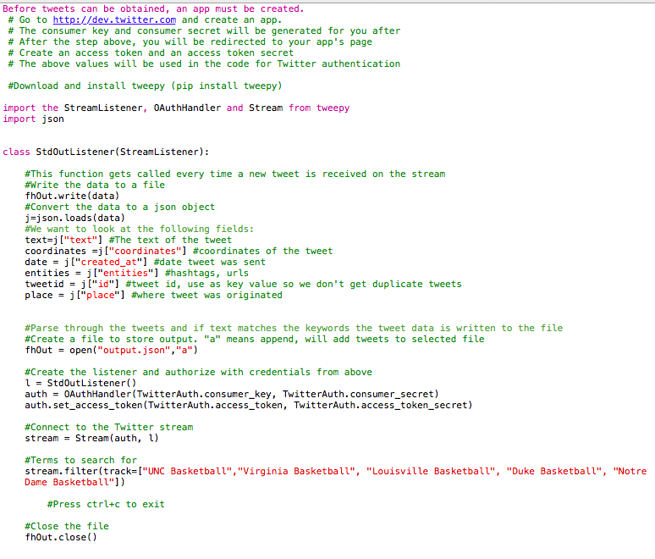
Getting the data
Streaming API
Provides a continuous
stream of information with
out further user input.
Will use the public
stream since it is the
most versatile

Slide 7
Using the search API
<pseudocode>
step 1 import Json, twitter libraries
step 2 create error log file log.txt
step 3 Create a variable term which takes keywords to be searched.
E.g. terms = ["UNC Basketball", "Virginia Basketball", "Duke Basketball"]
step 4 create a TwitterAuth class
step 4.1 The consumer key and secret will be generated.
step 4.2 It redirects to App page after the creation of key and secret
step 4.3 The Access token is created for the App page access
step 4.4 Use a handler function OAuthHandler() to set consumer key and consumer secret
step 4.5 Use set_access_token() function to set the twitter access tokens previously defined.
step 4.6 for all terms included in the keyword do the following
step 4.6.1 Search for the term in every tweet using RawParser
step 4.6.2 Write the matching tweet data to corresponding .json file
step 4.6.3 Update the max_id after every tweet search.
step 4.6.4 Repeat the steps above starting from previous max _id once the count of json files reaches 10000 for each term
step 4.6.5 If no match is found for the keyword exception will be raised
step 4.6.6 Check the status of the result and print the number of results found.
step 5 Close the connection between API and Twitter App.
</pseudocode>

Slide 8
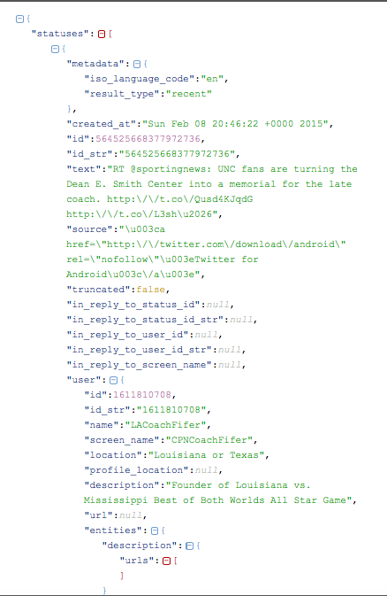
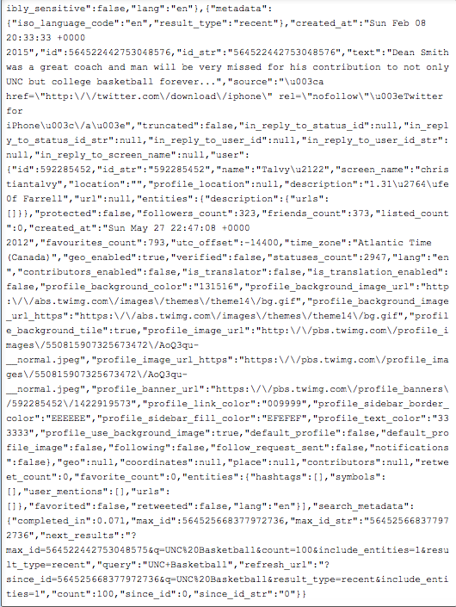
Understanding the data
Twitter data is received in JSON format
Parsing through the files are required to clean and prepare the data for analysis

Slide 9
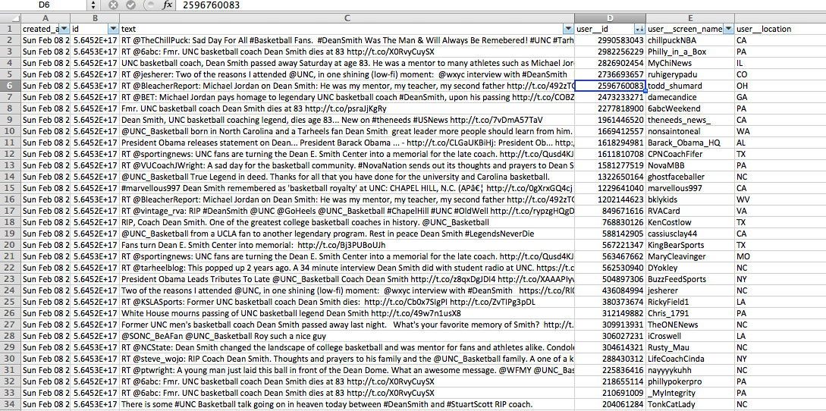
Twitter Data In CSV Format
Organized data in CSV for easy analysis of:
Trends over time
Sentiment of tweets
Geographical trends

Slide 10
Sentiment analysis
The method that is proposed to be used for sentiment analysis is AFINN lexicon.
<pseudocode>
Step 1: Open the csv file for reading
Step 2: Define a dictionary for keeping the hashtags as keys and their frequency as values
Step 3: Loop for every tweet in the csv file
Step 3.1: Extract text from the tweets
Step 3.2: Flatten the data such that each word in that text is one row and the frequency of occurrence of the word is recorded
Step 3.3: construct or upload a lexicon (eg. Afinn) and create a table with two columns, word from text and score based on the severity of the sentiment
Step 3.4: Join the flattened out text table with the lexicon table on words
Step 3.5: Sum the score group by tweet
Step 3.6: Compare with the threshold to determine whether it is a positive or negative tweet
</pseudocode>

Slide 11
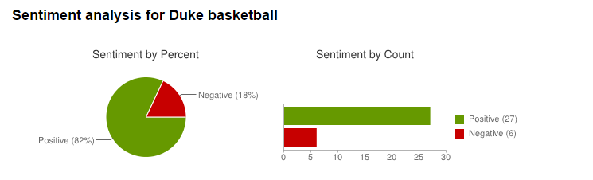
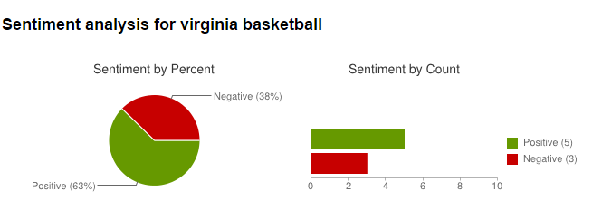
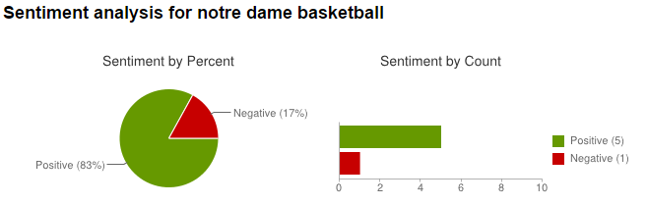
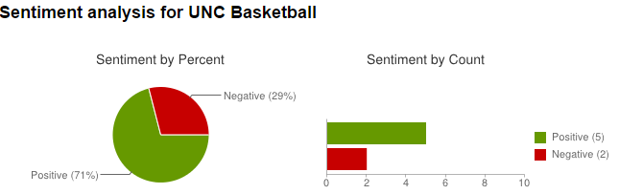
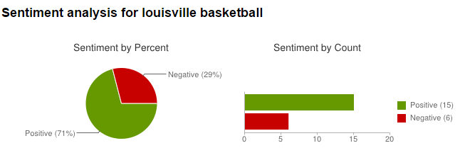
Sentiment analysis

Slide 12
Data storage
//Twitter data in MongoDB
connection = Connection();
db = connection.MarchMadDB
collection = db.TwitData
Insert Twitter JSON file to Collection;
//Create Indices on Twitter ID, create timestamp, url, hashtag
db.TwitData.ensureIndex({id:1},{unique:true, dropDups:true});
db.TwitData.ensureIndex({created_at:1})
db.TwitData.ensureIndex({url:1})
db.TwitData.ensureIndex({hashtag:1})
Close MongoDB connection;

Slide 13
Conclusion
We will validate our perception of “Tweets correlation with team’s performance” through the sentimental analysis of tweets
We will also compare our analysis of the Twitter data with ESPN’s coverage of the conference, to get a feedback on how our model is performing; and adjust and iterate thru our process for improvement of the model

Slide 14
References
Kumar, Shamanth, Morstatter, Fred, and Huan Liu. Twitter Data Analytics. Springer, 2013
http://espn.go.com/mens-college-basketball/conferences/teams/_/id/2/acc-conference
http://jsonstudio.com/mongodb-data-access-tools/
http://analyzecore.com/2014/04/28/twitter-sentiment-analysis/
http://www.milanor.net/blog/?p=594
https://dev.twitter.com/rest/public
http://runnable.com/UqCbQNqXMkkMAALL/twitter-sentiment-analysis-for-python

