Slide 1
Structured Query Language (SQL)

Slide 2
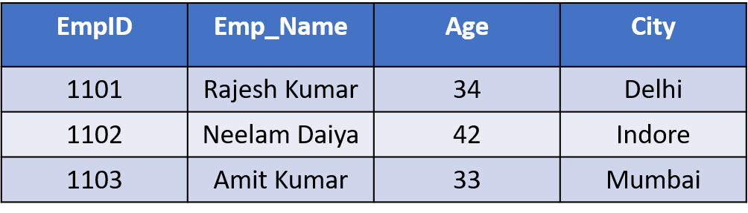
What is a table?
The data in an RDBMS is stored in database which are called as tables
This table is a collection of related data entries and it consists of many columns and rows
Remember, a table is the most common and simplest form of data storage in a relational database
The following is an example of a Employee table −

Slide 3
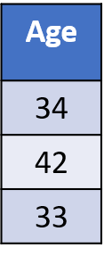
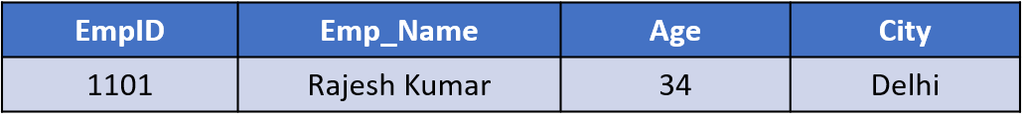
What is a field?
A table is broken up into smaller entities called fields
The fields in table are ID, NAME, AGE and SALARY
A field is a column that is designed to maintain specific information
What is a Record or a Row?
A record is also called as a row of data is each individual entry that exists in a table.
For example :-

Slide 4
What is a NULL value?
A NULL value in field that appears to be blank, which means field is with no value
It is important to understand that a NULL value is different than a zero value or a field that contains spaces.
What is a column?
A column is a vertical entity that contains all information associated with specific field in a table

Slide 5
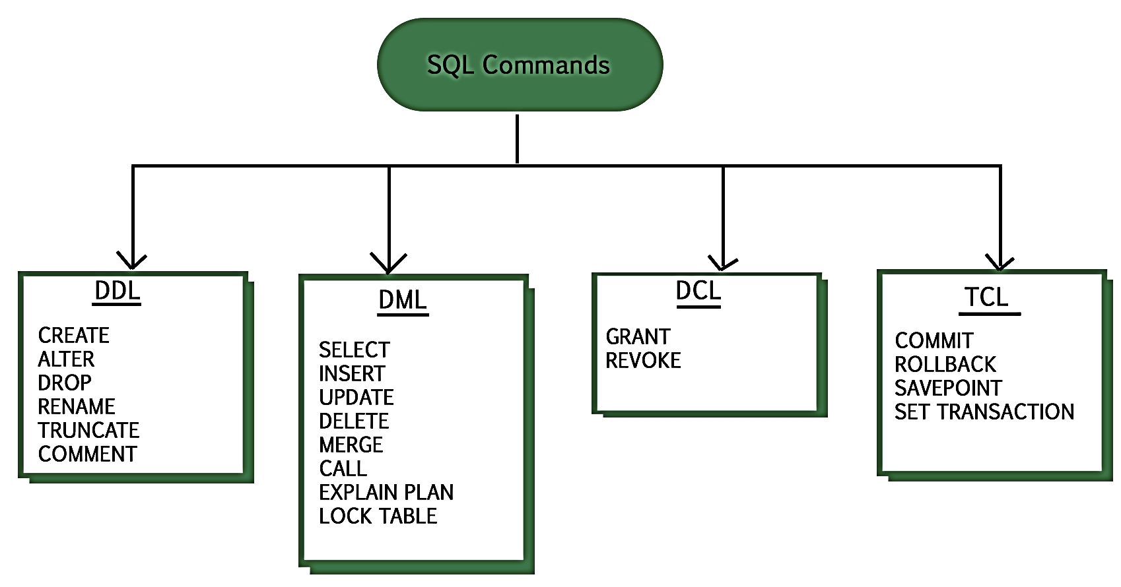
Types of SQL

Slide 6
Data Definition Language(DDL)
S.No | Command & Description
1 | CREATE Creates a new table, a view of a table, or object in the database.
2 | ALTER Modifies an existing database object, such as a table.
3 | DROP Deletes an entire table, a view of a table.

Slide 7
Data Manipulation Language(DML)
S.No | Data Manipulation Language
1 | SELECT Retrieves certain records from one or more tables.
2 | INSERT Creates a new record in the table.
3 | UPDATE Modifies or some changes in a records.
4 | DELETE Deletes or remove unwanted records.

Slide 8
Data Control Language(DCL)
S.No | Command & Description
1 | GRANT Gives a privilege to user.
2 | REVOKE Takes back privileges granted from user.

Slide 9
SQL Constraints
Constraints are the rules applied over the table
Constraints can either be column level or table level
These are used to limit the type of data that can go into a table
This ensures the accuracy and reliability of the data in the database
Most commonly used constraints available in SQL
NOT NULL Constraint − Column cannot have a NULL value
DEFAULT Constraint − Provides a default value for a column which appears automatically when a new record is added
UNIQUE Constraint − Ensures that all the values in a column are different
PRIMARY Key − Uniquely identifies each record in a table
FOREIGN Key − Uniquely identifies a record in any another table
CHECK Constraint − Ensures that all values in a column satisfy given conditions

Slide 10
SELECT query
SELECT QUERY is used to fetch records from the MySQL database
Databases store data for later retrieval
The purpose of MySQL Select is to return from the database tables, one or more rows that match a given criteria
The SELECT statement is used to select data from a database

Slide 11
SQL SELECT statement syntax
SELECT [DISTINCT|ALL | * | field] FROM tableName
[WHERE condition]
[GROUP BY fieldName] [HAVING condition] ORDER BY fieldname
[DISTINCT | ALL] are optional keywords that can be used to fine tune the results returned from the SQL SELECT statement. If nothing is specified then ALL is assumed as the default
{*| field} at least one part must be specified, "*" selected all the fields from the specified table name, field select only particular columns or performs some computations on the specified fields such as adding numbers
FROM tableName is mandatory and must contain at least one table
WHERE condition is optional, it can be used to specify a condition & only selected , true records will be returned
GROUP BY is used to put together records that have the same field values
HAVING is used to specify criteria when working with the GROUP BY keyword
ORDER BY is used to specify the sort order

Slide 12
Examples & Exercises
SELECT * FROM Employee;
SELECT * FROM Employee order by Age;
SELECT COUNT(*) from Employee;
SELECT * FROM Employee WHERE City not in (“Indore”,”Mumbai”);
SELECT DISTINCT City FROM Employee;
SELECT * FROM Employee WHERE EmpID=1102;

Slide 13
Thank you

