Slide 1

From Script to Screen Predicting Movie Success with Analytics & Piracy Insights
(Power BI + NLP + Piracy Analytics)
MSBA 286: Capstone Project - II Research by: Madhukar Goli
Eberhardt School of Business University of the Pacific
Stockton, California.
Xun (Peter) Xu Ph.D.
● Title ○ Intro ○ Goals ○ Dataset ○ Data Model ○ Summary ○ Genre Ratings ○ Budget vs Downloads ○ Avg Budget – Genre ○ Avg Budget – Industry ○ Genre Families ○ Top Revenue ○ Genre Piracy ○ Top Pirated ○ Ratings vs Piracy ○ Ratings Dist. ○ Storyline NLP ○ Story vs Downloads ○ Keywords ○ NLP Extraction ○ Insights ○ Business Value ○ Conclusion ○ Enhancements ○ Thank You

Slide 2
From Script to Screen: Predicting Movie Success with Analytics & Piracy Insights
“ A data-driven journey across the movie ecosystem — from production budgets and audience ratings to storyline patterns and piracy behavior. Using Power BI, NLP, and Piracy dataset Insights, this analysis uncovers what truly drives movie success in the modern digital landscape. ”
○ Title ● Intro ○ Goals ○ Dataset ○ Data Model ○ Summary ○ Genre Ratings ○ Budget vs Downloads ○ Avg Budget – Genre ○ Avg Budget – Industry ○ Genre Families ○ Top Revenue ○ Genre Piracy ○ Top Pirated ○ Ratings vs Piracy ○ Ratings Dist. ○ Storyline NLP ○ Story vs Downloads ○ Keywords ○ NLP Extraction ○ Insights ○ Business Value ○ Conclusion ○ Enhancements ○ Thank You

Slide 3
INTRODUCTION & PROJECT GOALS
Why Analyze Movies Using Both Metadata and Piracy Signals?
Why Movie Performance Prediction Matters ?
Rising budgets + unpredictable audience behavior
Piracy downloads distort true market performance
Studios struggle to forecast success early
Goal: Combine metadata + piracy + NLP to reveal hidden patterns
The film industry generates massive data — budgets, revenues, ratings, genres, and storyline content. But success today is influenced not only by box-office metrics, but also by an often-overlooked component: piracy downloads.
○ Title ○ Intro ● Goals ○ Dataset ○ Data Model ○ Summary ○ Genre Ratings ○ Budget vs Downloads ○ Avg Budget – Genre ○ Avg Budget – Industry ○ Genre Families ○ Top Revenue ○ Genre Piracy ○ Top Pirated ○ Ratings vs Piracy ○ Ratings Dist. ○ Storyline NLP ○ Story vs Downloads ○ Keywords ○ NLP Extraction ○ Insights ○ Business Value ○ Conclusion ○ Enhancements ○ Thank You

Slide 4
DATASET OVERVIEW
Datasets Integrated:
TMDb Metadata: Genre, storylines, popularity, runtime, ratings
Piracy Dataset: Number of downloads for each movie
Keywords Dataset: 3,000+ storyline themes extracted via NLP
Credits Dataset: 5K titles + Cast & Crew For additional support
User Ratings: To cross report Metadata Ratings for empty values
This combination of structured metadata, piracy signals, and NLP-driven insights forms the foundation for uncovering patterns behind movie success.
○ Title ○ Intro ○ Goals ● Dataset ○ Data Model ○ Summary ○ Genre Ratings ○ Budget vs Downloads ○ Avg Budget – Genre ○ Avg Budget – Industry ○ Genre Families ○ Top Revenue ○ Genre Piracy ○ Top Pirated ○ Ratings vs Piracy ○ Ratings Dist. ○ Storyline NLP ○ Story vs Downloads ○ Keywords ○ NLP Extraction ○ Insights ○ Business Value ○ Conclusion ○ Enhancements ○ Thank You

Slide 5
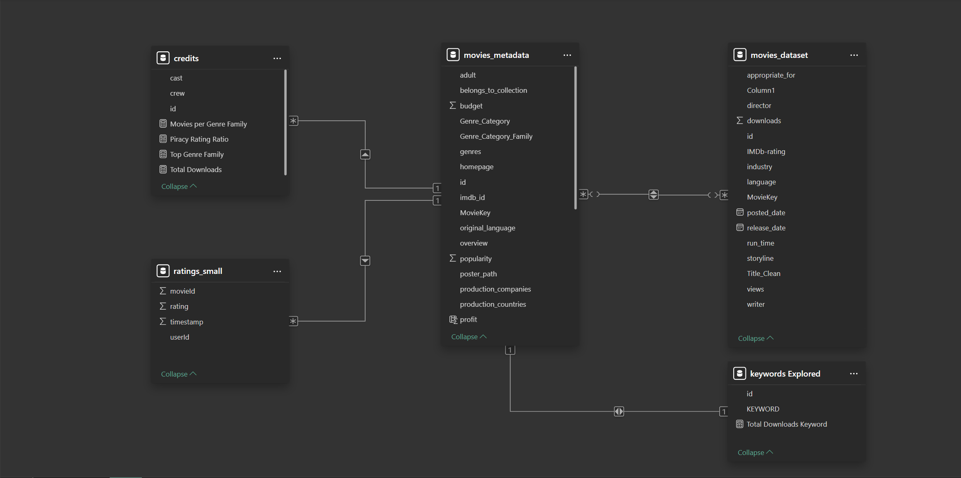
POWER BI DATA MODEL: Relationships across metadata → piracy behavior
○ Title ○ Intro ○ Goals ○ Dataset ● Data Model ○ Summary ○ Genre Ratings ○ Budget vs Downloads ○ Avg Budget – Genre ○ Avg Budget – Industry ○ Genre Families ○ Top Revenue ○ Genre Piracy ○ Top Pirated ○ Ratings vs Piracy ○ Ratings Dist. ○ Storyline NLP ○ Story vs Downloads ○ Keywords ○ NLP Extraction ○ Insights ○ Business Value ○ Conclusion ○ Enhancements ○ Thank You

Slide 6
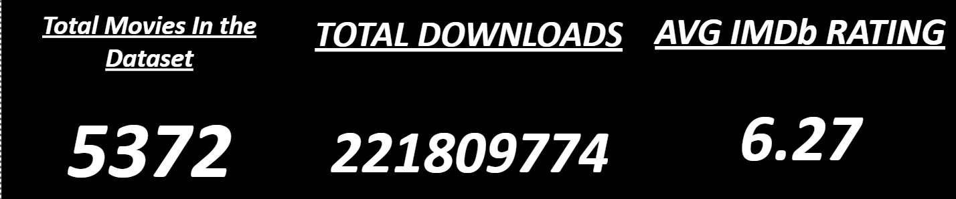
TOTAL DATASET SUMMARY DASHBOARD
This dashboard gives us the big picture:
Total movies analyzed
Average IMDb rating
Total piracy downloads
This establishes the Size and Scale of the Datasets that were contributing for this Analysis.
○ Title ○ Intro ○ Goals ○ Dataset ○ Data Model ● Summary ○ Genre Ratings ○ Budget vs Downloads ○ Avg Budget – Genre ○ Avg Budget – Industry ○ Genre Families ○ Top Revenue ○ Genre Piracy ○ Top Pirated ○ Ratings vs Piracy ○ Ratings Dist. ○ Storyline NLP ○ Story vs Downloads ○ Keywords ○ NLP Extraction ○ Insights ○ Business Value ○ Conclusion ○ Enhancements ○ Thank You

Slide 7
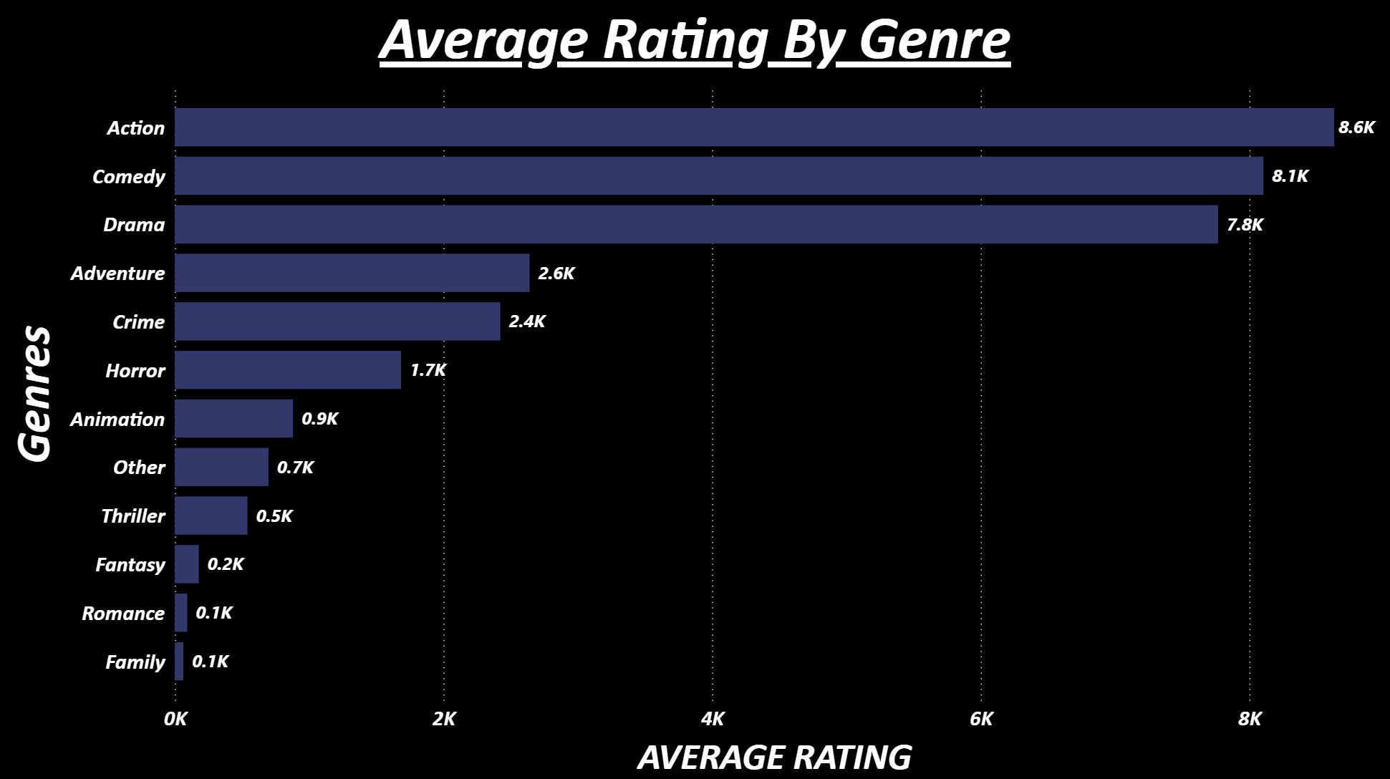
DISTRIBUTION OF GENRES WITH USER RATINGS
Key Insights:
Action, Comedy, and Drama consistently receive the highest user ratings, showing broad audience appeal.
Adventure and Crime also maintain strong engagement, reflecting demand for immersive and high-stakes storytelling.
Lower-rated genres like Family, Romance, and Fantasy appear less frequently and attract smaller audiences in comparison.
This rating distribution helps clarify which genres drive viewer satisfaction and which ones may rely more on niche audiences.
This establishes the diversity of the dataset before we dive deeper into more analytics
○ Title ○ Intro ○ Goals ○ Dataset ○ Data Model ○ Summary ● Genre Ratings ○ Budget vs Downloads ○ Avg Budget – Genre ○ Avg Budget – Industry ○ Genre Families ○ Top Revenue ○ Genre Piracy ○ Top Pirated ○ Ratings vs Piracy ○ Ratings Dist. ○ Storyline NLP ○ Story vs Downloads ○ Keywords ○ NLP Extraction ○ Insights ○ Business Value ○ Conclusion ○ Enhancements ○ Thank You

Slide 8
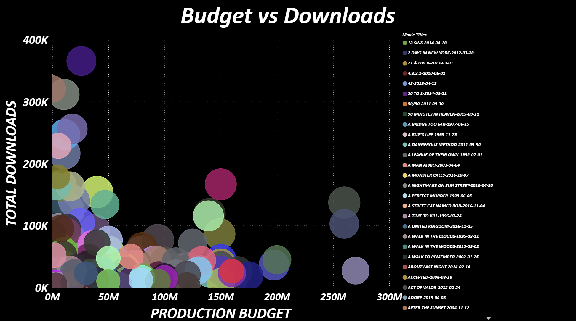
BUDGET VS DOWNLOADS
Key Insights:
High-budget films do not always generate the highest piracy downloads.
Many low- and mid-budget movies show disproportionately high download volumes.
This indicates that viral popularity, genre fit, and audience buzz often matter more than production spend.
Outliers show that certain films become piracy hits regardless of budget size.
Overall: Piracy behavior is driven more by audience interest than financial investment.
This pattern suggests strong word-of-mouth influence and viral popularity.
○ Title ○ Intro ○ Goals ○ Dataset ○ Data Model ○ Summary ○ Genre Ratings ● Budget vs Downloads ○ Avg Budget – Genre ○ Avg Budget – Industry ○ Genre Families ○ Top Revenue ○ Genre Piracy ○ Top Pirated ○ Ratings vs Piracy ○ Ratings Dist. ○ Storyline NLP ○ Story vs Downloads ○ Keywords ○ NLP Extraction ○ Insights ○ Business Value ○ Conclusion ○ Enhancements ○ Thank You

Slide 9
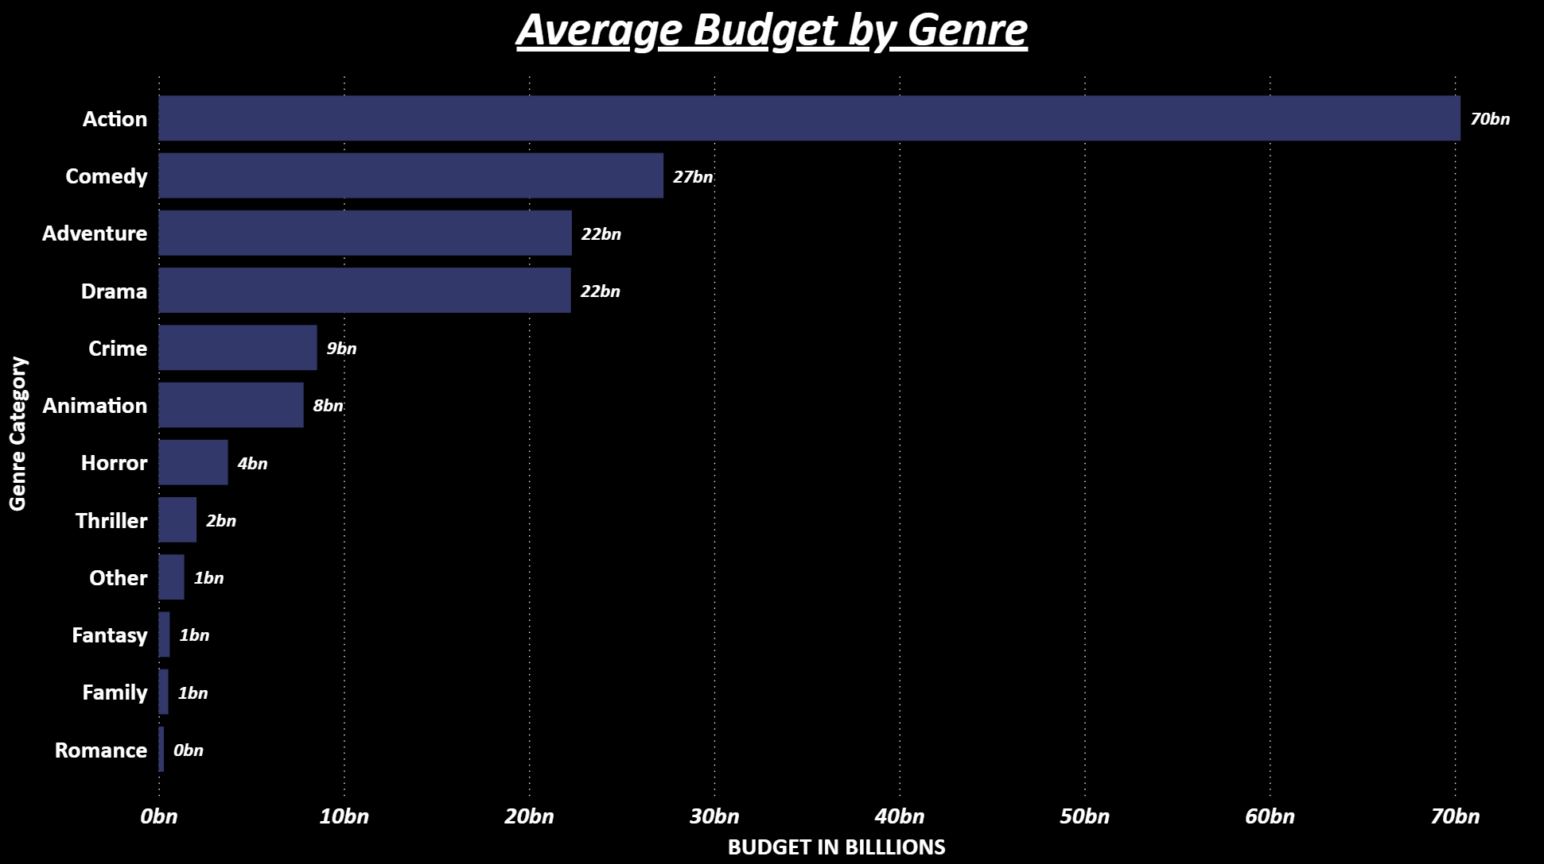
AVERAGE BUDGET BY GENRE
Key Insights:
Action films dominate with the highest average budgets, driven by large-scale effects, stunts, and global production.
Comedy, Adventure, and Drama follow, representing mid-range budget categories that balance commercial appeal with moderate production cost.
Horror, Thriller, Fantasy, and Family genres maintain lean budgets, yet many of these outperform expectations through strong niche audiences.
The contrast highlights how budget size is strategically aligned to expected box-office performance across genres.
○ Title ○ Intro ○ Goals ○ Dataset ○ Data Model ○ Summary ○ Genre Ratings ○ Budget vs Downloads ● Avg Budget – Genre ○ Avg Budget – Industry ○ Genre Families ○ Top Revenue ○ Genre Piracy ○ Top Pirated ○ Ratings vs Piracy ○ Ratings Dist. ○ Storyline NLP ○ Story vs Downloads ○ Keywords ○ NLP Extraction ○ Insights ○ Business Value ○ Conclusion ○ Enhancements ○ Thank You

Slide 10
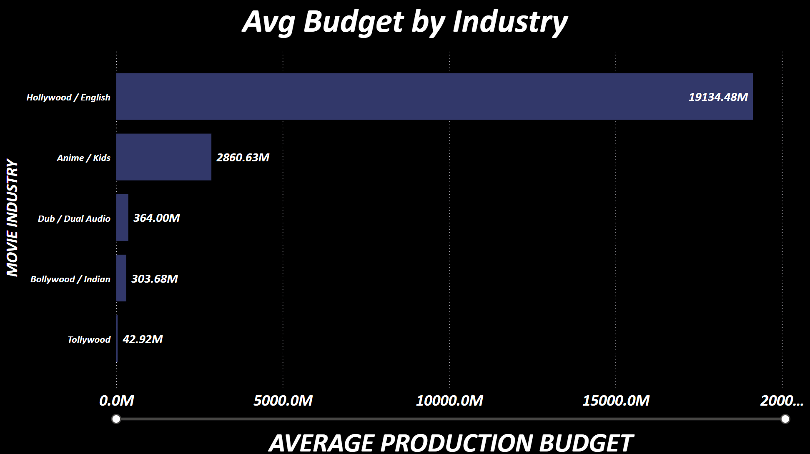
AVERAGE BUDGET BY INDUSTRY
Key Takeaways:
Hollywood/English films operate with significantly higher production budgets than any other industry.
Anime/Kids productions form the second-largest budget group, though far below Hollywood levels.
Regional industries like Dubbed Audio, Bollywood/Indian, and Tollywood operate with much leaner budgets, reflecting different market economics.
These differences highlight how industry scale shapes spending power, production quality, and ultimately revenue potential.
○ Title ○ Intro ○ Goals ○ Dataset ○ Data Model ○ Summary ○ Genre Ratings ○ Budget vs Downloads ○ Avg Budget – Genre ● Avg Budget – Industry ○ Genre Families ○ Top Revenue ○ Genre Piracy ○ Top Pirated ○ Ratings vs Piracy ○ Ratings Dist. ○ Storyline NLP ○ Story vs Downloads ○ Keywords ○ NLP Extraction ○ Insights ○ Business Value ○ Conclusion ○ Enhancements ○ Thank You

Slide 11
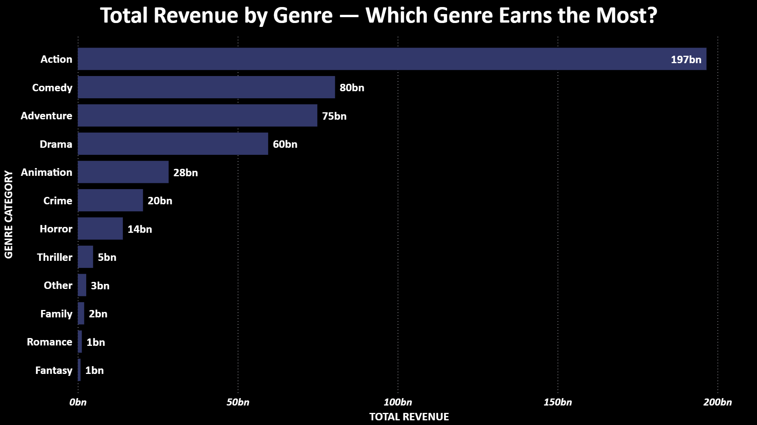
GENRE FAMILY ANALYSIS
Key Insights:
When aggregating the dataset into 10 genre families, we see that Action, Drama, Comedy, and Thriller dominate both Revenue and piracy volume.
Action continues to show the strongest connection with piracy.
○ Title ○ Intro ○ Goals ○ Dataset ○ Data Model ○ Summary ○ Genre Ratings ○ Budget vs Downloads ○ Avg Budget – Genre ○ Avg Budget – Industry ● Genre Families ○ Top Revenue ○ Genre Piracy ○ Top Pirated ○ Ratings vs Piracy ○ Ratings Dist. ○ Storyline NLP ○ Story vs Downloads ○ Keywords ○ NLP Extraction ○ Insights ○ Business Value ○ Conclusion ○ Enhancements ○ Thank You

Slide 12
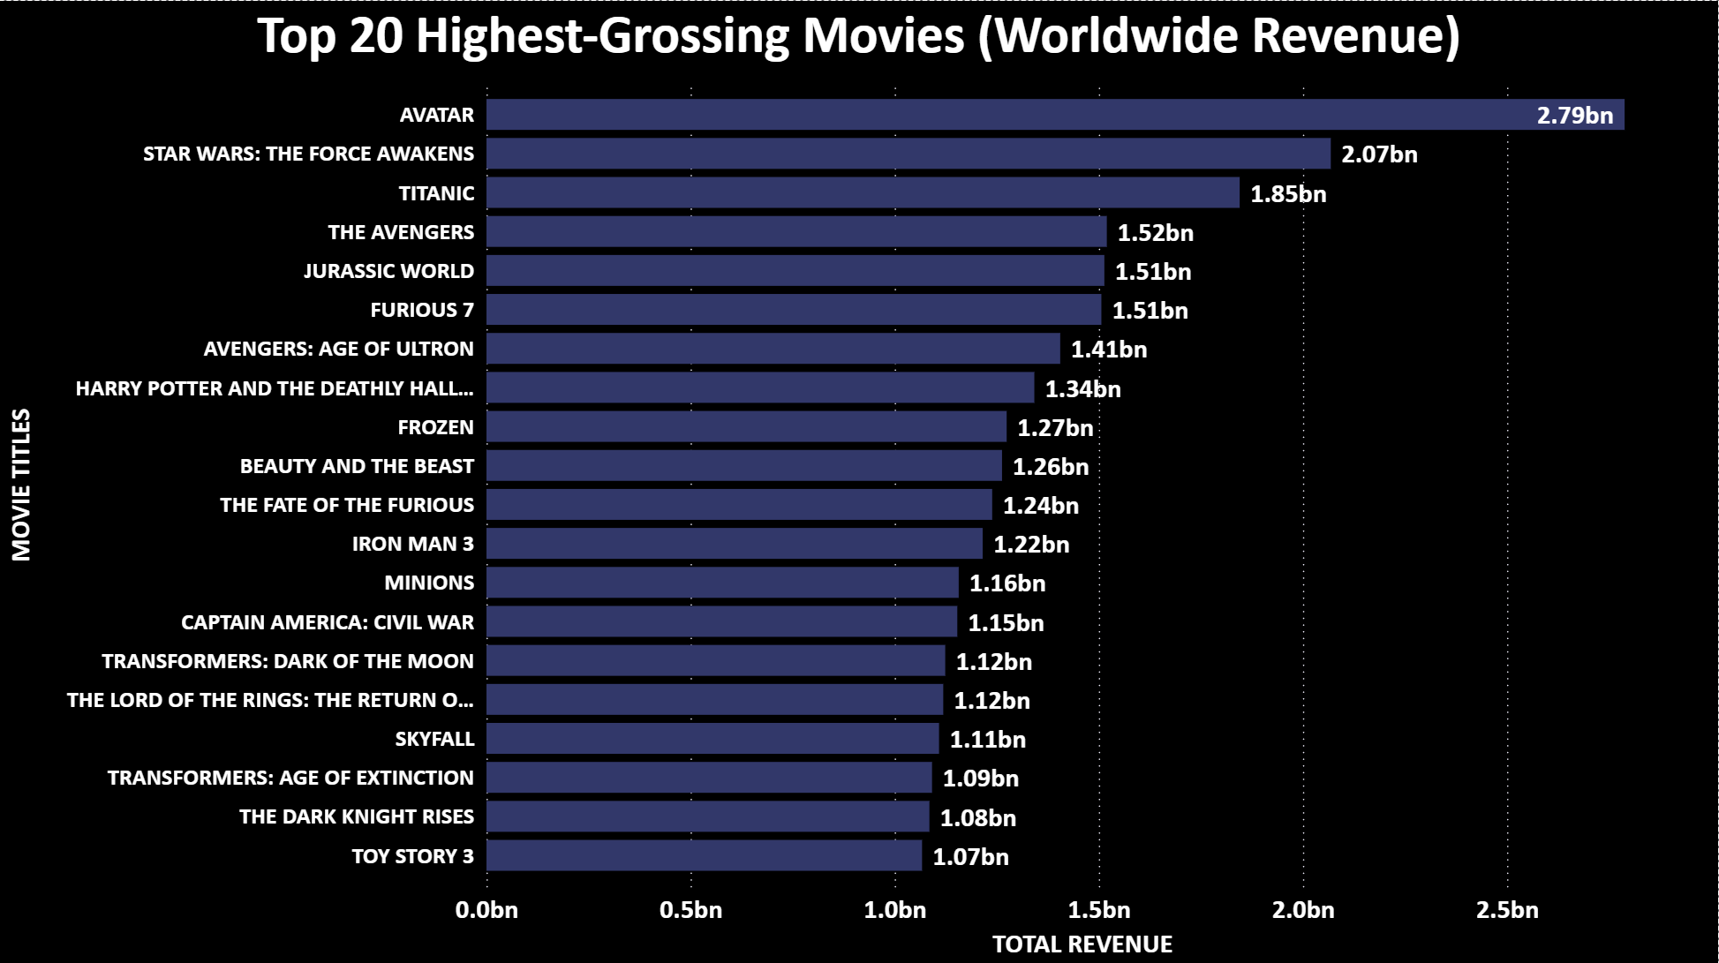
TOP 20 HIGH REVENUE MOVIES
Hollywood franchises dominate global revenue, led by Avatar, Star Wars, and Avengers — each exceeding the $1.5B+ mark.
Consistent patterns emerge superhero, fantasy, and sci-fi films continue to outperform all other genres internationally.
Revenue concentration shows the impact of franchise power, global fanbases, and strong international distribution.
Family-friendly titles such as Frozen, Minions, and Beauty and the Beast illustrate the strength of multi-demographic appeal, driving repeated viewership.
This chart provides a benchmark to compare against piracy patterns — identifying whether blockbuster success also correlates with high piracy activity.
○ Title ○ Intro ○ Goals ○ Dataset ○ Data Model ○ Summary ○ Genre Ratings ○ Budget vs Downloads ○ Avg Budget – Genre ○ Avg Budget – Industry ○ Genre Families ● Top Revenue ○ Genre Piracy ○ Top Pirated ○ Ratings vs Piracy ○ Ratings Dist. ○ Storyline NLP ○ Story vs Downloads ○ Keywords ○ NLP Extraction ○ Insights ○ Business Value ○ Conclusion ○ Enhancements ○ Thank You

Slide 13
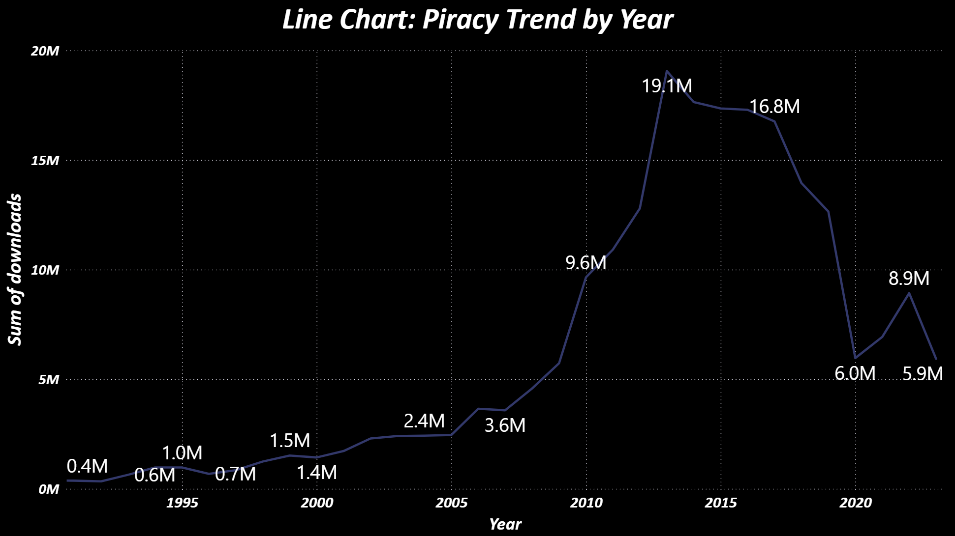
GENRE INSIGHTS FOR PIRACY
Key Insights:
Piracy rose steadily from the early 2000s, driven by expanding internet access.
A major surge occurs between 2010–2015, aligning with growth in streaming platforms and global media consumption.
Downloads peak around 2014–2015, indicating heightened demand and widespread sharing behavior.
A sharp drop follows, likely due to stronger anti-piracy measures and wider availability of legal streaming options.
Post-2020 shows partial recovery, reflecting pandemic-driven content consumption.
○ Title ○ Intro ○ Goals ○ Dataset ○ Data Model ○ Summary ○ Genre Ratings ○ Budget vs Downloads ○ Avg Budget – Genre ○ Avg Budget – Industry ○ Genre Families ○ Top Revenue ● Genre Piracy ○ Top Pirated ○ Ratings vs Piracy ○ Ratings Dist. ○ Storyline NLP ○ Story vs Downloads ○ Keywords ○ NLP Extraction ○ Insights ○ Business Value ○ Conclusion ○ Enhancements ○ Thank You

Slide 14
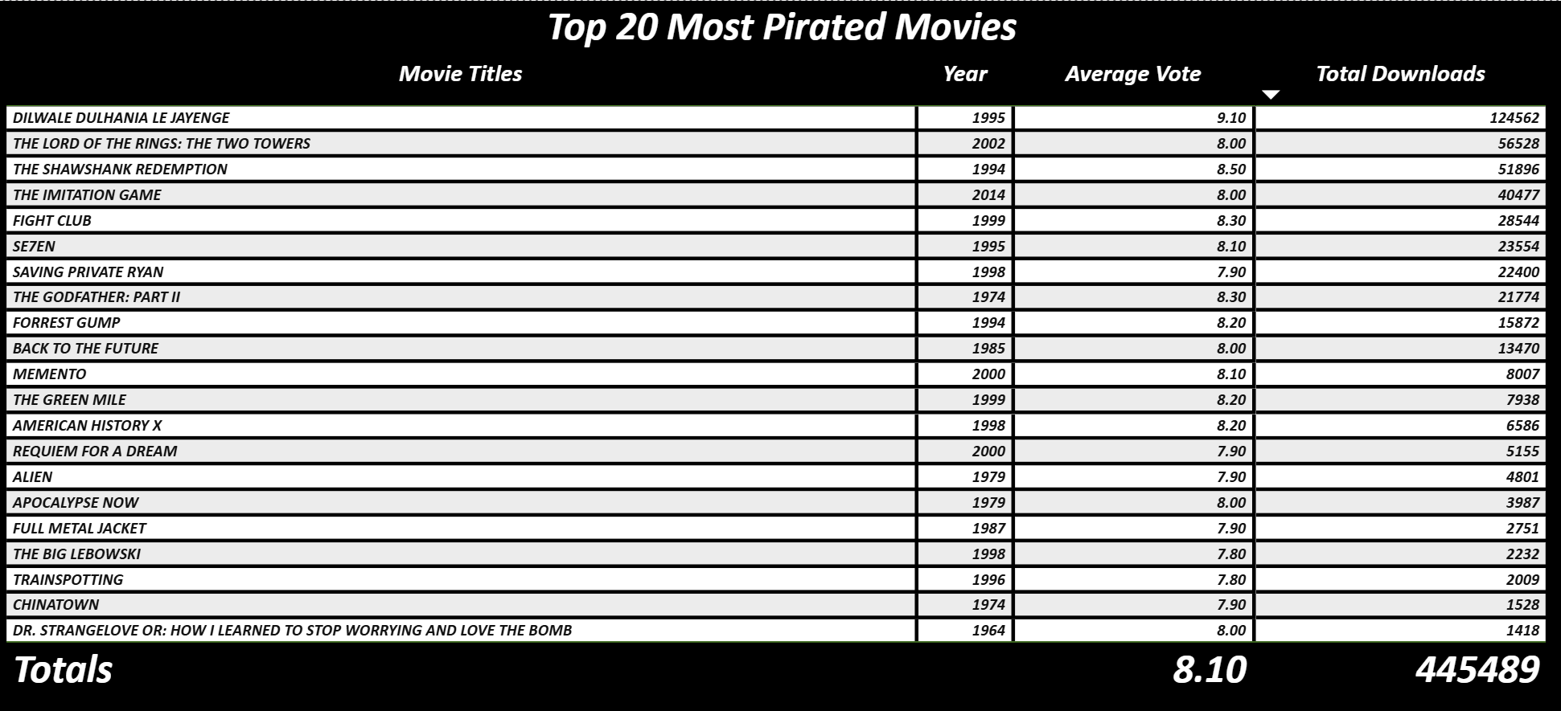
TOP 20 MOST PIRATED MOVIES
This table summarizes the top 20 most pirated movies.
Key Insights:
Only films with valid IMDb ratings are included to maintain analytical accuracy.
The table reflects cleaned and corrected data, replacing the earlier inaccurate version.
Many of these titles show exceptionally high download volumes, indicating sustained global interest.
Several movies combine strong critical reception with mass piracy—raising questions such as:
Is piracy volume driven by hype, nostalgia, or genre popularity?
Do highly rated films attract disproportionately more piracy?
This gives us a starting point for piracy behavior at a granular level.
○ Title ○ Intro ○ Goals ○ Dataset ○ Data Model ○ Summary ○ Genre Ratings ○ Budget vs Downloads ○ Avg Budget – Genre ○ Avg Budget – Industry ○ Genre Families ○ Top Revenue ○ Genre Piracy ● Top Pirated ○ Ratings vs Piracy ○ Ratings Dist. ○ Storyline NLP ○ Story vs Downloads ○ Keywords ○ NLP Extraction ○ Insights ○ Business Value ○ Conclusion ○ Enhancements ○ Thank You

Slide 15
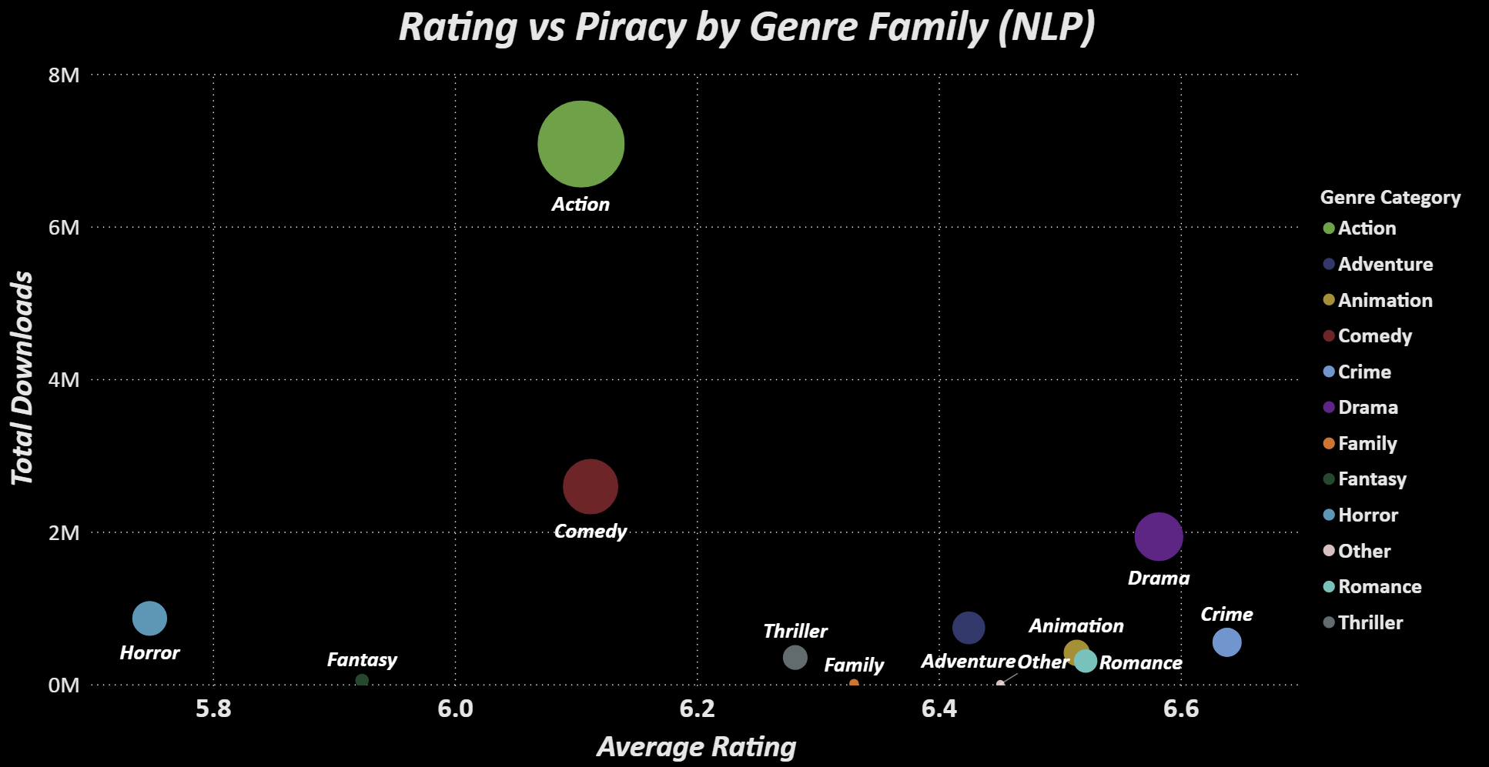
RATINGS VS PIRACY DOWNLOADS
This scatter plot reveals a significant trend:
Movies with higher IMDb ratings tend to generate more piracy downloads.
This suggests piracy is not
random — viewers often pirate films
that are already perceived as high-quality.
Key Insights:
Action and Thriller titles generate the
most clusters
Some mid-budget films show
abnormally high piracy (viral hits)
Outliers indicate cult films that attract
massive global attention.
NLP-derived genre families as points to see which ones are both high-rated and heavily pirated.
○ Title ○ Intro ○ Goals ○ Dataset ○ Data Model ○ Summary ○ Genre Ratings ○ Budget vs Downloads ○ Avg Budget – Genre ○ Avg Budget – Industry ○ Genre Families ○ Top Revenue ○ Genre Piracy ○ Top Pirated ● Ratings vs Piracy ○ Ratings Dist. ○ Storyline NLP ○ Story vs Downloads ○ Keywords ○ NLP Extraction ○ Insights ○ Business Value ○ Conclusion ○ Enhancements ○ Thank You

Slide 16
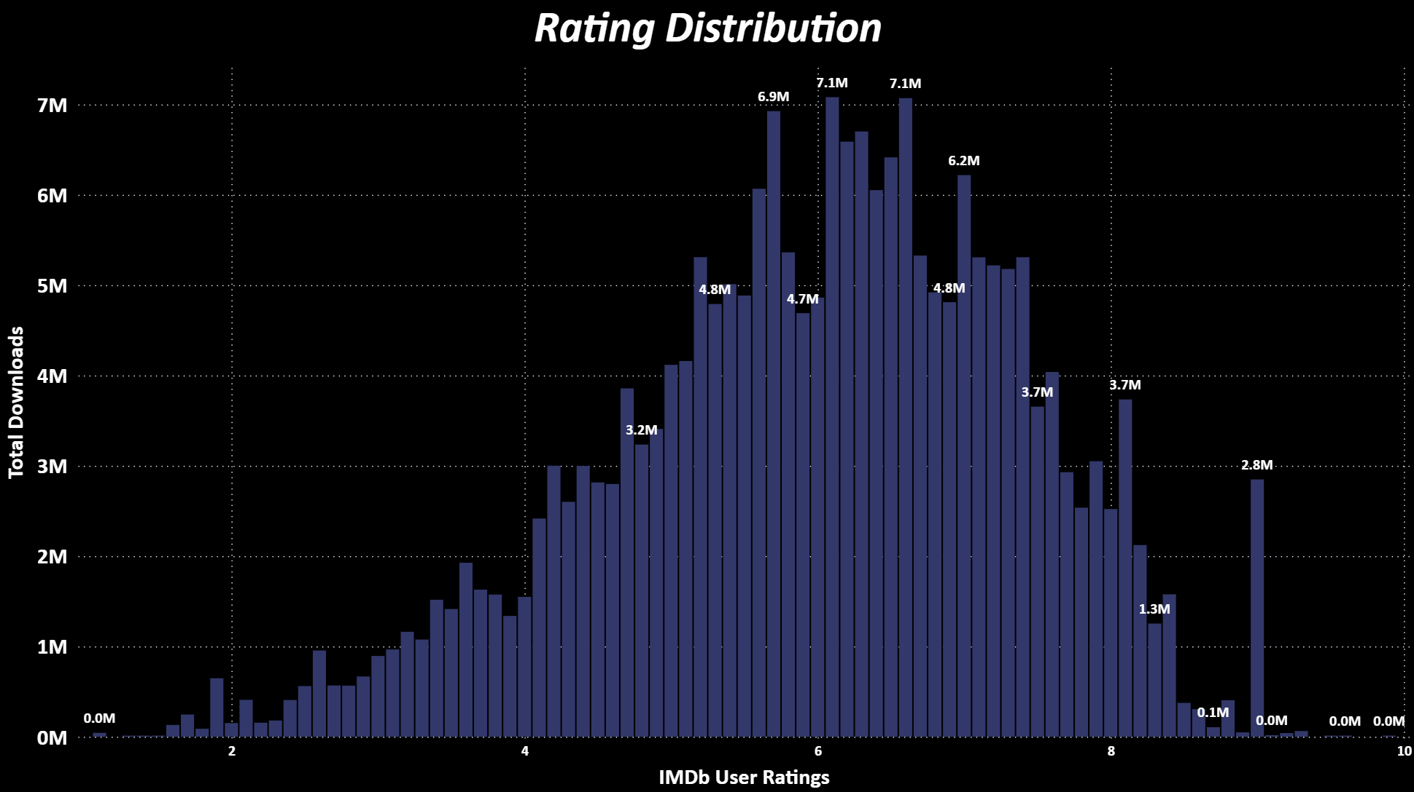
RATINGS DISTRIBUTION
Key Insights:
User ratings cluster heavily between 5.0 and 7.5, indicating this is the mainstream quality range for most films in the dataset.
Higher-rated films (6.5–7.5 range) show noticeably higher download volumes, suggesting that audience approval influences piracy activity.
Extremely low or high ratings see fewer downloads, showing that viewers gravitate toward moderately or well-reviewed movies.
○ Title ○ Intro ○ Goals ○ Dataset ○ Data Model ○ Summary ○ Genre Ratings ○ Budget vs Downloads ○ Avg Budget – Genre ○ Avg Budget – Industry ○ Genre Families ○ Top Revenue ○ Genre Piracy ○ Top Pirated ○ Ratings vs Piracy ● Ratings Dist. ○ Storyline NLP ○ Story vs Downloads ○ Keywords ○ NLP Extraction ○ Insights ○ Business Value ○ Conclusion ○ Enhancements ○ Thank You

Slide 17
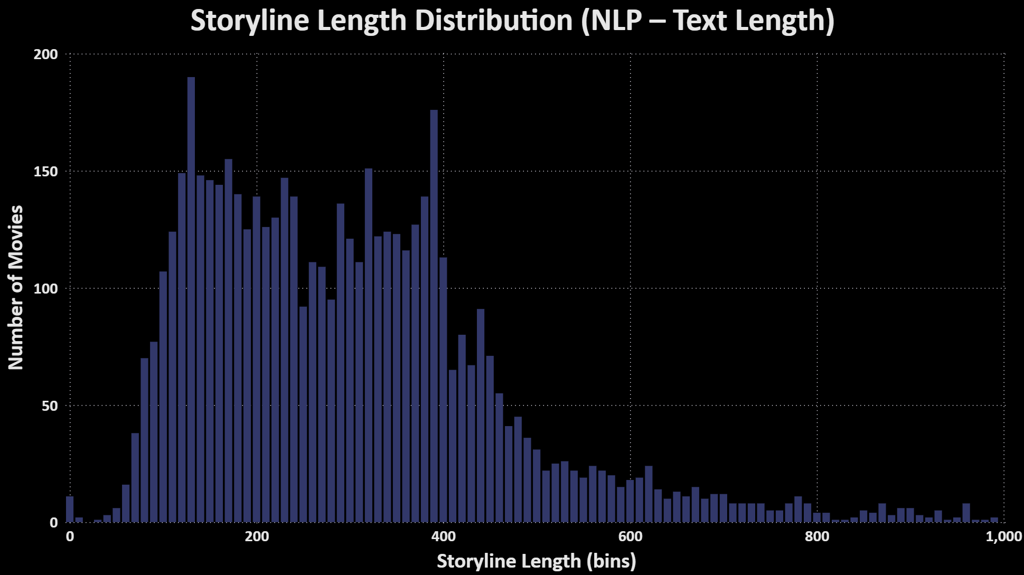
STORYLINE ANALYTICS (NLP)
Using NLP to Convert Movie Storylines Into Data:
Analyzed movie storyline descriptions using NLP.
The first step was to measure storyline length.
Longer descriptions often indicate complex narratives, while shorter ones suggest action-driven plots.
Piracy behavior clusters strongly around films that have short, simple premise lines — often blockbusters.
○ Title ○ Intro ○ Goals ○ Dataset ○ Data Model ○ Summary ○ Genre Ratings ○ Budget vs Downloads ○ Avg Budget – Genre ○ Avg Budget – Industry ○ Genre Families ○ Top Revenue ○ Genre Piracy ○ Top Pirated ○ Ratings vs Piracy ○ Ratings Dist. ● Storyline NLP ○ Story vs Downloads ○ Keywords ○ NLP Extraction ○ Insights ○ Business Value ○ Conclusion ○ Enhancements ○ Thank You

Slide 18

STORY LENGTH VS DOWNLOADS
Key Insights:
Shorter storylines—especially in Action and Thriller genres—attract noticeably higher piracy activity.
Clear clustering at lower word counts suggests pirates respond more to high-concept, fast-paced stories.
Longer storylines do not correlate with higher downloads, indicating simplicity and immediate appeal only drive piracy behavior.
○ Title ○ Intro ○ Goals ○ Dataset ○ Data Model ○ Summary ○ Genre Ratings ○ Budget vs Downloads ○ Avg Budget – Genre ○ Avg Budget – Industry ○ Genre Families ○ Top Revenue ○ Genre Piracy ○ Top Pirated ○ Ratings vs Piracy ○ Ratings Dist. ○ Storyline NLP ● Story vs Downloads ○ Keywords ○ NLP Extraction ○ Insights ○ Business Value ○ Conclusion ○ Enhancements ○ Thank You

Slide 19
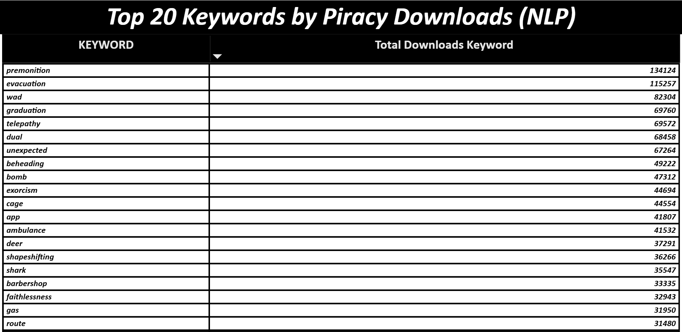
TOP 20 KEYWORDS DRIVING PIRACY
The Top 20 storyline keywords associated with the highest piracy download volumes reveal clear thematic patterns across pirated films. These patterns help us understand what narrative elements attract the most unauthorized viewership.
Action-Driven Story Elements:
Frequent presence of high-intensity triggers premonition, evacuation, bomb, beheading, shark, chase-related themes indicates strong audience interest in suspense, urgency, and physical risk
Psychological & Supernatural Themes:
Keywords such as telepathy, exorcism, shapeshifting, unexpected suggests viewers gravitate toward mystery, fear, and the supernatural
Human Emotion & Personal Conflict:
Themes around faithlessness, dual identity, premonition reflect strong engagement with personal dilemmas and emotional tension.
Crisis & Survival Indicator:
Words like gas, route, evacuation, ambulance shows interest in crisis-driven plots where survival is central.
○ Title ○ Intro ○ Goals ○ Dataset ○ Data Model ○ Summary ○ Genre Ratings ○ Budget vs Downloads ○ Avg Budget – Genre ○ Avg Budget – Industry ○ Genre Families ○ Top Revenue ○ Genre Piracy ○ Top Pirated ○ Ratings vs Piracy ○ Ratings Dist. ○ Storyline NLP ○ Story vs Downloads ● Keywords ○ NLP Extraction ○ Insights ○ Business Value ○ Conclusion ○ Enhancements ○ Thank You

Slide 20
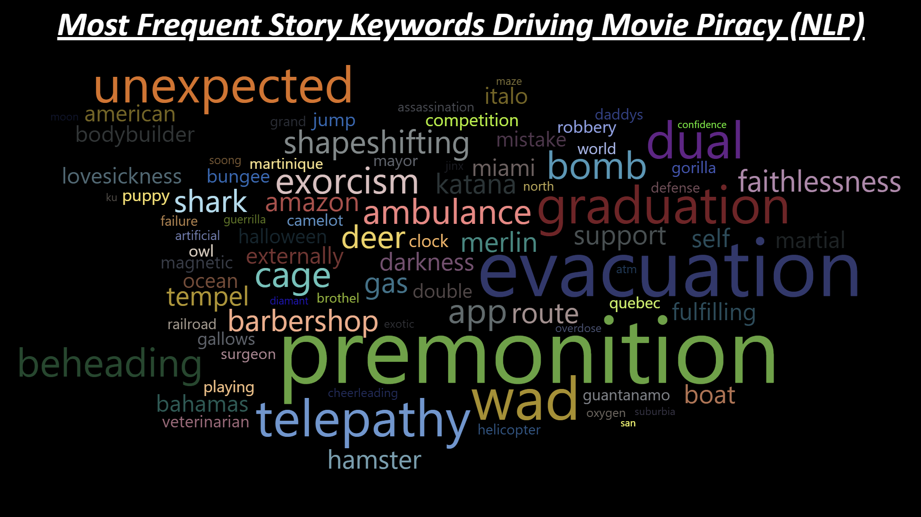
NLP KEYWORD EXTRACTION
Key Insights:
Storylines were cleaned and tokenized into keywords using a custom NLP pipeline.
Extracted individual themes — such as ‘revenge,’ ‘family,’ ‘police,’ ‘space,’ ‘shapeshifting’ — and mapped them to piracy downloads to understand which themes resonate most with global pirate audiences.
The word cloud visually highlights dominant themes. Larger words indicate themes with the highest total downloads. This helps quickly see what kind of narratives consistently drive global attention.
○ Title ○ Intro ○ Goals ○ Dataset ○ Data Model ○ Summary ○ Genre Ratings ○ Budget vs Downloads ○ Avg Budget – Genre ○ Avg Budget – Industry ○ Genre Families ○ Top Revenue ○ Genre Piracy ○ Top Pirated ○ Ratings vs Piracy ○ Ratings Dist. ○ Storyline NLP ○ Story vs Downloads ○ Keywords ● NLP Extraction ○ Insights ○ Business Value ○ Conclusion ○ Enhancements ○ Thank You

Slide 21
INSIGHTS & TAKEAWAYS
To summarize the findings:
Piracy activity reveals hidden popularity
Ratings influence downloads but not consistently
Genre clusters show predictable audience patterns
Keywords uncover emotional/plot drivers of virality
NLP + analytics create a holistic movie success model
○ Title ○ Intro ○ Goals ○ Dataset ○ Data Model ○ Summary ○ Genre Ratings ○ Budget vs Downloads ○ Avg Budget – Genre ○ Avg Budget – Industry ○ Genre Families ○ Top Revenue ○ Genre Piracy ○ Top Pirated ○ Ratings vs Piracy ○ Ratings Dist. ○ Storyline NLP ○ Story vs Downloads ○ Keywords ○ NLP Extraction ● Insights ○ Business Value ○ Conclusion ○ Enhancements ○ Thank You

Slide 22
BUSINESS VALUE
Applications for Film Studios
Forecast movie performance early
Identify profitable genres & keyword themes
Detect piracy-risk movies before release
Improve marketing strategies using storyline analytics
These insights can be used by streaming platforms, distributors, and filmmakers to strategically forecast demand, protect high-risk films from piracy, and design stories that capture global attention.
○ Title ○ Intro ○ Goals ○ Dataset ○ Data Model ○ Summary ○ Genre Ratings ○ Budget vs Downloads ○ Avg Budget – Genre ○ Avg Budget – Industry ○ Genre Families ○ Top Revenue ○ Genre Piracy ○ Top Pirated ○ Ratings vs Piracy ○ Ratings Dist. ○ Storyline NLP ○ Story vs Downloads ○ Keywords ○ NLP Extraction ○ Insights ● Business Value ○ Conclusion ○ Enhancements ○ Thank You

Slide 23
CONCLUSION
Final Summary:
Analytics + NLP reveal hidden audience patterns
Piracy data is a strong signal for movie attention
Multi-dashboard system enables strategic insights
○ Title ○ Intro ○ Goals ○ Dataset ○ Data Model ○ Summary ○ Genre Ratings ○ Budget vs Downloads ○ Avg Budget – Genre ○ Avg Budget – Industry ○ Genre Families ○ Top Revenue ○ Genre Piracy ○ Top Pirated ○ Ratings vs Piracy ○ Ratings Dist. ○ Storyline NLP ○ Story vs Downloads ○ Keywords ○ NLP Extraction ○ Insights ○ Business Value ● Conclusion ○ Enhancements ○ Thank You

Slide 24
FUTURE ENHANCEMENTS
What Can Be Added Next In This Project :
Deeper NLP sentiment analysis
Machine learning success prediction
Predicting piracy before release
Revenue forecasting models
Incorporating streaming platform data
○ Title ○ Intro ○ Goals ○ Dataset ○ Data Model ○ Summary ○ Genre Ratings ○ Budget vs Downloads ○ Avg Budget – Genre ○ Avg Budget – Industry ○ Genre Families ○ Top Revenue ○ Genre Piracy ○ Top Pirated ○ Ratings vs Piracy ○ Ratings Dist. ○ Storyline NLP ○ Story vs Downloads ○ Keywords ○ NLP Extraction ○ Insights ○ Business Value ○ Conclusion ● Enhancements ○ Thank You

Slide 25
THANK YOU FOR YOUR PATIENCE
Questions ?
○ Title ○ Intro ○ Goals ○ Dataset ○ Data Model ○ Summary ○ Genre Ratings ○ Budget vs Downloads ○ Avg Budget – Genre ○ Avg Budget – Industry ○ Genre Families ○ Top Revenue ○ Genre Piracy ○ Top Pirated ○ Ratings vs Piracy ○ Ratings Dist. ○ Storyline NLP ○ Story vs Downloads ○ Keywords ○ NLP Extraction ○ Insights ○ Business Value ○ Conclusion ○ Enhancements ● Thank You

