Slide 1

Expense Tracker
using Python and Streamlit
VAGGU MADHU KIRAN
BATCH : 577

Slide 2
About me:
I’m VAGGU MADHU KIRAN, a B.Sc. (Hons.) Statistics student from Ramjas College.
GitHub : https://github.com/madhukiranvaggu
LinkedIn :https://www.linkedin.com/in/vaggu-madhukiran-
"I chose this project to apply Python and data-handling skills to a practical personal finance problem. The Expense Tracker helps record income and expenses, calculate the available balance, and review transactions through a simple Streamlit interface."

Slide 3
Agenda
Business Problem
Business Problem Statement
Business Requirements
Project Objective
Workflow Diagram
Features and Insights
Recommendations
Conclusion

Slide 4
Managing personal income and daily expenses manually can become difficult. People may forget small purchases, lose track of spending categories, or find it hard to understand how much money remains after expenses. A simple digital tracker can organize transactions and show the current financial position clearly.
Business Problem :

Slide 5
Business Problem Statement :
The Easy Expense Tracker is a Python-based application developed using Streamlit. It allows users to record income and expenses by entering an amount, category, and note. The application stores transaction details, including date and time, calculates total income, total expenses, and remaining balance, and displays records in a simple dashboard. Users can also review transactions within a selected date range.

Slide 6
Business Requirements :
⮞ Allow users to add income and expense transactions.
⮞ Capture amount, category, and optional note for each transaction.
⮞ Automatically record the transaction date and time.
⮞ Store transaction details in a JSON file for later use.
⮞ Calculate total income, total expenses, and available balance.
⮞ Display financial summaries and charts on the dashboard.
⮞ Show transaction history in a table.
⮞ Filter records using a selected date range.
⮞ Provide a reset option to clear all saved transaction data.

Slide 7
Project Objective :
The main objective of this project is to develop a simple and user-friendly Expense Tracker using Python and Streamlit. The application records income and expenses, stores transaction details, and automatically calculates the remaining balance. It provides a dashboard with key financial metrics, charts, recent transactions, and date-range filtering. This project demonstrates practical use of Python functions, lists, dictionaries, file handling, JSON, Pandas, and Streamlit.

Slide 8
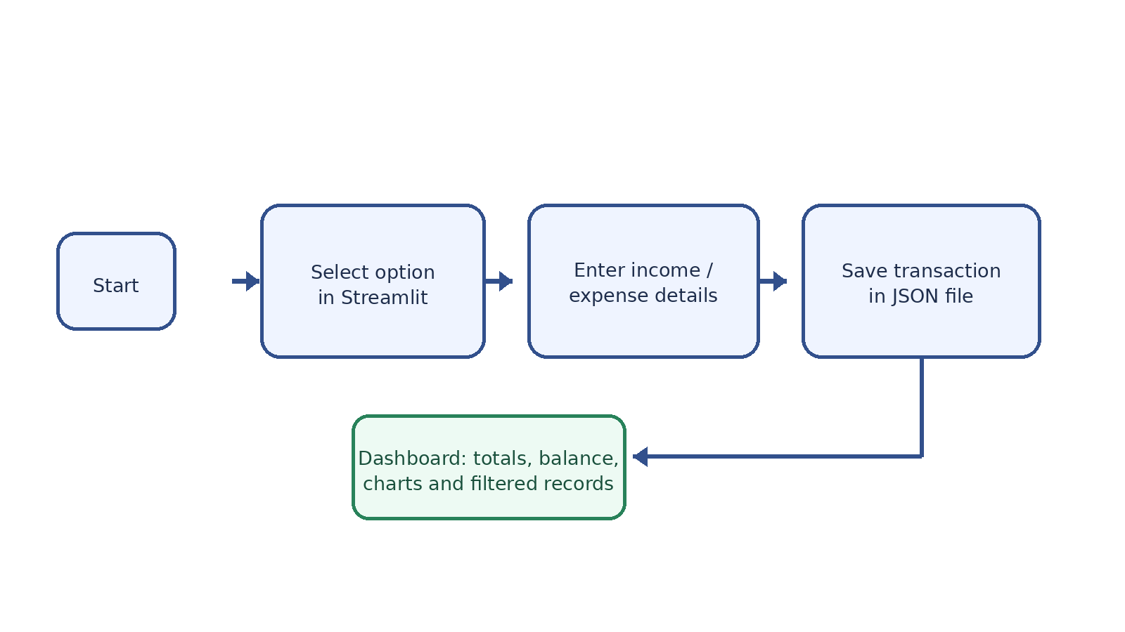
Workflow Diagram :

Slide 9
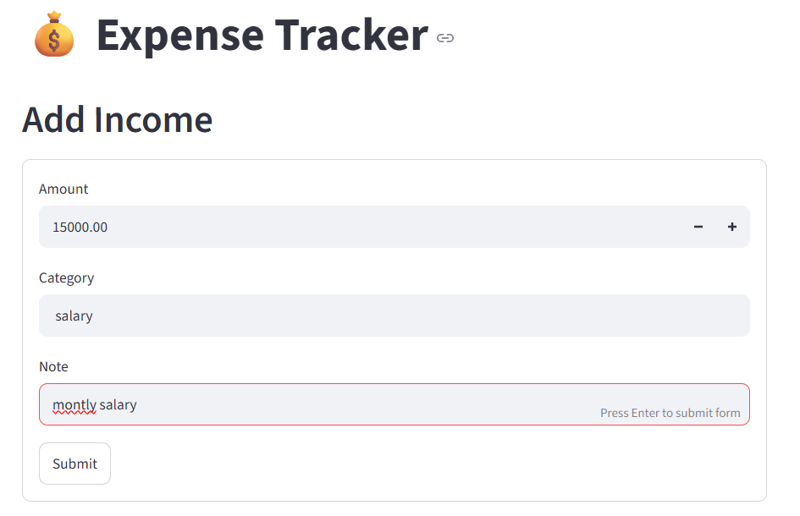
Expense Tracker
Project Insights
The project was developed in Python using VS Code. The application uses functions to load and save transaction records and provides a menu-driven structure for adding income, expenses, viewing records, and checking a summary.

Slide 10
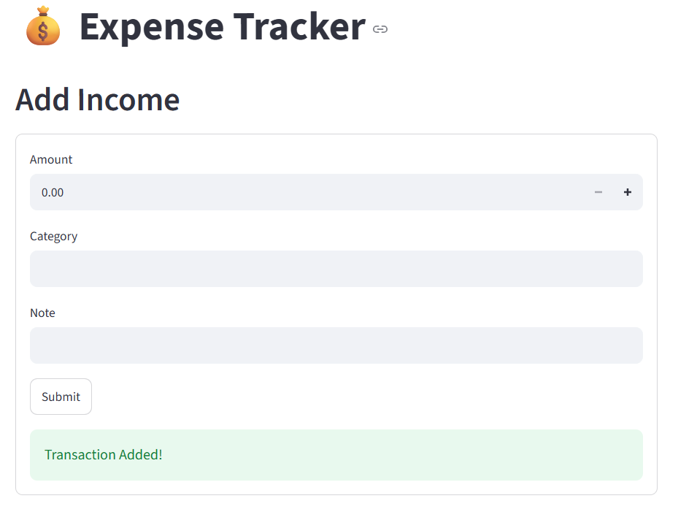
Expense Tracker – Development and excution
Project Insights :
The screenshots show the Python functions, and the Streamlit launch process used during development. The final app provides income and expense entry, transaction history, and a financial summary.

Slide 11
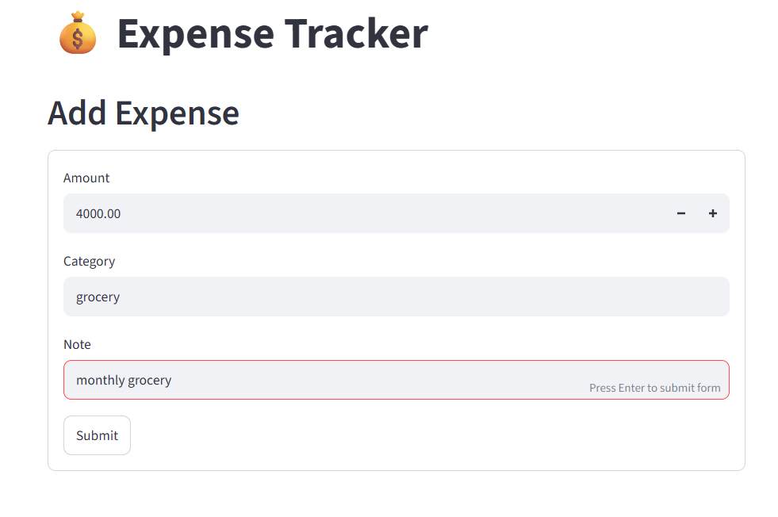
For expenses ;

Slide 12
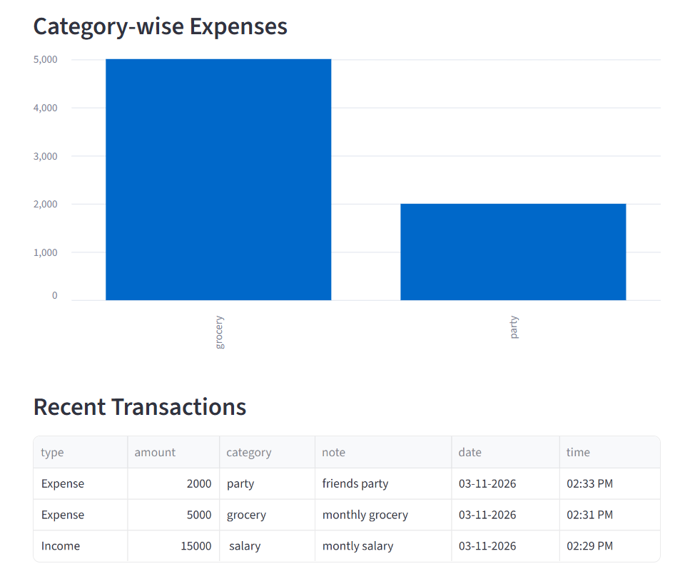
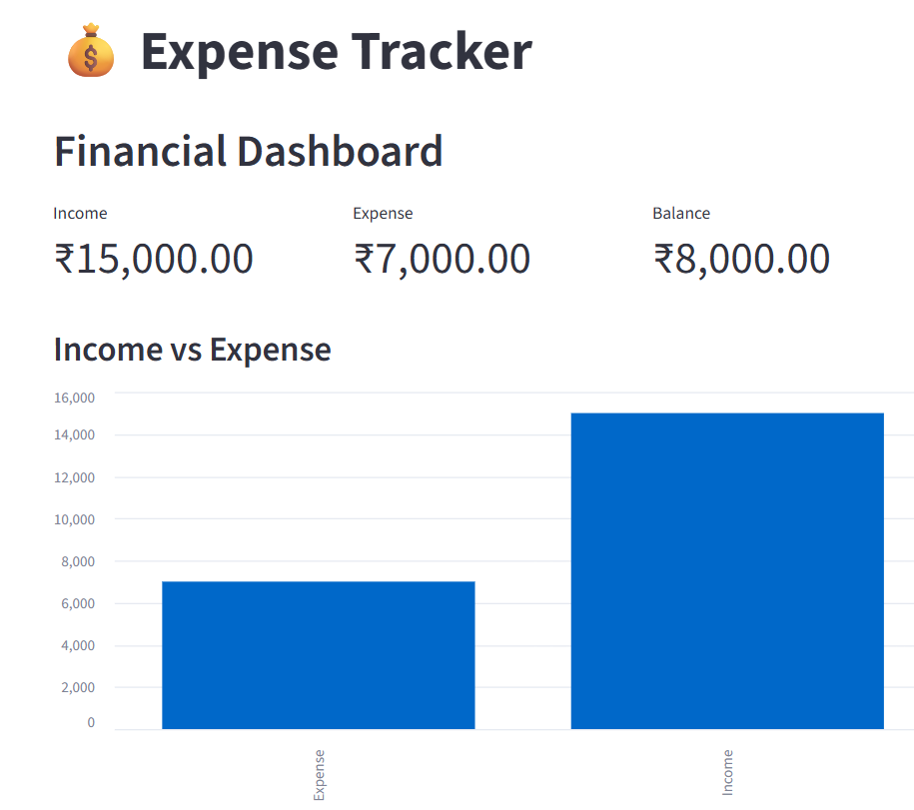
Financial Dashboard using graphs :

Slide 13
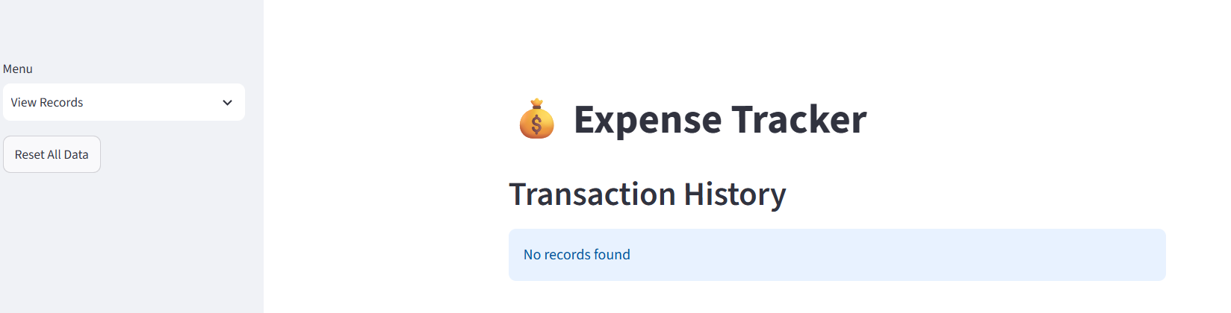
‘Reset’ and clearing the Data :

Slide 14
Conclusion :
The Easy Expense Tracker project demonstrates how Python and Streamlit can be used to organize personal finances. Users can add income and expense entries, record categories and notes, and save transactions in a JSON file. The dashboard calculates total income, total expenses, and the remaining balance, while charts and date filters help users review their spending. The project provides practical experience with Python functions, data structures, file handling, JSON, Pandas, and Streamlit.

Slide 15
Recommendations
⮞ Add monthly and yearly summaries to compare spending over time.
⮞ Add expense category budgets and alerts when limits are reached.
⮞ Export transaction history as PDF or Excel files.
⮞ Add password protection for personal financial data.
⮞ Improve the dashboard with more detailed charts and trends.
⮞ Add recurring income and expense options.

Slide 16


Slide 17

THANK YOU

