Slide 1



Slide 2


LEARN

Slide 3

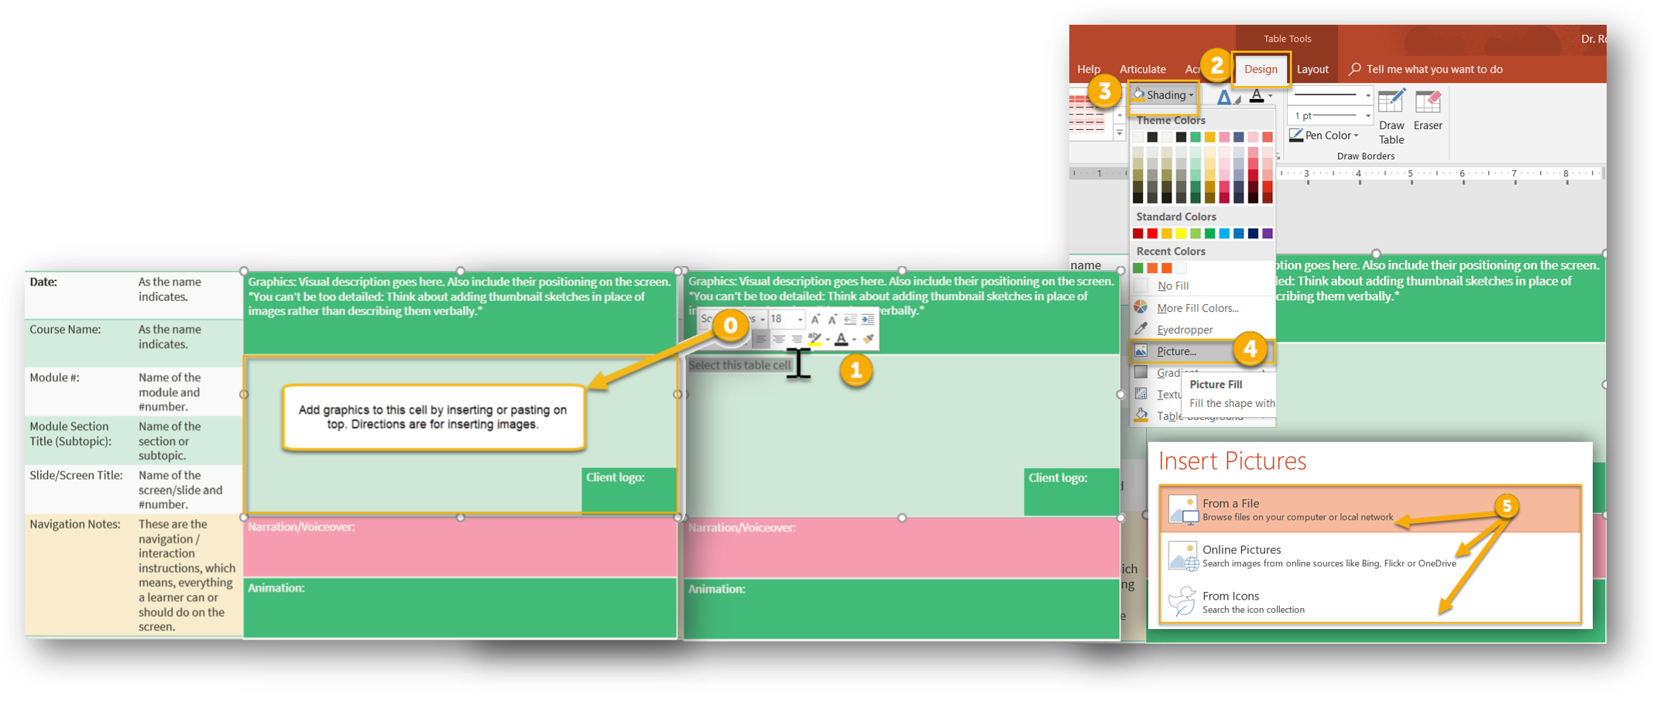
Date: | As the name indicates.
Course Name: | As the name indicates.
Module #: | Name of the module and #number.
Module Section Title (Subtopic): | Name of the section or subtopic.
Slide/Screen Title: | Name of the screen/slide and #number.
Navigation Notes: | These are the navigation / interaction instructions, which means, everything a learner can or should do on the screen.
Graphics: Visual description goes here. Also include their positioning on the screen. *You can’t be too detailed: Think about adding thumbnail sketches in place of images rather than describing them verbally.* You can enter images into the table cell or paste images on top of the cell.
Select this table cell Design Tab Shading, Picture, Select picture
Client logo:
Narration/Voiceover and Sound FX: Indicates the text that the characters/narrator already will say in each screen. This is the part that will be recorded as an audio file. Note that the “Slide Text” and the “Narration” are not necessarily the same. Sound FX are any notes about adding sound effects (whoosh, wham, clang, ringing).
Animation: Explain how the images should enter the screen and match the animations to the narration.

Slide 4
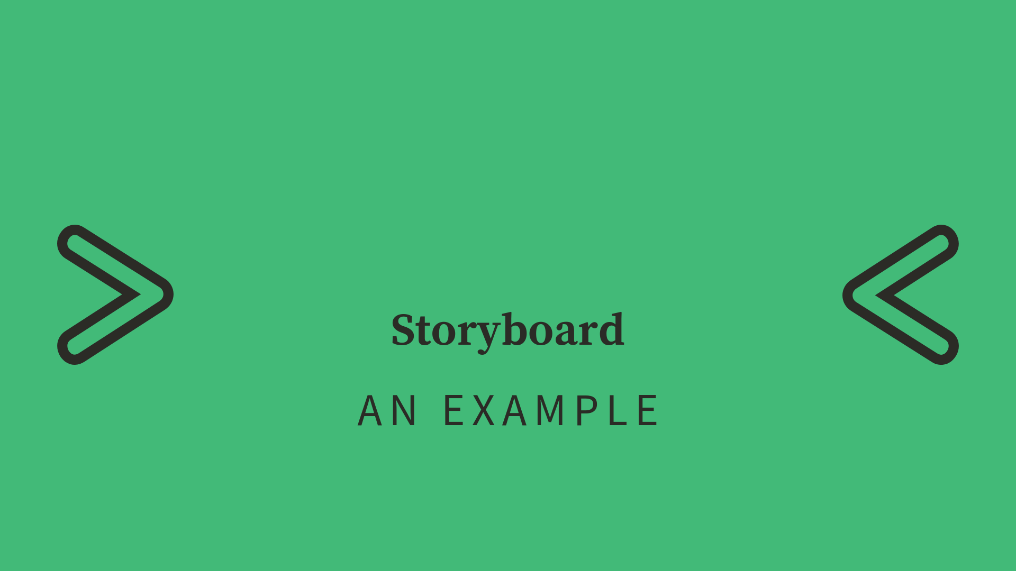
TEACH

Slide 5


Date: | 10/8/2018
Course Name: | Become An IDOL
Module #: | 6. Development
Module Section Title (Subtopic): | Storyboarding
Slide/Screen Title: | Storyboard Example 6.a
Navigation Notes: | Each square in the icon image highlights and shows a hand cursor. All four link/branch to the storyboard comic book example video (optional interaction). Auto next when audio ends.
Graphics and Slide Text:
Client logo:
Narration/Voiceover and Sound FX: A storyboard is a tool for sketching out how an elearning course will unfold, shot by shot. It looks like a comic strip. Each slide represents a single shot. It shows who or what is in the scene, what’s being said, and any text or graphics that appear on the screen. As you read through a storyboard, you should be able to “see” the video playing in your head. *include whooshing sounds to animations
Animation: Slide left and slide right the dots and squiggle lines at the same time. Wipe and fade enter the dashed arrows and circles in succession with pencil last during “sketching out how…shot by shot”. Flip down words starting at the top with Instructional Design & Online Learning to the last line. *Logo stays the entire slide duration.

Slide 6

DO

Slide 7
Date:
Course Name:
Module #:
Module Section Title (Subtopic):
Slide/Screen Title:
Navigation Notes:
Graphics and Slide Text:
Client logo:
Narration/Voiceover:
Animation:

Slide 8
Date:
Course Name:
Module #:
Module Section Title (Subtopic):
Slide/Screen Title:
Navigation Notes:
Graphics and Slide Text:
Client logo:
Narration/Voiceover:
Animation:
Notes:
Clean Version

