Slide 1
Color Scheme Design Template
Why and How to Use this Template

Slide 2

Contrast Considerations
When choosing colors for your course, it’s important to think about contrast—not just aesthetic appeal—if you want to deliver an optimal learning experience. There are two basic guidelines to follow:
01
All text should have a contrast ratio of at least 4.5:1*
All parts of the interface (i.e. buttons) and informational graphics should have a contrast ratio of at least 3:1 to both the background and anything touching them
02

Slide 3
Using This Template
To help you understand how this template works, we’ve filled it out with an example. You’ll want to replace the example colors and screenshots with your own. Here’s how to do that:
01
Mock up a couple slides and replace the placeholder screenshots in the next section of this document.
02
Update the color swatches on the Color Scheme slide with the colors you plan to use.
03
Update the Hex codes next to the color swatches.
04
Fill out the Contrast Ratios to Check table. Make sure to check text colors with the associated background colors as well as any elements of the interface with background colors and anything else they touch. If two buttons are touching each other, they need to be sufficiently contrasted.

Slide 4
Sample Slides
Insert screenshots of your slides in this section

Slide 5

Title Slide

Slide 6
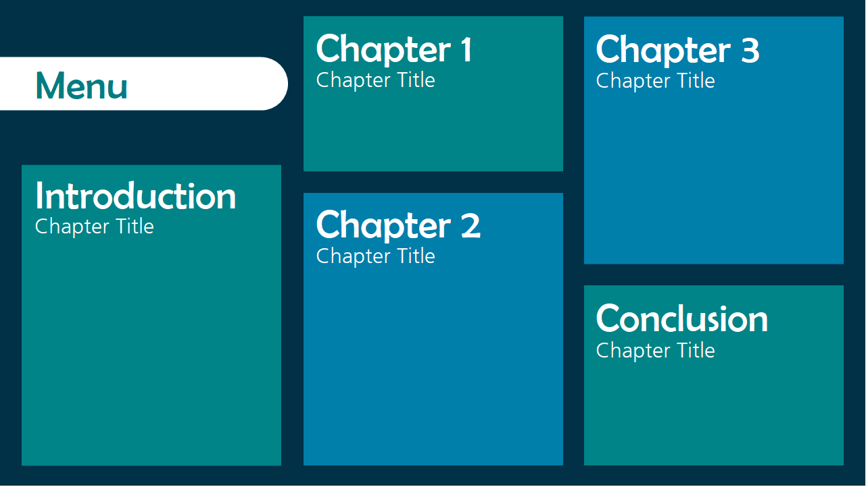
Menu Slide

Slide 7
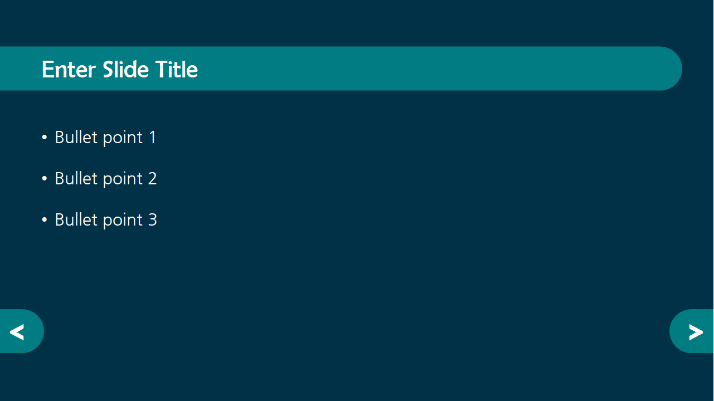
Content Slide

Slide 8
Color Scheme
Insert Your Colors in this Section

Slide 9
Color Scheme
Swatch | Hex Code
 | #003147
 | #007FAB
 | #008488

Slide 10
Contrast Ratios to Check
Foreground Color |  | Background Color |  | Contrast Ratio
Swatch | Hex Code | Swatch | Hex Code | Text or Interface? | Text: > 4.5 Interface: > 3
 | #003147 | White | #FFFFFF | Text | 13.72
 | #007FAB | White | #FFFFFF | Text | 4.54
 | #008488 | White | #FFFFFF | Text | 4.51
 | #003147 |  | #007FAB | Interface | 3.02
 | #003147 |  | #008488 | Interface | 3.04

