Slide 1
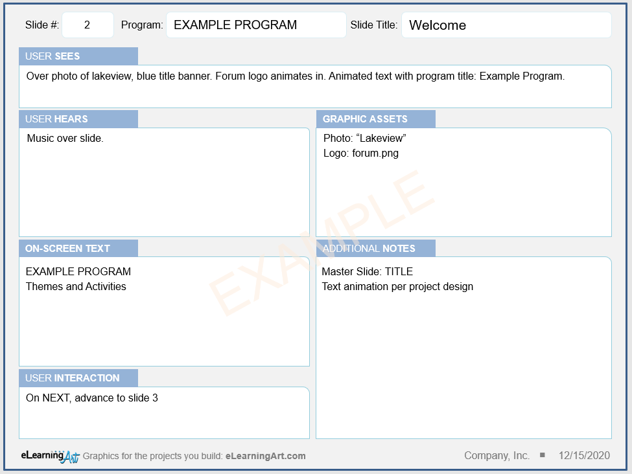
How to Use the Storyboard Slide
Slide number will autofill; no action needed
Add slide title
Describe slide visuals
Add VO script and other audio
List all graphic assets used on slide
Include all on-screen text
Great spot for notes, sketches, and other details
Describe user inputs and what will happen
Today’s date will autofill; no action needed

Slide 2
Welcome
EXAMPLE PROGRAM
Over photo of lakeview, blue title banner. Forum logo animates in. Animated text with program title: Example Program.
Music over slide.
Photo: “Lakeview”
Logo: forum.png
EXAMPLE
EXAMPLE PROGRAM
Themes and Activities
Master Slide: TITLE
Text animation per project design
On NEXT, advance to slide 3

Slide 3
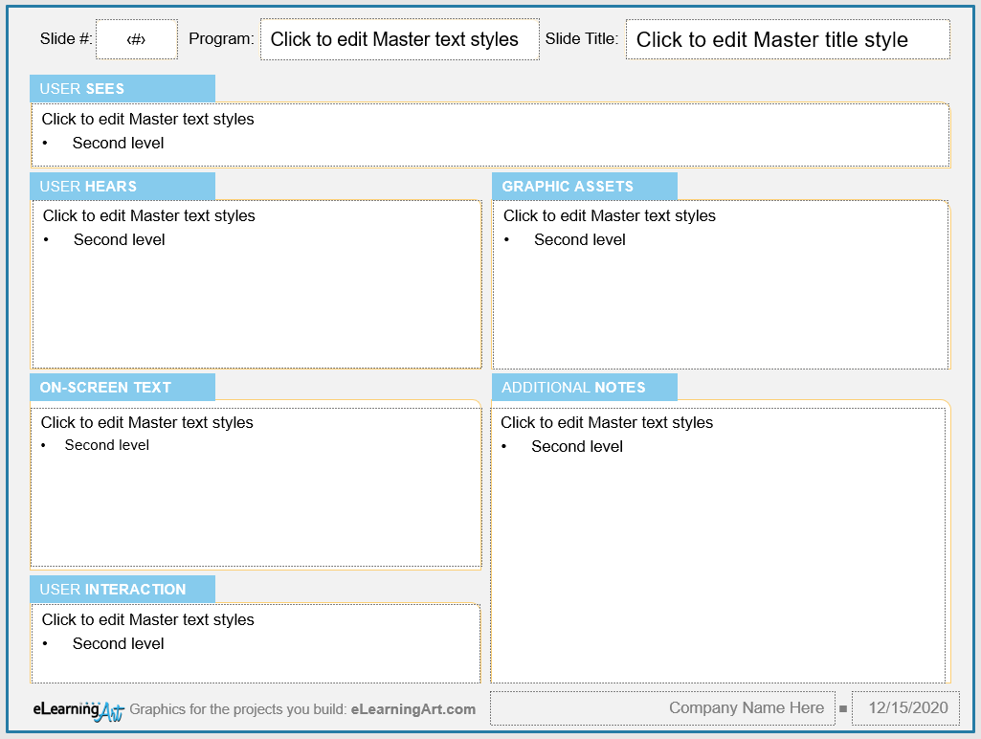
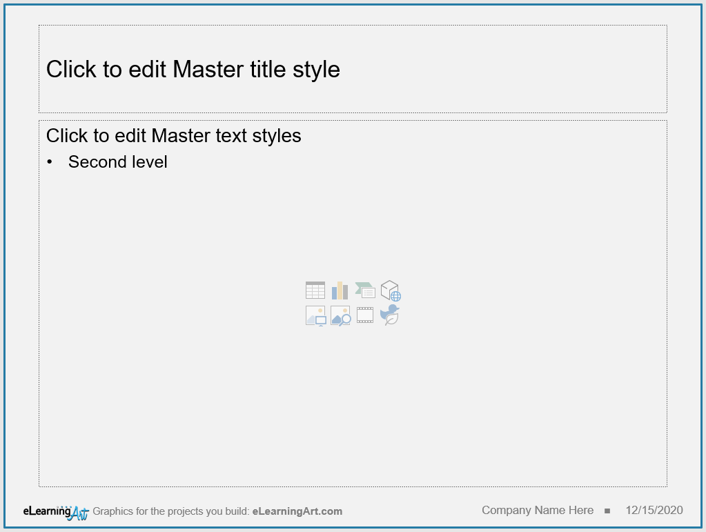
Storyboard Template Tips
This storyboard template includes two master slides. The first (left, top) includes everything you need to describe a program slide. The second (left, bottom) can be used to add more notes or details as needed.
To get started, navigate to Slide Master view and add your project name (A) and company name (B) to the slide masters, as shown here.
Avoid confusion and storyboard each slide in your program separately. Some storyboard slides, such as section title slides, will not have much information, but that’s OK, slides are free!
If you set up and name the master slides in your program before storyboarding, you can easily specify which master should be used for each slide in your program. This helps keep things consistent.
A
B
B

