Slide 1
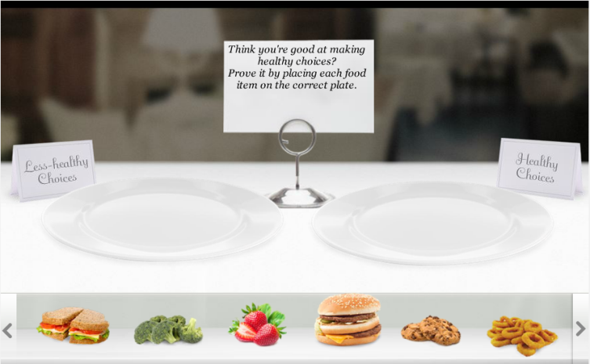

Instructions
[Add instructions here]
[Add incorrect feedback here]
Drop Target
Right-click and change this image with a plate graphic from image library
Drop Target
Right-click and change this image with a plate graphic from image library
[Add correct feedback here]
Healthy
1
Healthy
2
Healthy
3
Less-healthy
1
Less-healthy
2
Less-healthy
3

