Slide 1
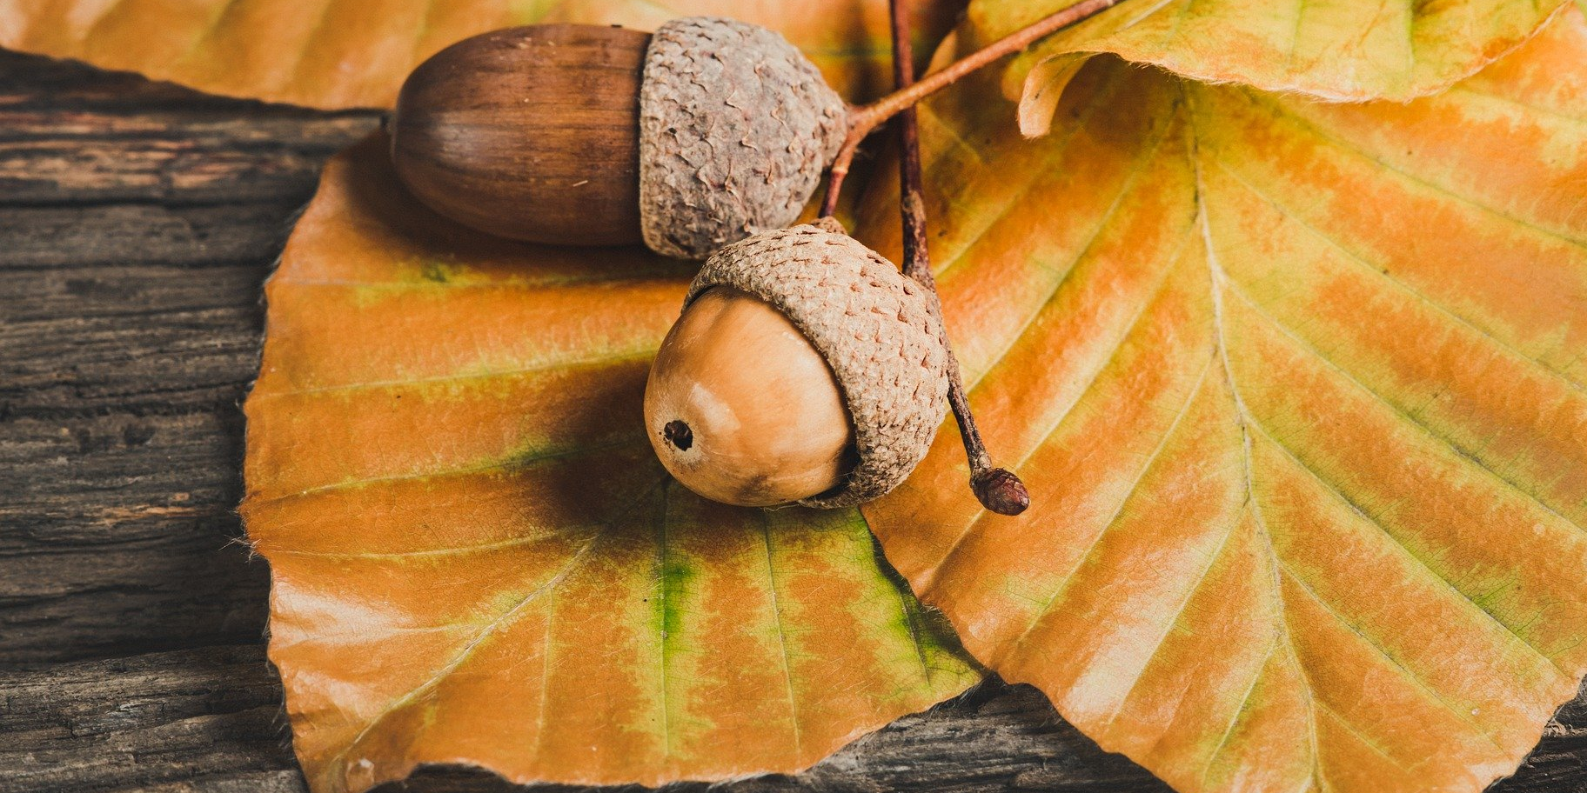
Welcome Autumn…

Slide 2

Time for Pumpkin Spice Latte…

Slide 3



And Autumn leaves…

Slide 4
Fall’s favorite fruit…

Slide 5
Comfy Socks…

Slide 6
Thank you!

