Slide 1
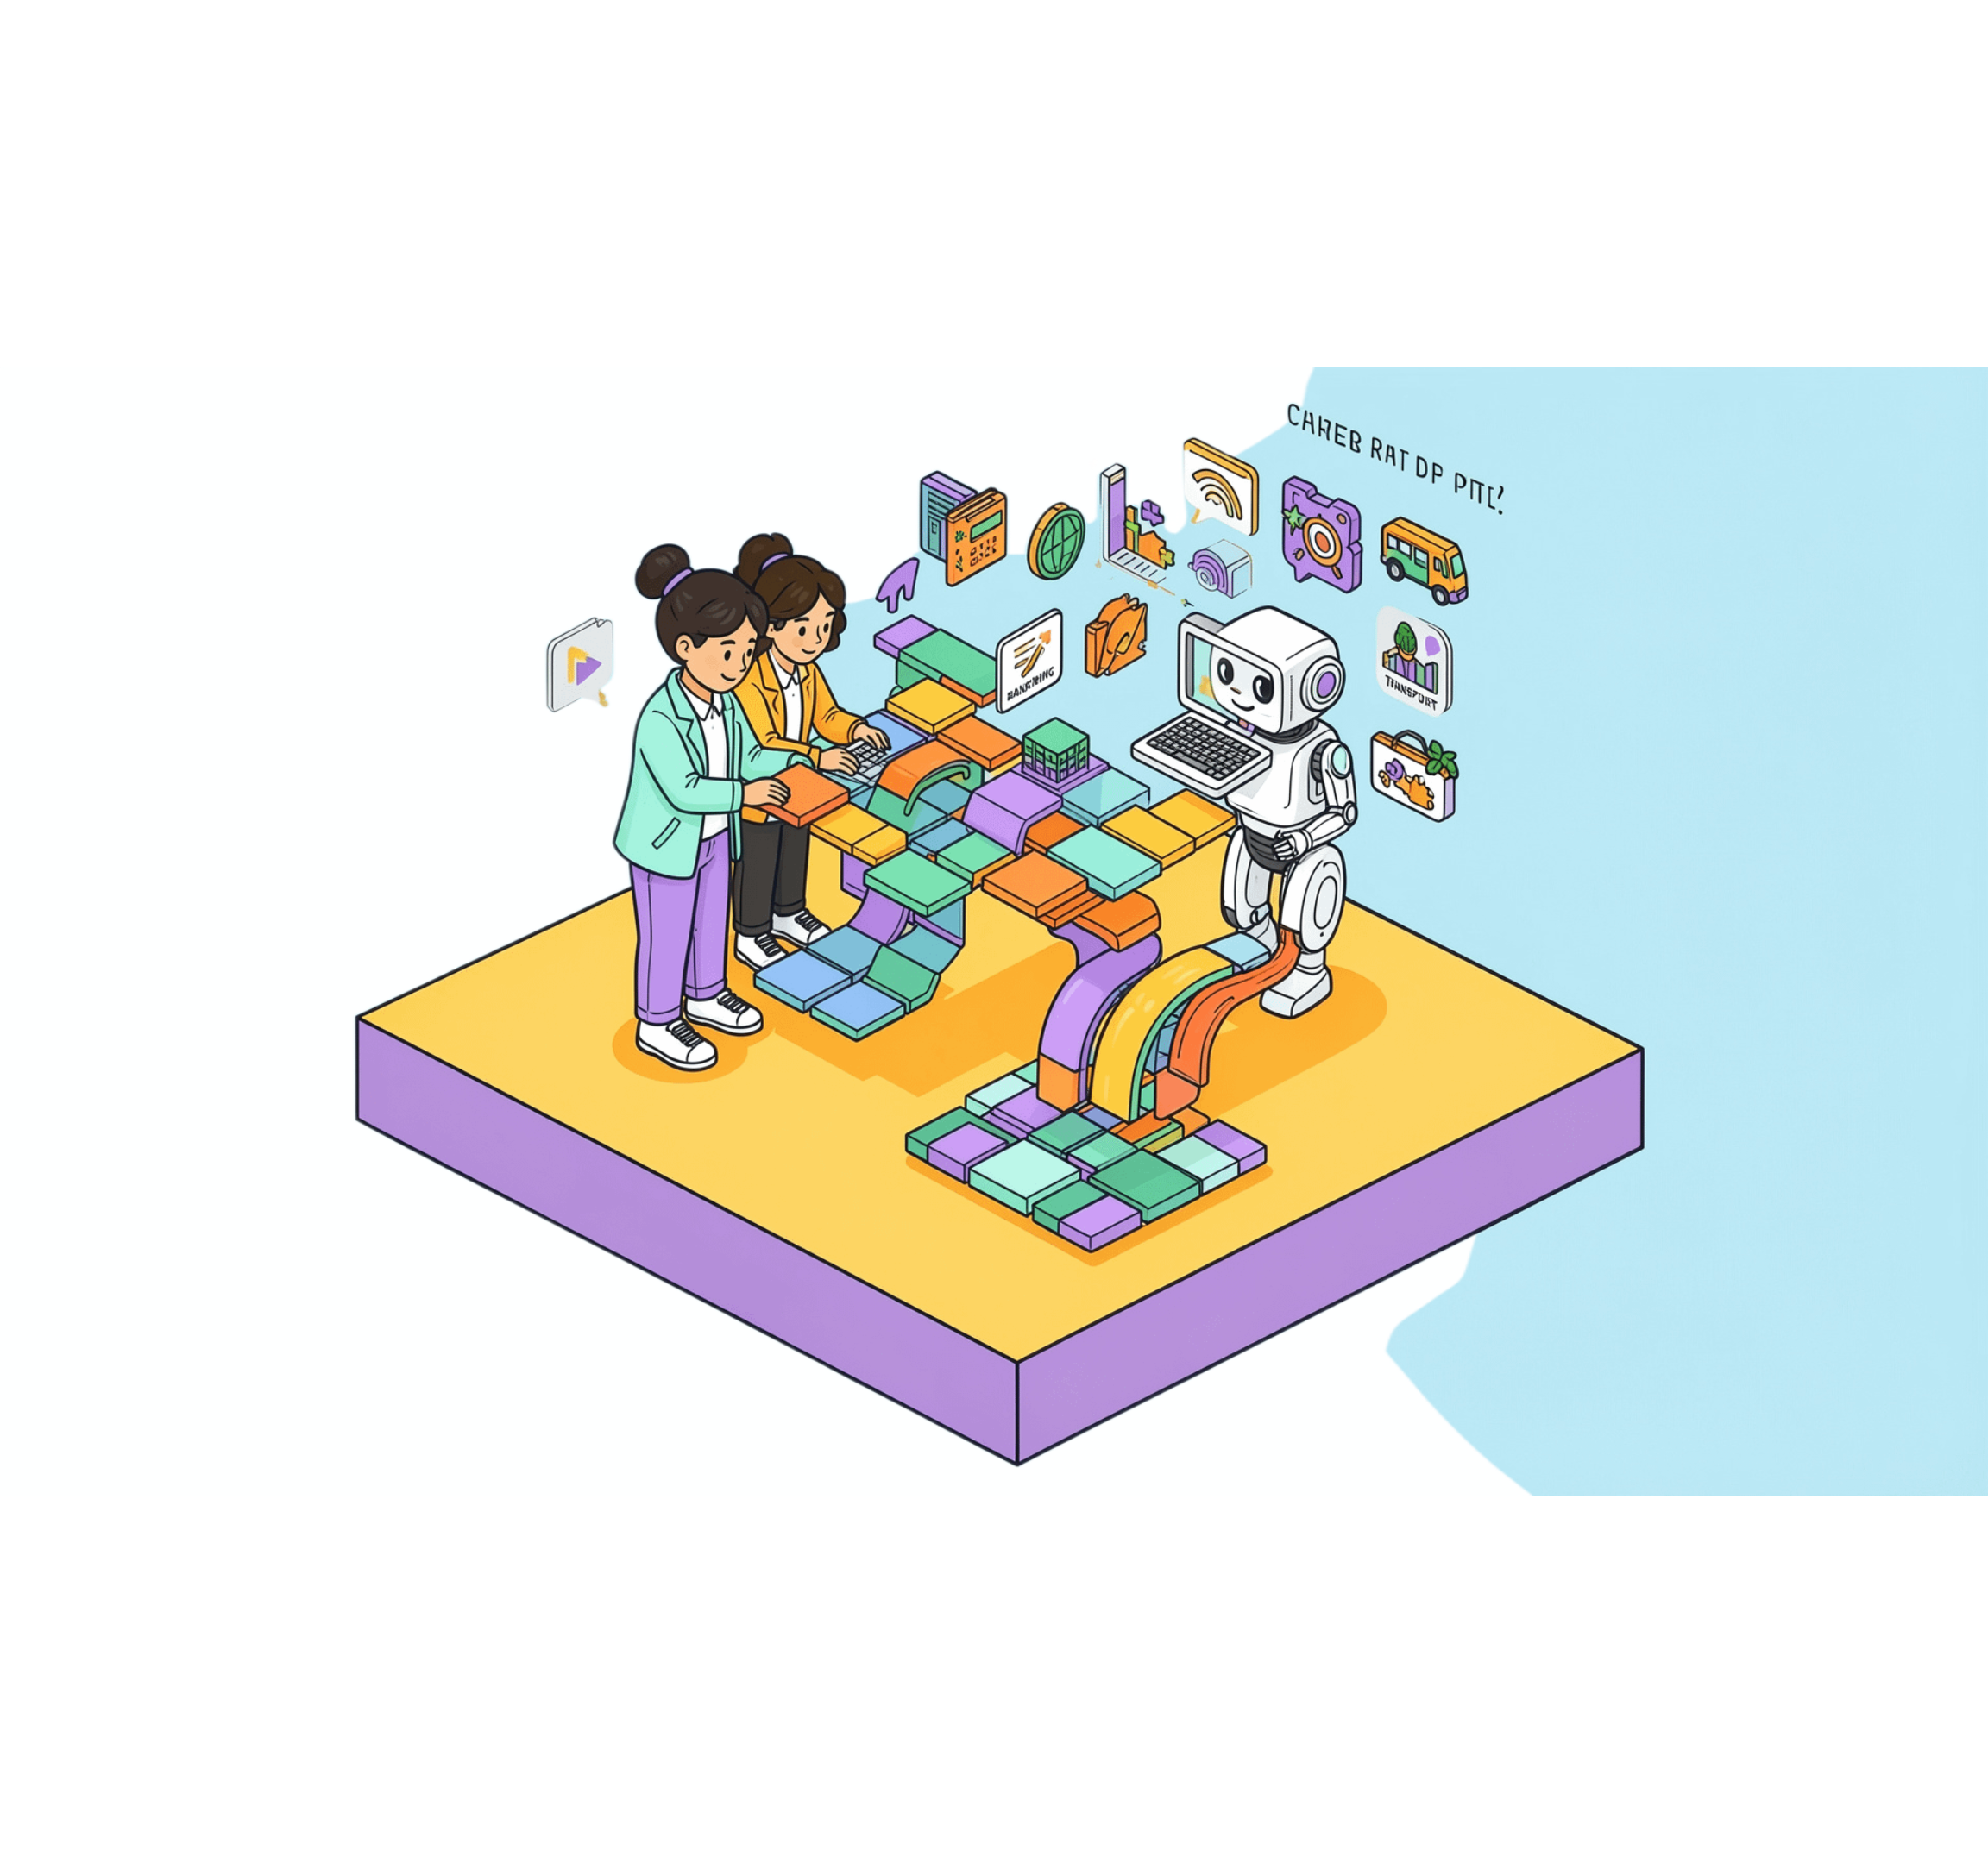
A FIELD GUIDE TO AI
Artificial Intelligence:
Transforming the
Modern World
UNDERSTANDING AI, APPLICATIONS, BENEFITS, AND RESPONSIBLE USE.
Notes:
Artificial intelligence is changing how people work, learn, make decisions, and create. This presentation explains what AI is, where it appears, what value it can create, and how to use it responsibly.

Slide 2



THE CORE IDEA
AI turns data into useful outputs
Instead of following only fixed rules, AI learns patterns from examples and uses them to predict or respond.
Data
AI model
Output
Information from text, images, sound, records, and behavior.
Computer systems study examples, detect patterns, and learn useful relationships.
A prediction, recommendation, response, or generated result.
UNLIKE TRADITIONAL SOFTWARE
Fixed rules become learned behavior shaped by examples. That is why AI can power virtual assistants, recommendations, chatbots, and image recognition.
Notes:
AI begins with data, processes it through a learned model, and produces something useful. The important distinction is that the behavior is shaped by examples rather than written entirely as fixed instructions.

Slide 3










HOW AI LEARNS
AI improves through a five-stage learning loop
Each cycle turns experience into better future performance.
Train
Collect
Study examples.
Gather relevant data.
Identify
Find patterns and relationships.
Improve
Use feedback and new data.
Generate
Make predictions or decisions.
FEEDBACK RETURNS TO TRAINING
Better feedback and better data help the model improve in the next cycle.
Notes:
The learning loop is continuous. AI systems collect relevant data, train on examples, identify patterns, generate predictions or decisions, and then use feedback to improve the next round.

Slide 4






AI IN CONTEXT
AI is already part of everyday life
The same core capabilities appear across services people use every day.
Education
Healthcare
Banking
Personalized learning and AI tutors.
Medical image analysis and decision support.
Fraud detection and risk analysis.
Business
Customer support and automation.
Notes:
AI is not limited to one industry. Students may encounter it in adaptive learning tools, medical systems, banking security, navigation, customer service, streaming recommendations, and creative software.

Slide 5
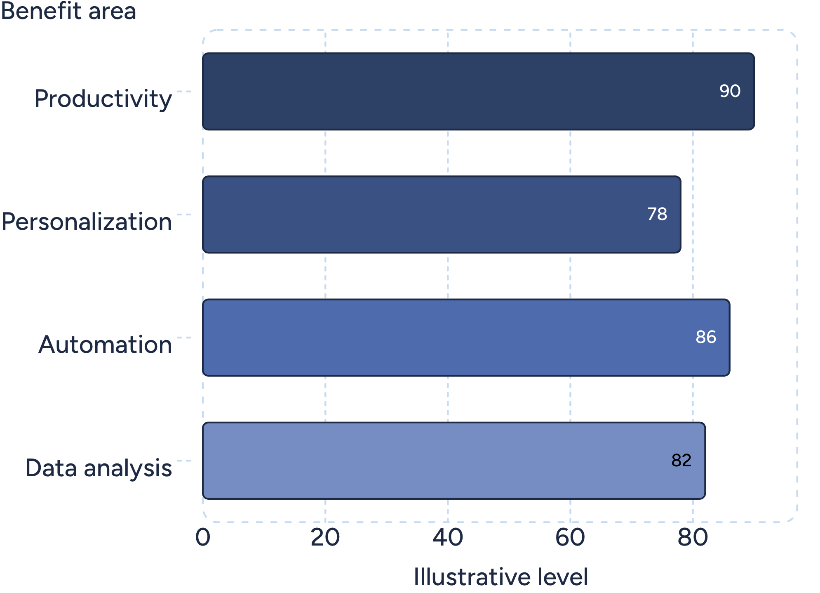
VALUE AND RESPONSIBILITY
AI creates value—and raises real questions
BENEFITS
Faster decisions, task automation, personalized experiences, higher productivity, and better data analysis.
CHALLENGES
Bias, privacy risks, incorrect generated information, job displacement concerns, and overdependence.
Illustrative comparison · conceptual values, not real-world statistics.
Notes:
The value of AI is real, but so are the questions. AI can support productivity, personalization, automation, and analysis. Responsible use requires attention to bias, privacy, accuracy, changing jobs, and the risk of relying on systems too much.

Slide 6
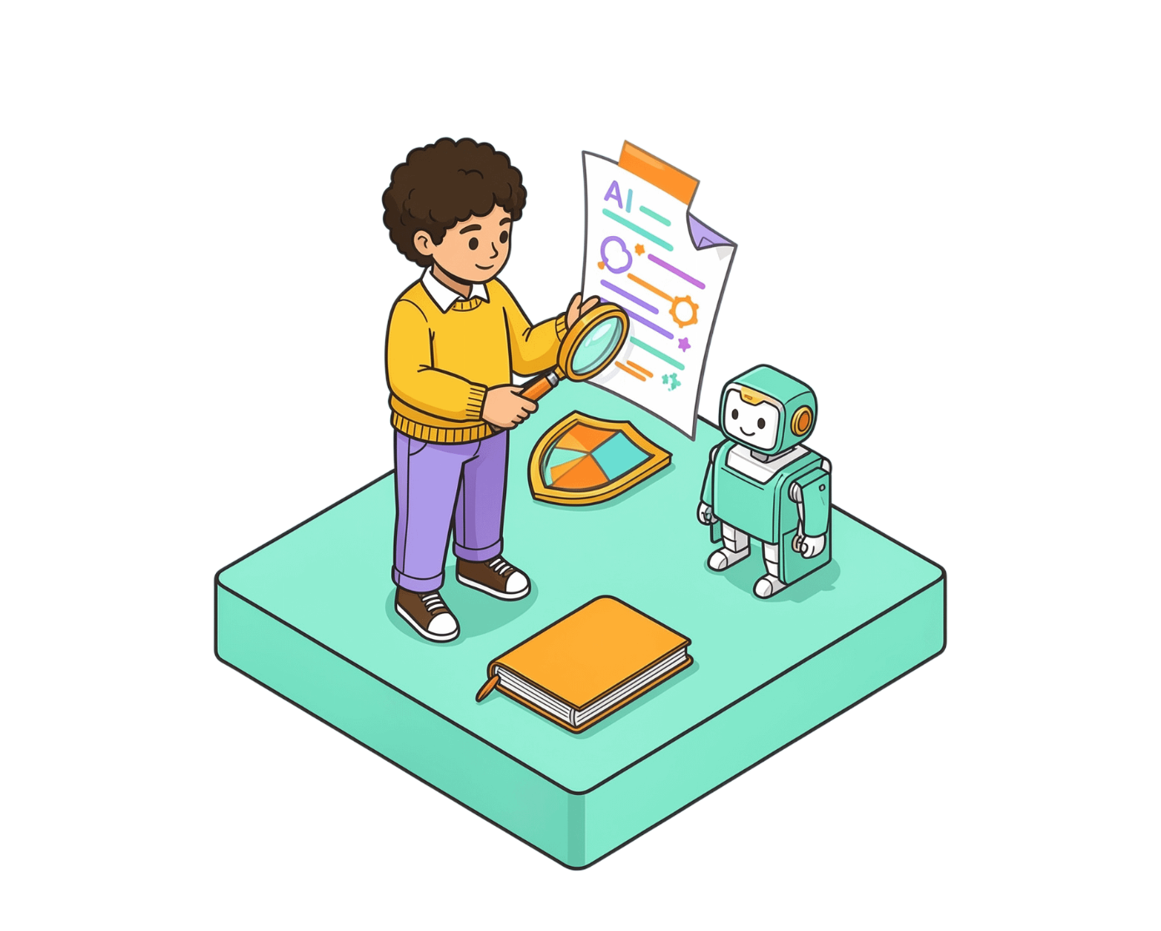
RESPONSIBLE USE
Use AI to enhance human intelligence
01
Verify important information
Check before relying on it.
02
Protect personal data
Keep confidential information out of unsafe tools.
Avoid plagiarism
Use AI to enhance human intelligence, not replace human judgment.
03
Cite sources when required.
04
Support learning
Use AI to support learning, not replace thinking.
05
Review and improve
Question and refine AI-generated content.
Notes:
Responsible use keeps human judgment in the loop. Verify important information, protect personal and confidential data, avoid plagiarism, use AI to support learning, and review what the system produces. The goal is stronger human thinking, not less of it.

