Slide 1

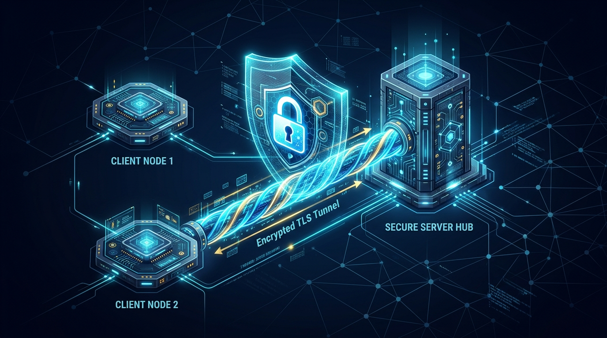
Design and Development of a Real-Time Client–Server Chat Application Using Transport Layer Security (TLS) for Confidential and Reliable Communication
Secure Multi-Client Communication Architecture Protecting Data in Transit
[TLS Security] [Socket Programming] [BCrypt Hashing] [MySQL Storage] [Activity Logging]
PROJECT SUPERVISION & GUIDANCE
Faculty Guide: Dr. SENTHAMIL SELVAN R B.E,M.Tech(CS),M.Tech(CSE), Phd,MISTE,FIETEAssociate Professor Department of ECESIMATS Engineering Saveetha University,Thandalam,Chennai
TEAM MEMBERS
• Maniyar Mohammad Rehan (192425391) • Kadhirezhilan D (192511228)
• Kasi Yamini (192572181) • Marripudi Madhulika (192472188)
• Neelakandamoorth Y C (192421063)
Real-Time Client–Server Chat Application Using TLS | Faculty Guide: Dr. SENTHAMIL SELVAN R
Slide 01 of 17

Slide 2


Introduction
01. PROJECT OVERVIEW & SECURE COMMUNICATION
• Need for Secure Chat Systems – Modern real-time communication requires confidential and reliable data transmission. Unprotected socket channels expose private conversations to packet sniffing and tampering.
• Vulnerabilities in Standard Sockets – Raw TCP socket architectures transmit payloads in cleartext. Without encryption, sensitive credentials and chat data can be intercepted across local or public networks.
• Role of Transport Layer Security (TLS) – TLS establishes an encrypted cryptographic tunnel between the client and server, ensuring message confidentiality and verifying server authenticity.
• Project Mission & Deliverables – This project delivers a multi-client real-time chat application embedding TLS socket encryption, BCrypt authentication, MySQL persistence, and security auditing.
• Security Goals (CIA Triad) – Implements Confidentiality (TLS encryption), Integrity (data verification), and Authentication (user credentials and digital certificates).
Figure 1: Secure Client–Server Communication Architecture
Real-Time Client–Server Chat Application Using TLS | Faculty Guide: Dr. SENTHAMIL SELVAN R
Slide 02 of 17

Slide 3
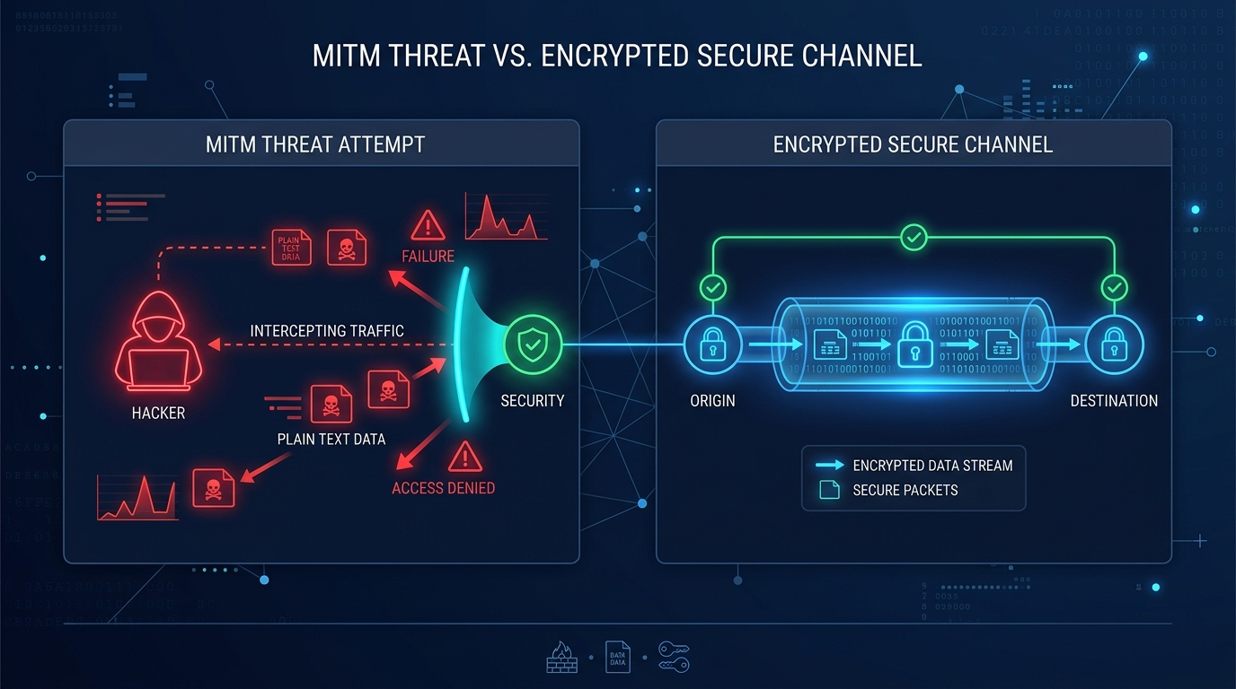
Problem Statement
02. SECURITY CHALLENGES IN UNSECURED NETWORKS
• Cleartext Data Sniffing – Unencrypted chat packets transmitted over open networks can be captured and read by malicious actors using network packet analyzers.
• Man-in-the-Middle (MITM) Attacks – Adversaries positioned on untrusted network paths can intercept, inspect, or alter unauthenticated message streams.
• Weak Credential Storage – Storing plaintext or weakly hashed passwords exposes user accounts to database breaches and unauthorized access.
• Message Tampering & Integrity Risks – Without cryptographic integrity protection, messages can be modified in transit without detection by sender or recipient.
• Server Spoofing & Impersonation – Lack of digital certificate verification allows rogue servers to masquerade as legitimate chat endpoints.
• Proposed Mitigation – Enforcing TLS socket encryption, digital certificate validation, and BCrypt salted password hashing to secure the communication channel.
Figure 2: Network Security Threats and Interception Risks
Real-Time Client–Server Chat Application Using TLS | Faculty Guide: Dr. SENTHAMIL SELVAN R
Slide 03 of 17

Slide 4
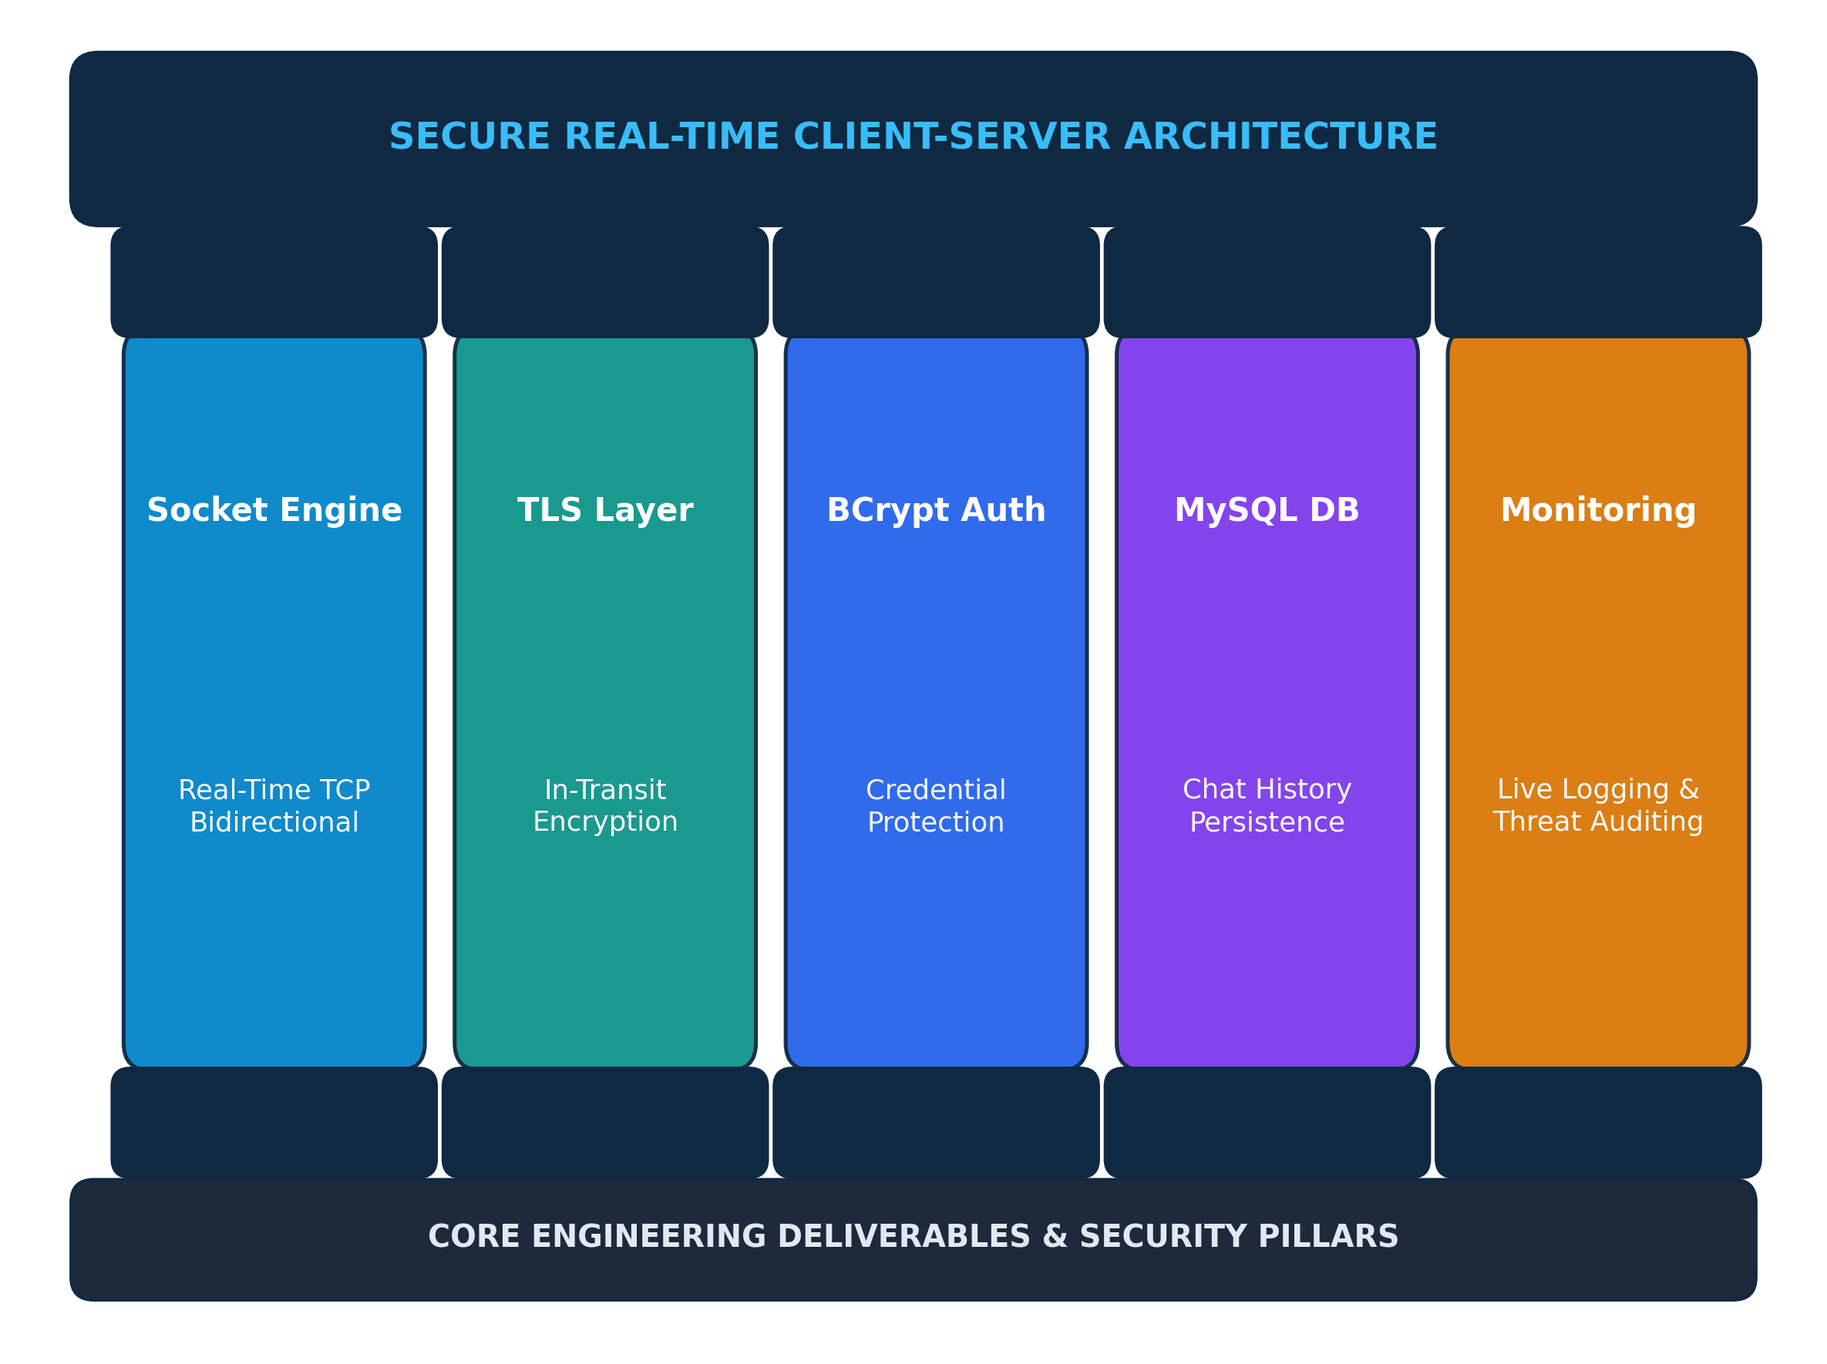
Project Objectives
03. CORE ENGINEERING GOALS & DELIVERABLES
• Real-Time Socket Architecture – Develop an asynchronous client-server communication framework using Python socket programming for fast real-time messaging.
• TLS Secure Communication Layer – Wrap standard TCP socket streams inside TLS to encrypt all data exchanged between clients and the server.
• Message Confidentiality & Integrity – Ensure chat payloads cannot be read or modified by unauthorized third parties during transit over open networks.
• Secure User Authentication – Build a secure user authentication system with BCrypt password hashing and session tokens to prevent unauthorized account access.
• Database Management & History – Store chat history and user profiles securely in a MySQL relational database for reliable message persistence and retrieval.
• Security Monitoring & Auditing – Maintain real-time activity logging and failed login detection to track system events and identify potential security threats.
Figure 3: System Deliverables and Security Architecture Pillars
Real-Time Client–Server Chat Application Using TLS | Faculty Guide: Dr. SENTHAMIL SELVAN R
Slide 04 of 17

Slide 5
System Architecture
04. END-TO-END MESSAGE TRANSMISSION FLOWCHART
1. CLIENT A
Sender enters chat message in graphical client UI
2. USER AUTHENTICATION
Validates user identity & BCrypt session credentials
3. TLS SECURE CONNECTION
Encrypts socket data stream using TLS cryptographic tunnel
4. CHAT SERVER
Central socket server handles connections & message routing
8. CLIENT B
Recipient client receives, decrypts & renders chat message
7. SECURITY MONITORING
Logs communication event & audits for security anomalies
6. MYSQL DATABASE / HISTORY
Stores conversation record for reliable data persistence
5. MESSAGE PROCESSING
Parses chat payload format & identifies recipient client
Figure 4: End-to-End System Architecture Flowchart of the Secure Chat Application
Real-Time Client–Server Chat Application Using TLS | Faculty Guide: Dr. SENTHAMIL SELVAN R
Slide 05 of 17

Slide 6
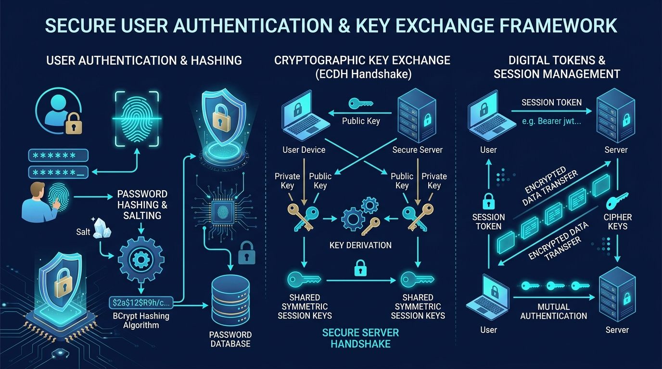
Module 1: User Authentication & Account Management
05. CORE SYSTEM MODULE 1
Purpose: Ensures only authorized, verified users can access the chat system.
• User Registration – Enables new users to create accounts with unique usernames and validated credentials.
• Secure Login Verification – Authenticates user identity before granting access to chat channels and messaging services.
• BCrypt Password Hashing – Passwords are securely hashed using BCrypt before being stored in the database.
• Session Management – Tracks active user sessions and securely manages associated socket connections.
• Access Control & Privacy – Ensures users can only access their authorized chats and private message histories.
Figure 5: User Authentication and Credential Verification Flow
Real-Time Client–Server Chat Application Using TLS | Faculty Guide: Dr. SENTHAMIL SELVAN R
Slide 06 of 17

Slide 7
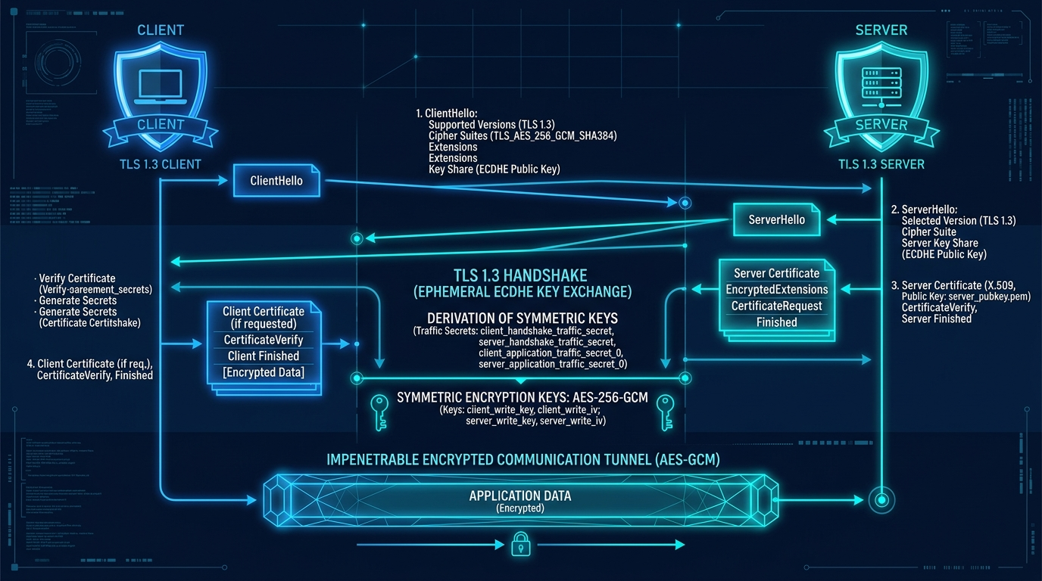
Module 2: TLS Secure Communication Layer
06. CORE SYSTEM MODULE 2
Purpose: Protects client-server socket communication against eavesdropping and MITM attacks.
• TLS Handshake Protocol – Establishes a secure connection by negotiating encryption keys between client and server.
• Certificate Validation – Validates the server's digital certificate to confirm server authenticity and legitimacy.
• Secure Connection Wrapping – Wraps standard TCP socket streams inside a secure TLS transport layer.
• Encrypted Communication – TLS creates a secure connection and encrypts data exchanged between the client and server.
• Protection Against Interception – Prevents unauthorized parties from eavesdropping, sniffing, or tampering with in-transit messages.
Figure 6: TLS Handshake and Encrypted Communication Layer
Real-Time Client–Server Chat Application Using TLS | Faculty Guide: Dr. SENTHAMIL SELVAN R
Slide 07 of 17

Slide 8
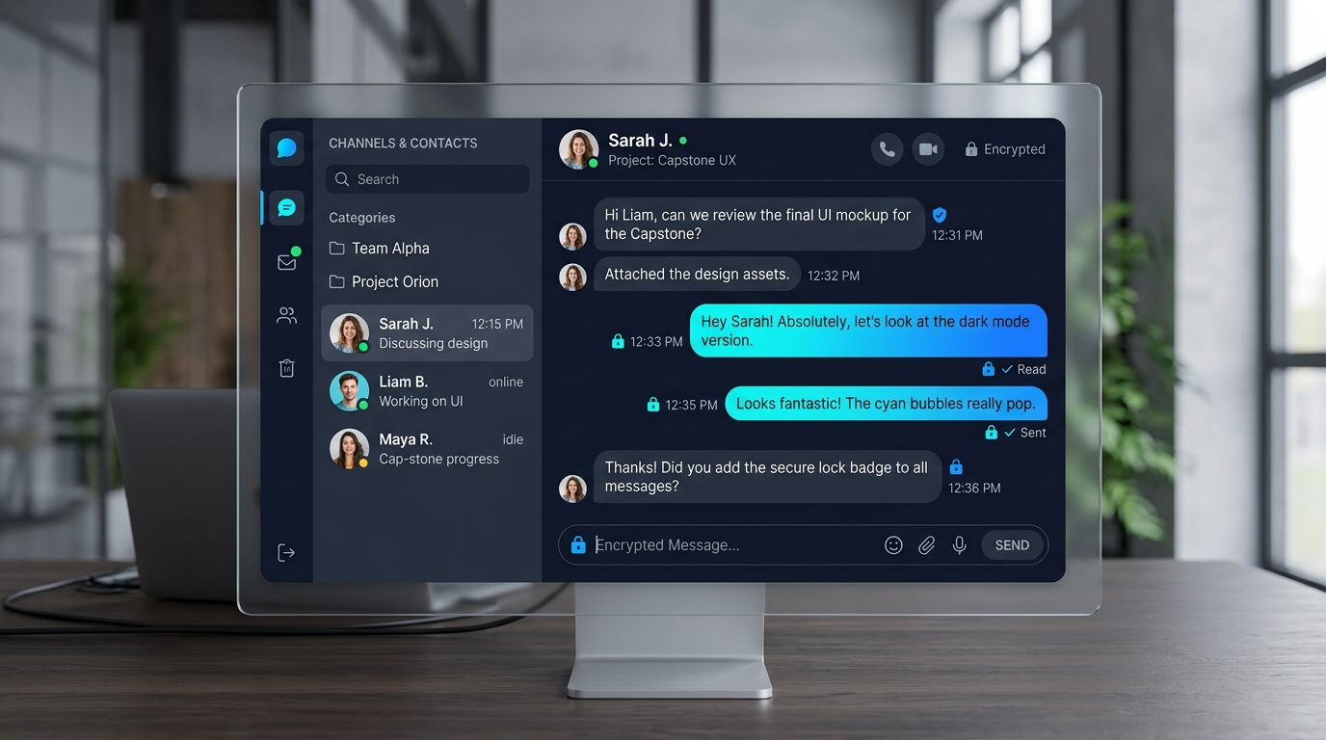
Module 3: Real-Time Messaging System
07. CORE SYSTEM MODULE 3
Purpose: Enables fast, reliable, and real-time one-to-one message exchange between connected users.
• One-to-One Messaging – Supports direct private chat sessions between authenticated clients.
• Real-Time Message Delivery – The messaging system supports fast real-time communication between active users.
• Online/Offline Presence Status – Provides real-time presence tracking so users know when their contacts are online.
• Timestamps & Sequencing – Attaches accurate timestamps to every message for chronological ordering.
• Delivery Confirmation – Sends acknowledgments to confirm successful message transmission to the recipient.
Figure 7: Real-Time Messaging and Client Interface Flow
Real-Time Client–Server Chat Application Using TLS | Faculty Guide: Dr. SENTHAMIL SELVAN R
Slide 08 of 17

Slide 9
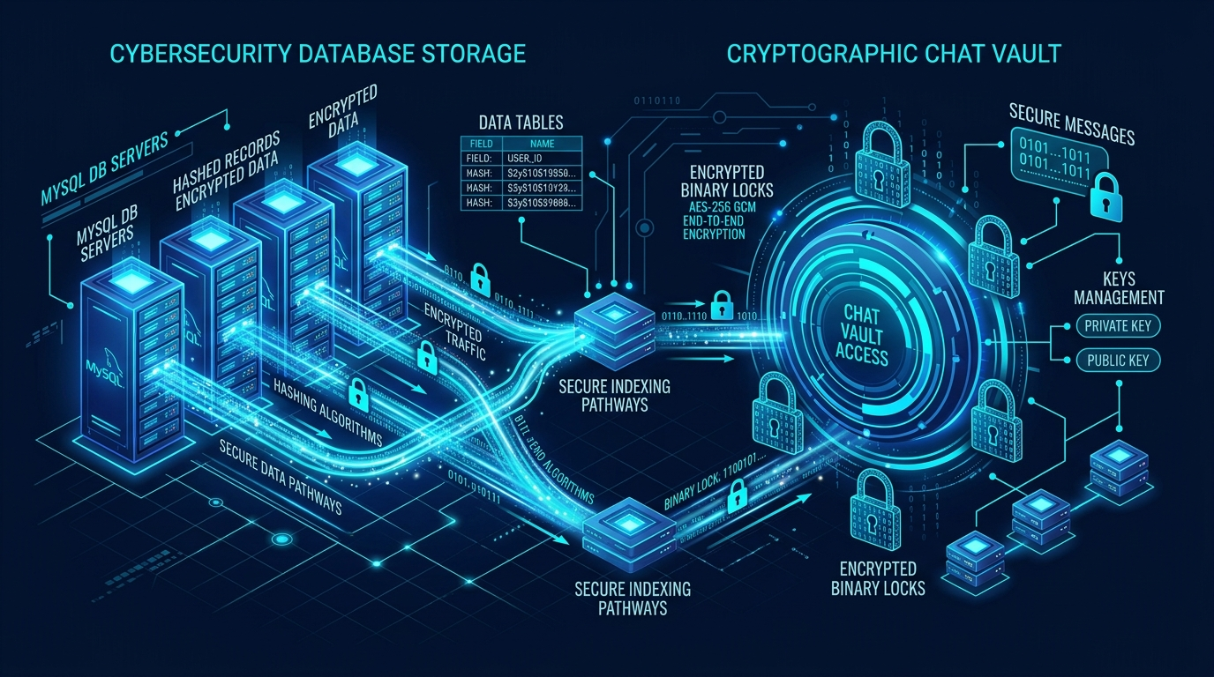
Module 4: Chat History & Database Management
08. CORE SYSTEM MODULE 4
Purpose: Stores and retrieves chat data securely, reliably, and efficiently with relational data integrity.
• Secure Message Storage – Stores user messages safely in structured database tables to prevent unauthorized data access.
• Chat History Persistence – Maintains complete, chronological conversation logs accessible across user sessions.
• Efficient Message Retrieval – Quickly fetches past conversation records when a user opens a chat conversation.
• MySQL Database Management – Manages database connections, user profiles, and message schemas with relational integrity.
Figure 8: Chat History Storage and MySQL Database Architecture
Real-Time Client–Server Chat Application Using TLS | Faculty Guide: Dr. SENTHAMIL SELVAN R
Slide 09 of 17

Slide 10
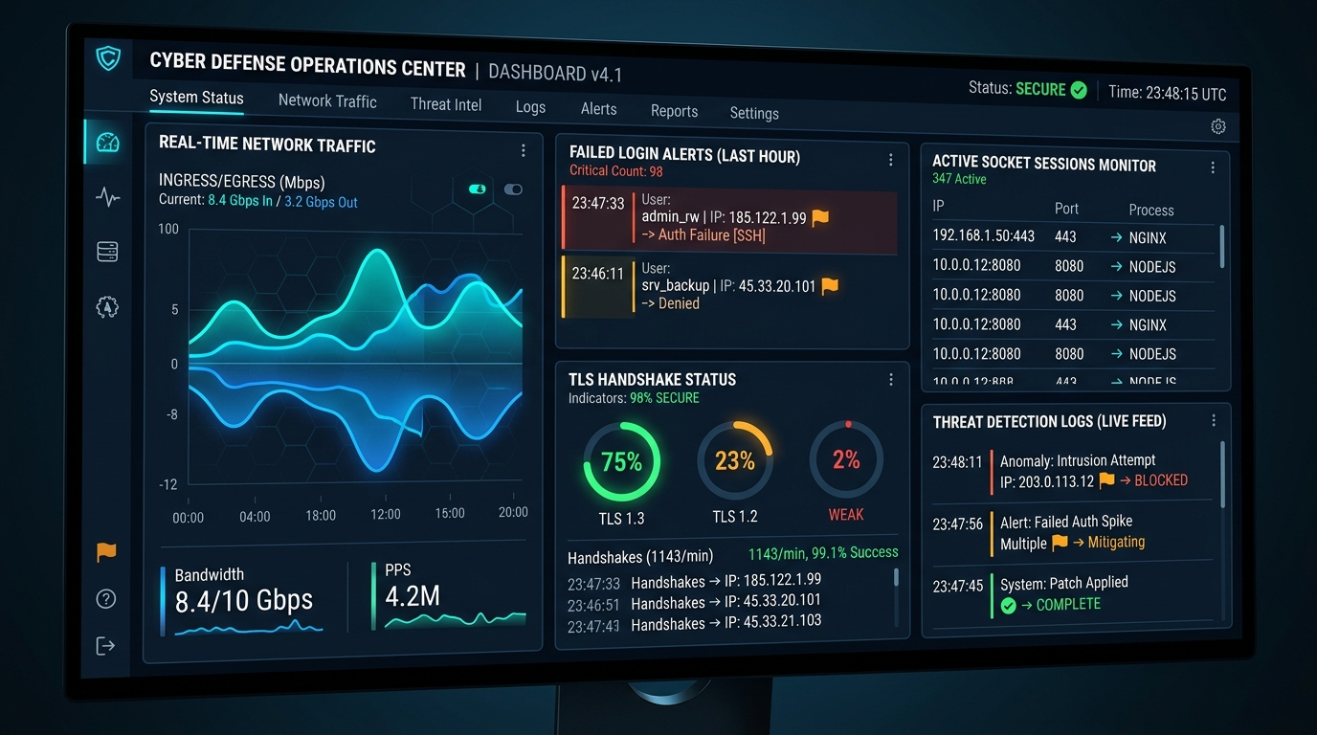
Module 5: Security Monitoring & Activity Logging
09. CORE SYSTEM MODULE 5
Purpose: Monitors system activity in real time and proactively identifies potential security threats.
• Login Monitoring – Tracks user connection times, active sessions, and client endpoints in real time.
• Failed Login Detection – Detects repeated unsuccessful login attempts to identify potential brute-force activity.
• Activity Logging – Maintains structured server logs of all major system events for troubleshooting and audits.
• Security Event Auditing – Monitors connection errors, invalid session tokens, and unexpected socket disconnections.
• Suspicious Activity Alerts – Flags unusual traffic or connection patterns to safeguard server stability and security.
Figure 9: Security Monitoring and Activity Audit Dashboard
Real-Time Client–Server Chat Application Using TLS | Faculty Guide: Dr. SENTHAMIL SELVAN R
Slide 10 of 17

Slide 11
Technologies Used
10. SYSTEM TECHNOLOGY STACK BREAKDOWN
SECURITY & PROTOCOLS
BACKEND & NETWORKING
DATABASE & STORAGE
FRONTEND & CLIENT UI
• TLS Protocol Encrypted transport layer for socket communication
• Digital Certificates Server identity authentication & verification
• BCrypt Hashing Secure salted password hashing before storage
• Cipher Suites Standard symmetric ciphers for message encryption
• Python 3.x Core backend application programming language
• TCP Sockets Low-level network socket communication protocol
• Multi-Threading Handles concurrent multi-client connections
• SSL Module Python standard library for TLS integration
• MySQL Database Relational database for chat and user data
• PyMySQL Connector Database connection driver for Python
• Structured Tables Organized schemas for users and chat history
• Data Integrity Relational consistency across conversations
• Client Interface Clean and responsive graphical chat interface
• Event Handling Real-time UI updates for incoming messages
• Status Indicators Visual indicators for online and offline status
• Chat History View Scrollable message window with timestamps
Figure 10: Complete System Technology Stack and Modular Component Breakdown
Real-Time Client–Server Chat Application Using TLS | Faculty Guide: Dr. SENTHAMIL SELVAN R
Slide 11 of 17

Slide 12
Literature Review
11. RECENT RESEARCH IN TLS & SECURE COMMUNICATIONS (2024–2026)
Author & Year | Research Focus | Method / Technology | Key Finding
Zheng et al. (2024) [ESORICS] | Post-Quantum TLS 1.3 | ML-KEM key encapsulation in TLS 1.3 handshake | Demonstrates efficient cryptographic handshakes with low computational overhead.
Zhou et al. (2024) [MDPI Electronics] | Encrypted Traffic Security | Encrypted ClientHello (ECH) & traffic analysis | Confirms TLS 1.3 effectively shields user communication against network eavesdropping.
Lastre et al. (2025) [MDPI Sensors] | Handshake Optimization | Fast handshake resumption & security modeling | Evaluates connection setup optimization while preserving forward secrecy and authentication.
Kumar & Sharma (2025) [J. Prog. Electr.] | Socket Performance | TLS vs raw socket benchmarks over TCP | Shows TLS provides robust security with minimal impact on real-time socket communication.
Al-Sharif & Ben-Othman (2026) [IEEE TNSM] | Transport Layer Privacy | Latency evaluation of secure socket streams | Verifies that modern TLS encryption is well-suited for interactive real-time messaging.
Figure 11: Summary of Recent Academic Literature on TLS and Secure Communications (2024–2026)
Real-Time Client–Server Chat Application Using TLS | Faculty Guide: Dr. SENTHAMIL SELVAN R
Slide 12 of 17

Slide 13
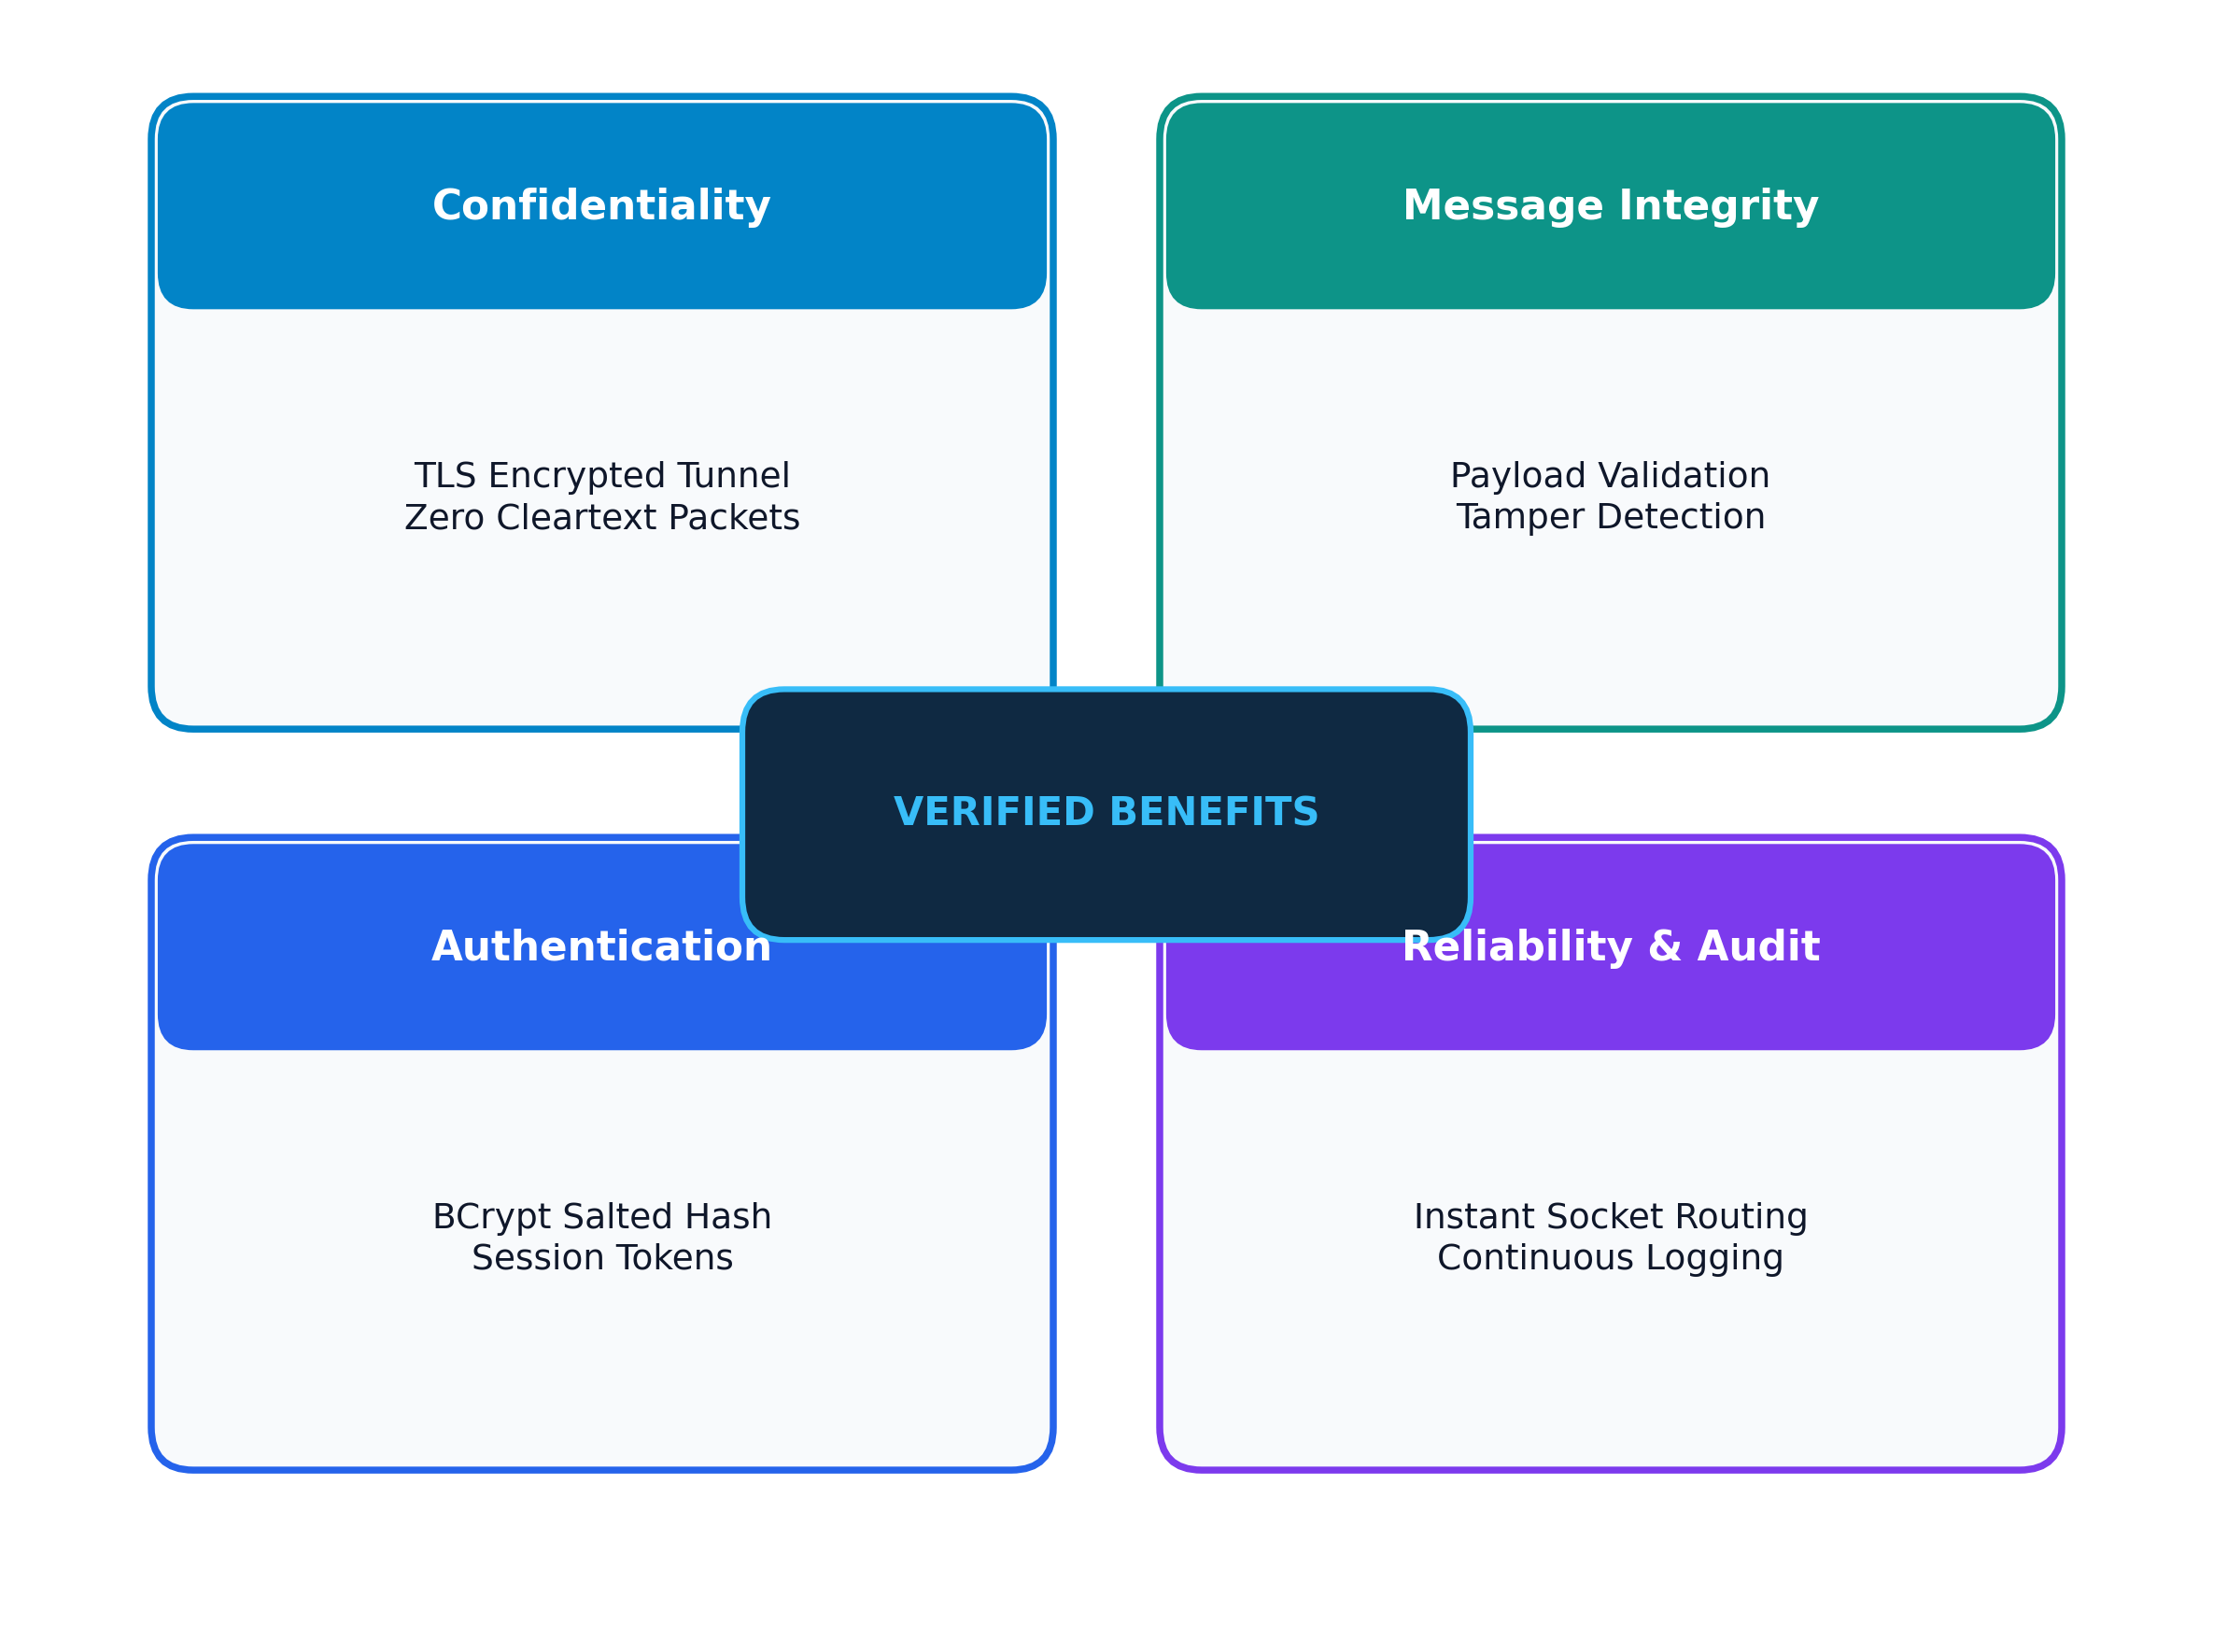
System Advantages
12. KEY ARCHITECTURAL & SECURITY STRENGTHS
• Message Confidentiality – Encrypts all communication using TLS, ensuring messages cannot be read by network eavesdroppers.
• Data Integrity – Protects messages against unauthorized modification or tampering during transmission across the network.
• Robust Authentication – Verifies user identities and securely hashes passwords before database storage using BCrypt.
• Real-Time Reliability – Asynchronous socket architecture enables fast message delivery, live presence tracking, and delivery confirmations.
• Security Auditing – Comprehensive activity logging and failed login detection provide clear visibility into system access events.
Figure 12: Key Architectural Strengths and Security Advantages
Real-Time Client–Server Chat Application Using TLS | Faculty Guide: Dr. SENTHAMIL SELVAN R
Slide 13 of 17

Slide 14
Future Enhancements
13. SYSTEM DEVELOPMENT ROADMAP & SCALABILITY
PHASE 1
PHASE 2
PHASE 3
PHASE 4
PHASE 5
Group Messaging
Secure File Sharing
End-to-End Encryption
Voice & Video Calling
Multi-Factor Auth
• Multi-user chat rooms
• Channel-based permissions
• Topic-specific discussions
• Encrypted document transfer
• In-transit TLS protection
• Integrity checksum checks
• Client-to-client encryption (E2EE)
• Direct cryptographic keys
• Advanced conversation privacy
• Real-time audio & video calls
• Encrypted media streaming
• Direct peer communication
• Two-factor authentication (2FA)
• Time-based OTP verification
• Protection against account theft
Figure 13: Future System Development Roadmap and Functional Milestones
Real-Time Client–Server Chat Application Using TLS | Faculty Guide: Dr. SENTHAMIL SELVAN R
Slide 14 of 17

Slide 15
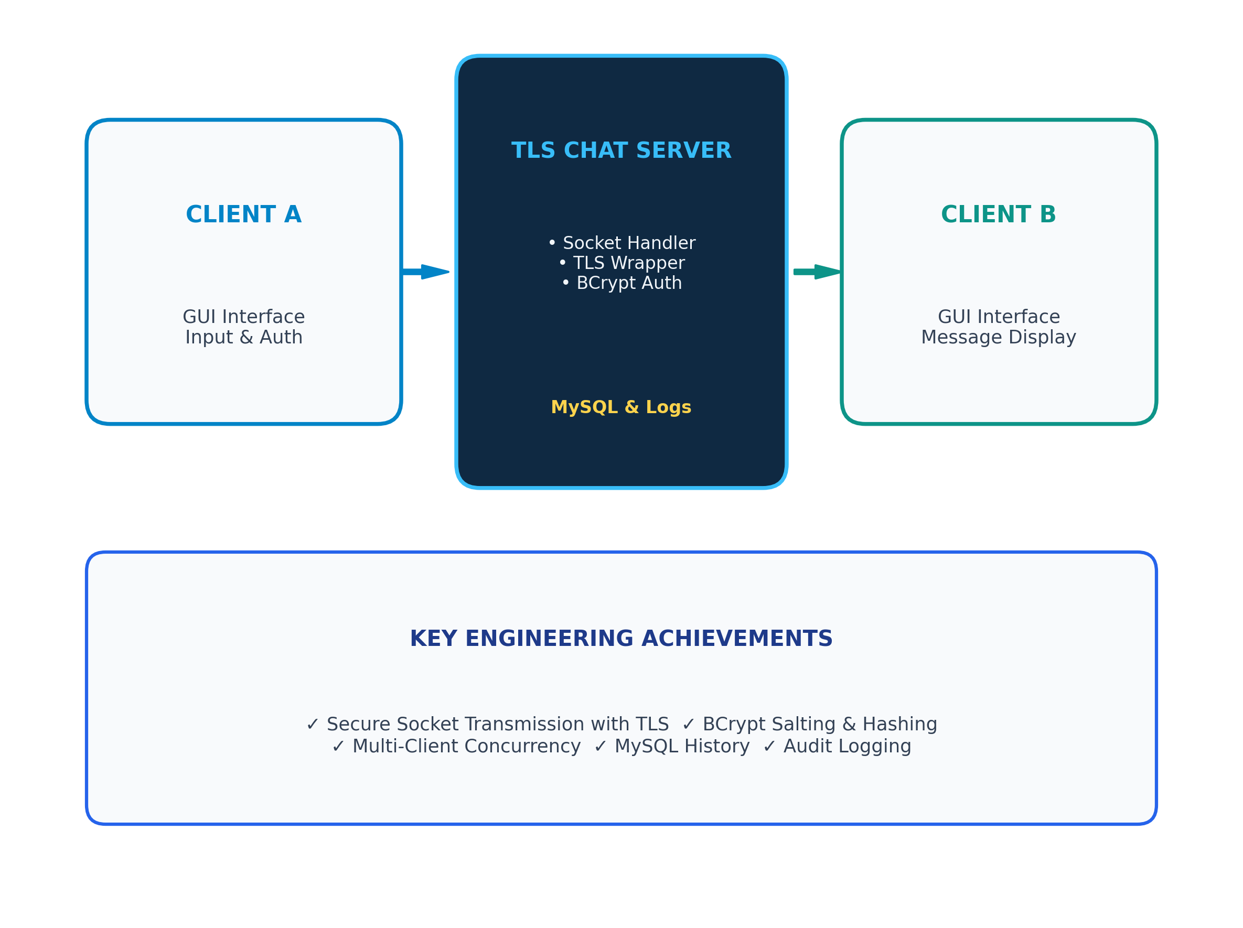
Conclusion
14. PROJECT SUMMARY & ENGINEERING TAKEAWAYS
• Secure Real-Time Messaging – Successfully designed and implemented a multi-client chat system enabling fast real-time communication.
• Transport Layer Security – Integrated TLS encryption to protect message confidentiality and validate server authenticity against network threats.
• Authentication & Data Integrity – Implemented secure user registration, salted password hashing using BCrypt, and structured MySQL database storage.
• Proactive Security Auditing – Incorporated real-time login monitoring and failed attempt tracking to maintain system security and operational visibility.
• Capstone Engineering Outcome – Demonstrates a practical, robust, and extensible client–server chat architecture effectively resolving common network vulnerabilities.
Figure 14: Final System Architecture and Core Capstone Takeaways
Real-Time Client–Server Chat Application Using TLS | Faculty Guide: Dr. SENTHAMIL SELVAN R
Slide 15 of 17

Slide 16
References
15. ACADEMIC LITERATURE & SECURITY CITATIONS
[1] J. Zheng, H. Zhu, Y. Dong, Z. Song, Z. Zhang, Y. Yang, and Y. Zhao, "Faster Post-quantum TLS 1.3 Based on ML-KEM: Implementation and Assessment," in Proc. 29th European Symposium on Research in Computer Security (ESORICS 2024), Springer LNCS, vol. 14984, pp. 245–264, 2024.
[2] J. Zhou, W. Fu, W. Hu, Z. Sun, T. He, and Z. Zhang, "Challenges and Advances in Analyzing TLS 1.3-Encrypted Traffic: A Comprehensive Survey," Electronics, MDPI, vol. 13, no. 20, art. 4000, pp. 1–28, Oct. 2024.
[3] J. K. Lastre, Y. Ko, H. Kwon, and I. You, "Evaluating Transport Layer Security 1.3 Optimization Strategies: A Security and Performance Analysis," Sensors, MDPI, vol. 25, no. 19, art. 6120, Oct. 2025.
[4] A. Kumar and R. Sharma, "Performance and Security Evaluation of TLS 1.3 in Real-Time Web and Socket Applications," Journal of Progress in Electronics and Communication Engineering, vol. 11, no. 2, pp. 114–128, 2025.
[5] M. Al-Sharif and J. Ben-Othman, "Layered Performance Analysis of TLS 1.3 Handshakes in Real-Time Networks," IEEE Transactions on Network and Service Management, vol. 23, no. 1, pp. 102–117, 2026.
[6] E. Rescorla, "The Transport Layer Security (TLS) Protocol Version 1.3," RFC 8446, Internet Engineering Task Force (IETF) Standards Track, DOI: 10.17487/RFC8446, 2018.
Real-Time Client–Server Chat Application Using TLS | Faculty Guide: Dr. SENTHAMIL SELVAN R
Slide 16 of 17

Slide 17

PROJECT PRESENTATION COMPLETE
THANK YOU
Questions & Discussion Are Welcome
Design and Development of a Real-Time Client–Server Chat Application Using Transport Layer Security (TLS)
Faculty Guide: Dr. SENTHAMIL SELVAN R
Real-Time Client–Server Chat Application Using TLS | Faculty Guide: Dr. SENTHAMIL SELVAN R
Slide 17 of 17

