Slide 1
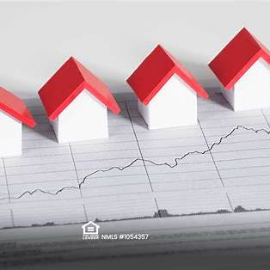
Predicting House Prices Using Machine Learning and Artificial Neural Networks
The King County, Washington, USA Housing Data
Presented By:
Madhukumar Gopal(2354612)

Slide 2

Abstract:
The project uses machine learning and artificial neural networks (ANNs) for house price prediction.
Based on the King County Housing Dataset with 21,613 rows and 21 features.
Methodologies include data preprocessing, feature analysis, and ensemble modeling.
Aims to improve decision-making in construction management using advanced predictive techniques.

Slide 3
Introduction
House price prediction is critical in real estate, urban planning, and construction management.
Accurate predictions help optimize budgeting, resource allocation, and project planning.
This project deals with the King County Housing Dataset, applying advanced machine learning and ANN techniques.
The goal is to develop a reliable model for house price prediction and improve decision-making.

Slide 4

Dataset Description
Dataset: King County Housing Dataset.
Features: 21,613 rows and 21 attributes.
Key Variables:
Price: The sale price of the house.
Bedrooms & Bathrooms: Number of rooms.
Living Space: Total indoor square footage.
Lot Size: Total property area.
Floors, Waterfront, Condition, Grade: Quality indicators.
Geospatial Features:
Latitude, Longitude, and Zip Code for location insights.
Provides comprehensive information for house price prediction.

Slide 5
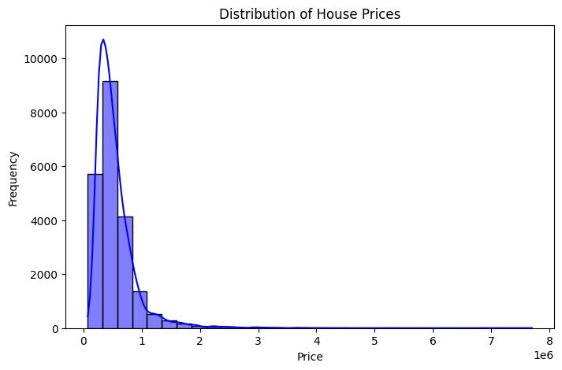
Exploratory Data Analysis (EDA)
Distribution of Prices:
Right-skewed distribution with most properties below $1,000,000.
Outliers with extremely high prices.

Slide 6
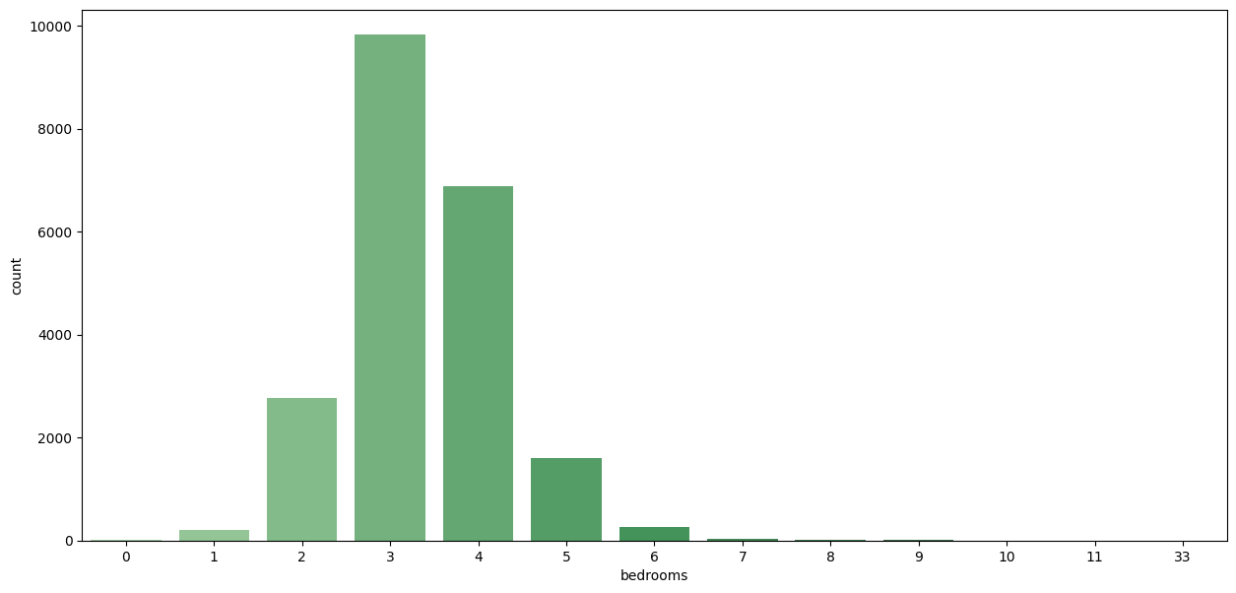
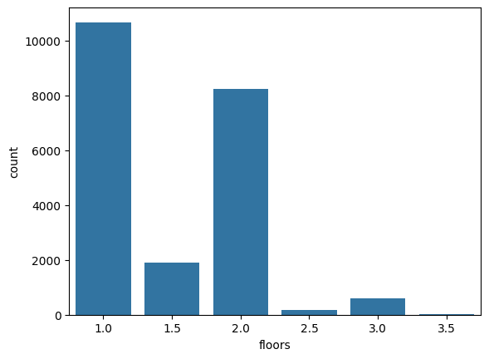
Distribution of Bedrooms and Floors:
Most houses have 3-4 bedrooms (single-story homes are most common).

Slide 7
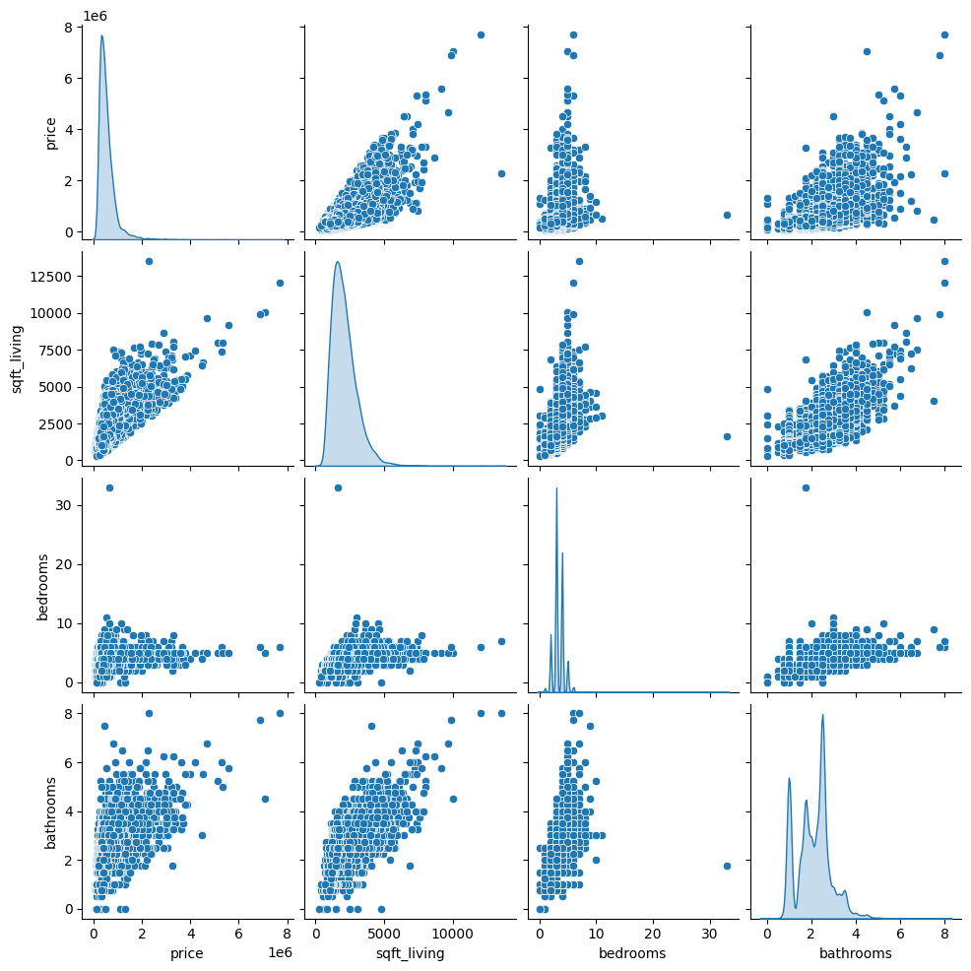
Pair plot Analysis:
Positive correlation observed between price and living area (sqft_living).
Bathrooms and prices also show a strong relationship

Slide 8
Exploring of Data
Dataset → Data Preprocessing → Feature Engineering → Model Training → Evaluation.
Data Loading And Cleaning:
Imported the dataset using Python libraries. (Example: Numpy, Matplotlib, Pandas, Sklearn)
Dropped rows with null values to maintain data quality.
Data Summary:
housing_df.info() reveals the data types and non-null counts.
housing_df.describe() provides key statistics like mean, median, and standard
deviation.
Data Visualisation:
Scatter plots highlighted relationships (Example: sqft_living vs. price).

Slide 9
Methodology
Data Preprocessing:
Handled missing values (Example: dropped rows with null sqft_above).
Applied RobustScaler for outlier handling and feature scaling.
Removed highly correlated features (e.g., sqft_above correlated with sqft_living).
Feature Engineering:
Removed irrelevant features like ID
Model Development:
Implemented various models: Linear Regression, Decision Tree, KNN, Random Forest, Gradient Boosting, XGBoost, and ANN.
Fine-tuned models for optimal performance.
Evaluation Metrics:
R-squared, Adjusted R-squared, Mean Absolute Error (MAE), and Root Mean Squared Error.

Slide 10
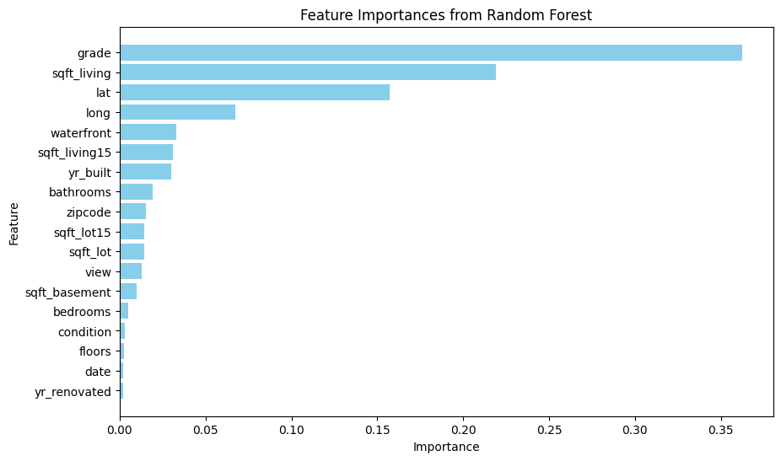
Feature Importance Analysis
sqft_living: Larger living space increases price.
grade: Higher construction/design quality correlates with a higher price.
waterfront: Waterfront properties are more valuable.
bathrooms: More bathrooms indicate higher value.
latitude and longitude: Geospatial features impact pricing.
Feature importance derived using ensemble models like Random Forest

Slide 11
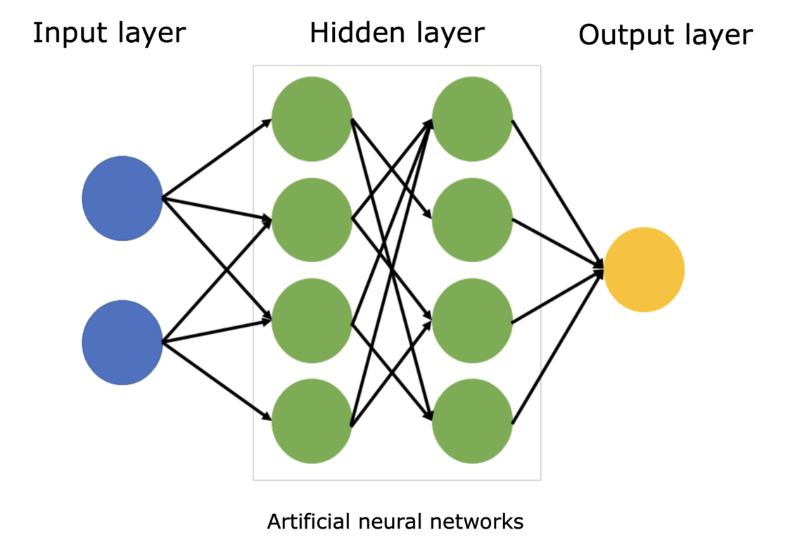
Model Development
Overview:
Multiple models were developed and tested to predict house prices.
Traditional Models:
Linear Regression: Simple and interpretable. Assumes a linear relationship between the target variable and predictors
Decision Tree: Captures non-linear relationships but is prone to overfitting.
K-Nearest Neighbors (KNN): Distance-based model - sensitive to scaling.
Ensemble Methods:
Random Forest: Robust and reduces overfitting with multiple decision trees.
Gradient Boosting: Corrects errors iteratively for higher accuracy.
XGBoost: Optimized version of Gradient Boosting with regularization.
Artificial Neural Network (ANN):
Custom ANN architecture with:
Input layer: 19 features.
Hidden layers: 128, 64, 32 neurons with ReLU activation.
Dropout regularization to prevent overfitting.
Output layer for regression with linear activation.

Slide 12
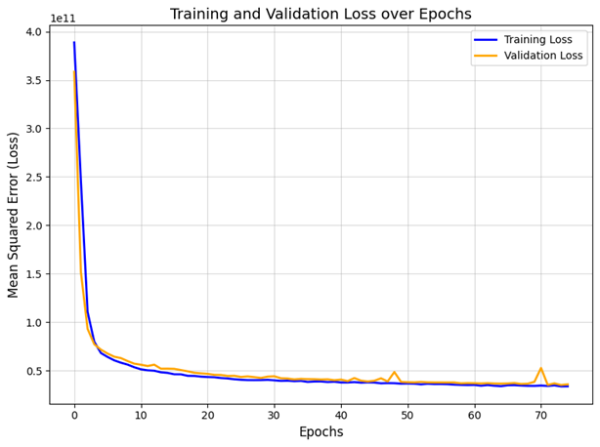
Model Training and Validation Loss:
The loss decreases rapidly in the first few epochs and stabilizes around epoch 30.
This indicates good generalization and minimal overfitting.

Slide 13
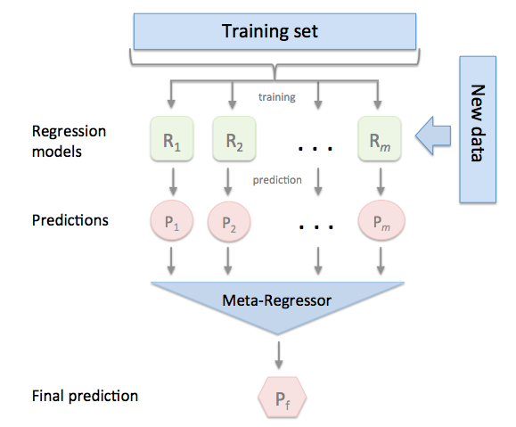
Stacking Regressor
What is Stacking?
Combines multiple models to improve prediction accuracy.
Models Used:
Random Forest
Gradient Boosting
XGBoost
How It Works:
Base models make predictions.
Meta-model combines these predictions for the final result.
Key Benefit: Achieved the best accuracy (R² = 0.8762) in the project.

Slide 14
Model Evaluation
Metrics Used:
R-squared (R²): Measures the model's goodness of fit.
Adjusted R-squared: Accounts for the number of predictors in the model.
Mean Absolute Error (MAE): Average magnitude of prediction errors.
Root Mean Squared Error (RMSE): Penalizes larger errors more than MAE.

Slide 15
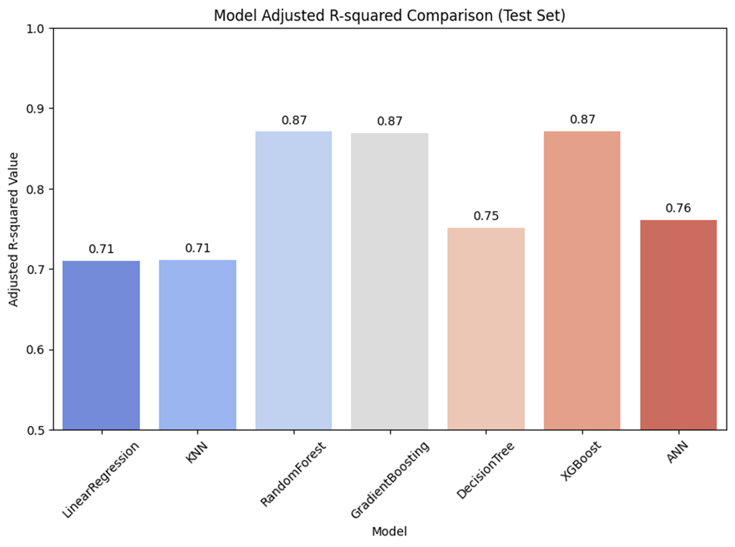
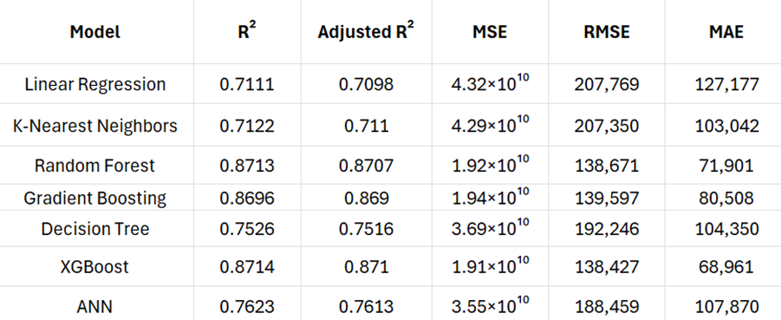
Results:
XGBoost performed best among individual models (R² = 0.87).
Stacking Regressor outperformed all with the highest R² (0.8762).
ANN showed promising results but lagged behind ensemble methods.

Slide 16
Overall Observation:
Performance Highlights: XGBoost emerged as the best individual model with an R² of 0.87. The stacking Regressor achieved the highest accuracy (R² = 0.8762).
Artificial Neural Network (ANN): Performed well but didn’t surpass ensemble models. Adjusted R² for ANN: 0.76.
Feature Importance Insights: Key predictors: sqft_living, grade, waterfront.
Overall Observation: Ensemble techniques like Stacking and XGBoost showed robust performance

Slide 17
House Price Prediction
Actual Price: 270000.0
Predicted Price (Random Forest): 295797.08
Predicted Price (Gradient Boosting): 301381.6330560958
Predicted Price (XGBoost): 284399.75
Example Output for Stacking Regressor:
Actual Price: 270000.0
Predicted Price: 281766.29

Slide 18
Conclusion:
Summary of Findings:
XGBoost and Stacking Regressor showed the best performance.
Key predictors include sqft_living, grade, and bathrooms.
Future Work:
Add external datasets for improved predictions.
Optimize ANN performance with advanced techniques.

