Slide 1
MUSIC LIBRARY

Slide 2
Data
-SONGS

Slide 3
Song Data
Title:7 Rings
Artist: Ariana Grande
Album: 7 Rings
Genre: Pop
Length: 3:02

Slide 4
User Interaction Flow
Local Music Library Database
Results can be Displayed.By category(Title,Artist
Genre,Band)
Songs from input file
User Searches Local Database for Song Title
User can save edited songs to output file
User can add/delete and save the data local database.
User can choose to undo deletion of song

Slide 5
Features
Add Data
Delete Data
Find and display records using primary key
Find by Title
Find by Genre
Find by Artist
List data in hash table sequence
List data in key sequence
Print indented tree
Write back to file
Undo delete
Hash stats
Quit and Save.

Slide 6
Data Diagram
HeadPrograme
search()
Capacity
Size
Hash
BST
title
HashTable
BST by Artist/Genre/
Album
arr[0]
probes
Genre
HashSearch
arr[1]
probes
arr[2]
probes
Artist
. . .
Album
arr[n]
probes
title
artist
Name
Ability
Type
Role
stats
genre
Song List A
length
title
Name
Ability
Type
Role
stats
artist
Song List B
BST by Title
genre
length
Name
Ability
Type
Role
stats
Song List C

Slide 7
Data Diagram
Hash
hashTable
bst
Count
size
bst
capacity
arrSize
Notes:
From main, this is the this contains the entire data structure of out program

Slide 8
Data Diagram
capacity
size
Hash
Bst
HashTable
BST
arr[0]
probes
arr[1]
probes
arr[2]
probes
. . .
arr[n]
probes

Slide 9
Data Diagram
HeadPrograme
Capacity
Size
Hash
BST
HashTable
BST
arr[0]
probes
arr[1]
probes
arr[2]
probes
. . .
arr[n]
probes
title
artist
Name
Ability
Type
Role
stats
genre
Song List A
length
*
Name
Ability
Type
Role
stats
Song List B
Song List C
Name
Ability
Type
Role
stats

Slide 10
Data Diagram
HeadPrograme
search()
Capacity
Size
Hash
BST
title
HashTable
BST by Artist/Genre/
Album
arr[0]
probes
Genre
HashSearch
arr[1]
probes
arr[2]
probes
Artist
. . .
Album
arr[n]
probes
title
artist
Name
Ability
Type
Role
stats
genre
Song List A
length
title
Name
Ability
Type
Role
stats
artist
Song List B
BST by Title
genre
length
Name
Ability
Type
Role
stats
Song List C

Slide 11
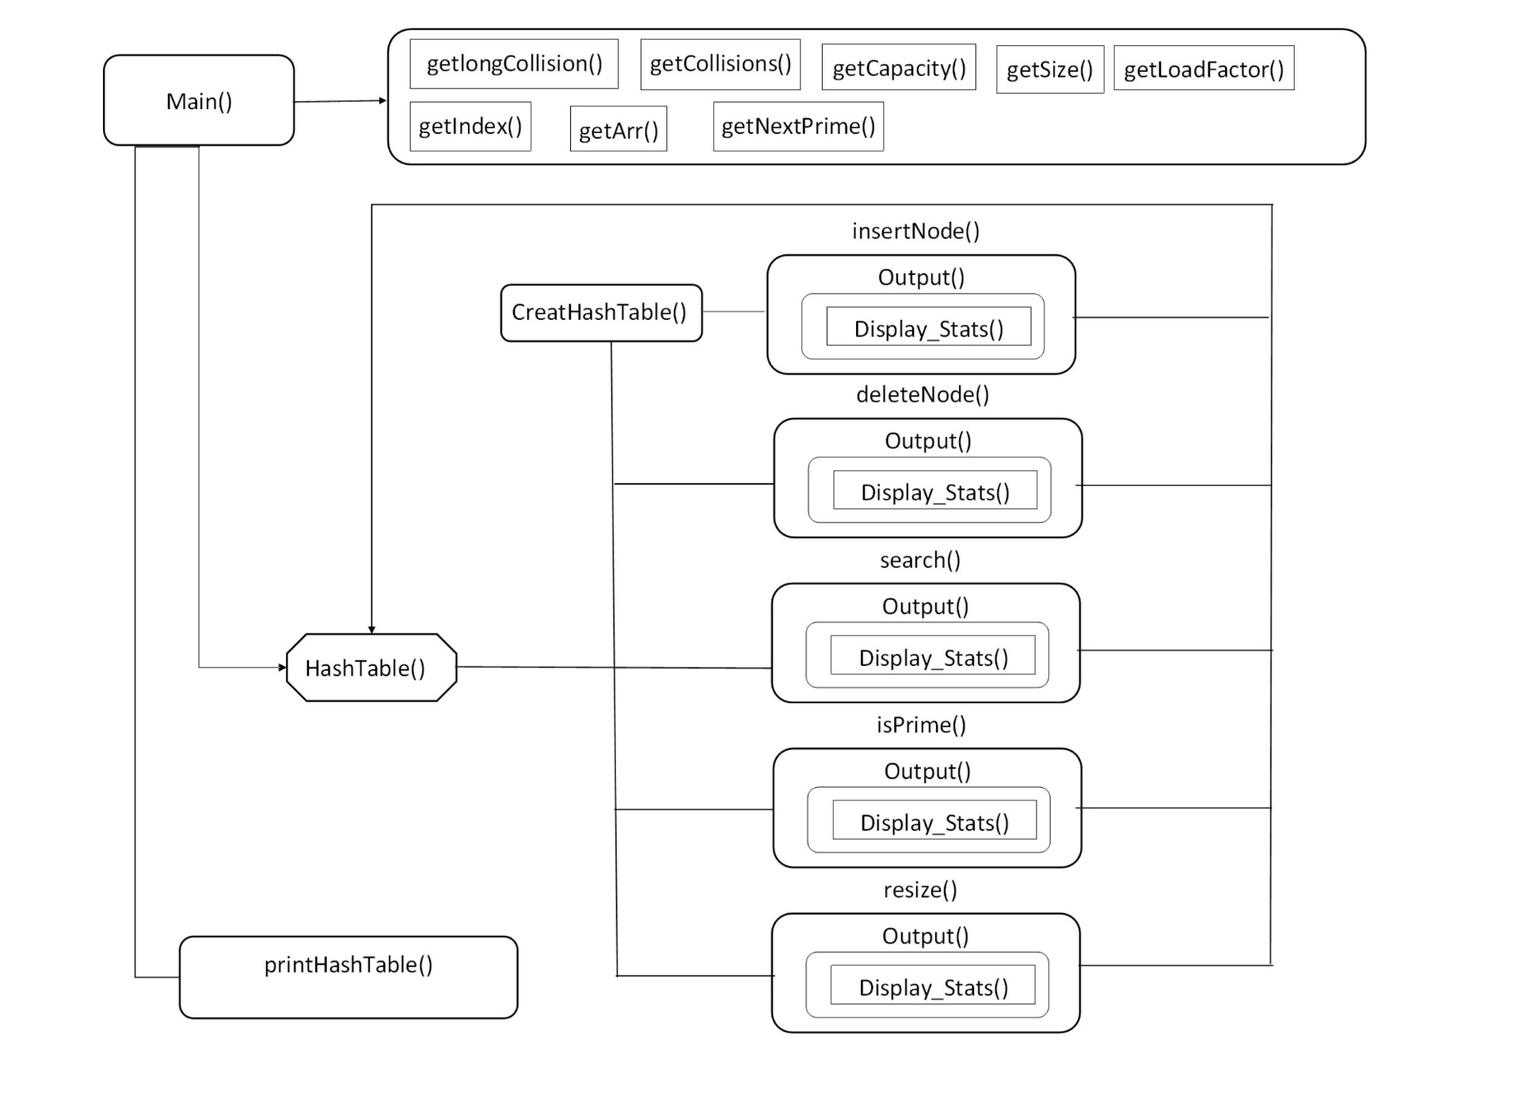
Flowchart of the Hash

Slide 12
Structure Chart (shortened)
Read file and upload to Music library
Main Menu
Remove a song
Add a song
Search a song
Ask to Title to delete
Ask for the details
Delete the song
Ask for option : By title/artist/genre etc
Add to music library
Print the song details
Exit Program

Slide 13
File IO
Local song Database
Music library To OutFile
FilePath
FilePath
Local song Database
Input file to Music library

Slide 14
Music Library Stats
Library Stats by Artist
Library Stats by Album
Library Stats by Genre
Special Feature

Slide 15
Hashing
Hashing: iterative sum of ASCII value of index of x
template <class K,class T>
int HashTable<K, T>::getIndex(K key)
{
size_t temp = key.size();
int sum = 0;
for (size_t x = 0; x < temp; x++)
{
sum += int(key[x]);
}
return sum % getCapacity();
}

Slide 16
Hash
Resolution: Quadratic Probe
{
collisions++;
index += collisions * collisions;
index %= capacity;
if (collisions > getLongCollision())
return false;
}
Notes:
In Quadratic probing we look for i²‘th slot in i’th iteration.

Slide 17
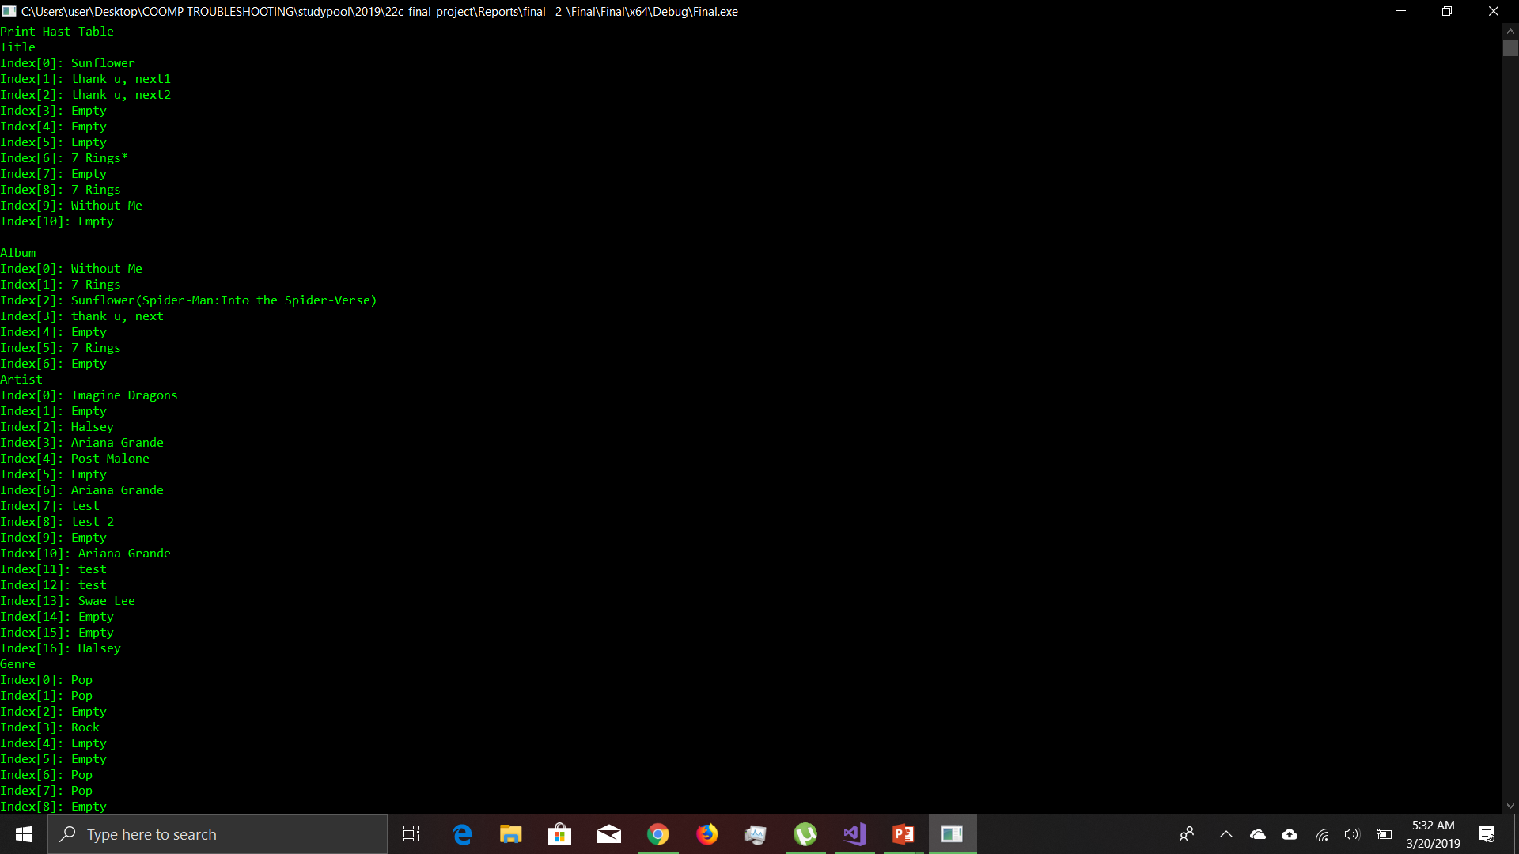

Hash
Before Deletion
After Deletion

Slide 18
DEMO

